Slide 1
DATA SCIENCE INTERNSHIP PROJECT
Retail Store Sales Insights
and Prediction Model
Using Random Forest Regression to forecast retail sales from transaction data
Submitted By Cirimamilla Chandrika Course Data Science Internship Organization Nyeras Technologies

Slide 2
INTRODUCTION
Why Sales Prediction Matters
📊
Data at Scale
Retail businesses generate large volumes of sales data every single day.
🧠
Understanding Behavior
Analyzing this data reveals customer behavior and emerging sales trends.
🤖
Predictive Power
Machine learning enables accurate forecasting of future sales performance.
🌲
Our Approach
This project applies Random Forest Regression to model retail sales.
Retail Store Sales Insights and Prediction Model
2

Slide 3
OBJECTIVES
What This Project Set Out To Do
Analyze retail store sales data
Perform data preprocessing
1
2
Conduct Exploratory Data Analysis (EDA)
Build a Random Forest Regression model
3
4
Predict future retail sales
Evaluate model performance
5
6
Retail Store Sales Insights and Prediction Model
3

Slide 4
DATASET DESCRIPTION
What's Inside the Retail Dataset
A retail store sales dataset combining customer, product, and transaction-level details, used to uncover patterns and train the prediction model.
👤
📦
💰
📈
Customer Information
Product Details
Sales Amount
Profit
🏷️
🔢
🌍
💳
Discount
Quantity
Region
Payment Method
Retail Store Sales Insights and Prediction Model
4

Slide 5
TOOLS & TECHNOLOGIES
The Stack Behind the Model
Python
Google Colab
Pandas
NumPy
Matplotlib
Seaborn
Scikit-learn
ALGORITHM
Random Forest Regression
Retail Store Sales Insights and Prediction Model
5

Slide 6
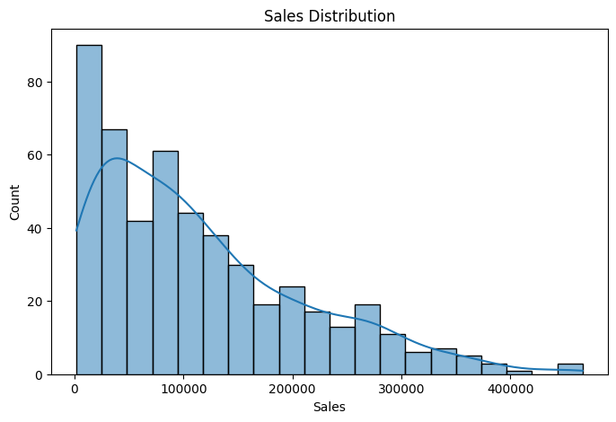
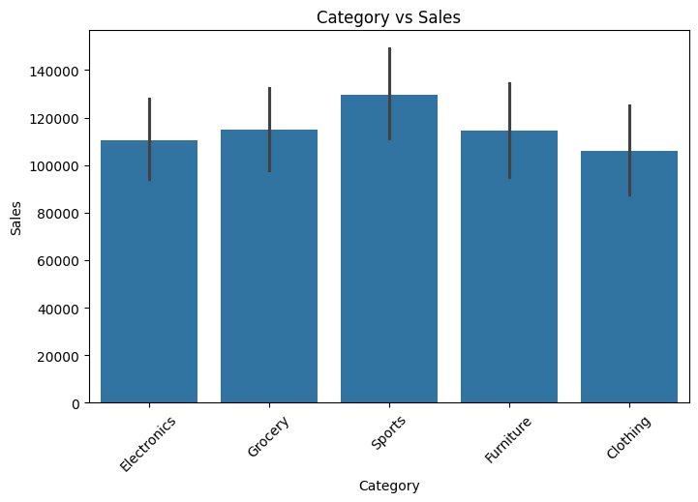
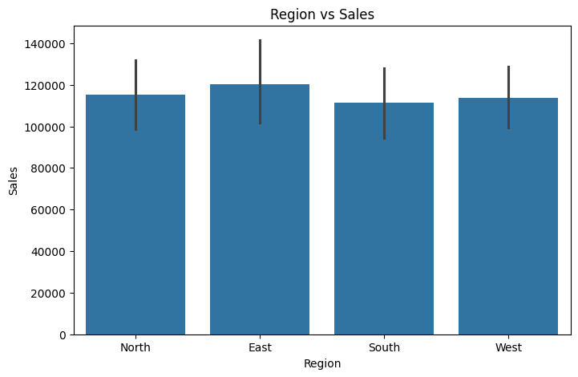
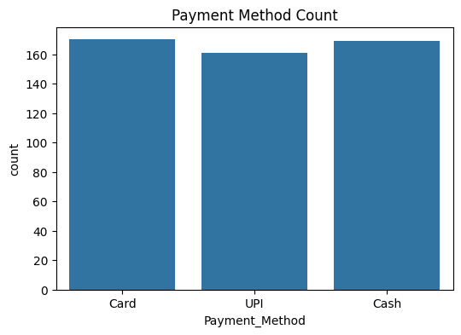
EXPLORATORY DATA ANALYSIS
Visualizing the Sales Data
Sales Distribution
Category-wise Sales
Region-wise Sales
Payment Method Distribution
Retail Store Sales Insights and Prediction Model
6

Slide 7
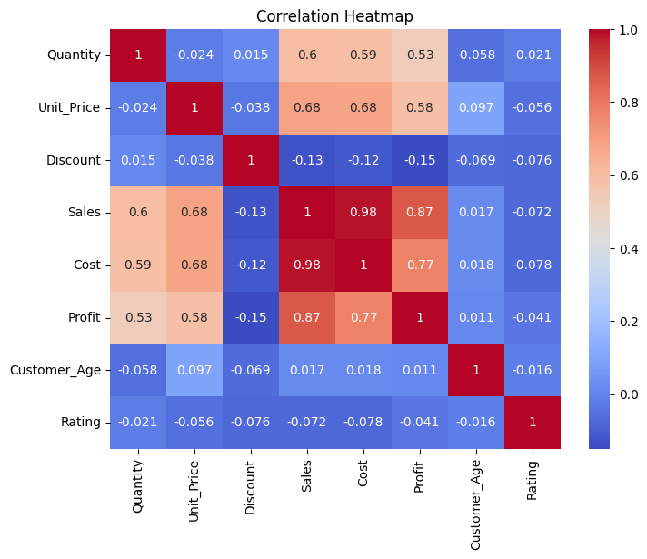
CORRELATION ANALYSIS
How the Variables Relate
Correlation Heatmap
The heatmap shows the relationship between numerical variables and helps identify important features.
Strong correlations guide which features matter most for predicting sales — supporting smarter feature selection for the model.
Retail Store Sales Insights and Prediction Model
7

Slide 8
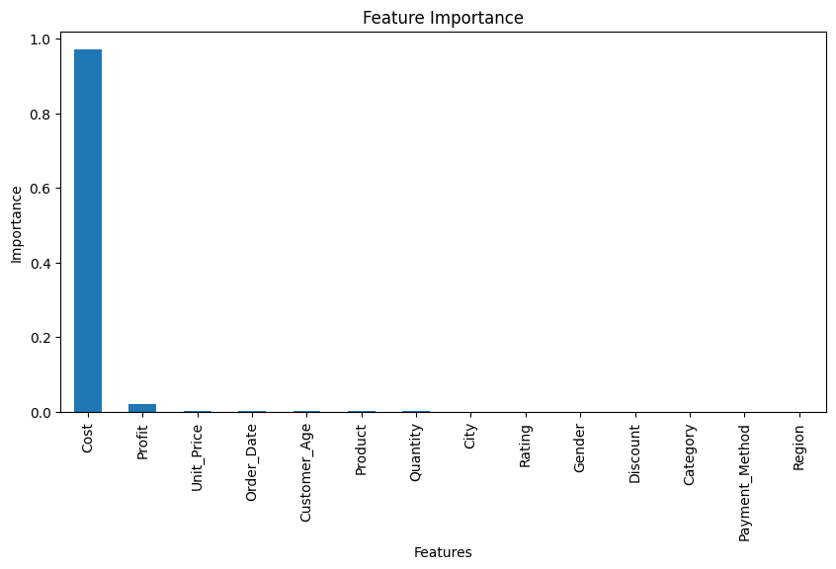
MODEL BUILDING & EVALUATION
Random Forest Regression Performance
4,656.20
66.6M
8,160.63
0.9927
MAE
MSE
RMSE
R² SCORE
An R² of 0.9927 means the model explains about 99.27% of the variation in sales — an excellent fit.
Feature Importance
Retail Store Sales Insights and Prediction Model
8

Slide 9
RESULTS
Turning Data Into Decisions
✓
Model predicted retail sales successfully
99.27%
✓
High prediction accuracy was achieved across the test data
R² Score achieved by
the Random Forest model
✓
The model can support better business decision-making
✓
Predicted sales values closely tracked actual sales, confirming the model learned real patterns
Retail Store Sales Insights and Prediction Model
9

Slide 10
CONCLUSION & FUTURE SCOPE
Wrapping Up and Looking Ahead
CONCLUSION
FUTURE SCOPE
Retail sales data was successfully analyzed
Random Forest Regression provided excellent prediction accuracy
Demonstrates the effectiveness of machine learning in retail sales forecasting
Use larger datasets
Compare different ML algorithms
Build a Power BI dashboard
Deploy as a web application
Retail Store Sales Insights and Prediction Model
10

Slide 11
Thank You
Retail Store Sales Insights and Prediction Model

