Slide 1

NEW YORK MOTORCYCLES COLLISION
GROUP C
Submitted to : Dr.Jongwook Woo
ANUSHA MANJAPPA
PRATHIBHA GUBBI PRAKASH
SRIHITHA REDDY SIVANNAGARI

Slide 2
CONTENTS
Introduction
Objective
Azure ML
SparkML
Results
Comparison
References
Summary

Slide 3
INTRODUCTION
Data Understanding - The data set contains the details of motor vehicles collisions in New York City
Data set format - CSV
Data set size - 215 MB
Data set URL - https://data.cityofnewyork.us/Public-Safety/NYPD-Motor-Vehicle-Collisions/h9gi-nx95

Slide 4
OBJECTIVE
Our project aims at predictive analysis of various elements associated with motorcycle accidents in New York city like borough, kind of vehicle, contributing factor of the accident , count of accidents in a particular area and factors contributing to those accidents based on available features in the data set using Machine Learning Algorithms with tools like AzureML and SparkML.

Slide 5
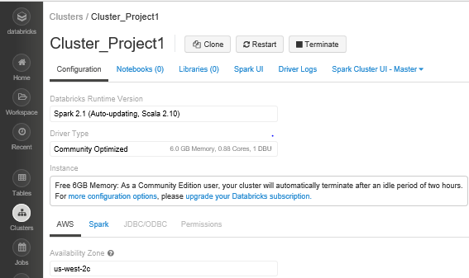
HARDWARE SPECIFICATIONS
Apache Spark Version - Spark 2.1
File System – DBFS(Data Bricks File System)
6GB Memory , 0.88 Cores, 1DBU

Slide 6
ALGORITHMS USED
AzureML
Multiclass decision forest classification
Multiclass decision jungle classification
Multiclass neural network classification
SparkML
Decision forest classifier
Random forest classifier
Logistic regression

Slide 7
AZUREML MODEL – Work Flow
LOAD DATA
SCORE
CLASSIFICATION ALGORITHM
EVALUATE
SPLIT DATA
ALGORITHMS
TRAIN
SELECT COLUMNS
CLEAN MISSING DATA

Slide 8
AZUREML MODEL - CLASSIFICATION FEATURES LABLES
Vehicle type code
Number of persons killed
Contributing factor
Borough

Slide 9
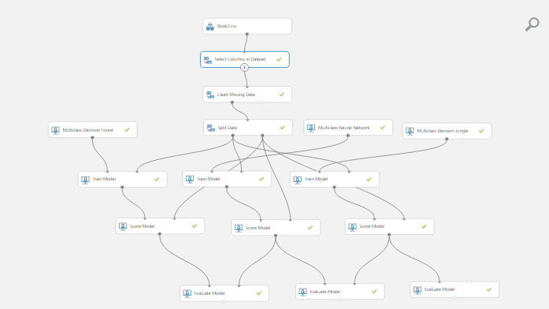
AZUREML MODEL BUILDING - CLASSIFICATION

Slide 10
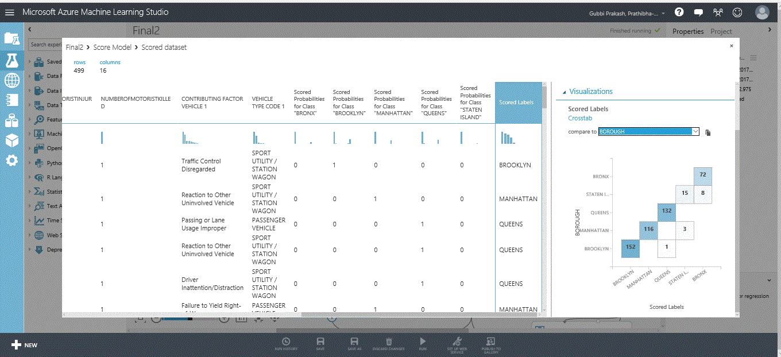
MULTICLASS DECISION FOREST

Slide 11
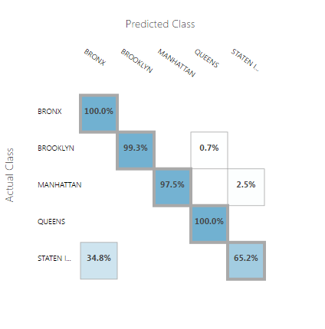
MULTICLASS DECISION FOREST
Overall accuracy | 0.975952
Average accuracy | 0.990381
Micro-averaged precision | 0.975952
Macro-averaged precision | 0.945163
Micro-averaged recall | 0.975952
Macro-averaged recall | 0.924086

Slide 12
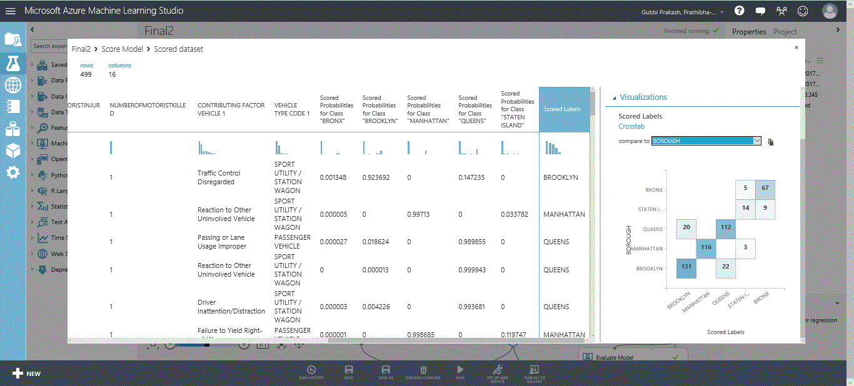
MULTICLASS NUERAL NETWORK

Slide 13
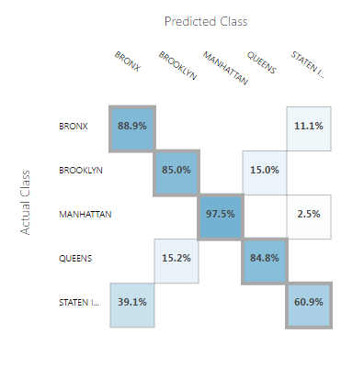
MULTICLASS NUERAL NETWORK
Overall accuracy | 0.961924
Average accuracy | 0.98477
Micro-averaged precision | 0.961924
Macro-averaged precision | 0.937895
Micro-averaged recall | 0.961924
Macro-averaged recall | 0.928256

Slide 14
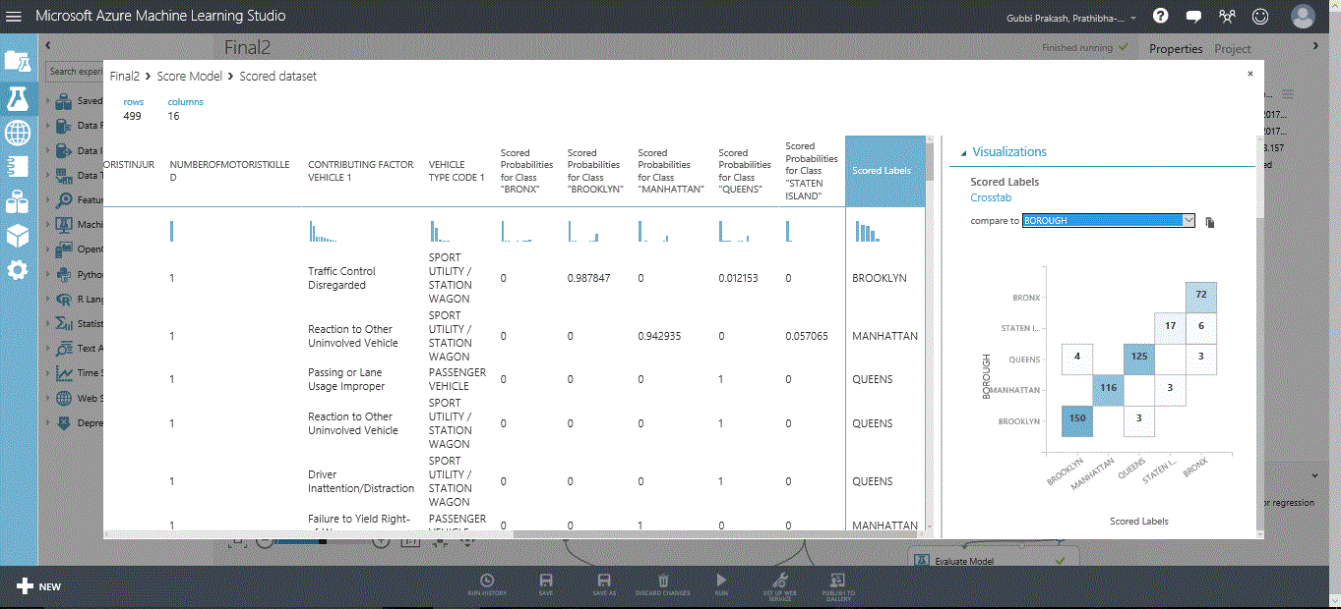
MULTICLASS DECISION JUNGLE

Slide 15
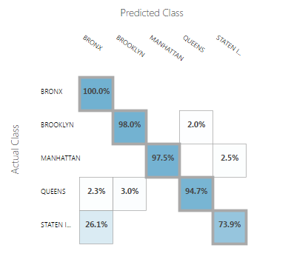
MULTICLASS DECISION JUNGLE
Overall accuracy | 0.961924
Average accuracy | 0.98477
Micro-averaged precision | 0.961924
Macro-averaged precision | 0.937895
Micro-averaged recall | 0.961924
Macro-averaged recall | 0.928256

Slide 16
COMPARISON OF CLASSIFICATION MODELS IN AZUREML
MULTICLASS DECISION FOREST | MULTICLASS DECISION JUNGLE | MULTICLASS NEURAL NETWORK
Overall accuracy-0.975952 | Overall accuracy-0.961924 | Overall accuracy-0.873747
Average precision – 0.945163 | Average precision – 0.937895 | Average precision – 0.826602
Average recall – 0.924086 | Average recall – 0.928256 | Average recall – 0.834107
Based on the above accuracy values we can conclude “Multiclass Decision Forest Classification” to be the accurate model

Slide 17
SPARKML MODEL - WORKFLOW
SPLIT DATA
TRAIN DATA USING ALGORITHMS
EVALUATE
CREATE TABLE
FEATURE AND LABLE IDENTIFICATION

Slide 18
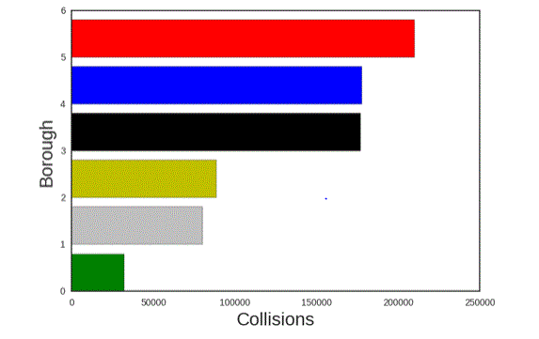
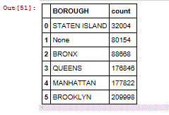
VISUALIZATION OF THE PREDICTED LABEL IN DATA BRICKS
Total Number of Collisions by Borough

Slide 19
SPARKML MODEL - CLASSIFICATION FEATURES
Borough
Vehicle Type Code
LABELS
Number of Accidents
SPLIT
Train Set : 70%
Test Set : 30%

Slide 20
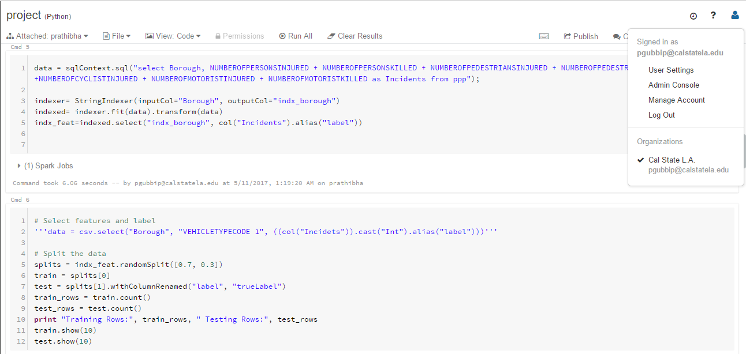
IPYTHON NOTEBOOK IN DATA BRICKS

Slide 21
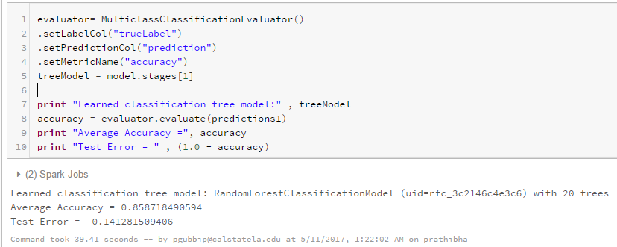
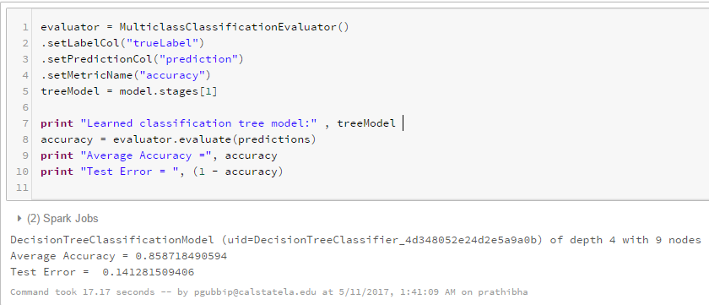
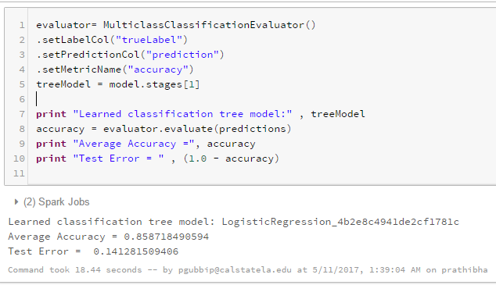
RANDOM FOREST
CLASSIFIER
DECISION FOREST
CLASSIFIER
LOGISTIC REGRESSION

Slide 22
COMPARISON OF CLASSIFICATION RESULTS IN SPARKML
DECISION FOREST CLASSIFIER | RANDOM FOREST CLASSIFIER | LOGISTIC REGRESSION
Accuracy – 85.8 % | Accuracy – 85.9 % | Accuracy – 85.1 %
Based on the above accuracy values we can conclude “Random forest classifier” to be the accurate model

Slide 23
SUMMARY
AZUREML SPARKML
MODEL | ACCURACY
Multiclass Decision Forest classification | 97.59%
Multiclass Decision Jungle Classification | 96.19%
Multiclass Neural Networks Classification | 87.37%
MODEL | ACCURACY
Decision Forest Classifier | 85.8%
Random Forest Classifier | 85.9%
Logistic Regression | 85.1%

Slide 24
GITHUB LINK
https://github.com/anushamanjappa/CIS5560-Big-Data-Analysis
REFERENCES
https://spark.apache.org/docs/1.6.1/ml-classification-regression.html
https://docs.microsoft.com/en-us/azure/hdinsight/hdinsight-apache-spark-jupyter-spark-sql

Slide 25
THANK YOU

