Slide 1
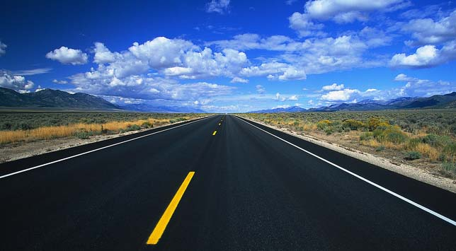
STANLEY COLLEGE OF ENGINEERING AND
TECHNOLOGY FOR WOMEN
BRANCH : COMPUTER SCIENCE & ENGINEERING
ROUTE SAVER: LEVERAGING ROUTE API’S FOR
ACCURATE AND EFFICIENT QUERY PROCESSING AT LOCATION BASED SERVICE
GUIDED BY: M SAROJINI (ASSISTANT PROFESSOR)
DONE BY
P HANITA-160612733078
R VASAVI PRIYANKA-160612733085
S SRIHITHA REDDY-160612733089

Slide 2
ABSTRACT
Location-based services (LBS) enable users to query points-of-interest (e.g., restaurants, cafes) on various features (e.g., price, quality, variety). In addition, users require accurate query results with up-to-date travel times. Lacking the monitoring infrastructure for road traffic, the LBS may obtain live travel times of routes from online route APIs in order to offer accurate results. Our goal is to reduce the number of requests issued by the LBS significantly while preserving accurate query results. First, we propose to exploit recent routes requested from route APIs to answer queries accurately. Our experimental evaluation shows that our solution is three times more efficient than a competitor, and yet achieves high result accuracy (above 98 percent).
2
34

Slide 3
INTRODUCTION
The project Route-Saver: Leveraging Route APIs for Accurate and Efficient Query Processing at Location-Based Services is a real-time application in the domain of JAVA.
This project is used to hide and also transfer the files to the users.
We propose an application where confidentiality and privacy is entirely held by the clients so guaranteeing them privacy.
We designed the application such a way that the storage provider/database only provides simple data access.
It does not contain any other information related to the file sharing. In this project, we present a secure file sharing application for both LAN and in web.
3
34

Slide 4
EXISTING SYSTEM
To meet the accuracy requirement, the framework SMashQ is used for the LBS to answer KNN queries accurately by retrieving live travel times (and routes) from online route APIs (e.g., Google Directions API, Bing Maps API, which have live traffic information.
Various shorteshave been t path indices developed to support shortest path search efficiently.
Thomsen study the caching of shortest paths obtained from online route APIs.
They exploit the optimal sub path property on cached paths to answer shortest path queries.
4
34

Slide 5
DISADVANTAGES OF THE EXISTING SYSTEM
Query results with inaccurate travel times may disrupt the users’ schedules, cause their dissatisfaction, and eventually risk the LBS losing its users and advertisement revenues.
Similarly, high response time may drive users away from the LBS.
As a remark, online maps (e.g., Google Maps, Bing Maps), on the other hand, cannot process queries for the LBS either, because those queries may involve specific attributes (e.g., quality, price, facility) that are only maintained by the LBS.
SMashQ does not utilize route log to derive exact travel times nor lower/upper bounds to boost the query performance of the LBS.
5
34

Slide 6
PROPOSED SYSTEM
We exploit an observation namely that travel times change smoothly within a short duration. routes recently obtained from online route apis may still provide accurate travel times to answer current queries. this property enables us to design a more efficient solution for processing range and knn queries.
Smashq does not utilize any route log to save route requests. we also consider an extension of smashq, called smashq*, which keeps the routes within expiry time into a route log. smashq applies only the optimal sub path property and retrieves exact travel times from the log.
Specifically, our method route-saver keeps at the lbs the routes which were obtained in the past d minutes (from an online route api), where d is the expiry time parameter. however, it does not apply the upper/lower bounding techniques in this paper. by default route server uses the desc and diff orderings for range and knn queries respectively.
It parallelize route requests in order to reduce the query response time further.
6
34

Slide 7
ADVANTAGES OF PROPOSED SYSTEM
Our experiments show that our solution is three times more efficient than smashq, and yet achieves high result accuracy (above 98 percent).
Combine information across multiple routes in the log to derive lower/upper bounding travel times, which support efficient and accurate range and knn search.
Develop heuristics to parallelize route requests for reducing the query response time further.
Evaluate our solutions on a real route api and also on a simulated route api for scalability tests.
7
34

Slide 8
LITERATURE SURVEY
The availability of GPS-equipped Smartphone leads to a huge demand of location-based services (LBSs), like city guides, restaurant rating, and shop recommendation websites, e.g.,OpenTable, Hotels, UrbanSpoon.1 They manage points-of-interest (POIs) specific to their applications, and enable mobile users to query for POIs that match with their preferences and time constraints. As an example, consider a restaurant rating website that manages a data set of restaurants P (see Fig. 1a) with various attributes like: location, food type, quality, price, etc. Via the LBS (website), a mobile user q could query restaurants based on these attributes as well as travel times on road network to reach them. Here are examples for a range query and a KNN query, based on travel times on road network. Successful LBS must fulfill two essential requirements: (R1) accurate query results, and (R2) reasonable response time. Query results with inaccurate travel times may disrupt the users’ schedules, cause their dissatisfaction, and eventually risk the LBS losing its users and advertisement revenues.
8
34

Slide 9
LITERATURE SURVEY
Similarly, high response time may drive users away from the LBS. Observe that the live travel times from user q to POIs vary dynamically due to road traffic and factors like rush hours, congestions, road accidents. As a case study, we used Google Maps to measure the live travel times for three pairs of locations in Brisbane, Singapore, and Tokyo, on two days. Even on the same weekday (Wednesday), the travel times exhibit different trends. Thus, historical traffic data may not provide accurate estimates of live travel times. Unfortunately, if the LBS estimates travel times based on only local information (distances of POIs from user q), then query results (for range and KNN) would have low accuracy (50 percent for NoAPI. Typical LBS lacks the infrastructure and resources (e.g., road-side sensors, cameras) for monitoring road traffic and computing live travel times. To meet the accuracy requirement (R1), the framework SMashQ is proposed for the LBS to answer KNN queries accurately by retrieving live travel times (and routes) from online route APIs (e.g., Google Directions API, Bing Maps API), which have live traffic information. Given a query q, the LBS first filter POIs by local attributes in P.
9
34

Slide 10
LITERATURE SURVEY
Next, the LBS calls a route API to Obtain the routes (and live travel times) from q to each remaining POI, and then determines accurate query results for the user. As a remark, online maps (e.g., Google Maps, Bing Maps), on the other hand, cannot process queries for the LBS either, because those queries may involve specific attributes (e.g., quality, price, facility) that are only maintained by the LBS. Using online route APIs raises challenges for the LBS in meeting the response time requirement (R2). It is important for LBS to reduce the number of route requests for answering queries because a route request incurs considerable time (0.1-0.3 s) which is high compared to CPU time at LBS. SMashQ obtains the latest travel times for queries from online route API. Though it guarantees accurate query results, it may still incur a considerable number of route requests.
10
34

Slide 11
MODULES
Online Route API
Mobile User
Location-Based Service/Server
11
34

Slide 12
MODULES
Online Route API: Such API computes the shortest route between two points on a road network, based on live traffic. It has the latest road network G with live travel time information. Examples are: Google / Bing route APIs
Mobile User. Using a mobile device (smartphone), the user can acquire his current geo-location q and then issue queries to a location-based server. In this paper, we consider range and KNN queries based on live traffic.
Location-Based Service/Server (LBS). It provides mobile users with query services on a dataset P, whose POIs (e.g., restaurants, cafes) are specific to the LBS’s application. The LBS may store a road network G with edge weights as spatial distances, however G cannot provide live travel times. In case P and G do not fit in main memory, the LBS may store P as an R-tree and store the G as a disk-based adjacency list .
12
34

Slide 13
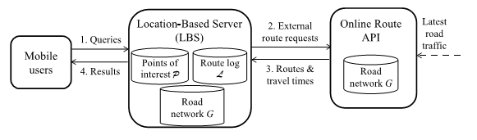
SYTEM ARCHITECTURE
13
34

Slide 14
ALGORITHMS
RANGE QUERY ALGORITHM
KNN QUERY ALGORITHM
14
34

Slide 15
RANGE QUERY ALGORITHM
Algorithm 1 Route-Saver Algorithm for Range Queries function Route-Saver-RANGE ( Query (q, T), Dataset P ) . system parameters: time-tagged graph G, route log L, expiry time δ
1: Remove from the log L any route ψt with t < tnow − δ
2: Create a result set R ← ∅
3: Cand. set C ← range search (q, T · VMAX) for P on G . By [26]
4: Run Dijkstra for q on G using ω +(e) and ω −(e) to retrieve p.τ + G , p.τ − G , p.τG .// Phase 1:detect results,prune objects
5: for each p ∈ C do . use time-tagged graph G
6: if p.τG is known or p.τ − G > T or p.τ + G ≤ T then
15
34

Slide 16
RANGE QUERY ALGORITHM
7: Remove p from C
8: if p.τG ≤ T or p.τ + G ≤ T then
9: Insert p into R
10: for each p ∈ C do . use route log L
11: if ∃ route ψ ∈ L such that ψ contains p and q then
12: Compute p.τL . optimal subpath property
16
34

Slide 17
RANGE QUERY ALGORITHM
13: if p.τL is known and p.τL ≤ T then
14: Insert p into R
15: Compute p.τ− as max{p.τ − G , p.τ − I }
16: if p.τ− > T or p.τL is known then
17: Remove p from C
18: while C is not empty do . Phase 2: Issue route requests
19: Pick an object p ∈ C with minimum p.τ− . Ordering
20: Route ψtnow ← RouteRequest(q, p) . call external API
17
34

Slide 18
RANGE QUERY ALGORITHM
21: Insert ψtnow into L; Update ω(e), µ(e) in G for e ∈ ψtnow
22: Update p.τL for all p on ψtnow . optimal subpath property [15] [31]
23: Run incremental Dijkstra to update all p.τ− . By [14]
24: for each p 0 ∈ C do
25: if p 0 .τ − > T or p 0 .τL is known then
26: Remove p 0 from C
27: if p 0 .τL ≤ T then
28: Insert p 0 into R
29: Return R T
18
34

Slide 19
KNN QUERY ALGORITHM
Algorithm 2 Route-Saver Algorithm for KNN Queries function Route-Saver-KNN ( Query (q, K), Dataset P ) . system parameters: time-tagged graph G, route log L, expiry time δ
1: Remove from the log L any route ψt with t < tnow − δ
2: Create a candidate set C ← P
3: Create a result set R with K pairs hNULL, ∞i
4: γ ← the largest travel time in R
5: Run Dijkstra for q on G using ω +(e) and ω −(e) to retrieve p.τ + G , p.τ − G , p.τG . Phase 1: obtain the threshold γ
6: for each p ∈ C do
19
34

Slide 20
KNN QUERY ALGORITHM
7: Update R, γ by p with p.τ + G or p.τG
8: for each p ∈ C do . Phase 2: prune objects
9: if p.τG > γ or p.τ − G > γ then
10: Remove p from C
11: if ∃ route ψ ∈ L such that ψ contains p and q then
12: Compute p.τL . optimal subpath property [15] [31]
13: Update R, γ by p with p.τL
14: Compute p.τ− as max{p.τ − G , p.τ − I }
20
34

Slide 21
KNN QUERY ALGORITHM
15: if p.τ− > γ or (p.τL is known and p.τL > γ) then
16: Remove p from C
17: while |C| > K do . Phase 3: Issue route requests
18: Pick an object p ∈ C with minimum p.τ− . Ordering
19: Route ψtnow ← RouteRequest(q, p) . call external API
20: Insert ψtnow into L; Update ω(e), µ(e) in G for e ∈ ψtnow
21: Update p.τL for all p on ψtnow . optimal subpath property
22: Run incremental Dijkstra to update all p.τ
23: for each p 0 ∈ C do
24: if p 0 .τ − > γ or p 0 .τL > γ then
21
34

Slide 22
KNN QUERY ALGORITHM
25: Remove p 0 from C
26: if p 0 .τL < γ then
27: Update R by p 0 with p 0 .τL
28: Return R
22
34

Slide 23
SYSTEM REQUIREMENTS
Software Requirements:
Operating System : Windows XP
Coding Language : Java
Front End : jsp , html
Database : MySql
23
34

Slide 24
SYSTEM REQUIREMENTS
Hardware Requirements:
Processor - Pentium –IV
Speed - 1.1 GHz
Ram - 256 Mb
Hard Disk - 20 GB
Key Board - Standard Windows
Mouse - Two or Three Button
Monitor - SVGA
24
34

Slide 25
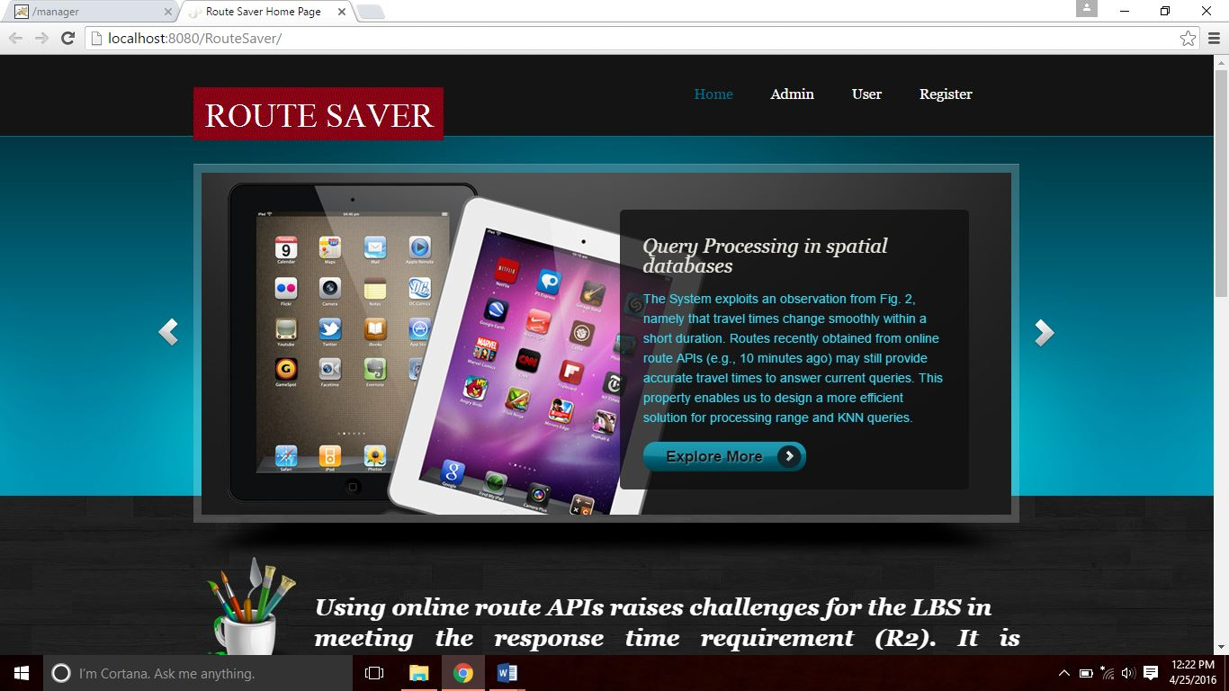
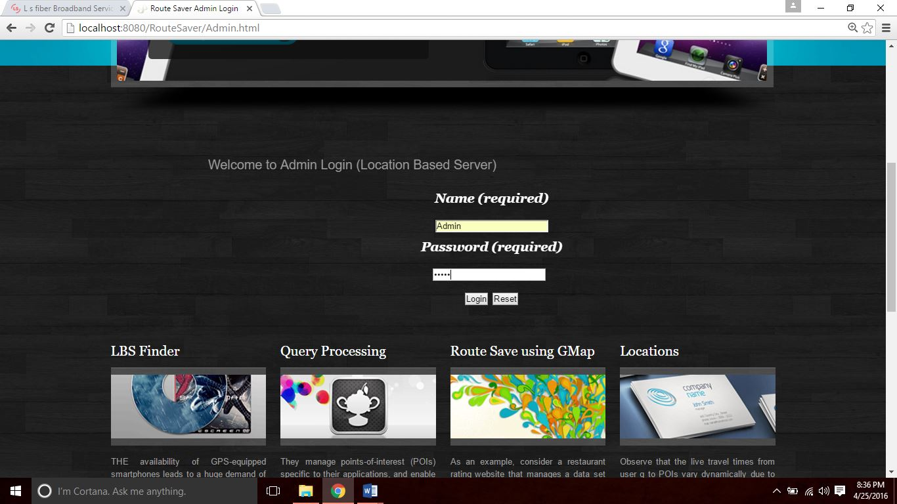
SAMPLE SCREENSHOTS
HOME PAGE
25
34
ADMIN LOGIN PAGE

Slide 26
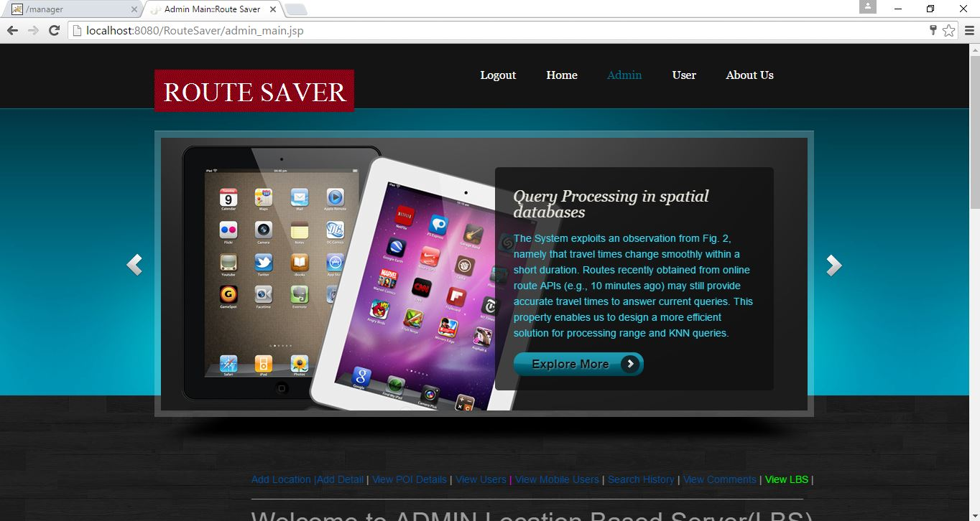
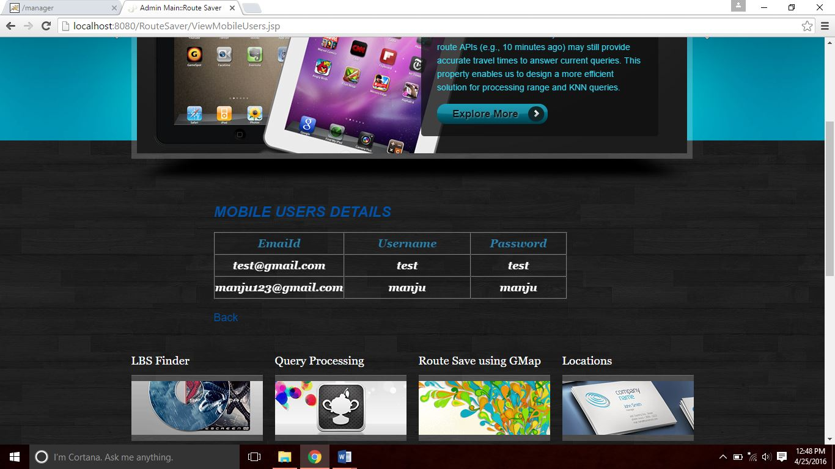
ADMIN PAGE
26
34
MOBILE USERS PAGE

Slide 27
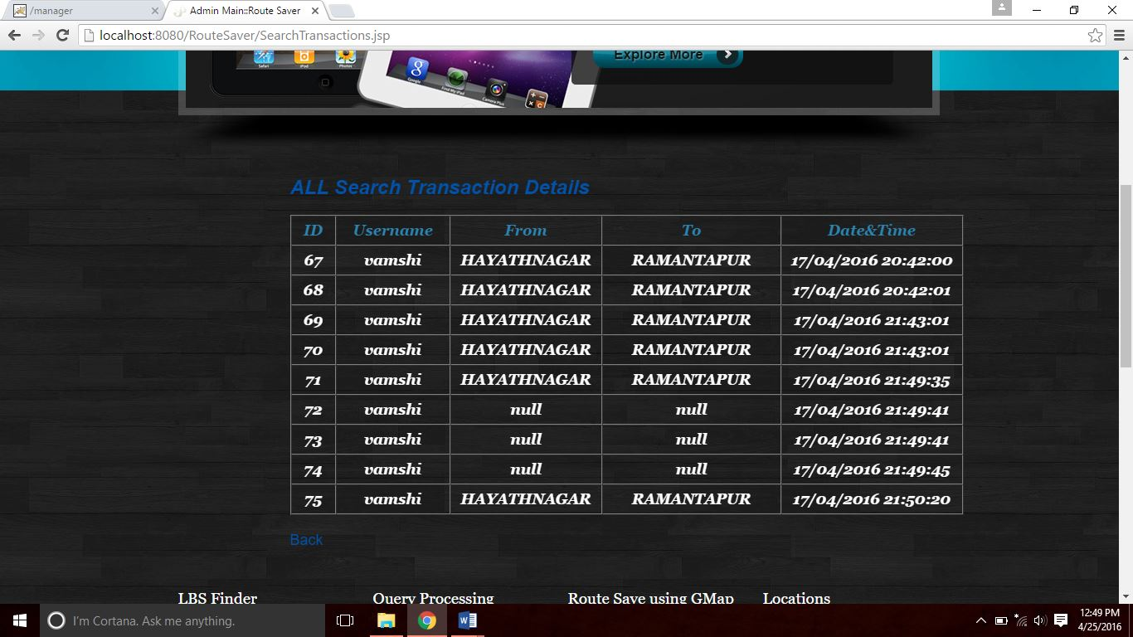
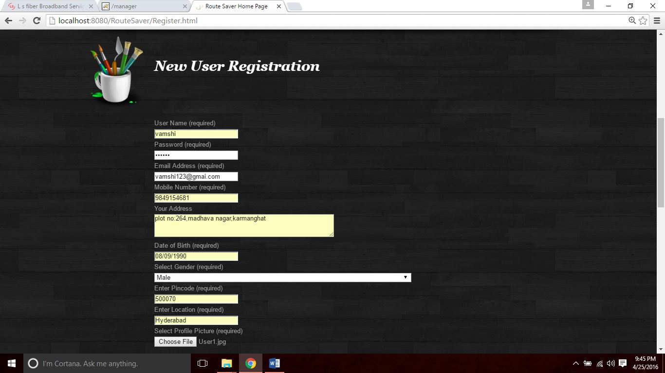
SEARCH HISTORY PAGE
27
34
REGISTRATION PAGE

Slide 28
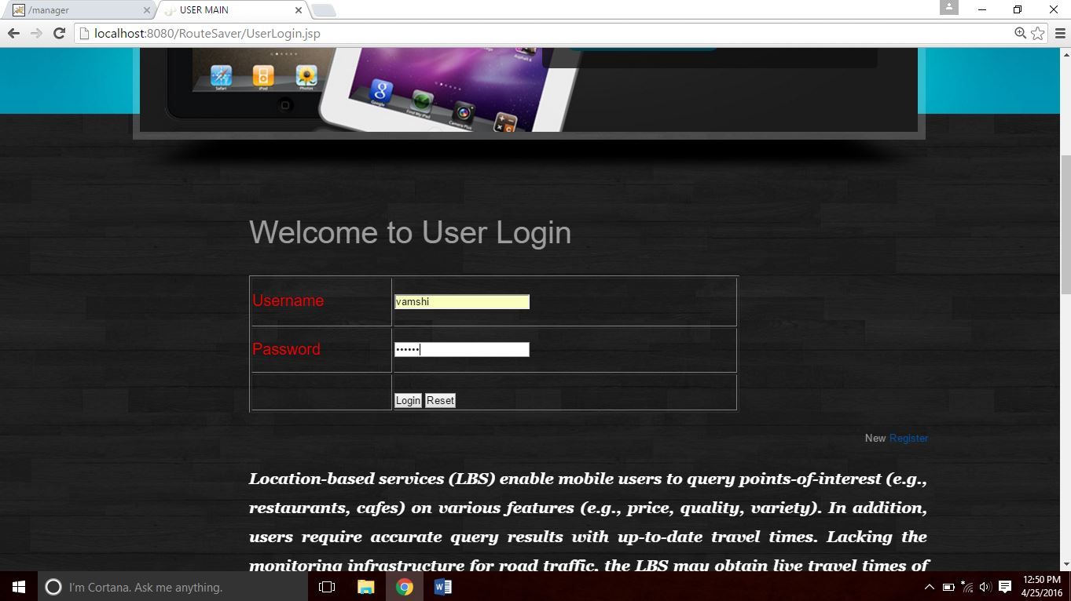
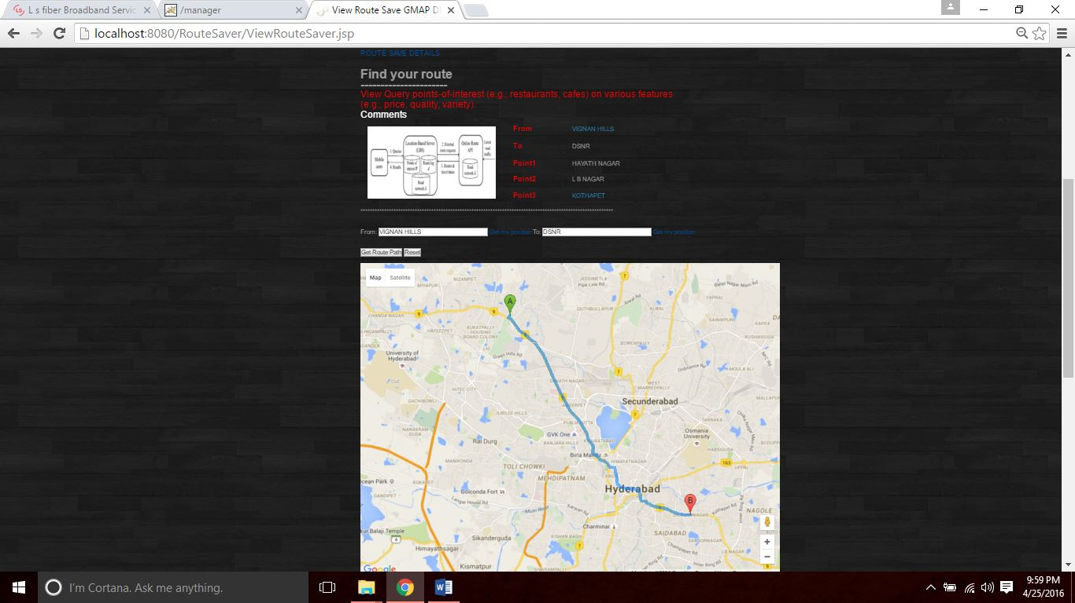
USER LOGIN PAGE
28
34
SELECT FROM & TO ROUTE MAP AND
POINTS

Slide 29
SAMPLE CODE
DATABASE CONNECTION
<%@ page import="java.sql.*"%>
<%@ page import="java.util.*" %>
<%
Connection connection = null;
try {
Class.forName("com.mysql.jdbc.Driver"); // driver load
connection = DriverManager.getConnection("jdbc:mysql://localhost:3306/routesaver","root","root");
String sql="";
}
catch(Exception e)
{
System.out.println(e);
}
%>
29
34

Slide 30
SAMPLE CODE
ADMIN LOGIN PAGE
<%@ include file="connect.jsp" %>
<%@ page import="java.util.Date" %>
<% String username=request.getParameter("adminname");
String Password=request.getParameter("password");
try
{
String sql="SELECT * FROM admin where username='"+username+"' and password='"+Password+"'";
Statement stmt = connection.createStatement();
ResultSet rs =stmt.executeQuery(sql);
String utype="";
if(rs.next())
{
response.sendRedirect("admin_main.jsp");
}
else
{
response.sendRedirect("wronglogin.html");
}
}
catch(Exception e)
{out.print(e);}
%>
30
34

Slide 31
SAMPLE CODE
USER LOGIN PAGE
<tr>
<td width="160" height="55"><span class="style5">Username</span></td>
<td width="392"><input type="text" name="userid"></td>
</tr>
<tr>
<td height="50"><span class="style5">Password</span></td>
<td><input type="password" name="pass"></td>
</tr>
<tr>
<td>&nbsp;</td>
<td><p>&nbsp;</p>
<p>
<input type="submit" name="Submit" value="Login">
<input type="reset" name="Submit2" value="Reset">
</p></td>
</tr>
31
34

Slide 32
REFERENCES
[1] 2011 Census TIGER/Line Shapefiles. (2011).[Online].Available: http://www.census.gov/cgi-bin/geo/shapefiles2011/main
[2] 9th DIMACS Implementation Challenge on Shortest Paths. (2013). [Online]. Available: http://www.dis.uniroma1.it/challenge9/data/tiger/
[3] Bing Data Suppliers. (2013). [Online]. Available: http://windows. microsoft.com/en-HK/windows-live/about-bing-data-supplie rs/
[4] Bing Maps API. (2013). [Online]. Available: http://www. microsoft.com/maps/developers/web.aspx
[5] Bing Maps Licensing and Pricing Information. (2013). [Online]. Available: http://www.microsoft.com/maps/product/licensing.aspx
[6] Google Directions & Bing Maps: Live Traffic Information. (2013). [Online]. Available: http://support.google.com/maps/bin/answer.py?hl=en&answer=2549020&topic=1687356& http://msdn.microsoft.com/en-us/library/aa907680.aspx
32
34

Slide 33
CONCLUSION
In this paper, we propose a solution for the LBS to process range/KNN queries such that the query results have accurate travel times and the LBS incurs few number of route requests. Our solution Route-Saver collects recent routes obtained from an online route API (wit hind minutes). During query processing, it exploits those routes to derive effective lower-upper bounds for saving route requests, and examines the candidates for queries in an effective order. We have also studied the parallelization of route requests to further reduce query response time. Our experimental evaluation shows that Route-Saver is 3 times more efficient than a competitor, and yet achieves high result accuracy (above 98 percent). In future, we plan to investigate automatic tuning the expiry time d based on a given accuracy requirement. This would help the LBS guarantee its accuracy and improve their users’ satisfaction.
33
34

Slide 34
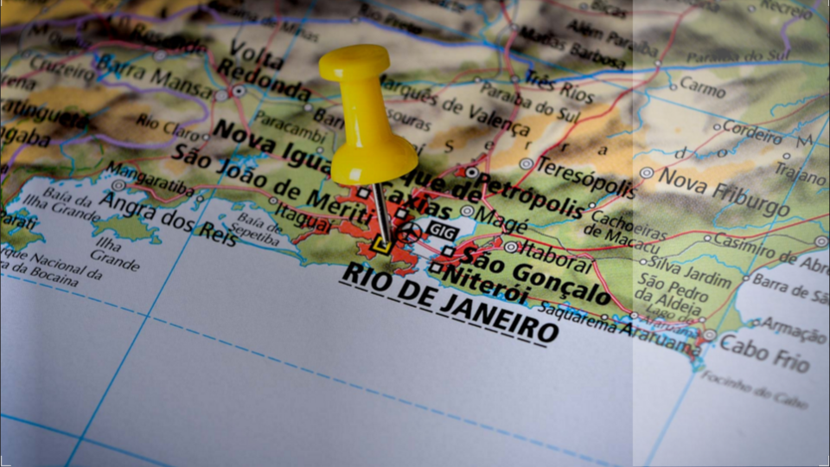
THANK YOU

