Slide 1
Deep Ultrasound Denoising Using Diffusion Probabilistic Models
Paper Review & Explanation

Slide 2
Introduction
- Ultrasound imaging is low-cost, real-time, and non-invasive
- Main challenge: low Signal-to-Noise Ratio (SNR)
- Traditional denoising methods (NLM, BM3D) remove useful speckle texture
- Goal: Preserve speckle while reducing noise
- Proposed: Use Denoising Diffusion Probabilistic Models (DDPM)

Slide 3
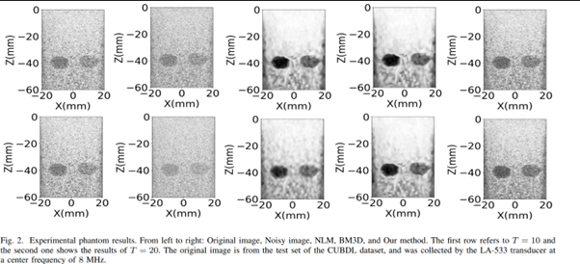

Slide 4
Background on DDPM
- DDPM learns to gradually denoise images
- Two main steps:
• Forward process: Add Gaussian noise step-by-step
• Inverse process: Iteratively remove noise
- Modeled as a Markov chain
- Neural network predicts noise at each timestep

Slide 5
Model Architecture
- Backbone: U-Net
- Time embedding added to inject timestep info
- Contracting path: progressively encodes features
- Expanding path: reconstructs denoised image
- Skip connections preserve spatial details
- Architecture designed to capture both global context and fine speckle details

Slide 6
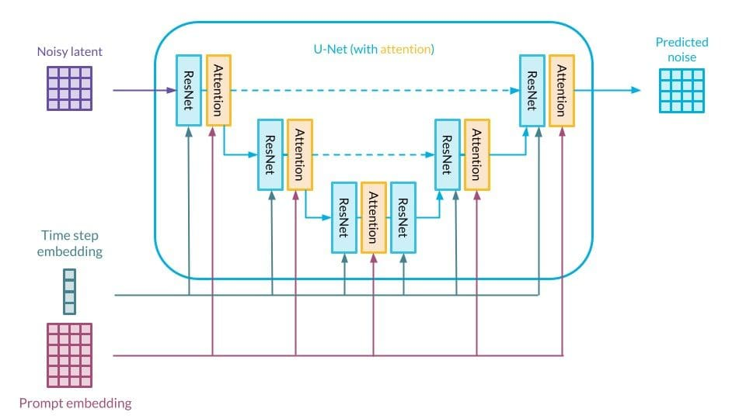

Slide 7
Input Data & Beamforming
- Input to model: Beamformed RF data (not raw channel data)
- RF data:
• Acquired from piezoelectric elements after reflection
• Contains Gaussian noise from sensors & acquisition hardware
- Envelope detection + log compression → B-mode images
- Diffusion model applied on beamformed images
- Beamforming (Delay-and-Sum) done before denoising

Slide 8
Experimental Setup
- Datasets:
• CIFAR-10: Pre-training
• CUBDL: Ultrasound fine-tuning
- Training:
• Batch size: 32, Epochs: 200
• Optimizer: Adam
• Loss: MSE
- Hardware: NVIDIA Tesla A100 (40 GB)

Slide 9
Forward Process
- Add small Gaussian noise at each timestep
- After T steps, image becomes pure noise
- Defines how noisy images are generated

Slide 10
Forward Process Equation
Noise addition in forward process:
xt = sqrt(αt) * x0 + sqrt(1 - αt) * ε
- x0: Original clean image
- xt: Noisy image at step t
- αt: Noise scheduling parameter
- ε: Gaussian noise

Slide 11
Inverse (Backward) Process
- Train a neural network to predict added noise
- Iteratively refine noisy image towards clean image
- Uses a U-Net + time embedding architecture
- Runs for T steps to recover denoised image

Slide 12
Inverse Process Equation
Noise removal in backward process:
xt-1 = (1 / sqrt(αt)) * (xt - (1-αt)/sqrt(1-α) * εt)
- xt: Noisy image at step t
- εt: Predicted noise from neural network
- xt-1: Denoised output at previous step

Slide 13
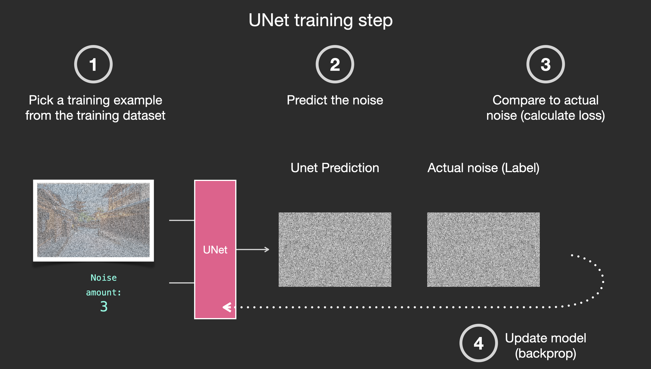

Slide 14
Methods
- Forward & inverse DDPM applied to ultrasound
- Parameters: T=300, βt=1/300, I=1
- Network: U-Net with time embedding
- Pre-trained on CIFAR10, fine-tuned on CUBDL dataset

Slide 15
Results - Quantitative
- Metrics: PSNR and GCNR
- Compared with BM3D and NLM
- Results:
• Higher PSNR than both methods
• Better GCNR for higher noise levels
- Preserves speckle texture unlike other methods

Slide 16
Results - Qualitative
- Visual comparison with BM3D & NLM
- Traditional methods blur textures as noise increases
- Proposed method preserves background and speckles
- Useful for diagnosis requiring subtle texture details

Slide 17
Conclusion
- Ultrasound images suffer from noise
- Traditional methods remove important speckles
- DDPM-based approach reduces noise while preserving details
- Outperforms BM3D and NLM in both PSNR and GCNR
- Promising step for clinical ultrasound applications

Slide 18
Ultrasound Image Enhancement with the Variance of Diffusion Models
Paper Review & Explanation

Slide 19
Introduction
- Ultrasound imaging: real-time, affordable, portable, and safe
- Challenges: electronic noise, speckle, reverberation, shadowing
- Standard DAS beamforming prioritizes speed but has poor resolution
- Speckle: useful in motion tracking, problematic for segmentation/classification
- Goal: Enhance image quality while balancing contrast, resolution, and speckle handling
- Proposed: Adaptive beamforming + variance of diffusion model outputs

Slide 20
Method Overview
Pipeline:
1. Acquire RF channel data from single Plane Wave (PW)
2. Apply adaptive pixel-wise beamforming (EBMV)
3. Run diffusion denoising multiple times
4. Compute variance across generated samples
5. Variance map produces despeckled, enhanced image

Slide 21
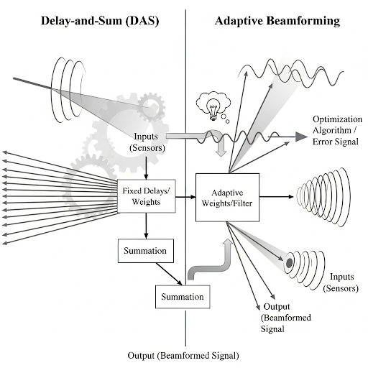
EBMV v/s DAS beamforming

Slide 22
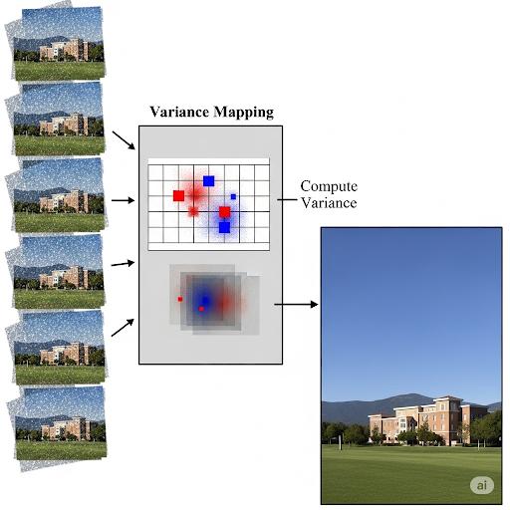
Why variance map makes a difference

Slide 23
Denoising Diffusion Variance Imaging
- Diffusion models denoise images using prior knowledge + measurement
- Each sampling run produces slightly different results due to stochasticity
- Instead of single output → compute variance across multiple outputs
- Speckle modeled as multiplicative noise: o = m ⊙ p
- Beamformed measurement: x = m ⊙ p + n
- Variance of reconstructions approximates echogenicity map
- Produces despeckled images while recovering background

Slide 24
Experimental Validation
- Dataset: PICMUS (Plane Wave Imaging Challenge)
- Reference: 75-PW DAS images
- Evaluation on:
• Experimental Contrast (EC) dataset (in-vitro)
• Carotid Cross-sectional (CC) dataset (in-vivo)
- Diffusion model: pre-trained on ImageNet, fine-tuned on 3551 high-quality RF images
- Each variance image: 10 samples, 50 iterations each
- Comparison against DAS and EBMV baselines

Slide 25
Results
- EBMV + Diffusion Variance :
• Outperforms DAS in contrast and spatial resolution
• Recovers background lost in EBMV-only results
- Quantitative metrics:
• Resolution (FWHM)
• Contrast (gCNR)
• Background SNR
- In-vivo validation confirms feasibility and generalization

Slide 26
Conclusion
- Novel method: EBMV beamforming + diffusion variance imaging
- Addresses both electronic and speckle noise
- Achieves higher contrast, resolution, and background recovery
- Avoids complexity of inverse problem approaches
- Adaptive beamformers beyond EBMV can be integrated
- Promising for enhancing single-plane-wave ultrasound imaging

