Slide 1
Aikhyaam Chat: A Comprehensive Secured Messaging Platform for Collaborative and Instant Messaging

Slide 2
TABLE OF CONTENTS
01
03
02
04
05
INTRODUCTION
PROPOSED TECHNIQUES
FUTURE SCOPE
04
PROBLEM STATEMENT
SCREEN SHOTS
CONCLUSION

Slide 3

01
INTRODUCTION

Slide 4
INTRODUCTION
The chat application is designed with privacy in mind and does not store any vital information or chat history.
There is no requirement for phone numbers or email addresses for account registration, ensuring user privacy.
The application does not have a password reset feature yet, but the team is actively working to find a solution.
The main objective of the application is to provide a secure and private communication platform for its users.

Slide 5
Facts About Privacy
68% of online users are not satisfied with the present cybersecurity laws and have reservations regarding their implementations.
59% of online users stated that they don’t believe in complete online anonymity.

Slide 6
FEATURES OF THE APP
Security
Privacy
User Friendly

Slide 7
TABLE OF CONTENTS
01
03
02
04
05
INTRODUCTION
PROPOSED TECHNIQUES
FUTURE SCOPE
04
PROBLEM STATEMENT
SCREEN SHOTS
CONCLUSION

Slide 8
02
PROBLEM STATEMENT

Slide 9
PROBLEM STATEMENT
Existing chat applications may compromise user privacy by storing personal information and chat history.
Users may not feel comfortable sharing their phone numbers or email addresses to register for a chat application.
There is a need for a chat application that prioritizes user privacy and provides a secure communication platform without compromising on ease of use or functionality.

Slide 10
108,000-3.84Million$
average cost of a single data breach from smaller to larger
business enterprises

Slide 11
TABLE OF CONTENTS
01
03
02
04
05
INTRODUCTION
PROPOSED TECHNIQUES
FUTURE SCOPE
04
PROBLEM STATEMENT
SCREEN SHOTS
CONCLUSION

Slide 12

03
PROPOSED TECHNIQUES

Slide 13

1.JSwing
JSwing is a Java GUI toolkit that enables developers to create desktop applications with ease. It provides a wide range of pre-built graphical components that can be customized to create user-friendly interfaces. With JSwing, developers can build highly responsive and attractive desktop applications using Java programming language.

Slide 14

2.MySQL
MySQL is an open-source Relational Database Management System (RDBMS) used to store and manage data in your chat application. It provides a scalable, reliable, and secure database solution that allows your application to store user data efficiently.

Slide 15
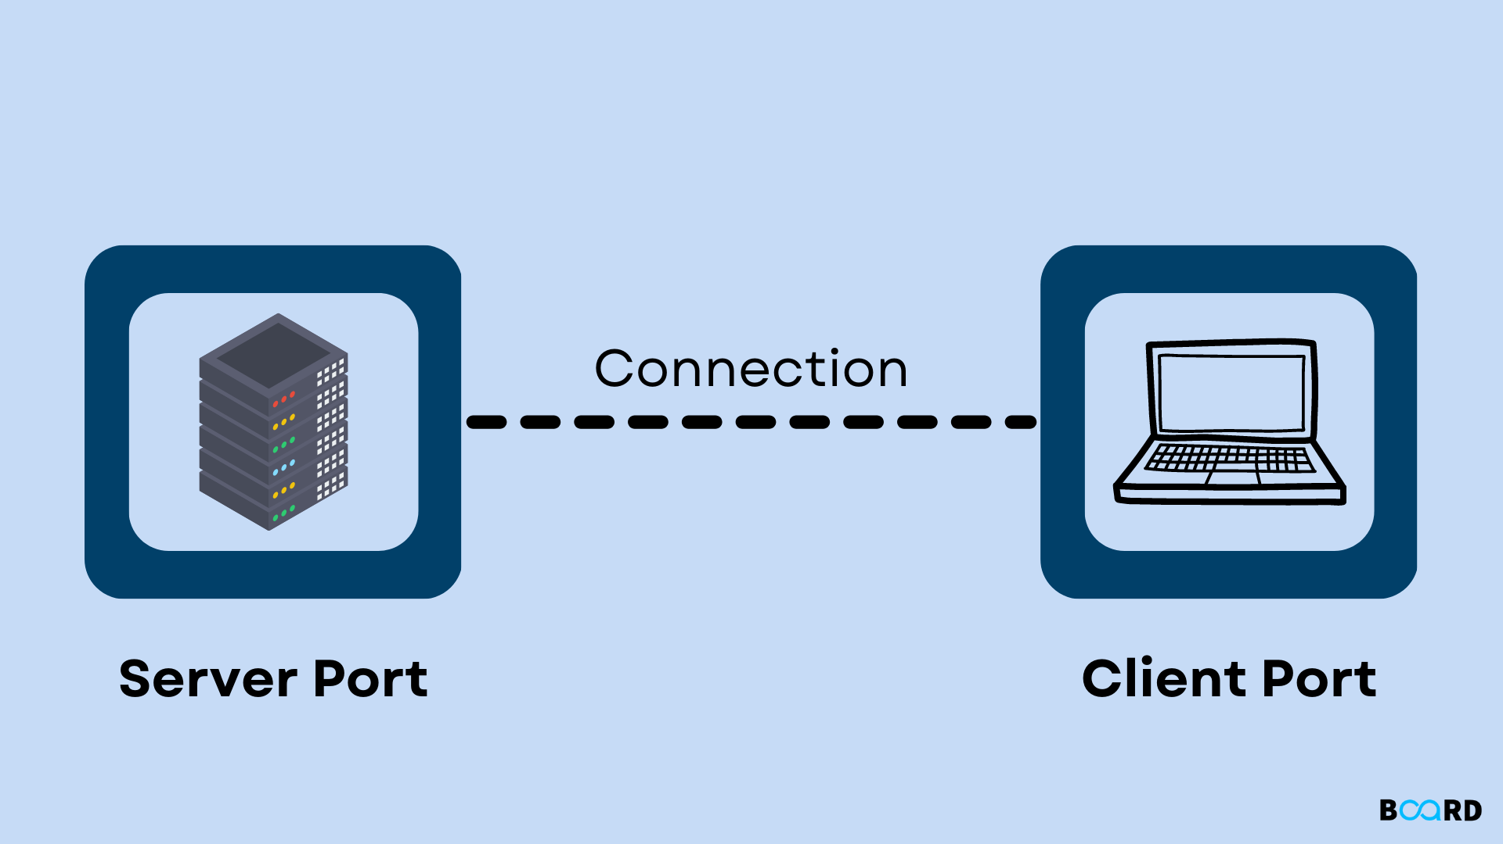
3.SHA256(Hashing)
SHA-2 is a set of cryptographic hash functions designed by the United States National Security Agency and first published in 2001. They are built using the Merkle–Damgård construction, from a one-way compression function itself built using the Davies–Meyer structure from a specialized block cipher..

Slide 16
3.Socket Programming
Java Socket programming is used for communication between the applications running on different JRE.
Java Socket programming can be connection-oriented or connection-less.
Socket and ServerSocket classes are used for connection-oriented socket programming

Slide 17
3.Socket Programming
What is Socket Programming in java?
Socket programming is a way of connecting two nodes on a network to communicate with each other. One socket (node) listens on a particular port at an IP, while other socket reaches out to the other in order to form a connection.
What is a Socket in java?
A socket in Java is one endpoint of a two-way communication link between two programs running on the network. A socket is bound to a port number so that the TCP layer can identify the application that data is destined to be sent to.
The socket value ranges from 0 and 65535. and we’ll be

Slide 18
TABLE OF CONTENTS
01
03
02
04
05
INTRODUCTION
PROPOSED TECHNIQUES
FUTURE SCOPE
04
PROBLEM STATEMENT
SCREEN SHOTS
CONCLUSION

Slide 19
04
SCREEN SHOTS

Slide 20
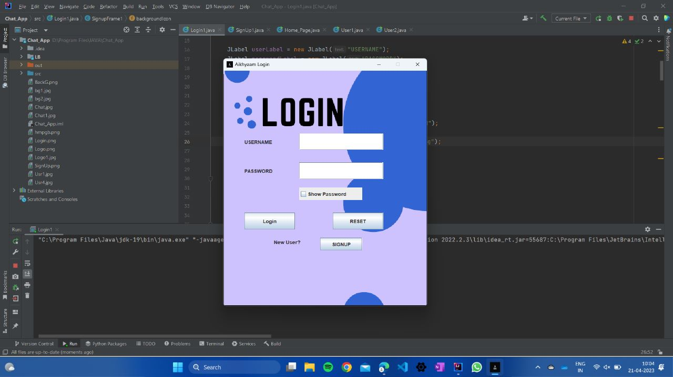
Login Page

Slide 21
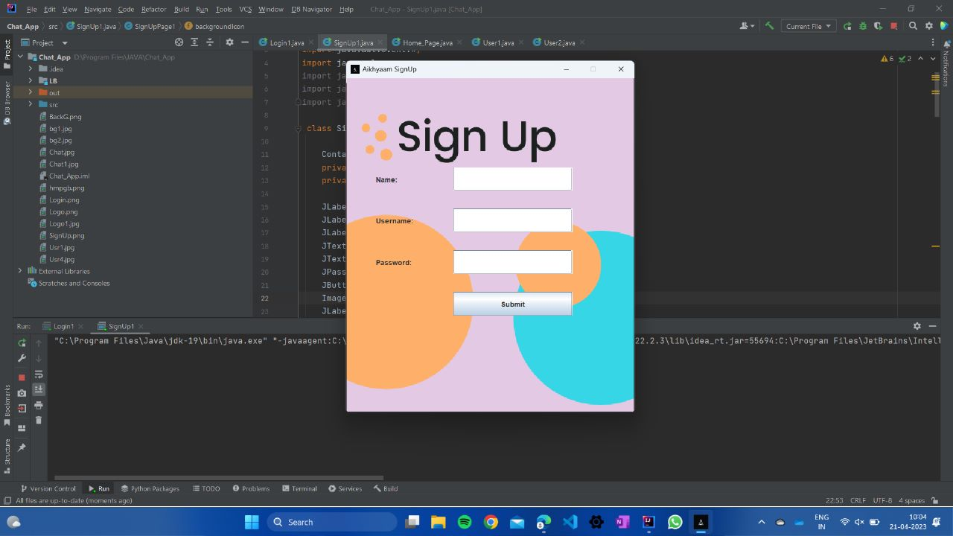
Sign-Up Page

Slide 22
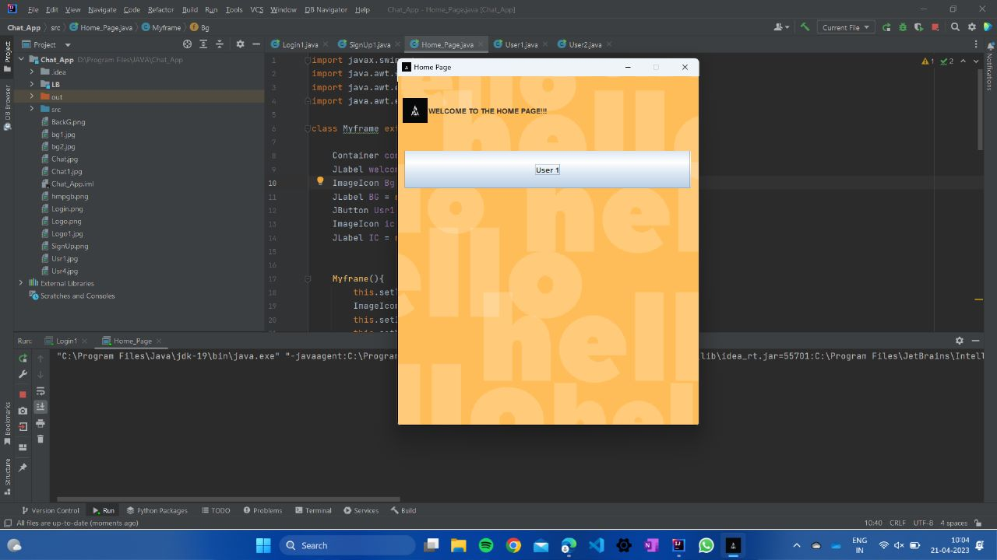
Home Page

Slide 23
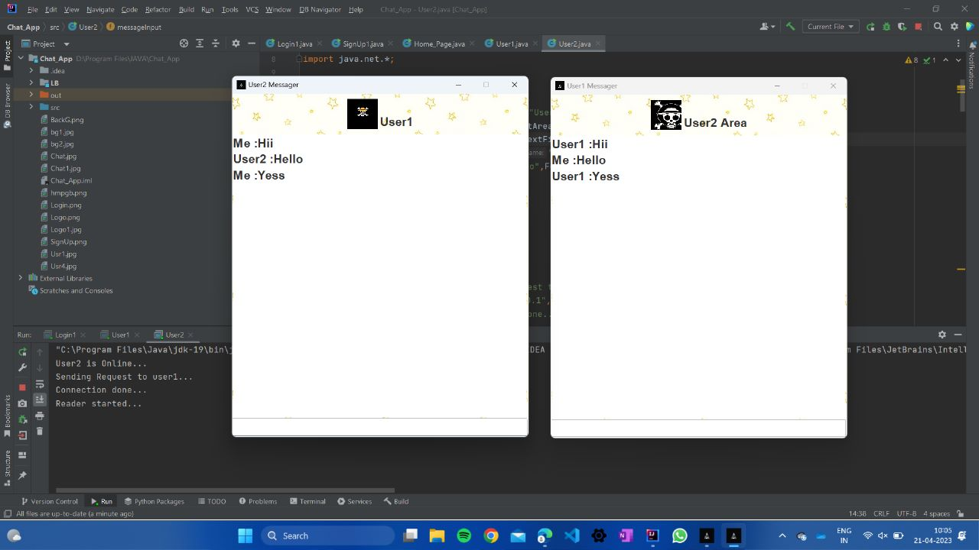
Chatting Page

Slide 24
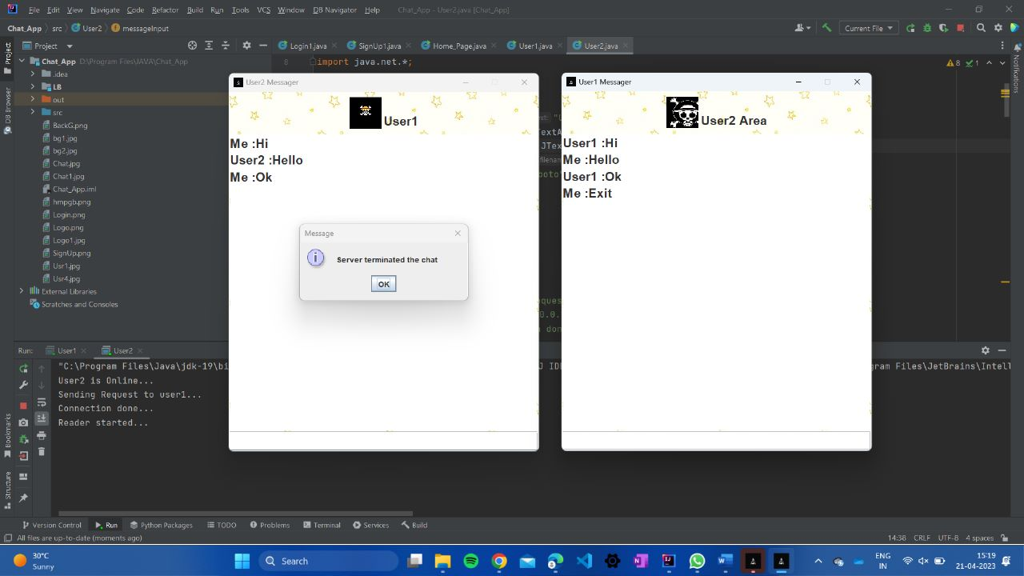
Exit Chatting Page

Slide 25
TABLE OF CONTENTS
01
03
02
04
05
INTRODUCTION
PROPOSED TECHNIQUES
FUTURE SCOPE
04
PROBLEM STATEMENT
SCREEN SHOTS
CONCLUSION

Slide 26
05
FUTURE SCOPE

Slide 27
FUTURE SCOPE
Integrating video and voice call features to enable users to make voice and video calls within the app.
Introducing group chat functionality to allow users to communicate with multiple people simultaneously.
Implementing AI-powered chatbots to assist users in their queries and enhance their overall experience.
Providing multi-device support, allowing users to seamlessly switch between devices without losing their chat history.
Adding Random Chat feature to connect more with the strangers .

Slide 28
6.CONCLUSION
In conclusion, the chat application you have developed is a secure and user-friendly platform for users to communicate with one another without worrying about their data privacy. The app uses Jswing and MySQL to create a smooth user interface and manage user data efficiently. The app's features, such as the unique login code and MD5 encryption for passwords, provide an added layer of security for users. The future scopes of the app, such as adding end-to-end encryption and integrating video and voice call features, show promise for further enhancing the user experience. Overall, the chat application is a great example of how technology can be used to create a secure and user-friendly communication platform.

Slide 29
THANK YOU

