Slide 1

FINAL YEAR RESEARCH PROJECT
Review-1 Presentation PlacementPro+: A Neuro-Symbolic AI Engine for Placement Prediction
Supervised By: Prof. /Dr.
Group No.: [Add Group]
Name of the Student(s): [Add Name]
Department of Computer Sc. and Engineering
Faculty of Engineering & Technology (ITER)
Siksha ‘O’ Anusandhan (Deemed to be) University
Bhubaneswar, Odisha
1

Slide 2
Presentation Outline
Problem Statement & Motivations
Problem Statement
Motivations
Literature Review
Existing Solutions & Limitations
Proposed Methodology & Approach
Key Components/Modules & Algorithms Used
Dataset & Tools/Technologies
Work Done So Far (Implementation Progress)
Preliminary Results (if any)
Future Work Plan
References
2

Slide 3
Problem Statement
Generic Preparation: Existing platforms offer one-size-fits-all roadmaps, ignoring base skills.
Lack of Logical Progression in AI: Standard LLMs hallucinate learning paths, failing to enforce prerequisites (e.g. ML before Python).
Siloed Systems: A fundamental disconnect exists between ML-based prediction and actionable GenAI curriculums.

Slide 4
Motivations
Personalized Learning: Empower students with tailored 12-week roadmaps that react to their skills.
Precision over Hallucination: A Neuro-Symbolic approach guarantees logically sound, executable study plans.
Holistic Solution: Bridge statistical prediction (likelihood of placement) with intelligent recommendation (how to improve).

Slide 5
Literature Review
Table 1:Summary of Existing Approaches and Research Limitations
[Example Table for Reference]
S. No. | Author & Year | Methods/Techniques Used | Dataset Used | Research Outcomes | Findings
Example 1 | Smith et al. (2022) | Feature Extraction: Ensemble Learning Classification: Random Forest | UCI Repository, Python | Accuracy: 92–95% F1 Score: 0.91 AUC: 0.93 Recall: 0.90 | High accuracy with structured data; stable and reliable performance but limited scalability
Example 2 | Kumar & Patel (2023) | Feature Extraction: CNN (Deep Learning) Classification: Convolutional Neural Network | Custom Dataset, TensorFlow/Keras | Accuracy: 90–93% F1 Score: 0.89 AUC: 0.91 Recall: 0.88 | Superior performance with automatic feature extraction; computationally expensive and requires large data
3
4
5

Slide 6
Research Gap & Improvements
The Gap: Current EdTech AI relies either entirely on rigid structural graphs or entirely on probabilistic language models.
Our Improvement: We use a Neuro-Symbolic architecture.
Neuro (Semantic): Sentence embeddings (SentenceTransformers) semantically match a student's unstructured skills to backend topics.
Symbolic (Logical): A weighted Knowledge Graph (NetworkX) transverses paths, ensuring the syllabus adheres to prerequisite dependencies.

Slide 7
Proposed Solution & Architecture
Brain MRI data
[INSERT ARCHITECTURE WORKFLOW DIAGRAM HERE]
1. User Profiling: Frontend captures skills/roles.
2. Predictive Engine: ML models assess placement likelihood.
3. Semantic Encoding: Encodes user skills into vectors.
4. Graph Traversal: Engine navigates a NetworkX directed graph.
5. Output: Structured 12-week roadmap is sent to the dashboard.
Preprocessing
CNN-Based Feature Extraction & Selection
Attention Mechanism
Classification
Fig. 1: Workflow of the Proposed Model
[Example Figure for Reference]
Result Analysis
Final Output

Slide 8
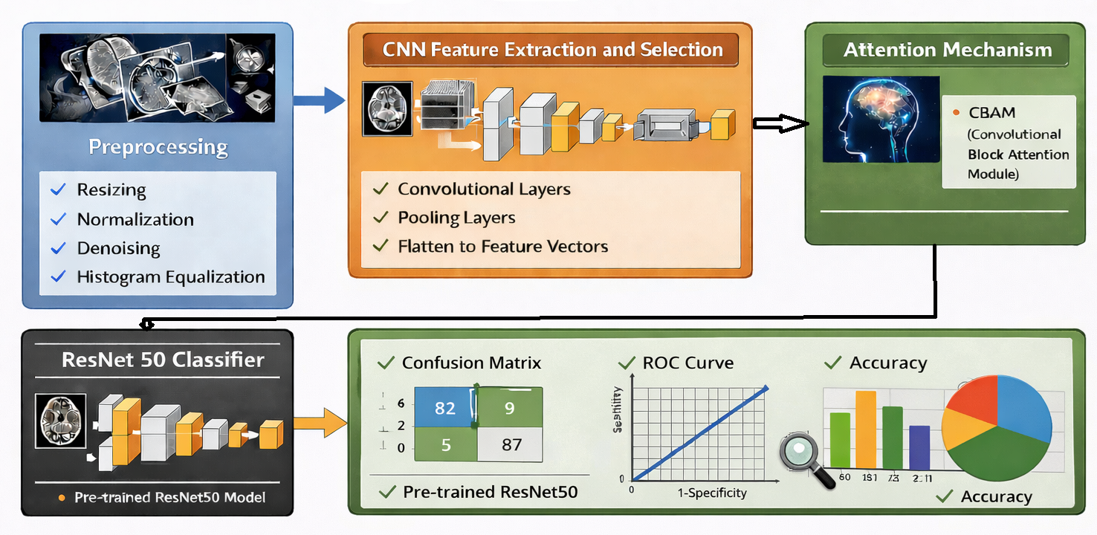
Proposed Solution & Architecture cont.
[INSERT ARCHITECTURE MODEL DIAGRAM HERE]
Frontend: React, TypeScript, and Vite.
Backend: FastAPI in Python.
AI/ML Engine: Placement Prediction & Neuro-Symbolic Roadmap Generator.
Fig. 2: Schematic Model Diagram of the Proposed Model
[Example Figure for Reference]

Slide 9
Dataset & Tools/Technologies
Datasets: Simulated historical student profiles, academic scores, and a custom Curriculum Graph.
Frontend Stack: React, TypeScript, Vite, Vanilla CSS.
Backend Framework: FastAPI (Python).
AI & ML Tools: SentenceTransformers, NetworkX, Scikit-Learn.

Slide 10
Progress in Implementation Plan & Methodology
System Skeleton: Successfully initialized the full-stack architecture.
Predictive Engine: Deployed the ML-driven placement prediction component.
Neuro-Symbolic Engine: Developed the backend using SentenceTransformers and NetworkX for the AI semantic graph.
Frontend Integration: Designed a dynamic dashboard to display the 12-week roadmaps natively.

Slide 11
Future Work Plan
Advanced State Tracking: Implement tracking for students' weekly progress.
Dynamic Re-Routing: Automatically regenerate roadmaps if a student falls behind.
Production Deployment: Prepare the application for cloud deployment using Docker.

Slide 12
References
[1] | A. Sharma, R. Kumar, and S. Das, “Deep learning-based brain tumor detection using MRI images,” IEEE Access, vol. 10, pp. 12345–12356, 2022.
[2] | P. Singh and M. Gupta, “Machine learning techniques for disease prediction,” International Journal of Medical Informatics, vol. 134, pp. 104–112, 2021.
[3] | S. Roy et al., “A hybrid CNN-LSTM model for medical image classification,” IEEE Transactions on Medical Imaging, vol. 39, no. 5, pp. 1400–1410, 2020.
[4] | K. Patel and N. Shah, “Transfer learning approach for image classification using VGG16,” Procedia Computer Science, vol. 167, pp. 197–206, 2022.
[5] | R. Das and A. Mishra, “EfficientNet-based model for disease detection,” Expert Systems with Applications, vol. 198, pp. 116–130, 2023.
[6]

Slide 13

13

