Slide 1

TEXT SUMMARIZATION USING NATURAL LANGUAGE PROCESSING
Course Title : CS323 – Introduction to NLP
Team Corpus
Topic wise contribution:
Implementation and analysis of Algorithms
Frequency based algorithm – Pravallika, Srija
Luhn algorithm - Srija, Pruthvi, Ashwitha
Cosine Similarity – Pravallika, Pruthvi, Ashwitha
PPT – Pruthvi, Ashwitha
Report – Pravallika, Srija
Submitted to:
Dr. Ashish Anand
Professor, Computer Science and Engineering
Submitted by:
Pruthvi Raj G N – 200101088
Kanchumarthi H Pravallika – 200101049
Gandrathi Srija – 200101030
Ashwitha Banoth – 200101021
Dataset : Random large text and CNN-DailyMail News Text Summarization

Slide 2
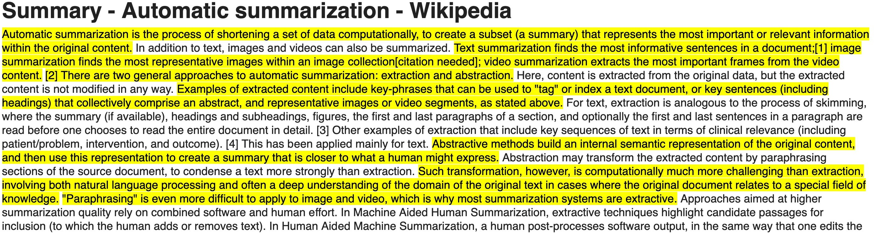
ALGORITHMS
Frequency-based algorithm - frequency_based_algorithm
Luhn algorithm - luhn_algorithm
Cosine similarity - cosine_similarity
Extractive

Slide 3
TEXT SUMMARIZATION
Artificial intelligence is human like intelligence. It is the study of intelligent artificial agents. Science and engineering to produce intelligent machines. Solve problems and have intelligence. Related to intelligent behavior. Developing of reasoning machines. Learn from mistakes and successes. Artificial intelligence is related to reasoning in everyday situations.
Steps
Preprocessing the texts
Word frequency
Weighted word frequency
Sentence tokenization
Score for the sentences
Order the sentences
Generate the summary

Slide 4
1. PREPROCESSING THE TEXTS
Sample example before preprocessing text
Artificial intelligence is human like intelligence. It is the study of intelligent artificial agents. Science and engineering to produce intelligent machines. Solve problems and have intelligence. Related to intelligent behavior. Developing of reasoning machines. Learn from mistakes and successes. Artificial intelligence is related to reasoning in everyday situations
Sample example after preprocessing text
artificial intelligence human like intelligence. study intelligent artificial agents. science engineering produce intelligent machines. solve problems intelligence. related intelligent behavior. developing reasoning machines. learn mistakes successes. artificial intelligence related reasoning everyday situations

Slide 5
2. WORD FREQUENCY
Word | Frequency
artificial | 3
intelligence | 4
human | 1
like | 1
study | 1
intelligent | 3
science | 1
engineering | 1
produce | 1
machines | 2
solve | 1
Word | Frequency
agents | 1
problems | 1
related | 2
behavior | 1
developing | 1
reasoning | 2
learn | 1
mistakes | 1
successes | 1
everyday | 1
situations | 1

Slide 6
3. WEIGHTED WORD FREQUENCY
Highest value: 4
Word | Frequency | Weigth
artificial | 3 | 0.75
intelligence | 4 | 1.00
human | 1 | 0.25
like | 1 | 0.25
study | 1 | 0.25
intelligent | 3 | 0.75
science | 1 | 0.25
engineering | 1 | 0.25
produce | 1 | 0.25
machines | 2 | 0.50
solve | 1 | 0.25
Word | Frequency | Weight
agents | 1 | 0.25
problems | 1 | 0.25
related | 2 | 0.50
behavior | 1 | 0.25
developing | 1 | 0.25
reasoning | 2 | 0.50
learn | 1 | 0.25
mistakes | 1 | 0.25
successes | 1 | 0.25
everyday | 1 | 0.25
situations | 1 | 0.25

Slide 7
4. SENTENCE TOKENIZATION
Artificial intelligence is human like intelligence. It is the study of intelligent artificial agents. Science and engineering to produce intelligent machines. Solve problems and have intelligence. Related to intelligent behavior. Developing of reasoning machines. Learn from mistakes and successes. Artificial intelligence is related to reasoning in everyday situations
Tokenization
Artificial intelligence is human like intelligence.
It is the study of intelligent artificial agents.
Science and engineering to produce intelligent machines.
Solve problems and have intelligence.
Related to intelligent behavior.
Developing of reasoning machines.
Learn from mistakes and successes.
Artificial intelligence is related to reasoning in everyday situations

Slide 8
5. SCORE FOR THE SENTENCES
Sentence | Score (sum of weights)
Artificial (0.75) intelligence (1.00) is human (0.25) like (0.25) intelligence (1.00). | 3.25
It is the study (0.25) of intelligent (0.75) artificial (0.75) agents (0.25). | 2.00
Science (0.25) and engineering (0.25) to produce (0.25) intelligent (0.75) machines (0.50). | 2.00
Solve (0.25) problems (0.25) and have intelligence (1.00). | 1.50
Related (0.50) to intelligent (0.75) behavior (0.25). | 1.50
Developing (0.25) of reasoning (0.50) machines (0.50). | 1.25
Learn (0.25) from mistakes (0.25) and successes (0.25). | 0.75
Artificial (0.75) intelligence (1.00) is related (0.50) to reasoning (0.50) in everyday (0.25) situations (0.25). | 3.25

Slide 9
6. ORDER THE SENTENCES
Sentence | Score (sum of weights)
Artificial (0.75) intelligence (1.00) is related (0.50) to reasoning (0.50) in everyday (0.25) situations (0.25). | 3.25
Artificial (0.75) intelligence (1.00) is human (0.25) like (0.25) intelligence (1.00). | 3.25
It is the study (0.25) of intelligent (0.75) artificial (0.75) agents (0.25). | 2.00
Science (0.25) and engineering (0.25) to produce (0.25) intelligent (0.75) machines (0.50). | 2.00
Solve (0.25) problems (0.25) and have intelligence (1.00). | 1.50
Related (0.50) to intelligent (0.75) behavior (0.25). | 1.50
Developing (0.25) of reasoning (0.50) machines (0.50). | 1.25
Learn (0.25) from mistakes (0.25) and successes (0.25). | 0.75

Slide 10
7. GENERATE THE SUMMARY
Artificial intelligence is human like intelligence. It is the study of intelligent artificial agents. Science and engineering to produce intelligent machines. Solve problems and have intelligence. Related to intelligent behavior. Developing of reasoning machines. Learn from mistakes and successes. Artificial intelligence is related to reasoning in everyday situations
Artificial intelligence is related to reasoning in everyday situations. Artificial intelligence is human like intelligence. It is the study of intelligent artificial agents.

Slide 11
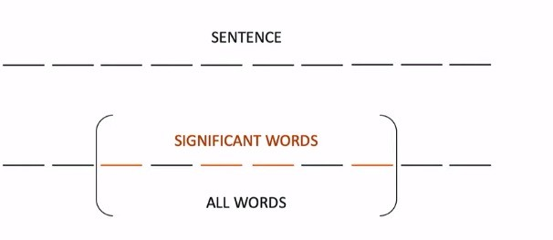
LUHN ALGORITHM
Select most important words based on frequency
Score of the sentence = (Number of meaningful words)²/(Span of meaningful words)
Source: https://iq.opengenus.org/luhns-heuristic-method-for-text-summarization/

Slide 12
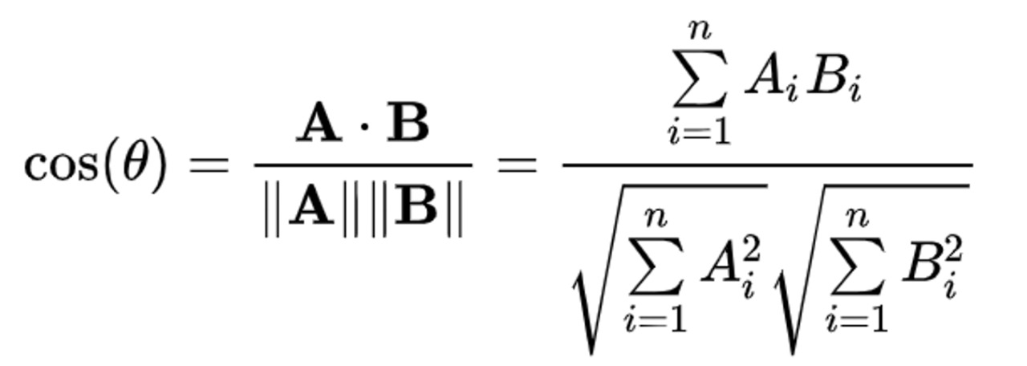
COSINE SIMILARITY
This algorithm is based on generating similarities between each sentence and assigning ranks based on the similarity matrix and selecting top ranked sentences.
THANK YOU

