Slide 1
Credit EDA Case Study
Driving factors for loan default
Team
Name | Email Address
Srija Palakurthi (Facilitator) | srija.palakurthimay1@gmail.com
Rajkumar Sakthibalan | rajbow@gmail.com

Slide 2
Problem Scope and Objective
Problem
It is difficult for the bank to identify risk while providing loan for individuals
Depending on different factors, clients might default on payment of due on time
Solution Objective
Identify Driving factors that make clients default on payment of due on time

Slide 3
Approach to EDA
To identify the factors the below steps are performed for analysis
Steps
Data Cleaning
Identify Missing Data
Missing Value Treatment
Dropping unwanted rows and columns
Identify Imbalance in the data based on Target Variable
Split Dataset based on imbalance percentage
Uni-variate Analysis
Bi/Multivariate Analysis
Provide Inferences

Slide 4
Data Summary
Observation Metrics |  | Comments on Observation
Dataset 1: | application_data | Current Applicants information
Total No. of Observations | 307511
No. of Columns | 122 | Some are functionally relevant. Some columns do not have data
Attribute of Interest | TARGET | Target variable. 1 - client with payment difficulties: he/she had late payment more than X days on at least one of the first Y installments of the loan in our sample 0 - all other cases
Dataset 2: | previous_application | Previous Applicantions information for the Current Applicants
Total No. of Observations | 1670214
No. of Columns | 37

Slide 5
1. Data Cleaning
Identifying Missing Data
Missing Data is identified by finding columns that have more 30% data
missing.
Missing Value Treatment
Depending on the problem statement, we have dropped columns with more than 30% data missing
Dropping Unwanted Rows and Columns
Rows which have null values based on no. of rows affected being insignificant
Rows which have data that is not relevant based on information from columns_description.csv
Rows which have missing values that cannot be imputed
Columns that are not relevant based on information from columns_description.csv

Slide 6
2. Imbalance Percentage
The dataset is analysed based on the Target variable
The percentage of Defaulters and Non-Defaulters is calculated
The Imbalance Percentage was found to be very high
Hence, the data was segmented between the two Targets
Segmented Univariate and Bi/Multi Variate Analysis was done on these data sets

Slide 7
3. Univariate Analysis
The list of columns for univariate analysis is picked based on information from column_description.csv
The outliers were identified
Units of some data were changed to facilitate analysis
Negative values were changed to absolute values
The data range was analysed and based on that, the numeric columns were binned for analysis
Observations were made by segmented univariate analysis for different columns and some inferences had been done
The following techniques were used:
Box Plots
Count Plots
Bar Plots

Slide 8
4. Multivariate Analysis
Many variables were found to be not individually effecting on the target
Segmented Multivariate Analysis was done for different sets of variables
Both the given datasets were cross-referenced for analysis
The following techniques were used:
Heatmap
Correlation
Scatter Plot
Identified Top 10 Highly Correlated Variables
Inferences were made

Slide 9
5. Inferences
Inferences were made based on the different analysis
We found that:
Some variables were corelated because they are part of same business information
Some variables were corelated with varying degress
Some variables from previous_application were influencing observations when cross-referencing with the current application_data.

Slide 10
Results
Insights and Visualizations

Slide 11
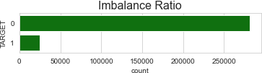
Imbalance Percentage
Imbalance Percentage:
Non-Defaulter Applicants: Defaulters:
281085 Percentage: 0.92
24736 Percentage: 0.08
Note:
Only 8% of the applicants are Defaulters(TARGET=1).
Others (92%) are Non-Defaulters(TARGET=0)
We will now split them into two different sets and analyze accordingly

Slide 12
Datasets for Segmented Analysis
Here, we look at variables directly influencing the target. We use the term Target for the target variable.
We split the data into two datasets based on the Imbalance Ratio between the two types of applicants(Clients*)
Target 1:
Defaulter Applicants -- (Clients*) with payment difficulties: he/she had late payment more than X days on at least one of the first Y installments of the loan in our sample.
Target 0:
Non-Defaulter Applicants (All other cases*) with no difficulties paying due on time
*As described in the columns_description.csv document

Slide 13
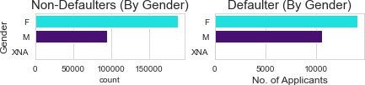
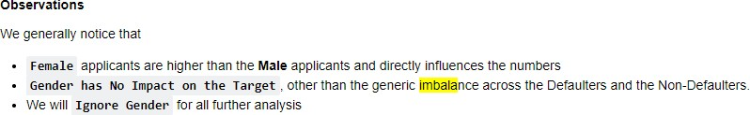
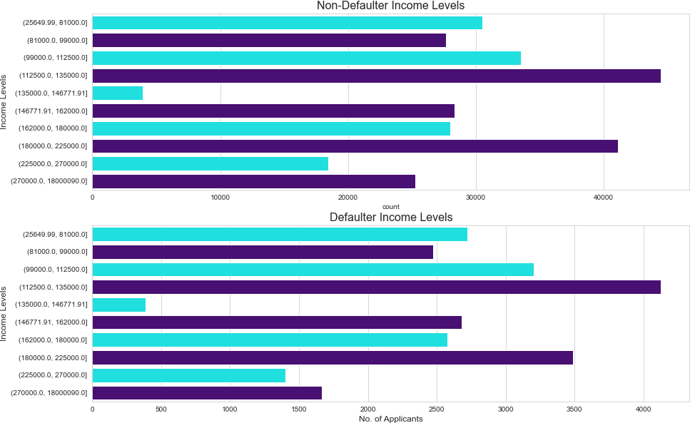
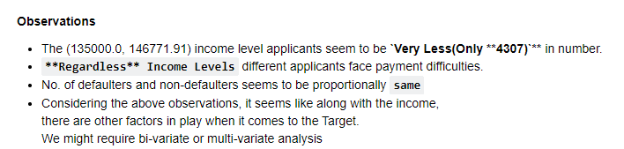

Univariate Analysis

Slide 14
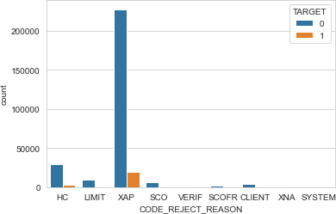
Univariate Analysis with cross-reference

Slide 15
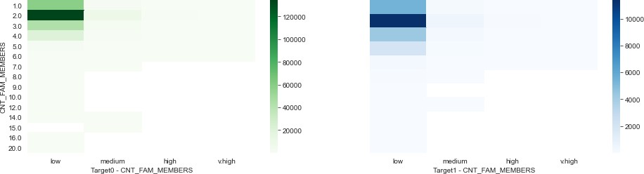
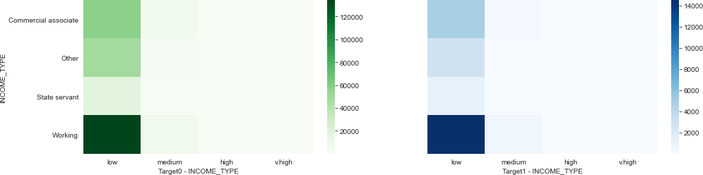
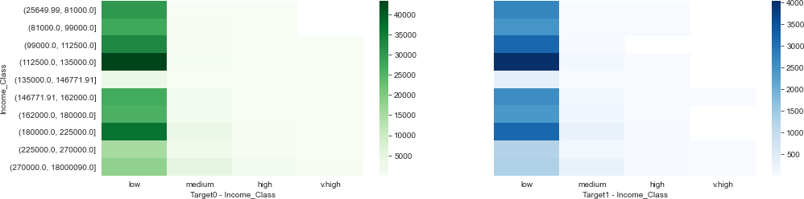
Bi-variate Analysis
Observations for Bi-variate Analysis:
No significance variations were observed for specific variables.
This calls for multi-variate analysis
Cross-referencing with Previous Application data could potentially yield more results

Slide 16
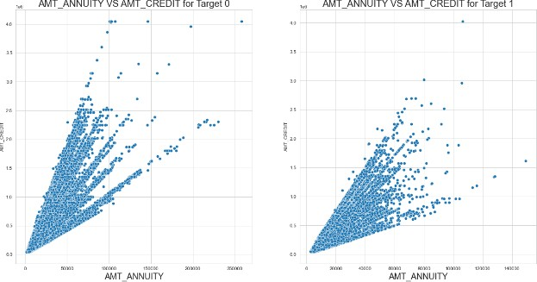
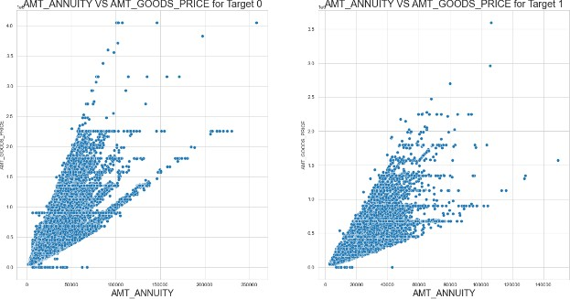
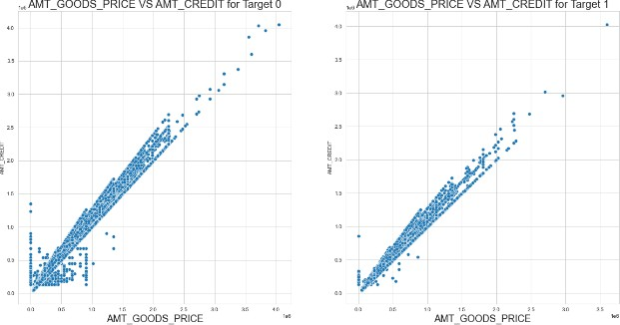
Bi-Variate Analysis – Top Correlation

Slide 17
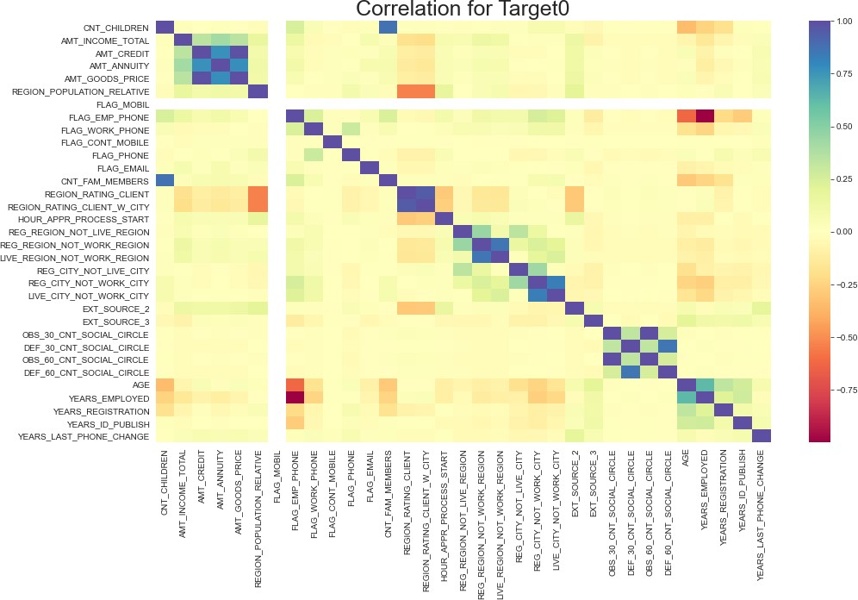
Multivariate Analysis – Target 0
Observations for Multivariate Analysis:
Variables from the same business information group show full correlation. These are ignored
Variables with higher correlation but from different business information are considered for inference
A spectral spread of colors are used to identify patterns of correlation across different variables
It was observed that different variables have varying degrees of correlation

Slide 18
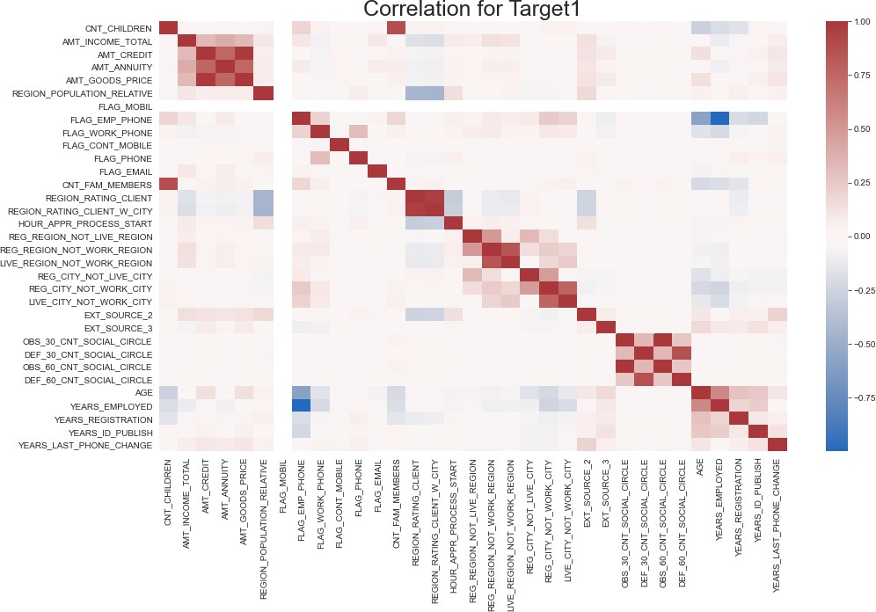
Multivariate Analysis – Target 1

Slide 19
Notes on analysis:
Pre-liminary analysis indicate that:
Some applicants are having multiple previous applications
There are more relevant business information like CODE_REJECT_REASON which means a direct impact on the Target variable.
Previous Applications dataset has more than double the number of records across both the
Target segments.

Slide 20
Thank you.
Team
Name | Email Address
Srija Palakurthi (Facilitator) | srija.palakurthimay1@gmail.com
Rajkumar Sakthibalan | rajbow@gmail.com

