Slide 1
BUS RESERVATION SYSTEM
Team members:
Navya sri (Teamlead) - 24KB1A0599 Saisrija - 24KB1A05LB
Keerthana – 24KB1A05R0 Ruchitha – 24KB1a0594

Slide 2
Introduction:
A bus reservation system is a software application designed to manage the booking and scheduling of bus tickets for passengers. It automates the entire process of ticket reservation, seat selection, fare calculation, and route management. Typically used by bus operators and travel agencies, the system allows customers to book tickets online or at ticket counters, view seat availability, and receive booking confirmations.

Slide 3
Objective:
Automate the ticket booking process:
simplify the process of booking bus tickets
Improve customer convenience:
selecting routes and making payments
Efficient seat management:
overbooking or seat conflicts
Generate reports and insights:
bus occupancy for better decision making

Slide 4
Why C & DSA:
C language advantages:
Low level memory control, speed, foundational are the advantages
DSA Importance:
Efficient data handling, optimised search and sort, Real world modeling

Slide 5
Algorithm:
Step1: Initialize bus details
Create a bus object with attributes :ID route, arrival time, total seats, and available seats
Store bus details in DS Step2: Display bus options
Retrieve bus details from DS
Display bus options Step3: Book a ticket
Prompt the user to select the bus
Generate a ticket with booking details
Step4: Cancel a ticket
Prompt the user to enter their booking details
Update the bus available seats
Step5: View booking details

Slide 6
Objective:
user friendly interface is crucial
Real time seat availability is essential
Payment gateway integration must be secure and reliable
scalability and performance matter
Accurate scheduling and route management
Cancellation and refund policies need clarity
Mobile optimization is non negotiable
Data security and privacy compliance

Slide 7
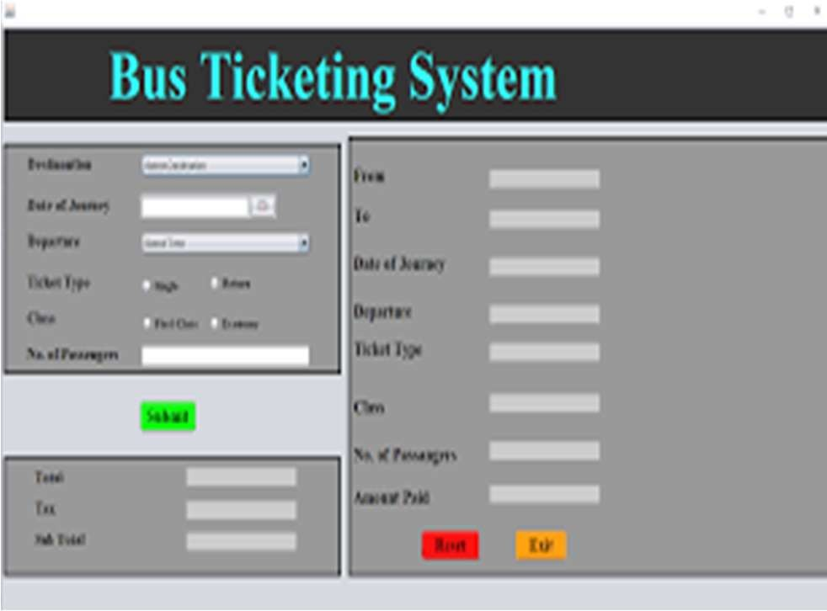
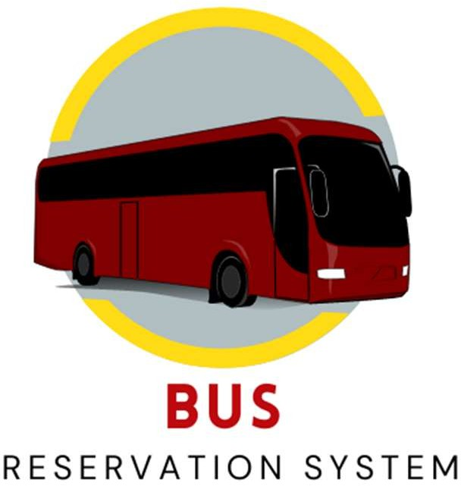

Slide 8
Conclusion:
The bus reservation system significantly enhances the efficiency, convenience, and reliability of booking and managing bus travel. By automating seat allocation, payment processing, and schedule updates, it reduces manual errors and improves customer satisfaction. A well designed system not only streamlines operations for bus operators but also offers a seamless experience for passengers through real-time information and user – friendly interfaces.

Slide 9
THANK YOU

