Slide 1
Fault Detection in Semiconductor Wafers Using ML models
Presented by-
Sairam Prudhvi Karri (BA13810)
Srija Adapa (UG87574)

Slide 2
Problem Statement
Fault detection in wafer manufacturing is difficult for ensuring the product quality and minimizing production losses. By using machine learning models and advanced data analysis techniques, this project aims to develop a robust fault detection system for wafer fabrication processes. By harnessing different algorithms, the system will analyze sensor data from various stages of the manufacturing process to identify anomalies indicative of defects in the wafers. Through employing a preventative strategy, defects can be addressed before they become more significant, reducing scrap rates and enhancing overall production efficiency.
The proposed system will not only focus on detecting faults but also on providing insights into the root causes of these faults, allowing for targeted process improvements. By leveraging clustering and predictions, the system will categorize different types of faults and correlate them with process parameters, environmental conditions, and equipment status which leads to continuous optimization of wafer manufacturing processes and ultimately improving product quality and yield.

Slide 3
Introduction
Semiconductor manufacturing is a complex process involving multiple steps to create integrated circuits (ICs) on silicon wafers. The following are steps:
Wafer Fabrication, Deposition, Photolithography, Etching, Doping, Annealing, Testing and Packaging
Quality Control in Wafer Manufacturing:
Quality control is critical in wafer manufacturing to ensure the reliability, performance, and longevity of electronic devices. Defects or irregularities in wafers can lead to malfunctioning ICs, reducing product yield and increasing production costs. Moreover, faulty ICs can cause device failures in end-user applications, compromising safety and reputation.
Effective quality control measures, including fault detection, help identify and rectify issues early in the manufacturing process, minimizing waste and maximizing yield. This not only improves profitability for manufacturers but also enhances the overall quality of electronic products in the market.

Slide 4
Data Set
The wafer dataset consists of 288,235 rows and 590 columns from around 31 csv files, with each row representing a wafer and each column representing a sensor measurement. This dataset provides a comprehensive view of sensor readings captured during wafer fabrication processes, offering valuable insights for developing machine learning models for fault detection.
The size of our dataset is around 2.5GB
•Number of rows: 288235
•Number of columns: 590
Columns : Sensor 1,Sensor 2,Sensor 3…………..,sensor 590.
Our data is a binary classification dataset where we have “0” for bad wafer and “1” for good wafer.

Slide 5
Analysis Methods
Programming Languages: Python is the main language used for analysis and data processing.
Libraries and Frameworks: For data processing, analysis, statistical computations, visualization, and geospatial representation, use tools like PySpark, Pandas, NumPy, Matplotlib, Seaborn.
Phases include data intake, data storage, data processing, data analysis, and data visualization are typically included in the big data project lifecycle. These phases are implemented appropriately in the context of our fault detection in wafers by using machine learning models.

Slide 6
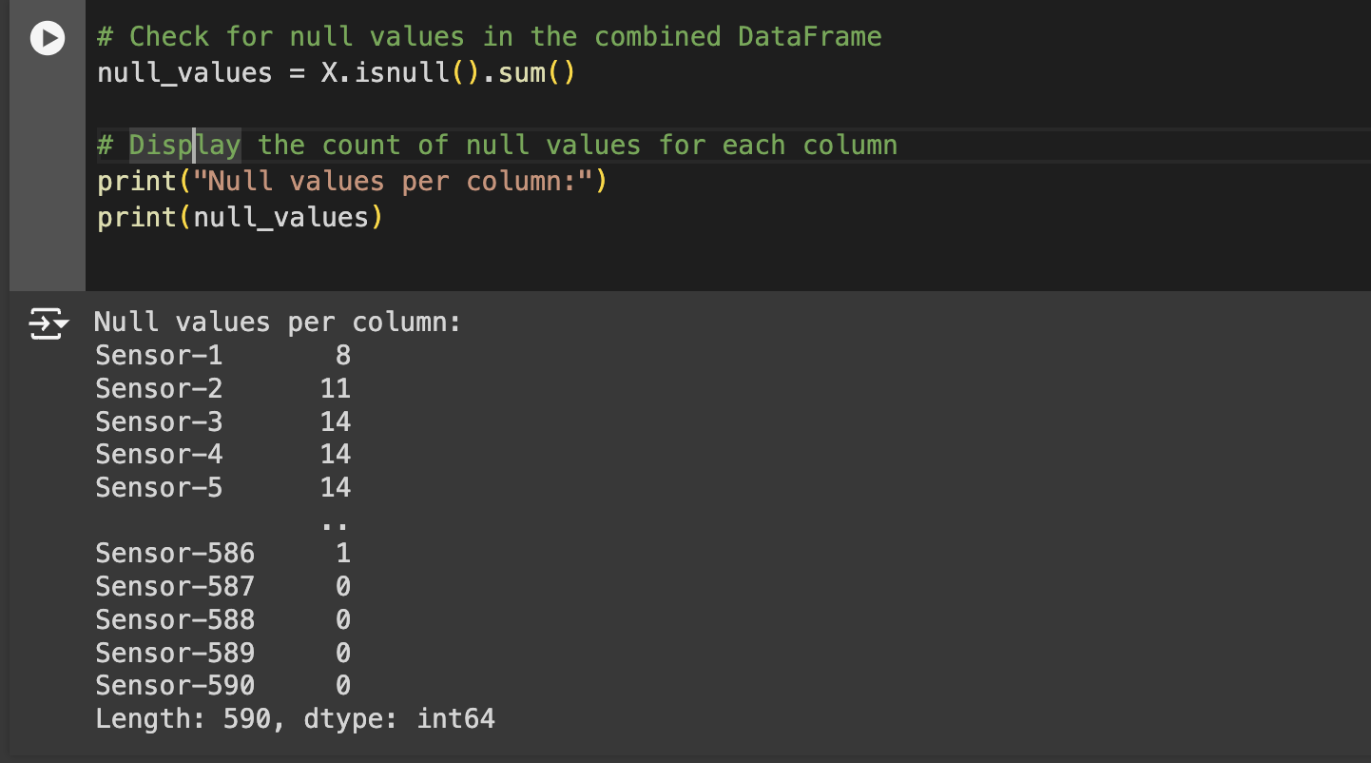
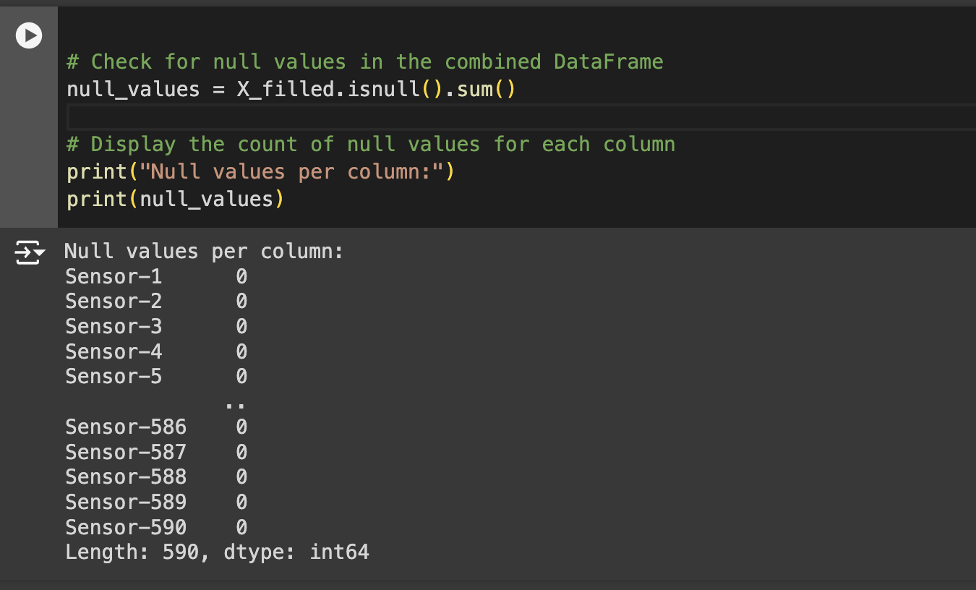
Data Preprocessing
We have imputed mean values in place of nulls
Before After

Slide 7
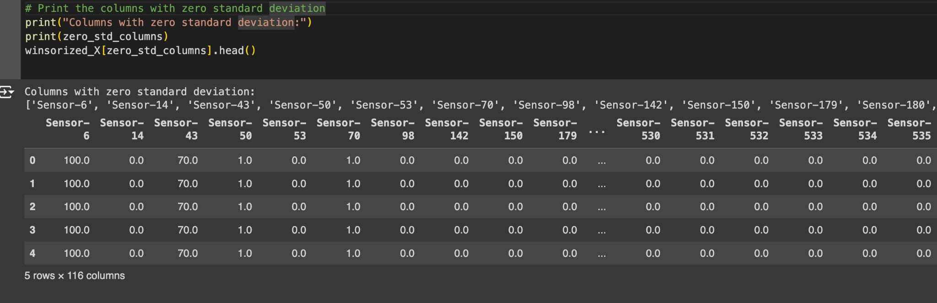
Standard Deviation
We have identified over 116 sensors is having 0 standard deviation which means all the data in each sensor is having same data for all the wafers. So, we have removed these sensors data.

Slide 8
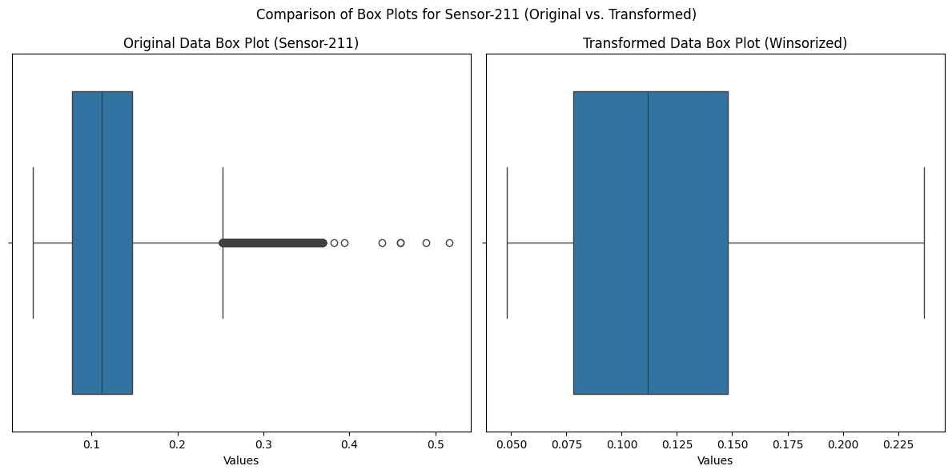
Outliers
We have identified outliers in most of the columns and handled those using “Winsorization“ technique.

Slide 9
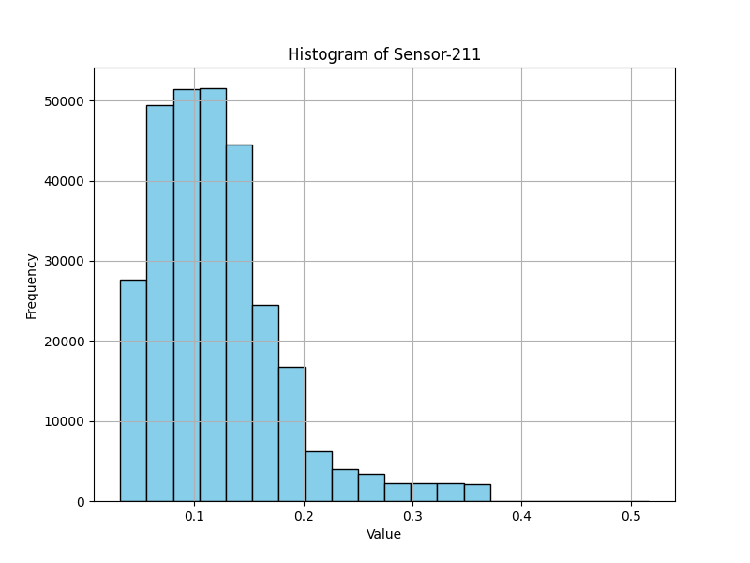
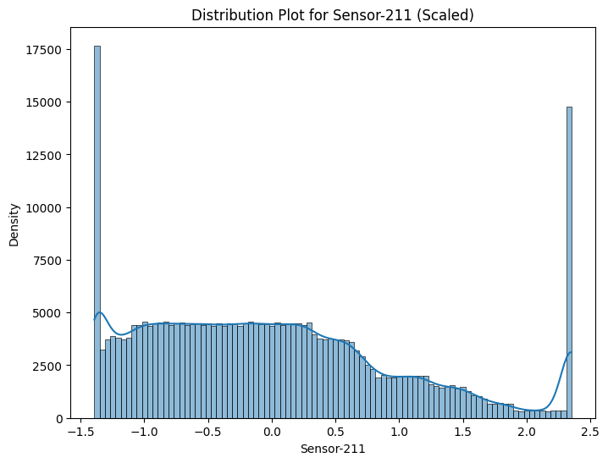
Data Distribution
We have used standardization technique to balance the dataset distribution.

Slide 10
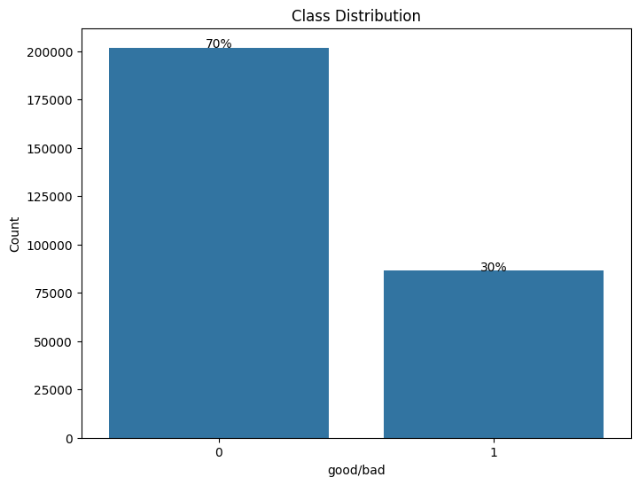
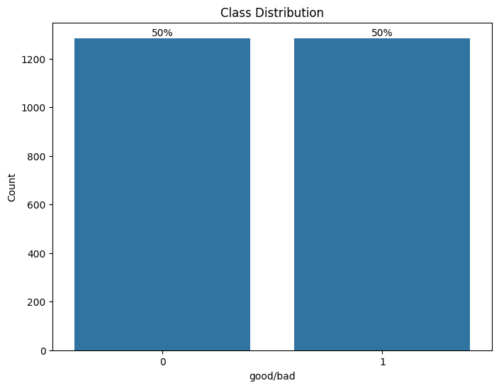
Target Class Imbalance
We have used SMOTE technique to balance the target class data.

Slide 11
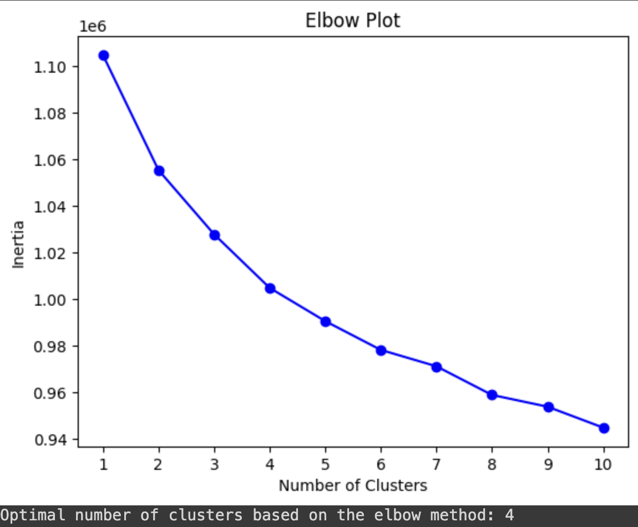
Clustering
As we have more number of columns and huge data. We decided to go with semi supervised method and implemented K-means clustering and based on this clustering we grouped the data into 4 clusters and trained ML models separately for these clusters.

Slide 12
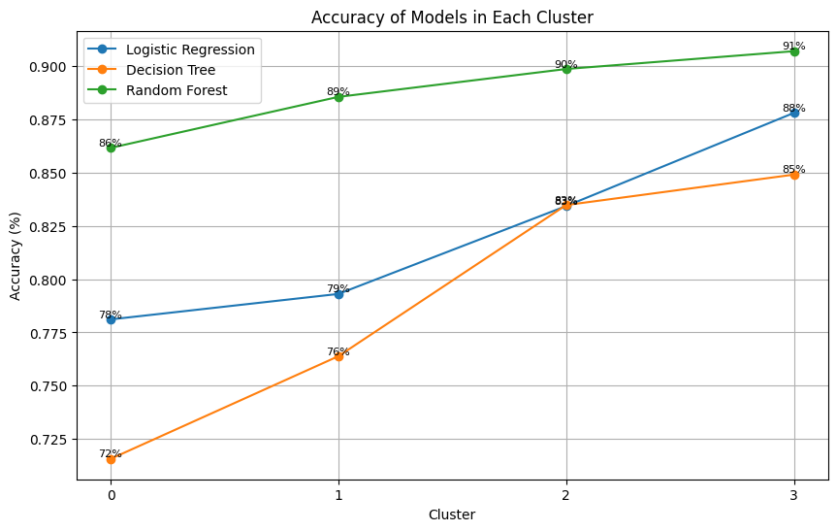
ML Model training and Evaluation
We trained Logistic regression, Decision Tree & Random Forest classifier on each cluster and validated the model on each cluster and identified the best fitted model for each cluster of data.

Slide 13
Conclusion:
Finally,we had trained three different machine learning classifiers-Logistic Regression, Decision Tree, and Random Forest ,on each cluster of data within our dataset. We then validated the performance of each model within its respective cluster to identify the best-fitted model for fault detection in wafer manufacturing.
Through this approach, we aimed to tailor the fault detection models to the specific characteristics and patterns present in each cluster of data, optimizing their accuracy and effectiveness. The utilization of Logistic Regression, Decision Tree, and Random Forest classifiers allowed us to explore a diverse range of modeling techniques, each with its own strengths and weaknesses. Logistic Regression offered with 88% of accuracy, Decision Tree provided with 85% of accuracy , while Random Forest offered robustness and improved accuracy through ensemble learning with 91% of accuracy.

Slide 14
THANK YOU

