Slide 1

Solar Output Prediction Using Weather Data
Phase IIi Presentation
Geeta Naga Sai Amrutha Chandaluri
Pavan Kumar Bellamkonda
Srija Adapa

Slide 2
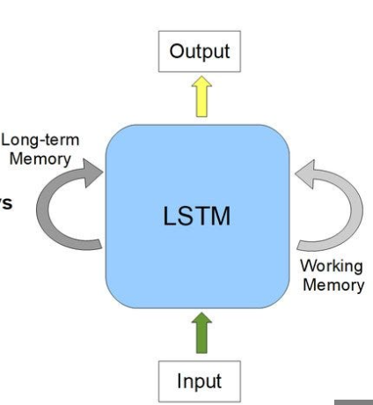
Long Short-Term Memory Network (LSTM)
Architecture:
Stacked LSTM layers (64 and 32 units) for capturing sequential weather patterns.
Dropout layers for preventing overfitting.
Dense Output Layer (1 unit) with linear activation for continuous GHI prediction.
Training:
Optimizer: Adam
Loss: Mean Squared Error (MSE)

Slide 3
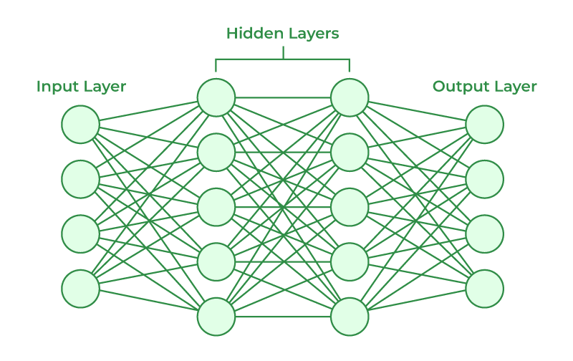
Artificial Neural Network(ANN)
Model Overview:
Architecture: Feedforward ANN with two hidden layers (64 and 32 neurons).
Activation: ReLU for hidden layers, Linear for output layer.
Optimization: Adam, with Mean Squared Error as the loss function.

Slide 4
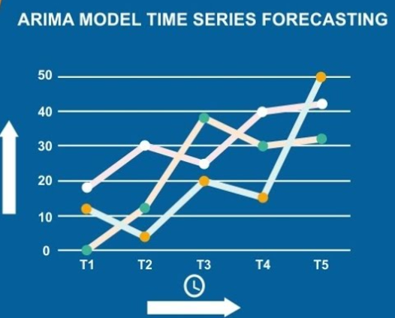
Autoregressive Integrated Moving Average Model (ARIMA)
AR (Autoregression): This emphasizes the dependent relationship between an observation
I (Integrated): To achieve a stationary time series, one that doesn’t exhibit trend or seasonality, differencing is applied
MA (Moving Average): This component zeroes in on the relationship between an observation and the residual error from a moving average model based on lagged observations.

Slide 5

XG BOOST
Key Features of XG Boost
Gradient Boosting Framework: Utilizes decision trees in a sequential process to minimize error.
Regularization: Incorporates L1 and L2 regularization to prevent overfitting.
Scalability: Efficient for large datasets with distributed computing capabilities.
Feature Importance: Provides insights into the most critical features influencing predictions.

Slide 6
Evaluation Metrics
Evaluation Metrics for Solar Output Prediction Evaluation metrics are crucial to assess the performance of prediction models in forecasting solar output. Key metrics include:
Mean Absolute Error (MAE): Measures the average error magnitude. Lower MAE indicates better accuracy.
Root Mean Squared Error (RMSE): Squares errors, emphasizing larger deviations. Lower RMSE signifies a better fit.

Slide 7
ML Models Performance
Model | Root Mean Squared Error (RMSE) | Mean Absolute Error (MAE)
ARIMA | 311.20 | 173.53
ANN | 63.78 | 31.50
LSTM | 61.95 | 33.48
XG Boost | 61.39 | 27.67

Slide 8
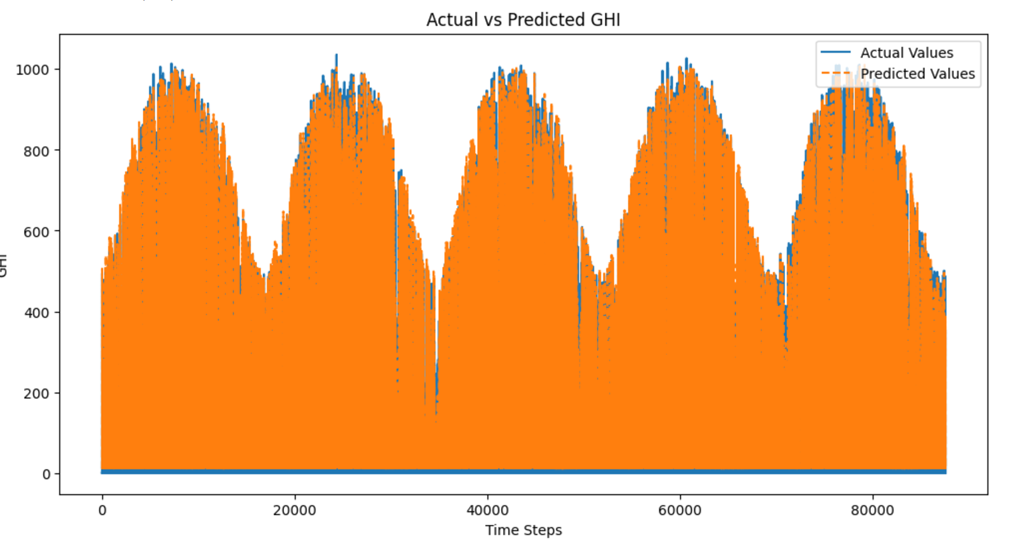
Final Model For Best Prediction
Best Model: XGBoost offers superior performance with the least error metrics, making it the most reliable model for solar output prediction.
Recommendation: Leverage XGBoost for production deployment, while considering LSTM for capturing temporal dependencies if needed.

Slide 9
What can be done Next..?
Combine multiple models (e.g., LSTM, XGBoost, and ANN) to create an ensemble, which can improve accuracy and reduce overfitting by leveraging the strengths of each model.
Utilize techniques like Random Search, Grid Search, or Bayesian Optimization to fine-tune hyperparameters of models (e.g., LSTM layers, XGBoost learning rate) for improved performance.
Deploy the best model into production with continuous monitoring and retraining, allowing it to adapt to new data and environmental changes for dynamic solar output predictions.

Slide 10

Thank you

