Slide 1

STUDENT PERFORMANCE ANALYTICS DASHBOARD
Final Project Review | Department of [CSE] | [KLH University]
TEAM MEMBERS
2420030062-A.Srija
2420030742-I.Srivalli
Guide: Dr. N. Sunanda | Academic Year: [2026–27]
Notes:
Title slide. Replace all bracketed text. Use the full project title, list every team member with registration number, and name your guide. Insert the institution logo in the dashed box.

Slide 2



Introduction & Problem Statement
Background
[Student performance analysis helps understand students' academic progress using marks, attendance, and study hours]
Problem Statement
[Manually analyzing student data is time-consuming and makes it difficult to identify performance patterns]
Motivation / Need
[This project helps teachers analyze student performance easily through an interactive dashboard and visual reports]
Notes:
State the domain, the exact problem and why it matters. Keep it to about 2 minutes. Add one real-world statistic if you can, with a citation.

Slide 3


Objectives & Scope
Objectives
1
[To analyze student academic performance using Python.]
2
[To clean and preprocess student performance data.]
3
[To identify relationships between study hours, attendance, and marks.]
4
[To develop an interactive dashboard using Streamlit for visualizing student performance.]
Notes:
Objectives should be measurable and start with action verbs. The scope slide tells the panel what you did and did not attempt.

Slide 4

Literature Survey
S.No | Author(s) & Year | Method / Technique | Key Findings | Limitation / Gap
1 | Yin (2026) | TabPFN and SHAP | Uses AI to analyze and explain predictions. | Complex for simple academic analysis.
2 | 2026 Review | ML, DL and XAI | Reviews AI techniques for educational data analysis. | Need for simple, understandable tools.
3 | Cabral et al. (2025) | AI-powered learning analytics dashboards | Uses dashboards to support learning analysis. | Need for accessible interactive dashboards.
4 | Lou & Colvin (2025) | Educational Data Mining | Focuses on discovering patterns in educational data | Need for easy performance visualization.
Research Gap
Existing methods can be complex, and manually analyzing student data is time-consuming. Our project provides a simple interactive dashboard to visualize marks, attendance, study hours, and student performance patterns.
Notes:
Summarise four to six relevant papers or existing systems. End with the research gap, because that gap justifies your project.

Slide 5





Proposed System & Methodology
STEP 1
STEP 2
STEP 3
STEP 4
STEP 5
Define Problem
Collect Data
Design
Implement
Test & Evaluate
Identify the difficulties in analyzing student academic performance manually.
Collect student data, including marks, attendance, study hours, and previous grades.
Design the dashboard layout and select suitable charts for performance analysis.
Use Python, Pandas, NumPy, Matplotlib, Seaborn, and Streamlit to develop the dashboard.
Test the dashboard and verify that charts and performance insights are displayed correctly.
Key Novelty / Contribution
Develop an interactive and user-friendly dashboard that makes student performance analysis easier through visualizations and data-driven insights.
Notes:
Walk through the five steps left to right. Rename the steps to match your project (for example, Requirement Analysis, Design, Coding, Testing, Deployment). End with your novelty.

Slide 6
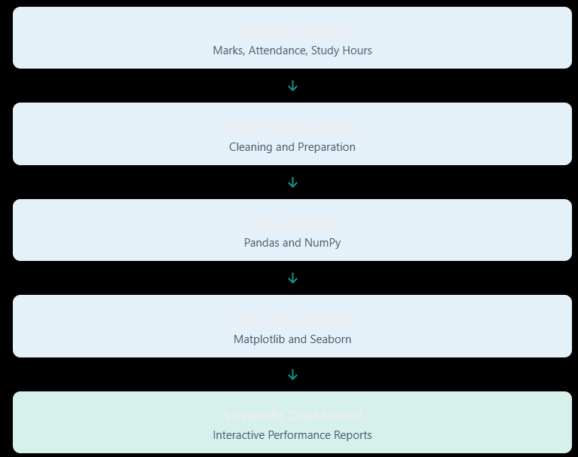
System Architecture
[Insert system architecture / block diagram
(Input → Processing → Output)]
Components
1
[Student Dataset]
Contains student academic information.
2
[Data Preprocessing]
Cleans and prepares the dataset.
3
[Data Analysis]
Analyzes marks, attendance, and study hours.
4
[Dashboard]
Displays charts and student performance insights.
Notes:
Insert a clear block diagram: input, processing, storage, output. Number each block and explain them on the right. Redraw the figure yourself rather than copying it.

Slide 7


Hardware & Software Requirements
Hardware
Software & Tools
Libraries / Frameworks
Processor: Intel Core i3 or above
RAM: Minimum 4 GB
Storage: Minimum 10 GB free space
Device: Laptop or Desktop
Operating System: Windows 10/11
Programming Language: Python 3
IDE: VS Code / Jupyter Notebook
Version Control: Git and GitHub
Pandas – Data handling
NumPy – Numerical operations
Matplotlib – Data visualization
Seaborn – Statistical charts
Streamlit – Interactive dashboard
Deployment / Platform: Local Machine – Python Environment – Streamlit Web Application
Notes:
List only what you actually used, with versions. For a pure software project, shorten the hardware list and add cloud or deployment resources.

Slide 8
Dataset / Data Understanding
Student Dataset – Records
Academic Features – Columns
Data Cleaning – Missing Values
Performance Analysis – Target Variable
Source: Student Performance Dataset
Features: Study time, absences, previous grades, attendance, and student details.
Quality:Checking missing values, duplicate records, and data consistency.
Notes:
Explain where the data came from and what it contains. Show a screenshot of the first rows or the info summary. For non-data projects, replace this slide with “Requirement Analysis” or “Input Specification”.

Slide 9
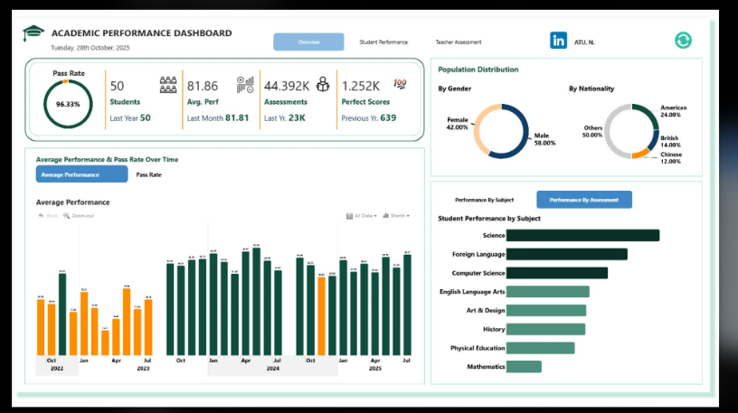
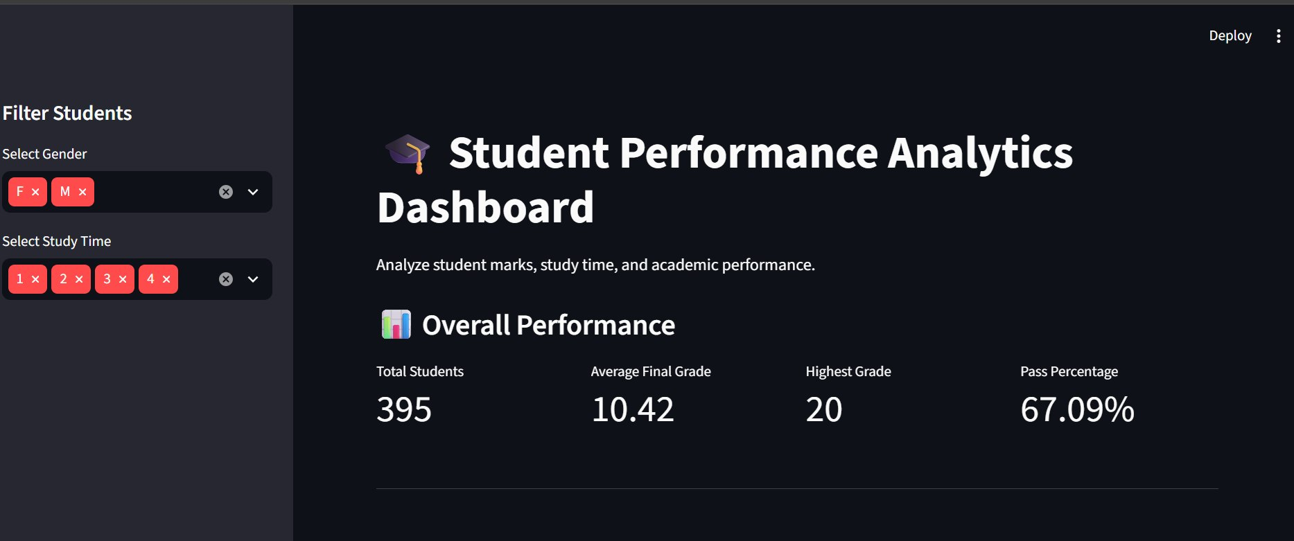



Data Preprocessing & Exploratory Analysis
[Insert feature distribution / histogram]
[Insert correlation heatmap / outlier box-plot]
Cleaning
Transformation
Feature Selection
Check and handle missing values, duplicate records, and incorrect data.
Prepare the dataset by organizing columns and converting data into suitable formats for analysis.
Select important features such as:
Study hours, Attendance, Absences
Previous grades, Student marks
Notes:
Show two or three plots that tell a story: distributions, correlations, outliers. Explain what each plot told you and what you did about it.

Slide 10
Module-wise Description
1
Data Collection
2
Data Preprocessing
Purpose: Load the student performance dataset.
Input → Output: CSV file → Student dataset
Developed by: Team
Purpose: Clean and prepare student data.
Input → Output: Raw data → Cleaned dataset
Developed by:Team
3
Data Analysis
4
Dashboard Visualization
Purpose: Analyze marks, attendance, and study hours.
Input → Output: Cleaned data → Performance insights
Developed by: Team
Purpose:Display student performance through interactive charts.
Input → Output: Analysis results → Streamlit dashboard
Developed by: Team
Notes:
Divide the project into three to five modules. For each, state its purpose, inputs, outputs and who built it. Duplicate a card if you have more modules.

Slide 11

Algorithms & Technologies Used
Python
Pandas & NumPy
Matplotlib & Seaborn
Why chosen
Easy for data analysis and processing.
Key parameters Python 3.x
Why chosen
Data cleaning, manipulation and numerical calculations.
Key parameters
DataFrames, arrays and statistical operations.
Why chosen
Create charts and visualize student performance.
Key parameters
Bar charts, histograms and heatmaps.
Selection criteria: Easy to use, efficient data processing, accurate analysis and clear visualizations.
Notes:
Name each model, algorithm or technology, say why you chose it, and list the key settings. Then explain how you picked the final one.

Slide 12
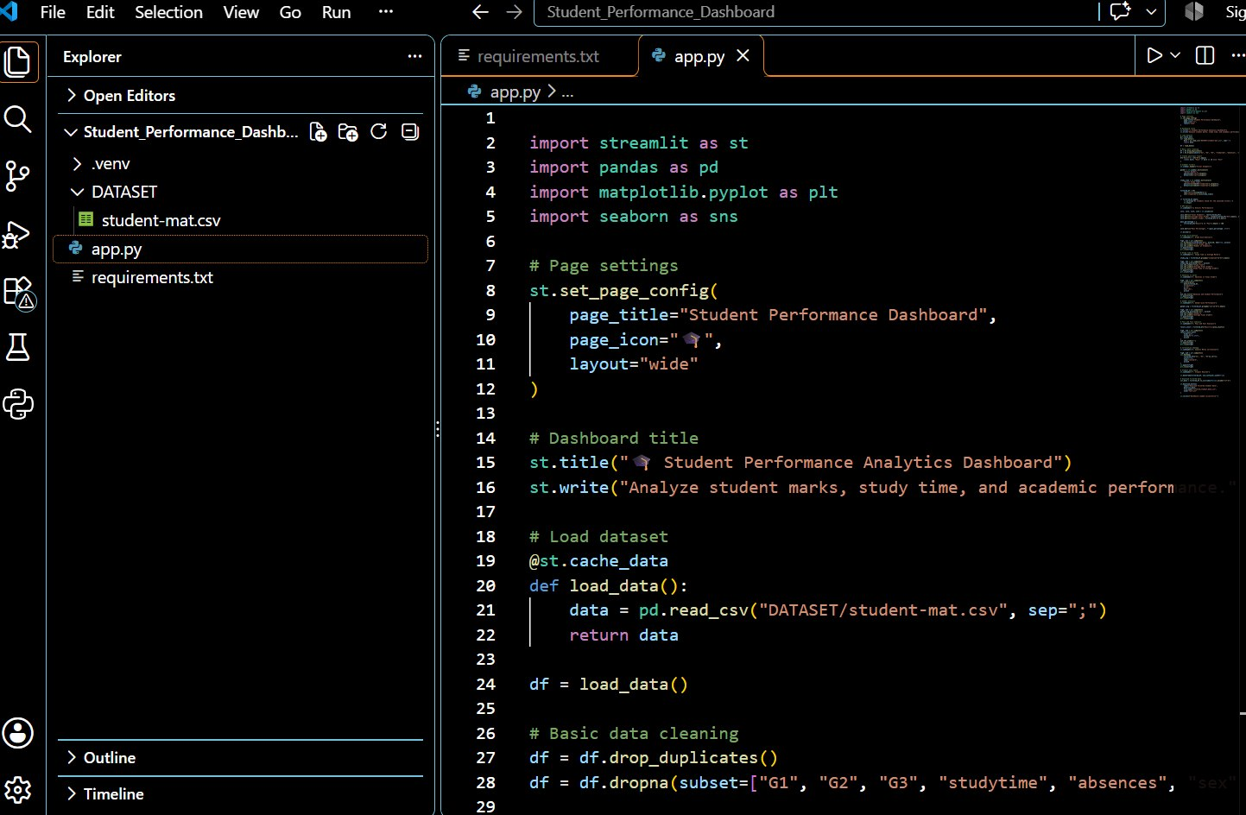
Implementation / Model Building
# Paste your key code here
X_train, X_test, y_train, y_test = \
train_test_split(X, y, test_size=0.2,
random_state=42)
pipeline = Pipeline([
("preprocess", preprocessor),
("model", Model())
])
pipeline.fit(X_train, y_train)
Feature Selection
Code snippet / pseudocode
Study Time, Attendance, Absences, Previous Grades, Student Marks
Preprocessing Pipeline
Data cleaning, handling missing values and removing duplicates.
Data Splitting
Analyze student marks, attendance and study hours.
Configuration
Python, Pandas, NumPy, Matplotlib, Seaborn and Streamlit.
Notes:
Describe the build in the order you did it. Paste only the most important code or pseudocode, not entire files. For hardware projects, show the circuit or wiring summary instead.

Slide 13
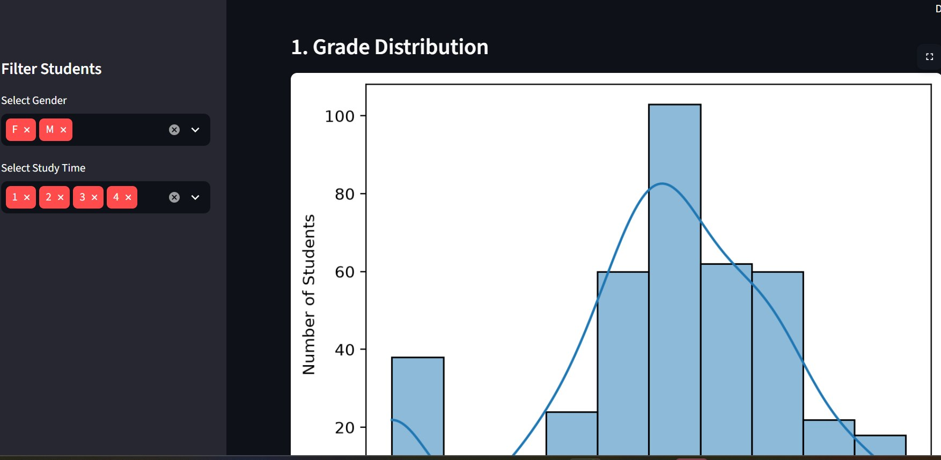
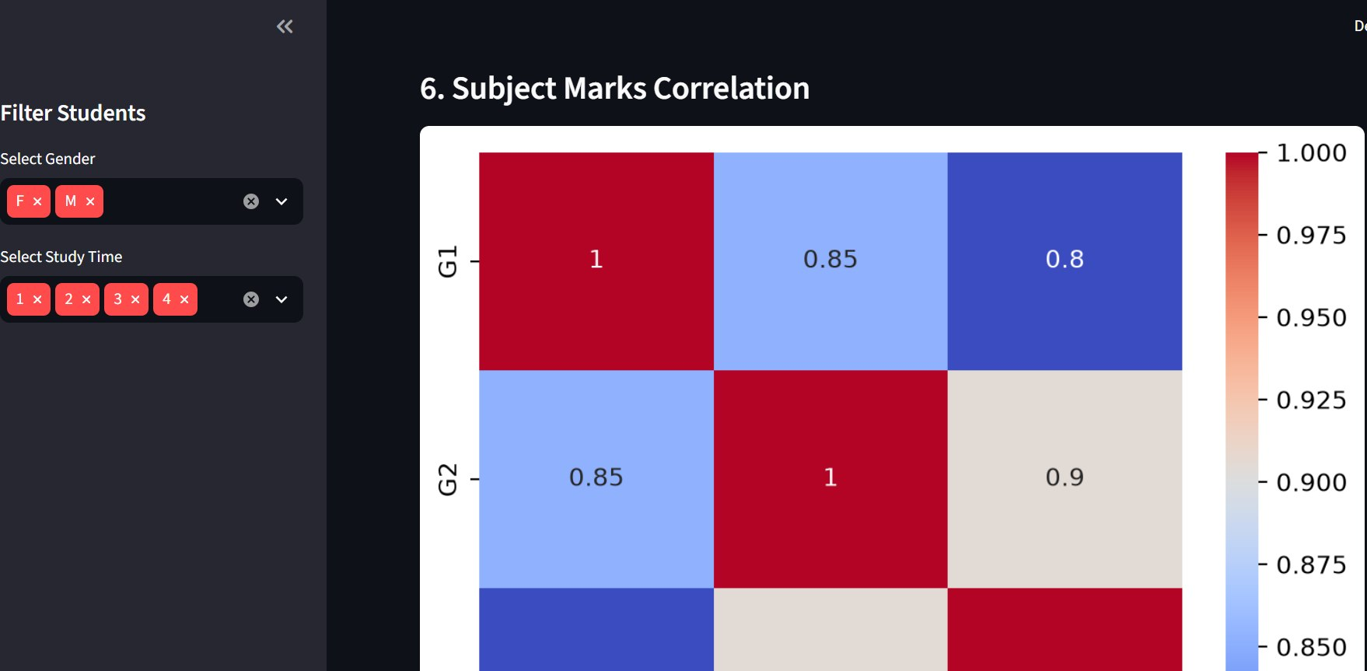
Output:
Notes:
Name each model, algorithm or technology, say why you chose it, and list the key settings. Then explain how you picked the final one.

Slide 14
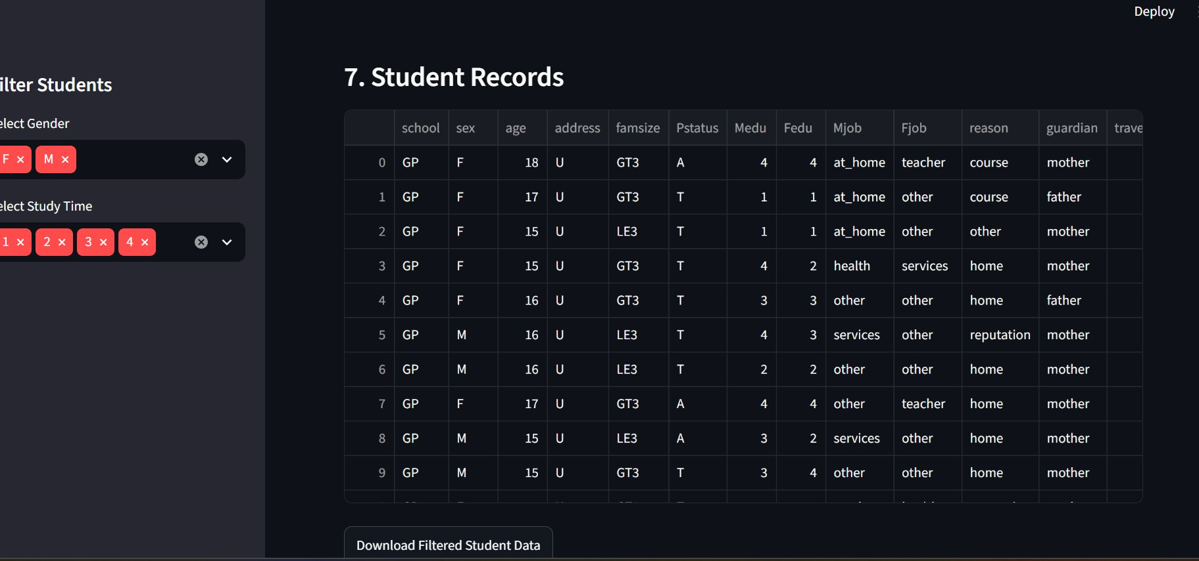
Output:
Notes:
Name each model, algorithm or technology, say why you chose it, and list the key settings. Then explain how you picked the final one.

Slide 15
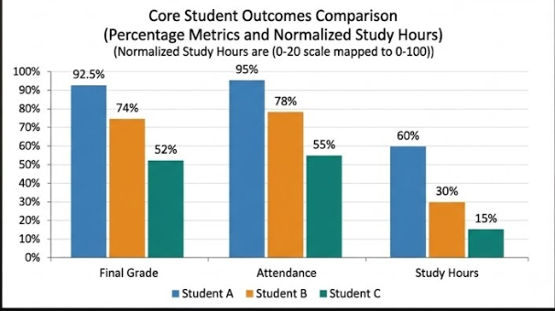
Results & Performance Comparison
Metric | Low Study (<5 hrs) | Medium Study (5-10 hrs) | High Study (>10 hrs)
Average Marks | 54.2 | 76.5 | 89.2
Average Attendance | 62.0% | 81.5% | 95.0%
Pass Rate (%) | 58.0% | 84.0% | 98.5%
At-Risk Rate (%) | 42.0% | 15.0% | 2.0%
Correlation Index | 0.42 | 0.68 | 0.85
Study hours and attendance show a strong positive correlation with final student grades.
Notes:
Right-click the chart and choose Edit Data to enter your real numbers. Replace the metrics with the ones that fit your project (accuracy, latency, power, throughput, user rating). State clearly which option performed best.

Slide 16
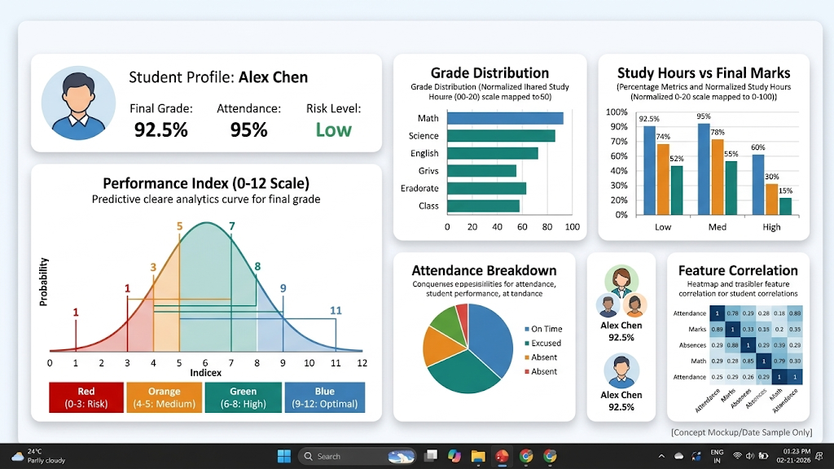
Analysis & Key Findings
[85.2%]
Highest Final Grade achieved by a student
Interpretation: Strong correlations between attendance, study hours, and academic success.
Error analysis: Dashboard currently uses small-scale data; a larger dataset would improve accuracy.
Key drivers: Attendance (most impactful), regular study time, and previous internal marks.
Notes:
Explain what the numbers mean. Use a confusion matrix, ROC curve, feature-importance chart or output comparison. Be honest about weak results; panels value that.

Slide 17

Testing & Validation
Test ID | Test Description | Expected Result | Actual Result | Status
TC-01 | Upload dataset | Dataset loads | verify output | [Pass / Fail]
TC-02 | Data cleaning | Clean data displayed | verify output | [Pass / Fail]
TC-03 | Calculate average marks | Correct average shown | verify output | [Pass / Fail]
TC-04 | Display charts | Charts appear correctly | verify output | [Pass / Fail]
Functional Testing
Validation Method
Performance Testing
Check dashboard features and charts.
Compare dashboard values with dataset calculations.
Check dashboard loading and response time.
Notes:
List representative test cases with expected and actual outcomes. Name the validation methods you used. Delete rows you do not need.

Slide 18


Challenges & Limitations
Challenges Faced
Limitations
Missing Data: Resolved using Pandas cleaning functions.
Visual Clutter: Resolved using clean Seaborn heatmaps.
Layout Design: Resolved using Streamlit container structures.
Relies on static records instead of live university database integration.
Feature scope is limited to foundational academic factors.
Performance depends on local memory during large data processing.
Notes:
Be candid. Pair every challenge with how you solved it, and list limitations that the panel would otherwise spot themselves.

Slide 19

Conclusion
Built an interactive Streamlit student performance dashboard using Python.
1
Final Outcome
Visualized relationships between study hours, attendance, and grades.
[100%]
2
Dashboard Built & Visualized
Objectives achieved: [[4 of 4]]
Enabled data-driven academic decisions for educators.
3
Notes:
Revisit each objective and say whether you met it. Quote your headline result with numbers. Do not introduce new material here.

Slide 20



Future Scope & Applications
Improve Performance
Integrate machine learning regression models for precise score prediction.
Applications
Track student performance trends.
Identify at-risk students early.
Support faculty decisions.
Adopted by universities & professors.
Expand Data / Features
Include student demographics, extracurricular records, and behavioral metrics.
Deploy & Build an Interface
Expand the Streamlit dashboard into a full web application.
Scale & Secure
Connect with live university databases securely.
Notes:
Give concrete next steps, ideally tied to the limitations. Then name two or three real-world uses.

Slide 21
Team Contribution
Reg. No. | Name | Contribution / Modules Handled
1 | A. Srija | Data cleaning, EDA, visualization using Seaborn & Matplotlib.
2 | I. Srivalli | Streamlit dashboard development, UI integration & documentation.
Notes:
Show that work was planned and shared. Every member should be able to explain their own module.

Slide 22

References
[1] Yin, "Predicting Student Academic Performance Using TabPFN and SHAP," Journal of Educational Data Mining, vol. 12, no. 1, pp. 1–10, 2026.
[2] Cabral et al., AI-Powered Learning Analytics Dashboards, Tech Insights Press, 2025.
[3] Lou & Colvin, "Performance Prediction Using Educational Data Mining Techniques," Conference on Learning Analytics, pp. 45–52, 2025.
[4] Romero & Ventura, "Educational Data Mining and Learning Analytics," Wiley Series on Data Science, 2024.
Notes:
Use IEEE style, numbered in order of first citation in the deck. Include datasets, documentation and code repositories.

Slide 23
THANK YOU
Notes:
Leave this slide up during questions. Make sure every team member can answer questions about their own module.

