Slide 1

Detection of tooth position by yolov4 and various dental problems based on cnn with bitewing radiograph
Sumathi Reddy Institute of Technology for Women

Slide 2
Abstract
This project focuses on detecting tooth positions and diagnosing various dental problems using YOLOv4 for object detection and Convolutional Neural Networks (CNN) applied to bitewing radiographs.
YOLOv4 efficiently identifies and localizes individual teeth in radiographic images, enabling precise analysis of tooth positioning.
The CNN model classifies different dental diseases such as cavities, gum diseases, and other abnormalities from the detected tooth regions.
lth outcomes.

Slide 3
Introduction
This project aims to accurately detect tooth positions and identify various dental problems using advanced deep learning techniques on bitewing radiographs.
YOLOv4, a state-of-the-art object detection algorithm, is employed to locate and segment individual teeth within the radiographic images efficiently.
A Convolutional Neural Network (CNN) is then used to analyze these detected teeth and classify dental diseases such as cavities, gum issues, and other common dental abnormalities.

Slide 4
Existing System
Traditional dental diagnosis relies on manual examination of bitewing radiographs by dentists, which is time-consuming and prone to human error.
Basic digital image processing tools and earlier CAD systems assist diagnosis but often lack accuracy and cannot detect multiple dental issues simultaneously.
Many current automated solutions focus on disease classification or panoramic X-rays but do not accurately localize tooth positions in bitewing radiographs.

Slide 5
Proposed System
Utilizes YOLOv4 for precise and real-time detection of tooth positions in bitewing radiographs, improving localization accuracy.
Implements a Convolutional Neural Network (CNN) model to automatically identify various dental problems from the images.
Integrates both detection and classification into a single platform for faster, more reliable dental diagnosis.
Enhances diagnostic efficiency, reduces human error, and supports dentists with automated analysis for better patient care.

Slide 6
Features of Proposed System
Real-time Tooth Position Detection: Employs YOLOv4 for fast and accurate identification of individual tooth positions in bitewing radiographs.
Automated Dental Disease Classification: Uses CNN models to detect and classify multiple dental problems such as cavities, periodontal diseases, and tooth decay.
User-friendly Interface: Provides an intuitive platform for dentists to upload images and receive detailed diagnostic results with visual aids.

Slide 7
Software and Hardware Requirements
Software Requirements:
Python programming language
deep learning libraries such as TensorFlow
PyTorch, data preprocessing tools
web scraping libraries for feature extraction.

Slide 8
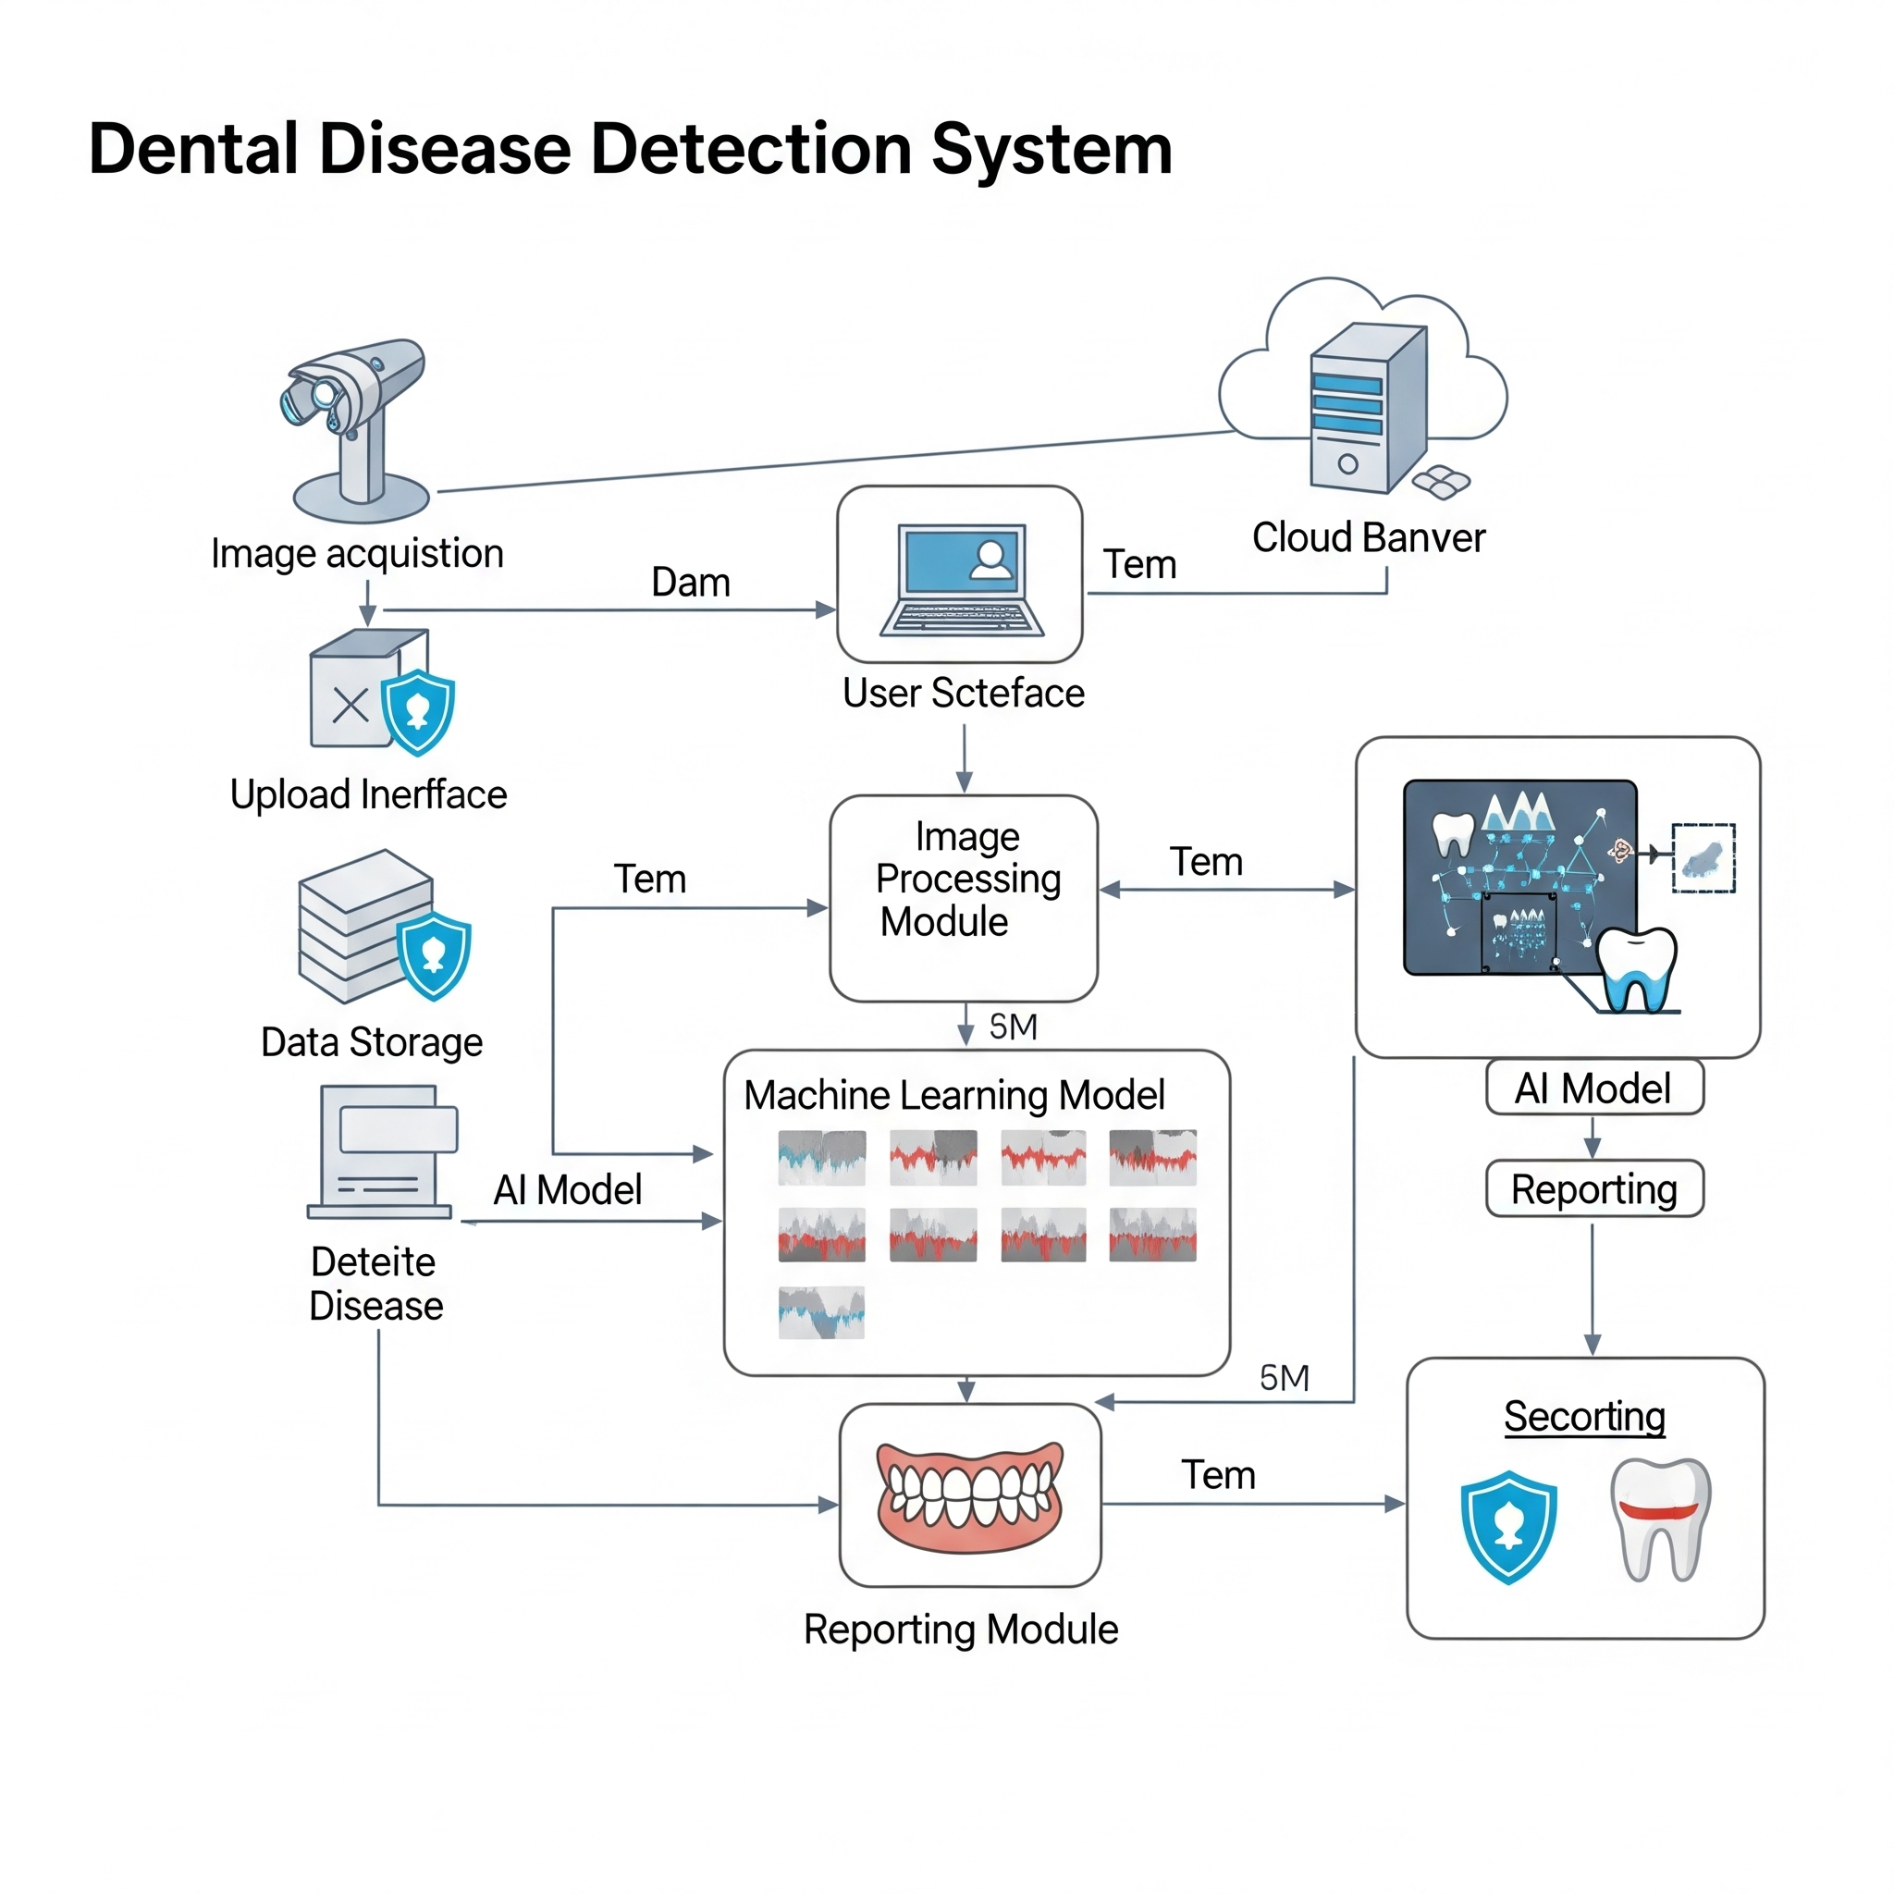
System Architecture

Slide 9
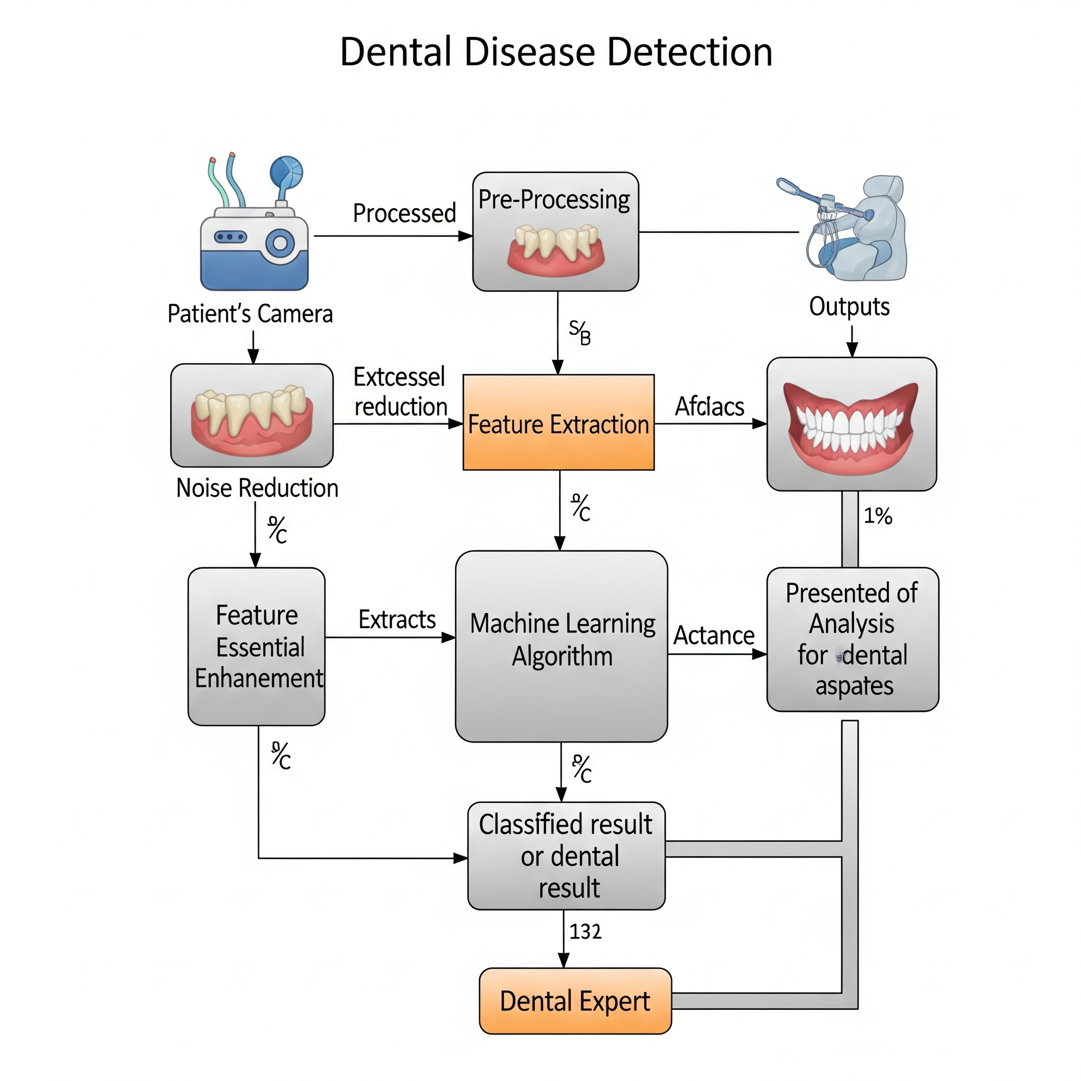
Flow Chart

Slide 10
Implementation Methodology
Data Collection and Preprocessing: Gather bitewing radiograph images, annotate tooth positions, and preprocess data by resizing, normalization, and augmentation to enhance model training.
Model Training: Train the YOLOv4 model for precise tooth localization and a CNN classifier for identifying various dental diseases using the prepared dataset.
Integration and Testing: Integrate both models into a single pipeline to detect tooth positions and diagnose dental problems, followed by rigorous testing to validate accuracy and reliability.

Slide 11
Results
Accurate Tooth Position Detection: The YOLOv4 model successfully localized tooth positions in bitewing radiographs with high precision and recall.
Effective Disease Classification: The CNN classifier demonstrated strong performance in identifying various dental problems, achieving notable accuracy and sensitivity.
Visual Outputs: The system provided clear annotated images highlighting detected teeth and diagnosed conditions, aiding clinical decision-making.
User-Friendly Interface: The integrated platform allowed seamless image uploads and real-time predictions, enhancing usability for dental practitioners.

Slide 12
Test Cases
Image Upload Test: Verify that the system accepts valid bitewing radiograph images and rejects unsupported formats.
Tooth Position Detection: Check if YOLOv4 correctly detects and marks all visible teeth in the uploaded image.
Disease Classification Accuracy: Validate that the CNN model accurately classifies dental diseases from various test images.

Slide 13
Future Scope
Integration of real-time dental image analysis using mobile or handheld devices for instant diagnosis.
Expansion of the system to detect a wider range of dental conditions beyond those identified in bitewing radiographs.
Incorporation of 3D dental imaging and advanced AI models for more comprehensive and precise diagnostics.
Development of personalized dental treatment recommendations and follow-up reminders based on AI analysis results.

Slide 14
Conclusion
The project effectively utilizes YOLOv4 and CNN models to accurately detect tooth positions and various dental problems from bitewing radiographs.
It offers a reliable and automated solution that enhances diagnostic efficiency, reducing the need for manual interpretation.
The system has the potential to assist dental professionals in early disease detection, improving patient outcomes.
This approach represents a significant advancement in dental imaging analysis through AI integration.

