Slide 1
Seamless Healthcare Data Integration: Building an ETL Pipeline with FHIR APIs
INSTRUCTOR: GOPI KRISHNAN CHANDRASEKHARAN Ph.D
TEAM MEMBERS
ARCHITA SINGAMSETTY
KAVYASRI JANAGAM
SAI SHAKTI RAO LENDALE
SRI JAHNAVI ADUSUMILLI
VEERA VENKATA SATYAVATHI SURAPUREDDY

Slide 2
INTRODUCTION
GitHub repository link: https://github.iu.edu/kjanagam/Project_Group_1.git
FHIR (Fast Healthcare Interoperability Resources) is a standard framework designed for healthcare data exchange, introduced by HL7. It utilizes modern web technologies like RESTful APIs, XML, and JSON, making it efficient and scalable (Ayaz et al., 2021).
Importance in Healthcare:
Interoperability: FHIR overcomes limitations of previous HL7 standards (v2, v3, and CDA), enabling seamless communication across systems, irrespective of operating platforms or devices (Ayaz et al., 2021)​.
Adoption by Tech Leaders: Companies like Microsoft, IBM, Amazon, and Google have recognized FHIR as a vital tool for breaking down interoperability barriers in healthcare​ (Ayaz et al., 2021).
Versatility: It supports a wide range of applications, from mobile health apps to big data analytics and precision medicine (Ayaz et al., 2021)​.
Efficiency: By standardizing data at a granular level, FHIR ensures integrity while reducing complexity in implementation​ (Ayaz et al., 2021).

Slide 3
ETL PROCESS- HOW IT WAS USED IN PROJECT?
The Extract, Transform, Load (ETL) process is a cornerstone for integrating and utilizing healthcare data. This process is vital for clinical research databases, where data from operational systems like Electronic Health Records (EHRs) is repurposed for research, quality improvement, and analytics (Denney et al., 2016).
Extraction:
Patient data and related medical conditions are extracted from the OpenEMR FHIR API.
Data sources include specific FHIR resources such as Patient, Condition, and Observation.
Authentication is managed using access tokens to securely access the data from OpenEMR.
Transformation
Missing fields (e.g., district in the patient address) are filled with placeholder values like "N/A".
Standard terminologies such as SNOMED CT codes are applied to ensure consistent representation of conditions, procedures, and observations.
Parent and child SNOMED terms are identified to refine medical condition hierarchies for accurate representation in the target system.

Slide 4
ETL PROCESS- HOW IT WAS USED IN PROJECT?
Loading:
Transformed data is posted to the Primary Care EHR FHIR server through API endpoints.
Resources such as Patient, Condition, Observation, and Procedure are created using validated JSON payloads.
Automated logging tracks successful data transfers and identifies issues during the posting process.
Integration and Interoperability:
The process adheres to FHIR standards, enabling seamless communication between the source (OpenEMR) and target (Primary Care EHR) systems.
Ensures data integrity and compliance with healthcare interoperability standards.

Slide 5
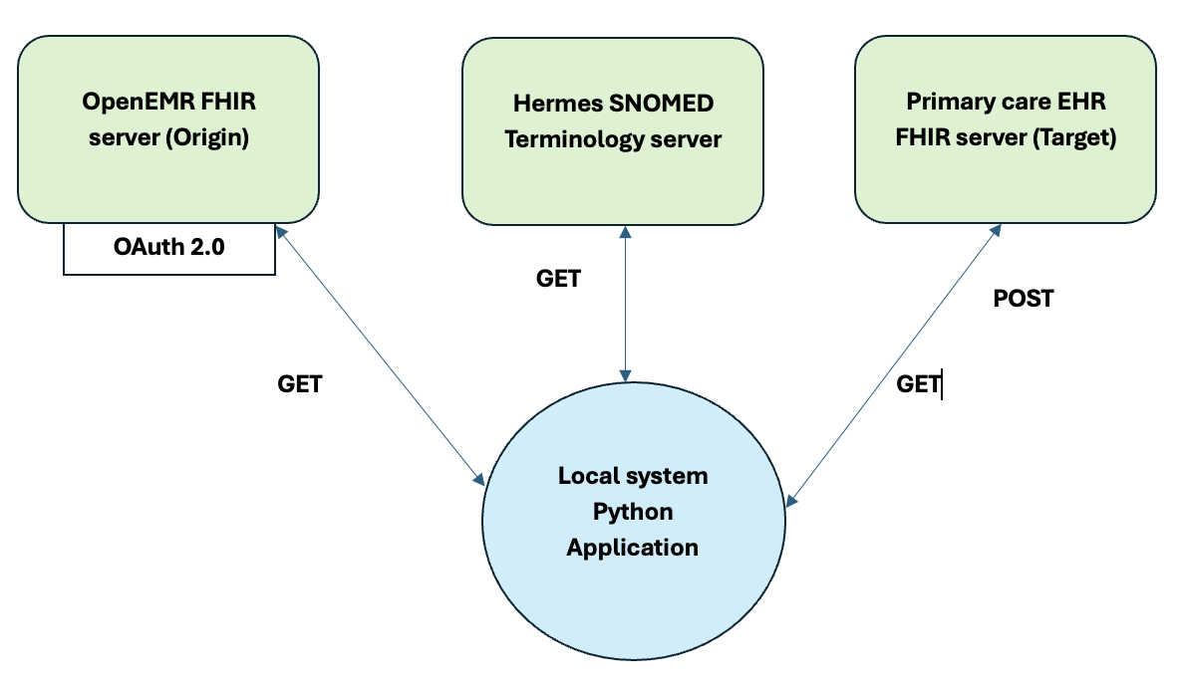
ETL PROCESS VISUALIZATION

Slide 6
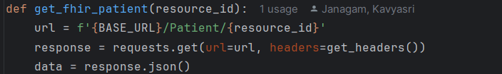
ETL PIPELINE- EXTRACTION
The ETL process (Extract, Transform, Load) is a structured method used to move and process data between systems.
1. Connecting to a FHIR API Using requests Library
The Python scripts use the requests library to establish communication with the OpenEMR FHIR API server (source) and the Primary Care EHR FHIR API server (target). The library allows the use of GET and POST methods for extracting and loading data.
The requests.get() method is used to retrieve data from the source FHIR server. Headers include an Authorization token to ensure secure access.
The BASE_URL points to the OpenEMR FHIR API server, and the response is parsed as JSON to extract data.

Slide 7
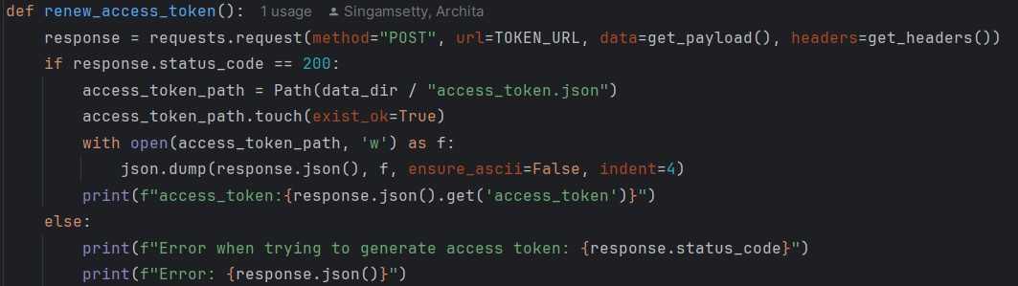
ETL PIPELINE
Posting Data to the Target API: The requests.post() method is used to send transformed data to the target FHIR server.
2. Error Handling for API Authentication and Data Retrieval
The scripts include robust error handling mechanisms to address common issues:
Authentication Errors: If the access token is missing or expired, the renew_access_token() function in refresh_token.py refreshes the token automatically.

Slide 8
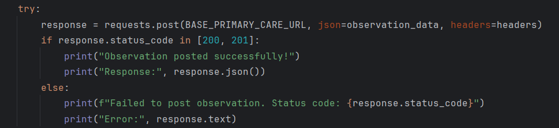
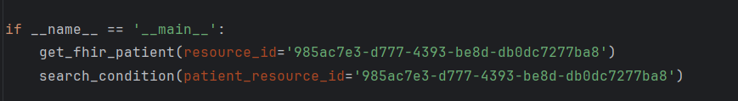
ETL PIPELINE
API Request Errors: Each GET and POST request checks the HTTP response status code. If the response indicates an error, the script logs the status code and error message for debugging.
3. Executing the Python Scripts Each Python script is structured to be executed as a standalone module using the if __name__ == "__main__": block. This ensures that tasks are triggered when the script is run.

Slide 9
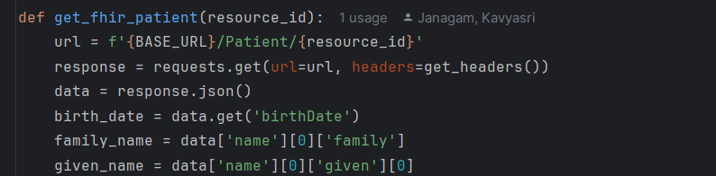
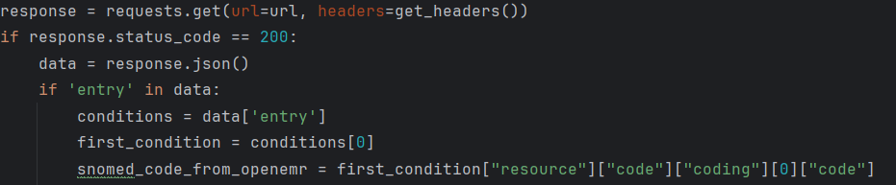
ETL PIPELINE
4. Retrieving Specific Resources
The scripts extract patient data and conditions from the source FHIR server.
Patient Data: In Task 1, patient details are retrieved using their resource ID. The response includes information like name, birthdate, address, and gender.
Patient Conditions: In Tasks 1 and 2, patient conditions are fetched using the GET request. The SNOMED concept ID of one condition is extracted for further processing

Slide 10
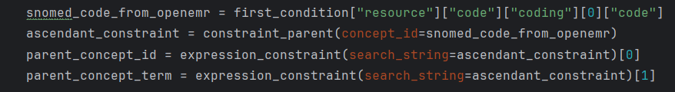
ETL PIPELINE- TRANSFORMATION
Parent Term Transformation (Task 1): The parent term of a SNOMED code is retrieved using the constraint_parent() and expression_constraint() functions. The parent term enriches the data before loading it into the target API.
Child Term Transformation (Task 2): Similarly, the child term is retrieved for the condition. The child term adds additional semantic meaning to the condition being created.

Slide 11
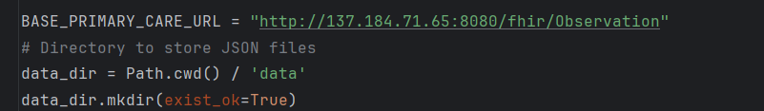
ETL PIPELINE
5. Handling Missing or Inconsistent Fields If certain fields required by the FHIR standard are not available like in the (patient_template_dict, condition_template_dict, etc.) we ensured compliance by populating them with fallback values (eg. “N/A”)
6. Saving Processed Data to the Target API The processed data is sent to the Primary Care EHR FHIR server using the POST method. Each task generates a specific resource (Patient, Condition, Observation, or Procedure) and saves it to the appropriate endpoint.

Slide 12
INSIGHTS
Key Insights from OpenEMR API Data
Enhanced Patient Management and Workflow Efficiency: The OpenEMR API centralizes access to critical patient information, such as demographics, medical history, and appointments, streamlining workflows. By automating data synchronization across modules (e.g., clinical notes, billing, and scheduling), it reduces administrative tasks and minimizes errors, enabling providers to focus more on patient care.
Improved Decision Support through Real-Time Data: The API provides real-time access to clinical data, enabling healthcare providers to identify trends, optimize treatment plans, and support population health initiatives. For instance, aggregated data can reveal high-risk patient groups, while lab results and clinical notes allow for faster, evidence-based adjustments to individual treatments.

Slide 13
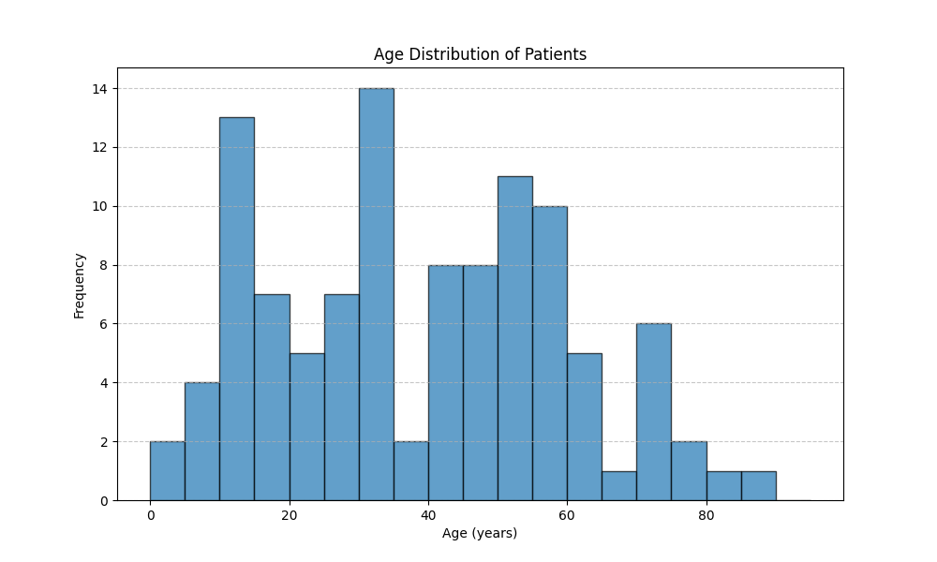
VISUALIZATION
This histogram, created using data from OpenEMR, visualizes the distribution of patients across various age groups. The data highlights significant trends, including a high concentration of patients in the 10-20 and 40-50 age ranges, while older age groups, particularly those above 70, have comparatively fewer patients. Such demographic insights are valuable for identifying trends, understanding patient populations, and informing healthcare strategies. This visualization showcases the potential of leveraging EMR data for data-driven decision-making and improved resource allocation in healthcare.

Slide 14
CHALLENGES
Handling Missing Data: Some data fields required by the Primary Care API were not present in the OpenEMR source system. For example, the severity field in our patient’s condition was missing in OpenEMR but mandatory in the Primary Care API. To address this, fallback strategies were implemented, such as using place holders "N/A" to ensure successful data transfer.
Patient Data Transfer Issues: Transferring patient data from OpenEMR to the Primary Care API was challenging. Errors occurred intermittently during the process, often related to missing or invalid fields in the payload. Debugging involved inspecting API responses to ensure all required fields, such as resource IDs and identifiers, were correctly mapped and populated.
Access Token Expiry: The access token used for API authentication expired every hour, disrupting the data transfer process. To resolve this, an automated token refresh file (refresh_token.py) was implemented, ensuring the token was renewed without manual intervention to maintain uninterrupted data transfer.
Primary Care API Performance: Due to heavy load on the Primary Care API, accessing or retrieving patient details was often delayed. This impacted validation processes, requiring retries and additional logging to confirm whether data was successfully processed by the server.

Slide 15
CLOSING SUMMARY
The ETL pipeline plays a critical role in healthcare by ensuring data is seamlessly integrated, standardized, and ready for use across systems. It extracts data from multiple sources, transforms it to meet compliance and interoperability standards (like FHIR or HL7), and loads it into target systems, enabling better data management and decision-making.
Real-Life Example: Consider a healthcare organization that wants to implement an automated system to send reminders for breast cancer screenings. The ETL pipeline: Extracts patient data (e.g., demographics, medical history, and screening eligibility) from different sources such as EHR systems, lab reports, and claims data. Transforms the data to: Identify eligible patients based on predefined rules (e.g., women aged 50-74 years who haven’t had a mammogram in the last year). Handle missing or inconsistent data (e.g., filling incomplete addresses or converting diagnosis codes into a standard format like SNOMED CT or ICD-10). Loads the processed data into the patient portal or reminder system, which then sends out personalized messages to patients about their upcoming screenings. This ensures that reminders reach the right patients at the right time, improving preventive care outcomes while saving time for healthcare staff. The ETL pipeline not only automates this workflow but also ensures data accuracy, compliance with healthcare standards, and scalability as the organization’s data needs grow.

Slide 16
REFERENCES
Ayaz, M., Pasha, M. F., Alzahrani, M. Y., Budiarto, R., & Stiawan, D. (2021). Correction: The FAST Health Interoperability Resources (FHIR) Standard: systematic literature review of implementations, applications, challenges and opportunities. JMIR Medical Informatics, 9(8), e32869. https://doi.org/10.2196/32869
Denney, M. J., Long, D. M., Armistead, M. G., Anderson, J. L., & Conway, B. N. (2016). Validating the extract, transform, load process used to populate a large clinical research database. International Journal of Medical Informatics, 94, 271–274. https://doi.org/10.1016/j.ijmedinf.2016.07.009

Slide 17


