Slide 1

ULPAC: A Miniaturized Ultralow-Power Atomic Clock DEP Presentation (CP301)
Prepared by:
Aryan Arora(2022EEB1161)
Srijan Kumar Kar (2022EEB1349) &
Samarth Bajpai (2022EEB1212)
Mentored by: Azhar Yaseen N.J.
Supervised By: Dr. Devarshi Mrinal Das
DEPARTMENT OF ELECTRICAL ENGINEERING INDIAN INSTITUTE OF TECHNOLOGY, ROPAR
2025

Slide 2
Introduction
A Chip-Scale Atomic Clock (CSAC) is a miniaturized atomic clock that provides highly accurate timekeeping in a compact, low-power package.
It is based on atomic resonance principles including coherent population trapping (CPT) techniques. CSACs are widely used in applications where precise timing is essential, such as GPS-denied navigation, secure communications, and scientific measurements.
Desired Characteristics of CSAC
High Accuracy – Provides precise timekeeping with minimal drift, featuring a frequency stability of 2.2 × 10⁻¹² over 10⁵ seconds.
Miniaturized Size – Compact form factor, suitable for portable and embedded systems, with a volume as small as 15 cm³.
Low Power Consumption –Operates with very low power, consuming up to 59.9 mW.
Resistance to Environmental Factors – Performs reliably under varying temperatures, vibrations, and electromagnetic conditions.

Slide 3
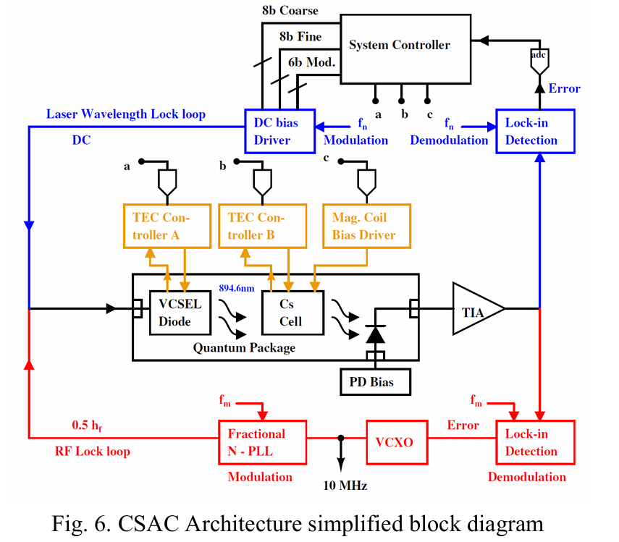
Block Diagram Description
Fig.1 CSAC Architecture simplified block diagram
Reference: Azhar Yaseen, “Chip Scale Atomic Clock - Architecture Technical Report” [unpublished manuscript as on 9th May 2025]

Slide 4
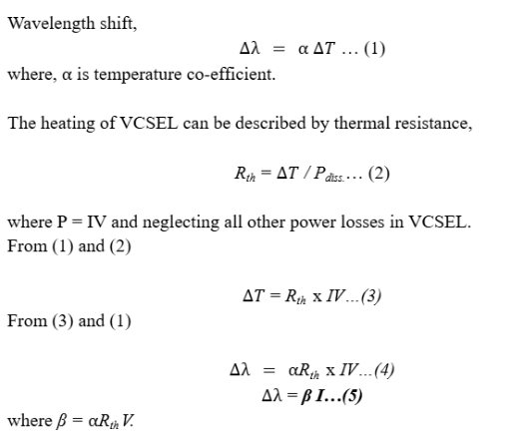
Vertical-cavity surface-emitting laser (VCSEL)
The VCSEL provides stable, narrow-linewidth laser emission at 894.6 nm, enabling resonant interaction with cesium atoms.
Its direct modulation generates dual optical sidebands separated by 9.192 GHz, facilitating coherent population trapping
(Reference:- Azhar Yaseen, “Chip Scale Atomic Clock - Architecture Technical Report” [unpublished manuscript as on 9th May 2025])
The eq. 5 shows that on varying I_{DC}, we can vary the wavelength to fine tune it with the Cs atom’s D1 line transition frequency of 3.35 THz

Slide 5
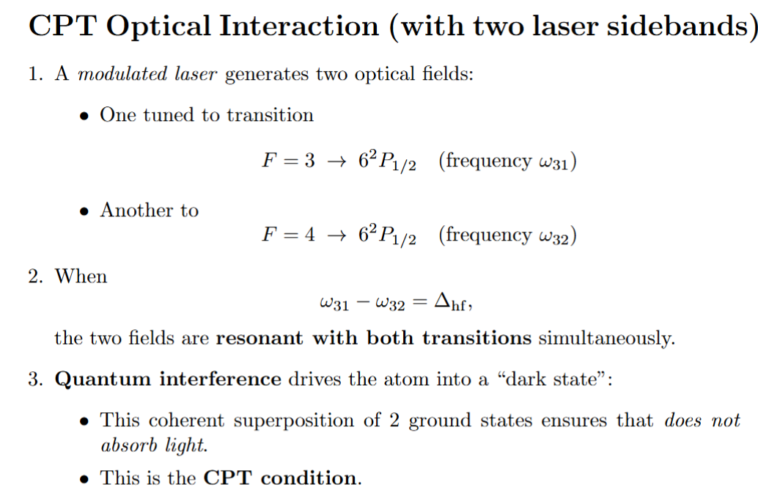
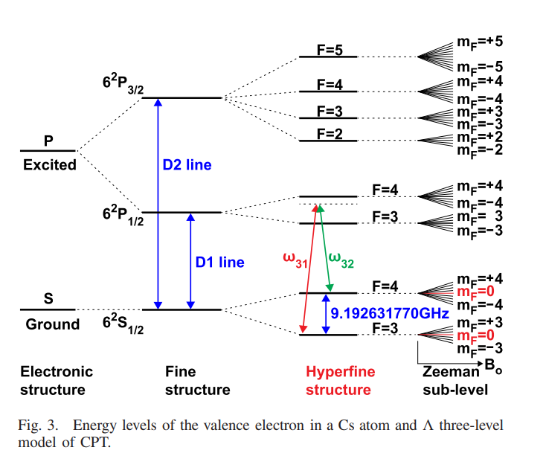
Coherent Population Trapping
Fig 2:- Hyperfine Structure of Cesium
Reference:- H. Zhang et al., "ULPAC: A Miniaturized Ultralow-Power Atomic Clock," in IEEE Journal of Solid-State Circuits, vol. 54, no. 11, pp. 3135-3148, Nov. 2019.

Slide 6
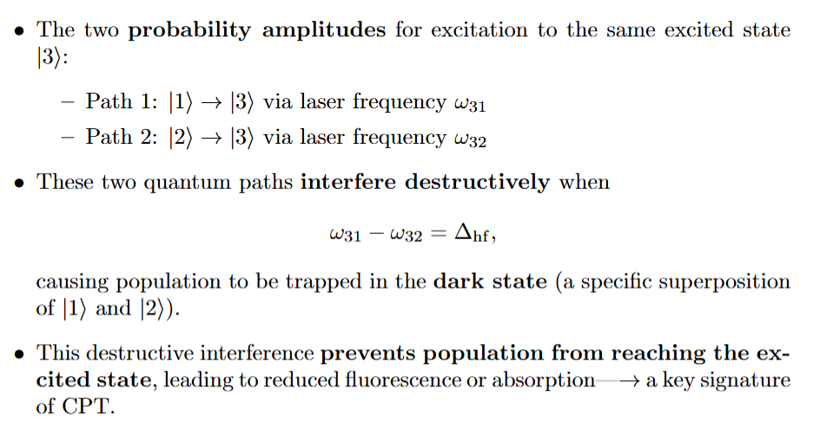
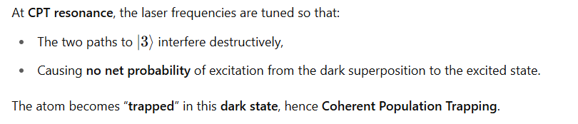
Reference:- H. Zhang et al., "ULPAC: A Miniaturized Ultralow-Power Atomic Clock," in IEEE Journal of Solid-State Circuits, vol. 54, no. 11, pp. 3135-3148, Nov. 2019.

Slide 7
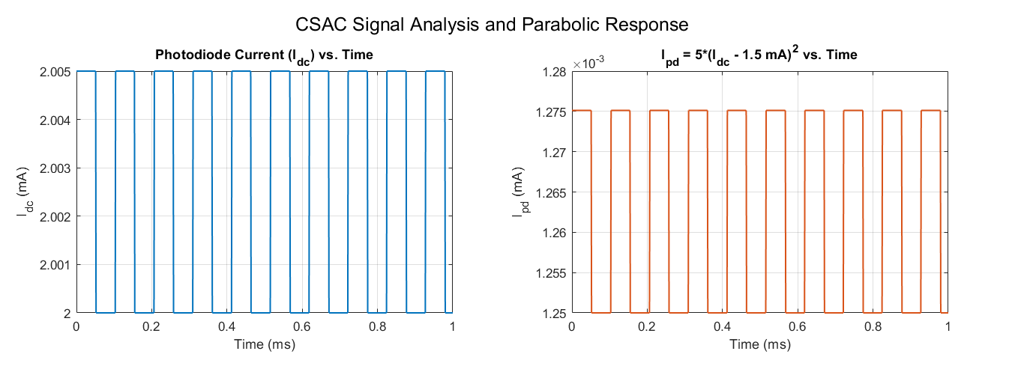
Initial I_{DC} & I_{PD}
We have modelled I_{DC} as a square wave (with I_{DC,0}=2mA) and ΔI=5µA.
Correspondingly, we have a square wave in I_{PD} using the parabolic relation discussed later.
Fig.3 Initial values of I_{DC} and I_{PD} with time

Slide 8
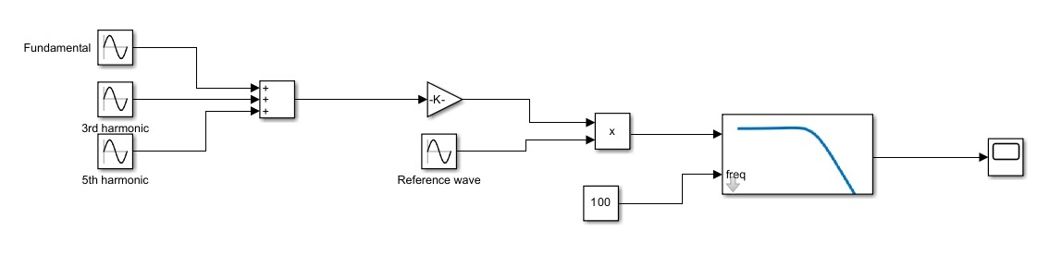
Lock in Detection
Fig.4 Implementation of basic lock-in amplifier circuitry in Simulink
A lock-in amplifier isolates a specific weak input signal from noise by multiplying it with a reference signal at the same desired frequency and filtering out unwanted components.
This enhances the desired signal's detectability for the system controller.

Slide 9
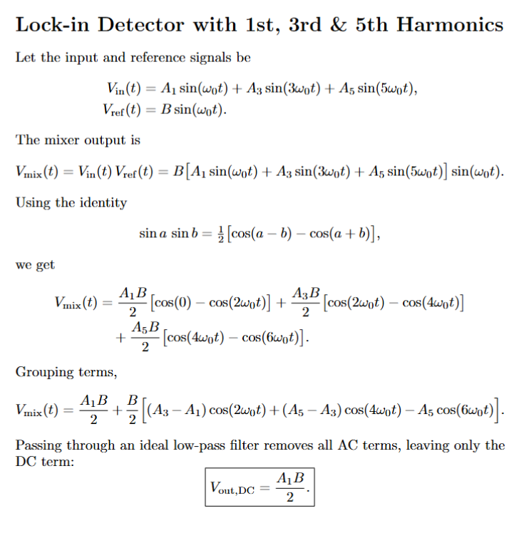

Slide 10
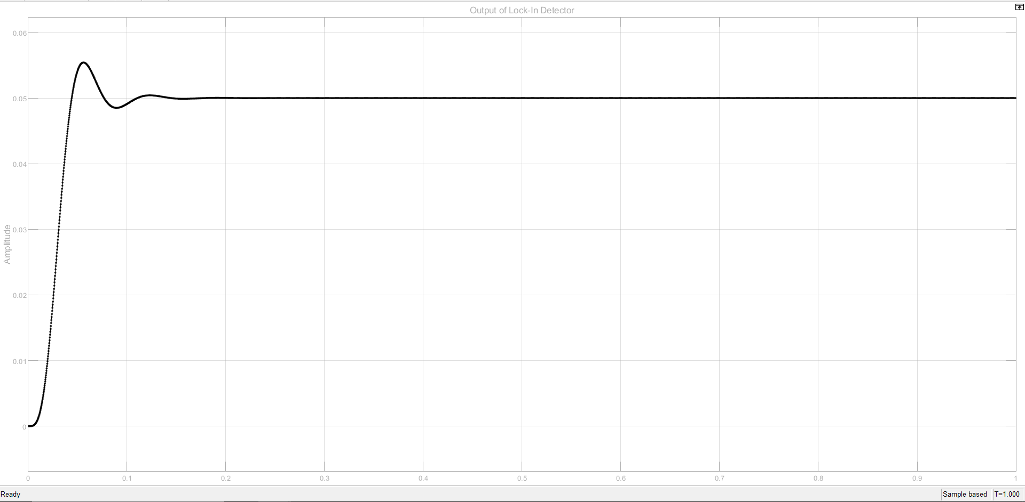
Output of Lock-in Amplifier in Simulink
Fig.5 SIMULINK output of lock-in amplifier

Slide 11
Physics behind I_{PD} Minimisation
When the VCSEL wavelength is locked at 894.6 nm, the photodetector current I_{PD}​ drops to a minimum.
Laser Wavelength Lock (894.6 nm)
This is about ensuring the laser is tuned to the D1 transition line of Cs (around 894.6 nm).
When the laser approaches the resonance wavelength (894.6 nm), cesium atoms begin to strongly absorb light.
More absorption = Less light reaches the photodetector → I_{PD}​ drops.
Hence, the I_{DC} which corresponds to dip in I_{PD} is the required value of I_{DC} which can drive VCSEL block to produce a laser with wavelength of 894.6nm (i.e. 3.35THz)
We have a parabolic relationship between Idc and Ipd and we have simulated a logic for this minimization as mentioned in the next slide.

Slide 12
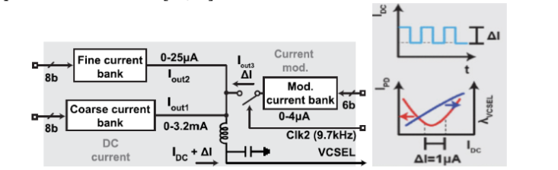
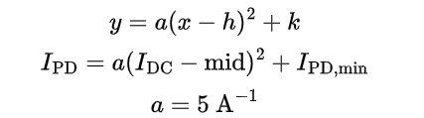
We have taken a parabolic function defined as
Here, we have taken the I_{DC} i.e. the VCSEL driving current as 1.5mA. This is so because choosing 1.5 mA places the bias point approximately mid-range of coarse bank (as in Fig.6), which offers maximum headroom for modulation and tuning thereby allowing increment or decrement of the current as required. Also, we have taken I_{PD,min}= 0 without loss of generality of algorithm.
FIg. 6 Current driver circuit operation
(Reference:- H. Zhang et al., "ULPAC: A Miniaturized Ultralow-Power Atomic Clock," in IEEE Journal of Solid-State Circuits, vol. 54, no. 11, pp. 3135-3148, Nov. 2019).

Slide 13
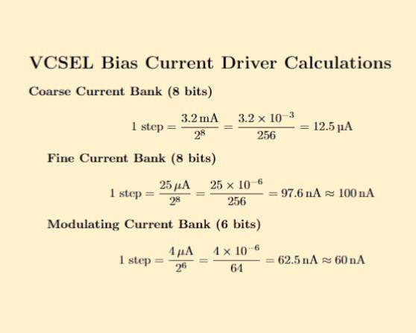
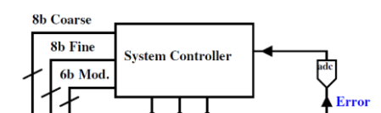
VCSEL Current driver circuit operation
Fig.7 System Controller block diagram
Reference:- H. Zhang et al., "ULPAC: A Miniaturized Ultralow-Power Atomic Clock," in IEEE Journal of Solid-State Circuits, vol. 54, no. 11, pp. 3135-3148, Nov. 2019.

Slide 14
System Controller Logic of I_{PD} Minimisation
Starting Points
  Two initial current values are chosen:
    x_{1,initial}: A baseline value (e.g., 2 mA)
    x_{2,initial}: A slightly higher value (e.g., x_{1,initial} + 5µA)
Parabolic Function
  These current values are passed through a parabolic function defined as:
I_{PD} = 5(I_{DC}-1.5mA)²
  This yields two outputs y₁ and y₂, corresponding to x_{1,initial} and x_{2,initial}, respectively.
Comparison
  The script compares and to determine how the system should shift:
    If y₁>y₂ ,it implies x_{1,initial} is on the left side of the parabola (before the minimum), and the system should shift accordingly.
    If , it implies x_{1,initial} is on the right side of the parabola (after the minimum), and the system should adjust in the opposite direction.

Slide 15
4. Loop Process
  Depending on the determined side, both x₁ and x₂ are incremented (or decremented) by the coarse step.
  The outputs y₁ and y₂ are recalculated after each step.
  The process continues iteratively until the ordering of y₁ and y₂ reverses, indicating that the operating point has passed through the optimal region.
5. Recording History
  Each iteration’s values of x₁ , x₂ and y₁, y₂ are stored. This historical data is later used for plotting the tuning process.
6. Fine Tuning (Two-Point Method)
Precision Adjustment
  Uses a much smaller step size (100 nA) compared to coarse tuning (12 A).
  Starts from the final coarse tuning value and defines x_{2,fine} slightly offset from .
Iterative Refinement
  Adjusts x₁ and x_{2,fine} in the same direction as coarse tuning.
  Stops when the output response y₁-y₂ changes sign, indicating the optimal point is reached

Slide 16
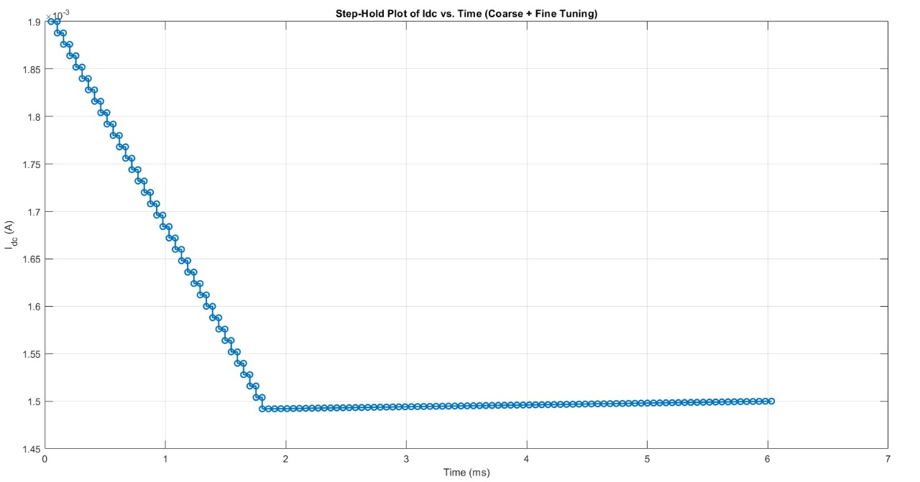
Plot of I_{DC} with time
Fig.8 MATLAB simulation of I_{DC} with time as each loop iterates

Slide 17
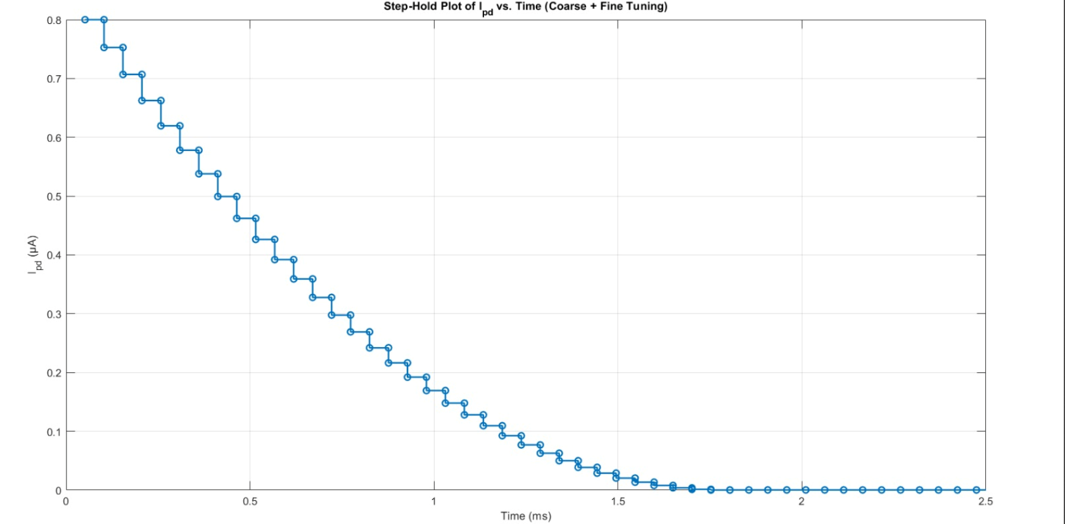
Plot of I_{PD} with time
Fig.9 MATLAB simulation of I_{PD} with time as each loop iterates

Slide 18
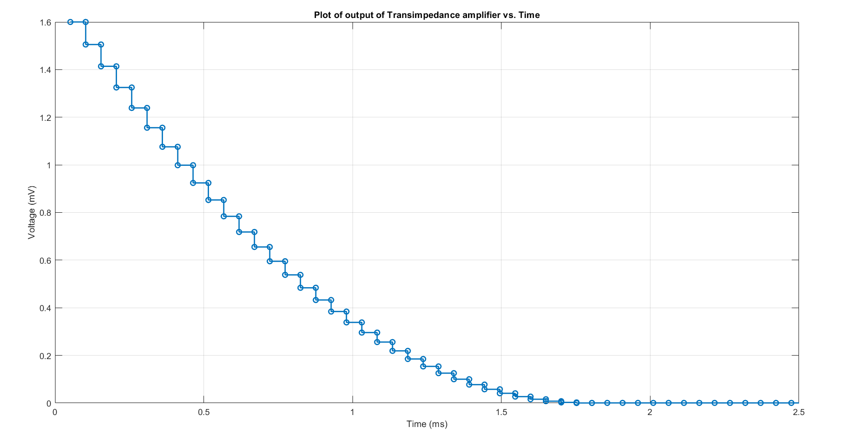
Transimpedance Amplifier
Fig.10 MATLAB simulation of output of transimpedance amplifier with gain 2000V/A

Slide 19
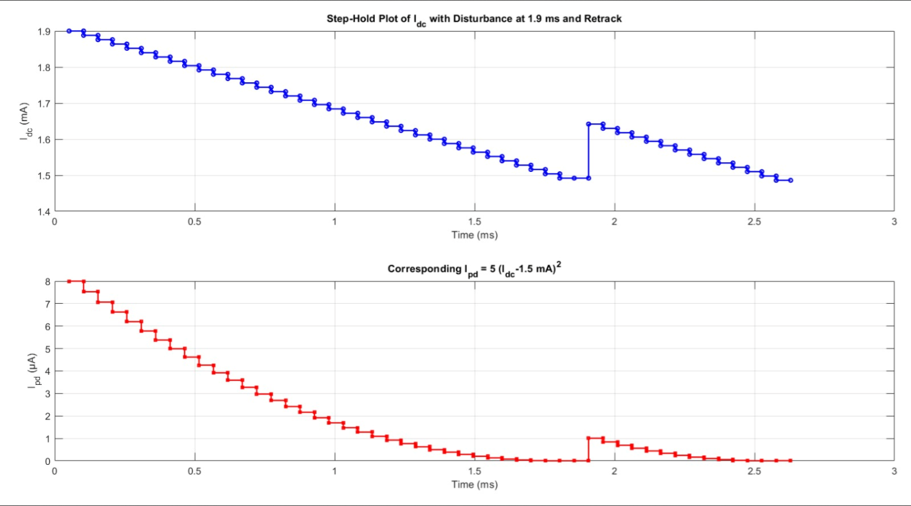
Stability Test to Perturbations
Fig 11 :- MATLAB Simulation of I_{DC} and I_{PD} upon a step perturbation
Time Response of I_{DC} and I_{PD} to a step perturbation of 0.25 mA in I_{DC} at t=1.9 ms. We can see that the algorithm is able to ‘re-track’ the minima and I_{PD} gets back to zero

Slide 20
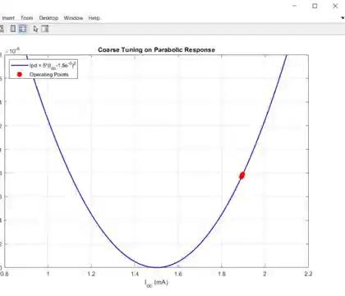
Coarse Tuning Animation
Animation 1: The trajectory followed by I_{DC} in system controller

Slide 21
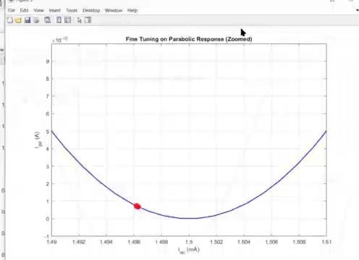
Fine Tuning Animation
Animation 2: The trajectory followed by I_{DC} in system controller

Slide 22
Overview of Work Done
ULPAC Architecture Overview: A simplified ultra-low-power atomic clock (ULPAC) system.
VCSEL-Based RF Signal Modulation: A VCSEL (Vertical Cavity Surface Emitting Laser) modulated by an RF signal generates interference light for a Cs atom cell.
Atomic Frequency Reference: The CPT (Coherent Population Trapping) resonance of Cs atoms provides a stable frequency reference.
Photodetector Feedback: A photodetector (PD) detects the resonance signal, which is used to correct and stabilize the VCXO (Voltage-Controlled Crystal Oscillator) frequency.
Wavelength Locking: A current-source bank maintains the VCSEL wavelength at 894.6 nm.
Frequency Locking via PLL: A Phase-Locked Loop (PLL) locks the modulation RF signal frequency to half the Cs hyperfine frequency (hf) using multiplication.
CPT Resonance Locking: Feedback loops detect and lock the CPT resonance dip.
Stable 10-MHz Output: The VCXO output (10 MHz) inherits the stability of the 133Cs CPT resonance.
:Completed
:To be done

Slide 23


Slide 24
References
H. Zhang et al., "29.4 Ultra-Low-Power Atomic Clock for Satellite Constellation with 2.2×10-12 Long-Term Allan Deviation Using Cesium Coherent Population Trapping," 2019 IEEE International Solid-State Circuits Conference - (ISSCC), San Francisco, CA, USA, 2019, pp. 462-464
C. Wang et al., "Chip-Scale Terahertz Carbonyl Sulfide Clock: An Overview and Recent Studies on Long-Term Frequency Stability of OCS Transitions," in IEEE Transactions on Terahertz Science and Technology, vol. 9, no. 4, pp. 349-363, July 2019.
C. Wang et al., An on-chip fully electronic molecular clock based on sub-terahertz rotational spectroscopy. Nature Electronics 1, 421–427 (2018
Kitching, John. "Chip-scale atomic devices." Applied Physics Reviews 5.3 (2018)
Azhar Yaseen, “Chip Scale Atomic Clock - Architecture Technical Report” [unpublished manuscript as on 9th May 2025]

