Slide 1

Driver Drowsiness Detection System
Department of Computer Science and Engineering
Institute of Engineering and Technology
Dr. A.P.J. Abdul Kalam Technical University
Name of Group Members | Under the Supervision of
1. Srijan Shankar Dubey (1900520310060) | 1. Dr. Natthan Singh
2. Jay Singh (1900520130024) | 2. Mr. Abhishek Singh
3. Manish Mayank (1900520130030)

Slide 2
Content
Motivation
Problem Statement
Literature Review
Methodology
Technologies Used
Expected Results
Conclusion
References

Slide 3
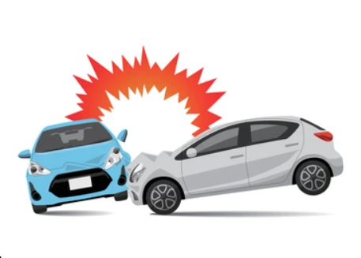
Motivation
The attention of drivers degrades of lower sleep, long distance driver or any other condition like brain disease etc.
Several checks on road accidents says that around 30% of accidents are caused by fatigue of the motorist.
Source - Google

Slide 4
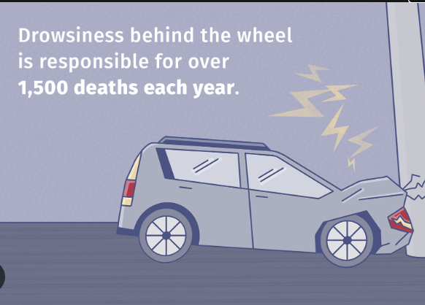
Motivation (Continued..)
Drowsiness causes drop in cautions and conscious situations of the driver.
Driver drowsiness and fatigue are among the important causes of road accidents.
Though there is no direct measure to descry the drowsiness but several other indirect approaches can use for this purpose.
Source - Google

Slide 5
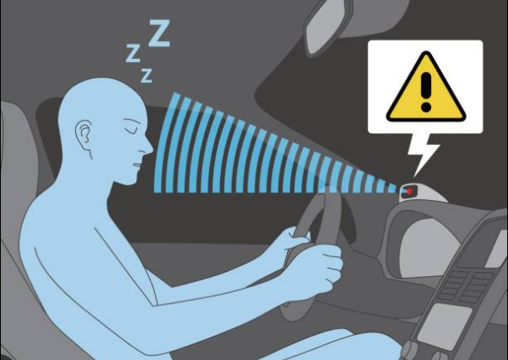
Motivation (Continued..)
Driver Drowsiness Detection System is presented in order to reduce the number of accidents caused by driver fatigue.
Source - Google

Slide 6
Problem Statement
To distinguish the simulated drowsy or sleepy states from the normal state of driving.
The high resolution images of faces and eye observed from an oblique viewing angle.
Effectively monitor driver’s attention level without extra requirement for cameras.

Slide 7
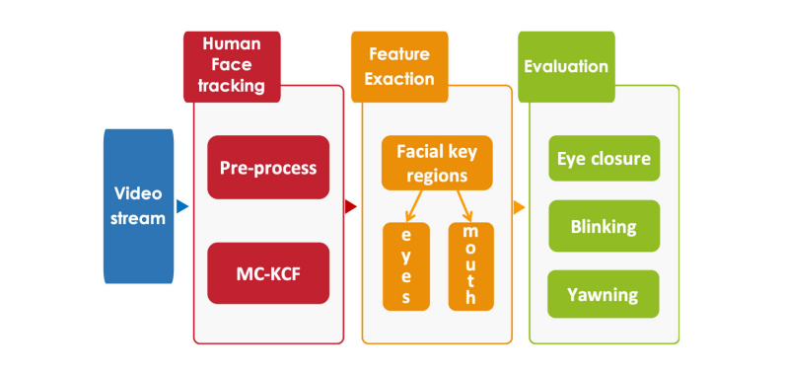
Literature Review
Real-Time Driver-Drowsiness Detection System Using Facial Features
combining the features of the eyes and mouth
used the MC-KCF algorithm to track and recognize the facial key regions based on key-point detection ^{[1]}
[1]

Slide 8
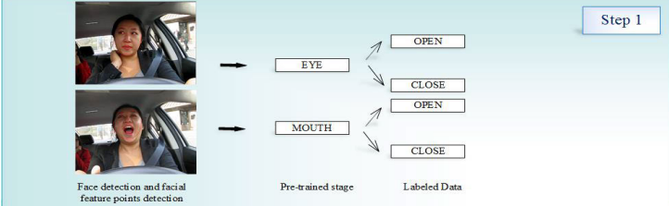
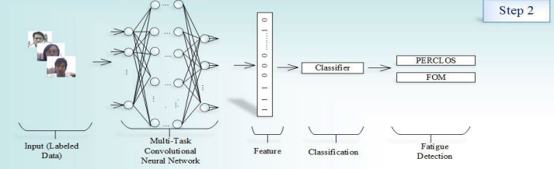
Literature Review (Continued..)
Real Time Driver Fatigue Detection System Based on Behavioral Monitoring Technique.
Designed a two-label (fatigue/not fatigue) system for driver fatigue detection
SVM and CNN algorithms were used for classification ^{[2]}
[1]

Slide 9
Literature Review (Continued..)
Real Time Driver Fatigue Detection System Based on Physiological Monitoring Technique.
Li et al.[3] proposed a system that classifies drowsiness states using EEG signals and an SVM-based model.
Lee et al.[4] utilized HRV signals from wearable PPG or ECG sensors and a CNN classifier, achieving improved accuracy.

Slide 10
Literature Review (Continued..)
Real Time Driver Fatigue Detection System Based on Environmental Monitoring Technique.
McDonald et al. [5] developed a method to analyze driver state by Lane departure analysis using steering wheel angle and using a computer algorithm called random forest (RF).
Mac et al.[6] proposed detection of the distance from the side using wavelet transform and neural network. Used SVM and neural network algorithms achieved detection accuracy of more than 90%.

Slide 11

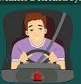

Methodology
IMAGE
NOISE REDUCTION
FACE DETECTION
ROI EXTRACTION
SHAPE PREDICTION AND PLOTTING POINTS
DISTANCE LESS THAN THRESHOLD
ALERT
TRACKING

Slide 12
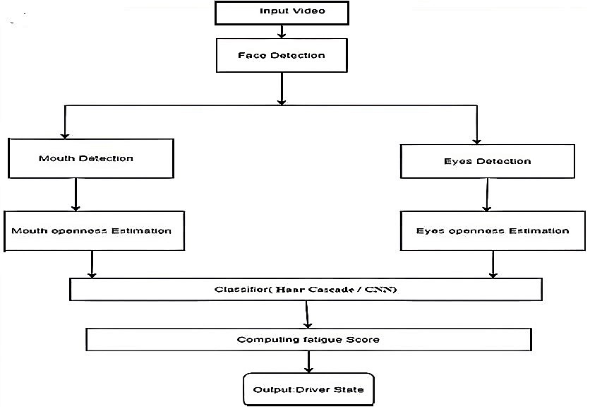
Flow Chart
Methodology (Continued..)

Slide 13
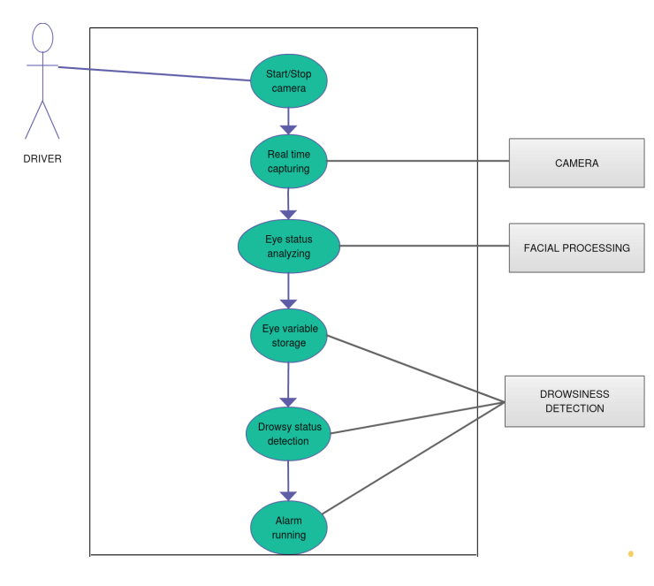
Use Case Diagram
Methodology (Continued..)

Slide 14
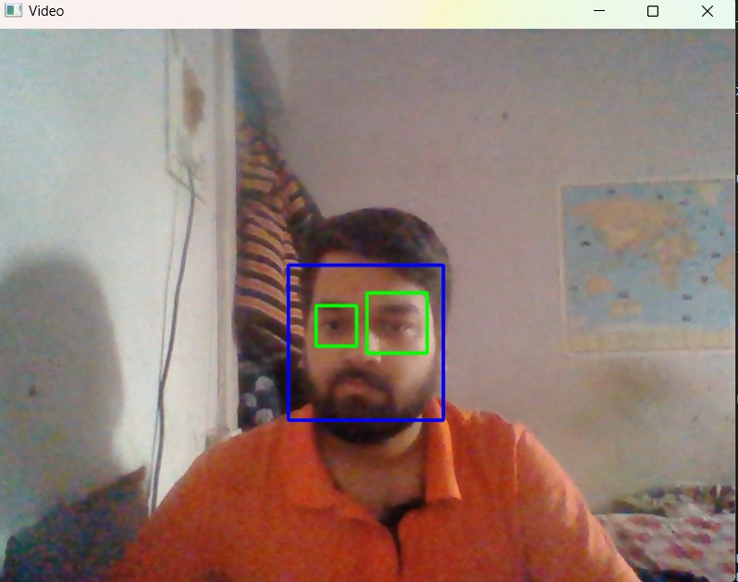
Basics working of project
Methodology (Continued..)
Take image as Input from a camera.
Perform image pre-processing and filter noise.
Detect face in image and create a region of interest (ROI)

Slide 15
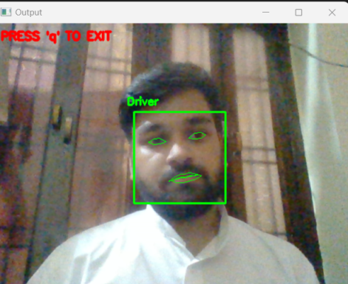
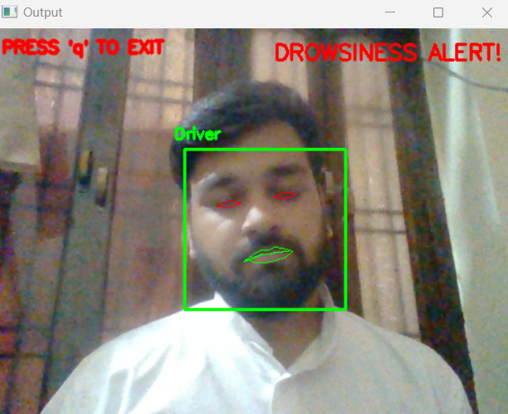
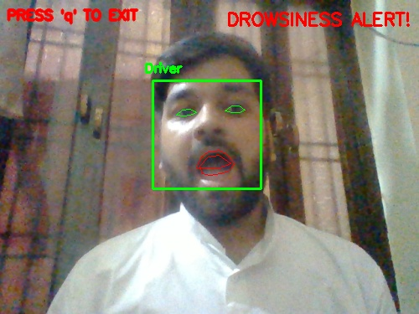
Methodology (Continued..)
Detect the eye and mouth shape, then
plot the landmarks points on boundary.
Calculate distance among these plotted points.
If distance become less than threshold, turn on alarm else continue monitoring.
Drowsiness Alert
Yawning Alert

Slide 16
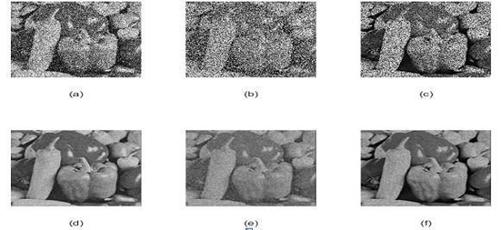
Noise reduction
Methodology (Continued..)
Image pre-processing
Hue, saturation and intensity (HSI)
Grey scale image
Filtering
Filtering
Gaussian noise
Salt and pepper noise
Source - Google

Slide 17
Face Detection and ROI Extraction
Methodology (Continued..)
HAAR Algorithm
feature extraction for an object in an image, with the help of edge detection, line detection, center detection for detecting eyes, nose, mouth, etc. in the picture.
Detects facial features(Eye) by scanning the image pixel by pixel, from top-left to bottom right.

Slide 18
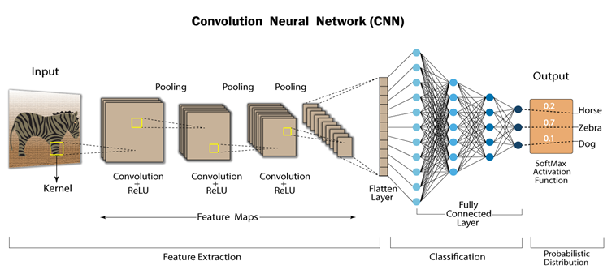
SHAPE PREDICTION AND PLOTTING POINTS
Methodology (Continued..)
Convolutional Neural Network(CNN)
To predict the shape of eye.
Plot point on predicted shape.
[3]

Slide 19

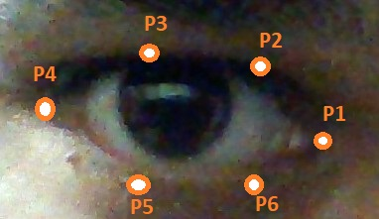
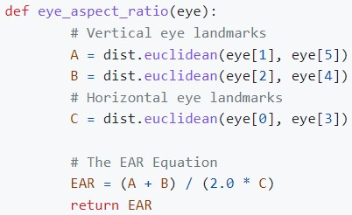
Adopted Algorithm
Methodology (Continued..)
Calculation of EAR and MAR:
Eye Aspect Ratio (EAR): ratio of distances between specific eye landmarks. It is typically computed using the following formula.
Points plotted along eye

Slide 20
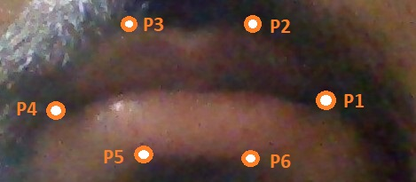

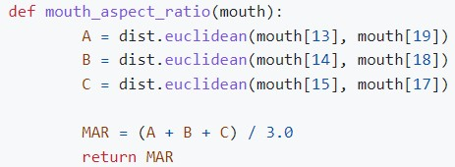
Methodology (Continued..)
Mouth Aspect Ratio (MAR): ratio of the distance between the top and bottom lip to the width of the mouth. The formula for calculating MAR is as follow.
Points plotted along mouth

Slide 21
Technologies used
Frontend
HTML
CSS
JavaScript
Backend
Python
Flask
Library Used
OpenCV
NumPy
Scipy
Pandas
Dlib

Slide 22
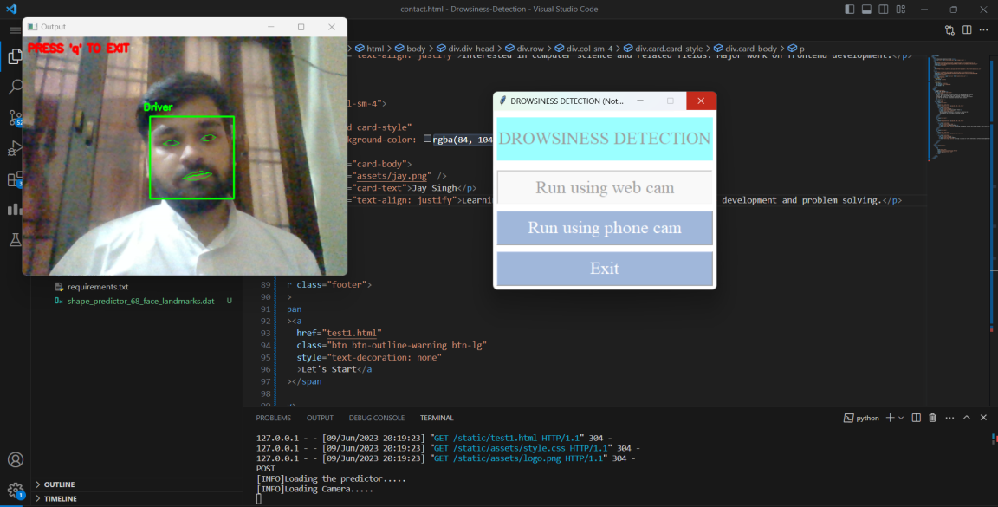
Expected Result
When user would sit in front of camera in presence of sufficient light the following outcomes are expected.
Without any drowsiness features (such as closed eyes or yawning) the system would constantly monitor the driver and eye outline and mouth outline would be in green color.

Slide 23
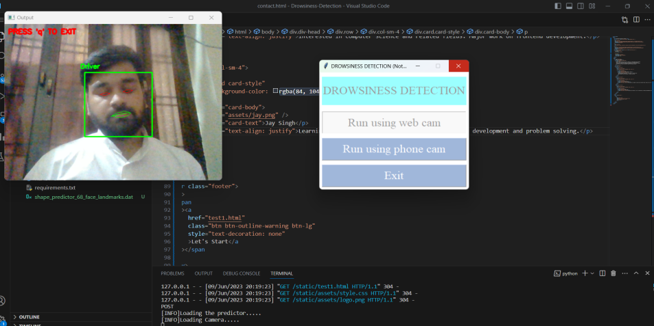
Expected Result
(continued..)
With eye closed and EAR value is less than the threshold the drowsiness alert is shown. The eye outline is shown is red color.
In case of yawning, MAR value is more than the threshold the yawning alert is shown. In this case mouth outline is shown is red color.

Slide 24
CONCLUSION
The Driver Drowsiness Detection System (DDDS) uses Machine Learning (ML) techniques like OpenCV, Mouth Aspect Ratio (MAR), and Eye Aspect Ratio (EAR), and to effectively detect driver drowsiness with promising results.
The system effectively extracts EAR and MAR features from facial landmarks detected by OpenCV, enabling reliable drowsiness detection. The real-time performance of the system ensures timely alerts and interventions to prevent potential accidents.

Slide 25
CONCLUSION (continued..)
By training the ML model on diverse datasets, the system can generalize well to different individuals and driving scenarios, making it applicable in real-world environments.
Factors like extreme lighting conditions, sudden facial movements, or partial occlusions can affect the accuracy of drowsiness detection. Future improvements can focus on addressing these challenges and exploring more sophisticated ML models to enhance the system’s performance.

Slide 26
REFERENCES
[1] WANGHUA DENG AND RUOXUE WU, Real-Time Driver- Drowsiness Detection System Using Facial Features, Available:https://ieeexplore.ieee.org/stamp/stamp.jsp?arnum ber=8949469
[2] BURCU KIR SAVAŞ AND YAŞAR BECERİKLİ et al., Real Time Driver Fatigue Detection System Based on Multi-Task ConNN,8949469,Availablehttps://ieeexplore.ieee.org/stamp/sta mp.jsp?arnum ber=8808931
[3] Li G., Lee B.-L., Chung W.-Y. Smartwatch-based wearable EEG system for driver drowsiness detection. IEEE Sens. J. 2015;15:7169–7180. doi:10.1109/JSEN.2015.2
473679.
[4] Lee H., Lee J., Shin M. Using wearable ECG/PPG sensors for driver drowsiness detection based on distinguishable pattern of recurrence plots. Electronics. 2019;8:192. doi:10.3390/electronics8020192

Slide 27
REFERENCES (continued..)
[5] McDonald A.D., Schwarz C., Lee J.D., Brown T.L. Real time detection of drowsiness related lane departures using steering wheel angle; Proceedings of the Human Factors and Ergonomics Society Annual Meeting; Boston, MA, USA. 22–26 October 2012; pp.2201–2205.
[6] Ma J., Murphey Y.L., Zhao H. Real time drowsiness detection based on lateral distance using wavelet transform and neural network; Proceedings of the 2015 IEEE symposium series on computational intelligence; Cape Town, South Africa. 7–10 December 2015; pp.411–418.

Slide 28
Thank You

