Slide 1
DESIGN AND IMPLEMENTATION OF A CLOUD BASED STORAGE SCHEME PROVIDING DYNAMIC DATA OPERATIONS AND INDIRECT MUTUAL TRUST
Project Guide – Ms .Prathibha B.S.
Anup Kumar
Nikhil Kumar
Parmesh Ishaan
Srijan Chaudhary

Slide 2
Introduction

Slide 3
Cloud Computing
Cloud Computing is internet based development and use of computer technology.
Cloud computing comes into focus only when we think about what IT always needs: a way to increase capacity or add capabilities on the fly without investing in new infrastructure, training new personnel, or licensing new software.

Slide 4
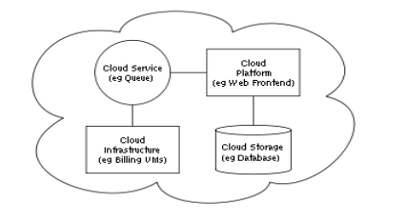
A sample cloud architecture

Slide 5
Storage As a Service
The amount of sensitive data produced by many organizations is outpacing their storage ability.
The management of such huge amount of data is quite expensive due to the requirements of high storage.
Storage-as-a-Service (StaaS) offered by cloud service providers (CSPs ) is a paid facility that enables organizations to outsource their data to be stored on remote servers.

Slide 6
In this project, we propose a cloud-based storage scheme that allows the data owner to benefit from the facilities offered by the CSP
It enables indirect mutual trust between user and CSP.
It allows the owner to outsource sensitive data to a CSP and perform operations on the files.
It allows only the authorized users to access the files.
It allows the owner to grant or revoke the access to the files.

Slide 7
System Requirements
HARDWARE REQUIREMENTS:
System : Pentium IV 2.4 GHz.
Hard Disk : 40 GB.
Monitor : 15 inch VGA Color.
Mouse : Logitech Mouse.
Ram : 512 MB
Keyboard : Standard Keyboard
SOFTWARE REQUIREMENTS:
Operating System : Windows 7
Coding Language : C#
Database : Microsoft SQL 2008
Server : IIS7
IDE :Visual Studio 2010

Slide 8
Functional requirements:
To provide login interface through which only authorized user can pass by.
The owner should be able to upload his data completely.
An authorized user sends a data-access request to the CSP and receives the data file in an encrypted form that can be decrypted by him.
The TTP is an independent entity, and thus has no incentive to collude with any party in the system. However, any possible leakage of data towards the TTP must be prevented to keep the outsourced data private.
The owner should be able to perform full block level operations which includes modify, insert, append, and delete specific blocks. In addition the owner enforces access control by granting or revoking access rights to the outsourced data.
The file should be stored in an encrypted form on the server.

Slide 9
Non Functional Requirements
Usability: Since the users are not experienced of a system like this, it should have a traditional wed based designing approach.
Security: Confidentiality, integrity, newness, access control, and CSP’s defense properties has to be combined.
Price should be feasible to attract more number of customers.
Performance/Time: The time taken for the encrypted data to be stored on the server should be optimal.

Slide 10
SYSTEM ANALYSIS

Slide 11
EXISTING SYSTEM
Currently, the user and storage servers are believed to be in same trust domain, which doesn’t hold when the data is outsourced to a remote server.
This structure leaves a scope for a dishonest party to claim false accusations on the other.
Both CSP and the owner of the data need to be safeguarded against data corruption and false accusation.

Slide 12
Proposed System
The proposed systems allows the owner to take advantages of the services from CSP and provides an indirect mutual trust between the two parties.
It allows the authorized users to access the latest version of data.
It allows the owner to grant or revoke access to only those users who it desires.

Slide 13
SYSTEM DESIGN

Slide 14
System Components and Their Relations:
Trusted third party (TTP)
Data Owner
Cloud servers
CSP
Authorised users

Slide 15
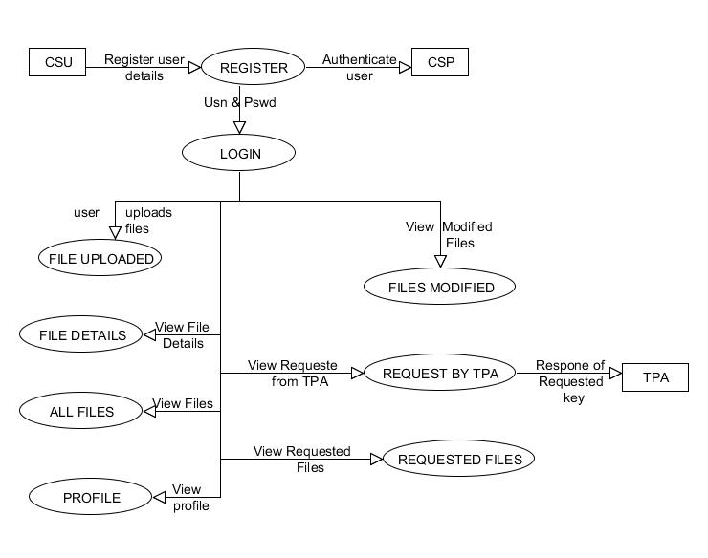
Data flow diagrams: Cloud Service User(CSU) CSU

Slide 16
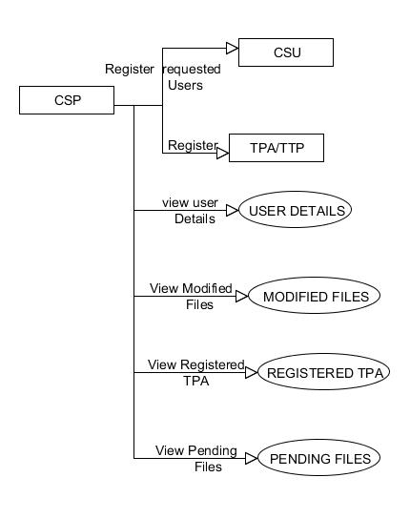
Cloud Service
Provider(CSP)

Slide 17
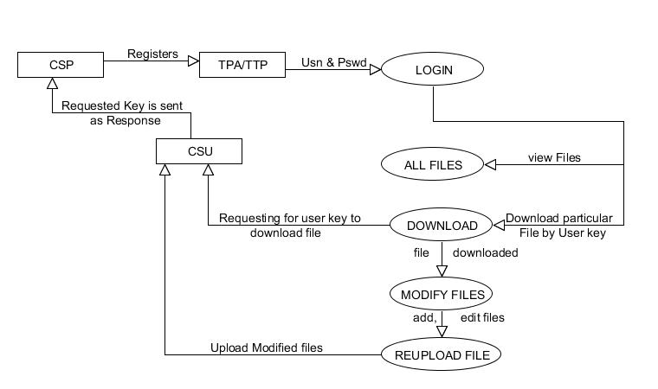
Trusted Third
Party(TTP)
Verify

Slide 18
IMPLEMENTATION

Slide 19
User:
Registration: A user will have to register to the CSP first in order to upload his files on the cloud.
Modification: A user can download his file to make modifications and then re-upload the modified file.
Access control: A user, being the owner of file can control who accesses his files. He can grant access to another user by providing the key for the requested file.

Slide 20
Encryption/Decryption:
Encryption: All the files being uploaded are encrypted by an AES encryption algorithm. The length of a key is 9. This key is sent to the owner of the file when they upload a file via an email. This grants access control to the user.
Decryption: To access a file, the owner provides the key via an email to the user. This key is used to access the file. When the user downloads the file, the decrypted version is being downloaded.

Slide 21
Trusted Third Party:
Register: The TTP has to register to the CSP in order to provide its services and get the entitlement.
Verification: The TTP verifies all the files that are being uploaded to the cloud. It first requests for the key to the user, which user has to provide. The TTP then verifies the file and keeps a track of all the properties of this file to solve the disputes in future, should they arise.
Modification: When the user modifies a file it undergoes a similar process. It again has to be verified by the TTP about the modifications made.

Slide 22
Cloud Service Provider:
Registration: It registers all the TTPs and Users, and keeps a track of all these entities for its cloud.
All Files: It can see all the files uploaded on its cloud, but can’t modify them.
Pending Files: It can see all the files that are yet to be verified by the TTP.

Slide 23
Working
The cloud user after logging in can upload his file.
The TTP then requests for the key to verify the file, after the receipt of which, TTP verifies it with an authorized copy of it.
The TTP then uploads the file for others users to be visible.
The owner can delete an uploaded file or update an existing file. These updates need to be verified by the TTP again, to be visible to other users.

Slide 24
In order to access a file, a user has to send the request to the owner of that file, who then accepts it by responding by the decryption key, or rejects it.
The cloud service provider can view all the files that are uploaded on its server. It also has the access to the files which are yet to be verified by the TTP.
It also keeps track of all the registered users and TTPs along with all their details.

Slide 25
Architecture
Architecture 1
OWNER
Cloud Database
FILE
CLOUD DB
CSP
KEY
TTP

Slide 26
Architecture 2
key
owner
user
Cloud db
csp

Slide 27
Modules:
Data Owner Registration
Data User Registration
TTP (TRUSTED THIRD PARTY) LOGIN
CSP(CLOUD SERVICE PROVIDER) LOGIN

Slide 28
Data Owner Registration
If an owner wants to store some data on the cloud server, he should register his details with TTP first.
These details are maintained in a database.
Then he has to upload files in a file database.
The files are stored in an encrypted form.
Authorized users have the right to decrypt the files.

Slide 29
Data User Registration
If a user wants to access the data stored in the cloud, he has to register his details first.
These details are stored in a database.
Each user is provided with the keys to decrypt the block(s) of data which it is authorized to use.

Slide 30
Trusted Third Party Login:
The trusted third party monitors the owner’s files by the verifying the files and storing them in the database.
It also checks the cloud service provider and finds out weather CSP access is authorized or not.
The TTP is always online with the owner over a secure line.
It is responsible for transferring the data from the owner to CSP and from CSP to users.

Slide 31
Cloud Service Provider Login:
The CSP has access to the stored files.
The TTP checks weather the files stored on Cloud Server is authenticated or not.
A fake CSP is not allowed to access files in the cloud server.
The CSP does not allows unauthorized access to the data as everything has to be verified by TTP.
It is the job of the TTP to verify the data provided by the CSP upon an access request.

Slide 32
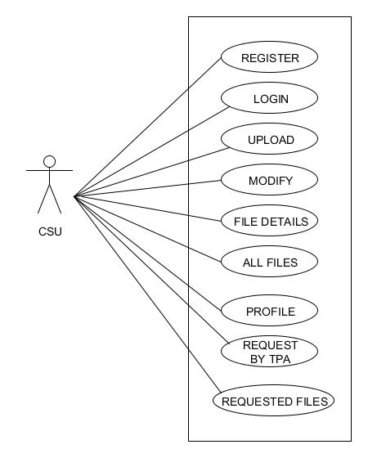
Use case Diagrams User:

Slide 33
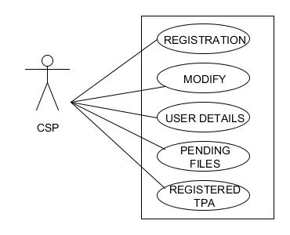
Cloud Service Provider:

Slide 34
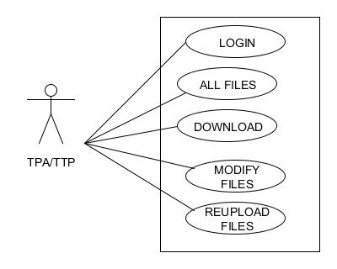
Trusted third party:

Slide 35
Testing
SYSTEM TESTING:
The purpose of testing is to discover errors.
It provides a way to check the functionality of components.
It is the process of exercising software with the intent of ensuring that the Software system meets its requirements and user expectations

Slide 36
Type of test
Unit testing
Registration Of user
Login
File Upload
All files details
Requested key & Files
Download
2.Integration testing
3.Black Box Testing

Slide 37
Conclusion
Outsourcing data to remote servers.
A cloud-based storage scheme which supports outsourcing of dynamic data, where the owner is capable of archiving and accessing the data stored by the CSP.
Owner can also update and scale this data on the remote servers
The authorized users can be sure that they are receiving the most recent version of the outsourced data.

