Slide 1
TWITTER SENTIMENTAL ANALYSIS AND VISUALISATION
By: SRIJAN MALHOTRA
(SM9439/N18390405)

Slide 2
INTRODUCTION
Twitter is one of the leading social networking platforms that has been attracting a huge amount of attention not only from general users but also from researchers all around the world.
A large amount of data is being generated almost every day which can be used to analyze and visualize the usage of social media data which not only helps understand how it is being used but also allows helps understand the general trend for that specific period.

Slide 3
GOAL
To analyze and visualize the Twitter dataset in an engaging manner.
Preprocessing the data using NLP techniques, which includes working on bag of words, parts of speech etc.
Understand the sentiment of the dataset by extracting emotions and then providing various visualizations and gather more information about the ongoing/current trends.

Slide 4
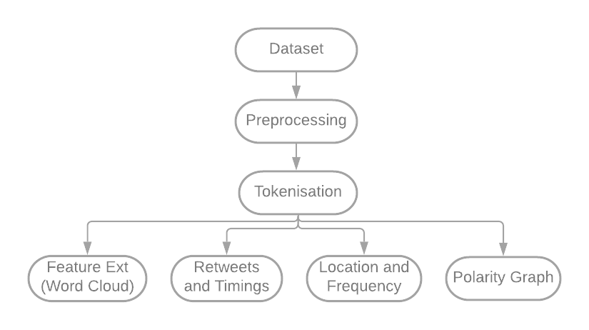
METHODOLOGY

Slide 5
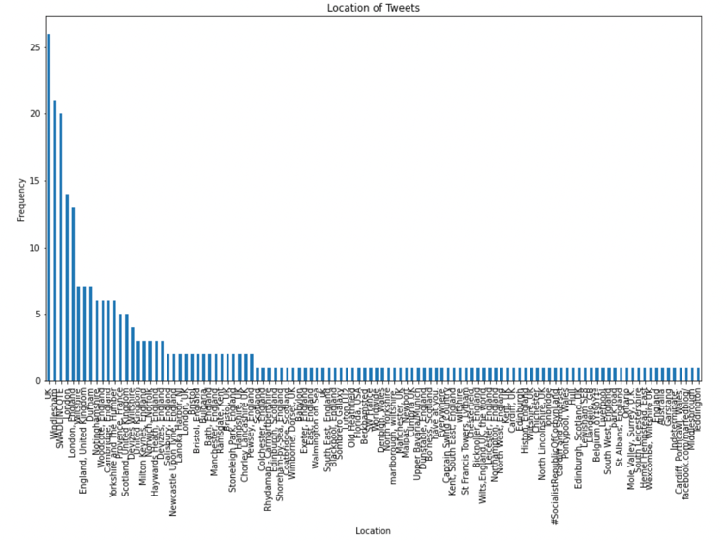
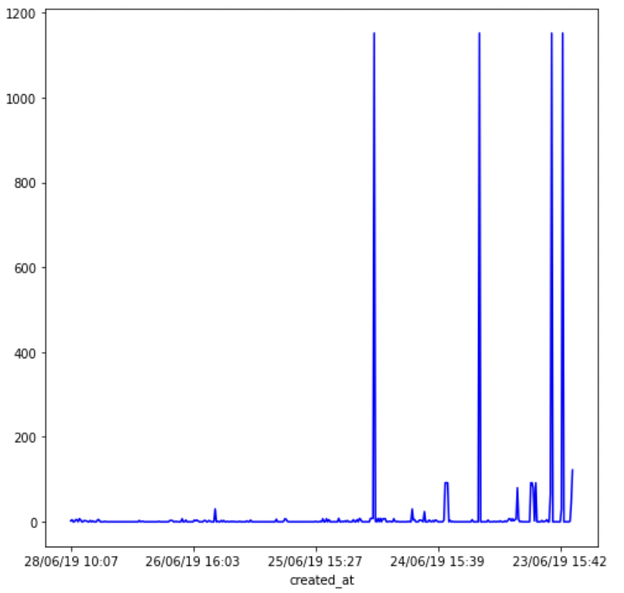
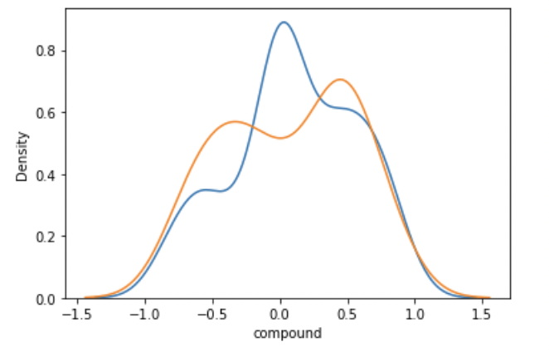
VISUALISATIONS
Freq of Tweets VS Locations
Retweets VS Frequency
Polarity Comparison

Slide 6
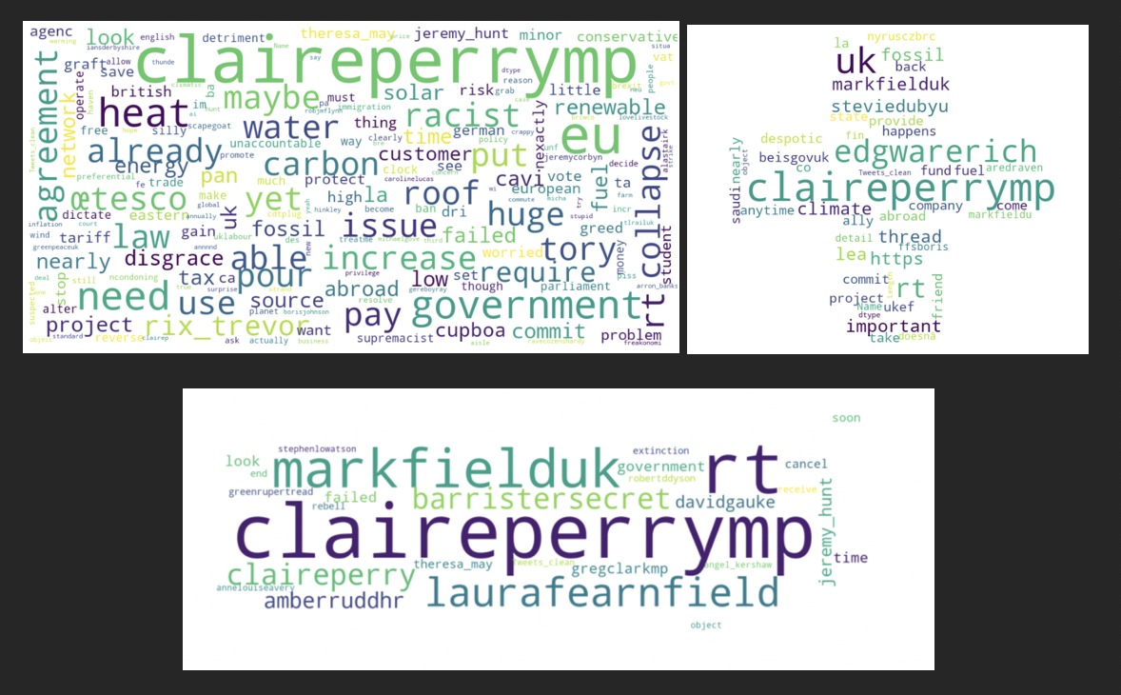
WORD CLOUD (Sentiments)

Slide 7
THANK YOU
Incase you have any questions regarding this please do contact me on
sm9439@nyu.edu

