Slide 1

Dynamic Memory Management Visualizer: Understanding Paging & Segmentation
Memory management is a vital part of modern operating systems, ensuring efficient allocation, tracking, and freeing of memory for processes. This project introduces a Dynamic Memory Management Visualizer, an interactive tool designed to simulate paging and segmentation techniques. It aims to help users grasp complex memory management concepts through real-time graphical representations and user interaction.
The visualizer bridges theory and practice, demonstrating memory allocation, replacement policies, fragmentation, and process execution flow dynamically.

Slide 2
Memory Management Techniques: Paging and Segmentation
Paging
Segmentation
Divides physical memory into fixed-size frames and logical memory into equal-sized pages. It eliminates the need for contiguous memory allocation, reducing external fragmentation.
Divides programs into variable-sized segments based on logical divisions like code, data, and stack. It offers better logical organisation but can suffer from external fragmentation.
Pages are loaded into available frames, allowing efficient memory use and smooth multitasking.
Requires additional management to handle fragmentation and dynamic allocation.

Slide 3

Project Objectives and Features
Interactive Visual Tool
User-Defined Inputs
Educational Insights
Simulates paging and segmentation with graphical representation of memory allocation and deallocation in real-time.
Allows customization of frame size, number of pages, allocation strategy, and page replacement algorithms (FIFO, LRU) for personalised simulations.
Visualizes page faults, memory states, fragmentation, and dynamic process execution to enhance understanding of memory management.

Slide 4
Paging Simulation: FIFO and LRU Algorithms
FIFO (First-In-First-Out)
LRU (Least Recently Used)
Replaces the oldest page in memory when a new page needs allocation. Tracks page faults and updates memory frames accordingly.
Replaces the page that has not been used for the longest time. Maintains a recency list to manage page usage dynamically.

Slide 5
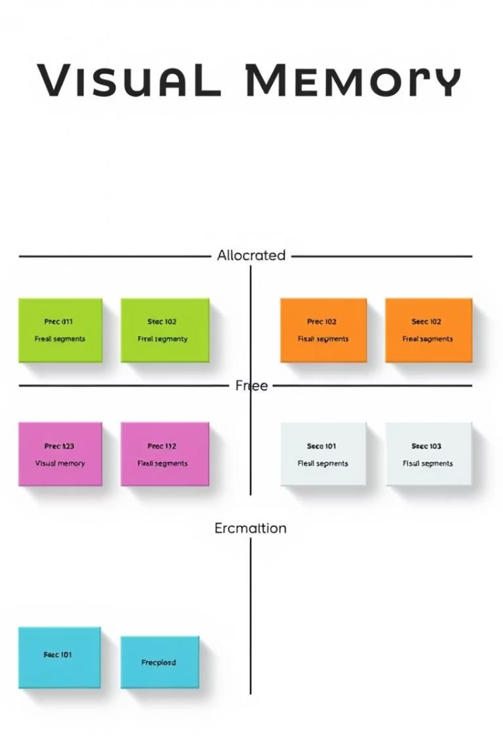
Segmentation Simulation: Dynamic Allocation and Fragmentation
First-Fit Allocation
Fragmentation Management
Allocates memory segments by finding the first suitable free block, supporting dynamic allocation and deallocation.
Merges adjacent free blocks to reduce external fragmentation and improve memory utilisation.
Visual Representation
Displays allocated and free memory segments with colour coding, helping users understand segmentation effects.

Slide 6

Methodology and Technology Stack
Programming Language
Python is used for its simplicity and powerful libraries.
Visualization Library
Matplotlib generates graphical representations of memory states and simulations.
User Interface
Console-based interaction with plans for GUI enhancements using Tkinter or PyQt.
Version Control
GitHub repository maintains code revisions and collaboration.

Slide 7
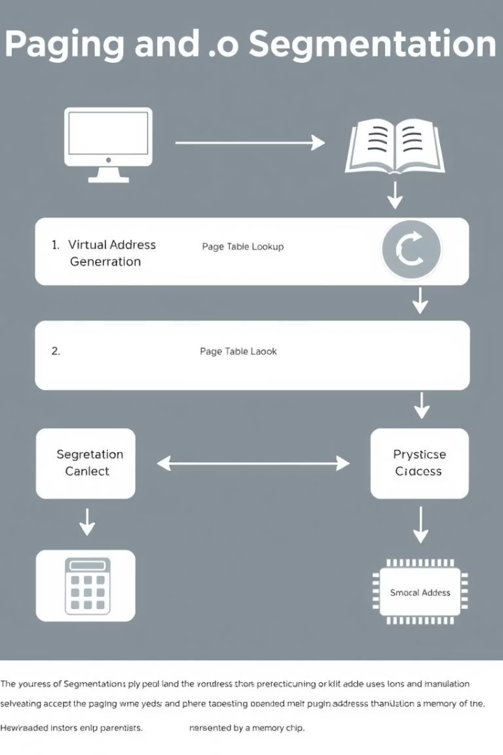



Implementation Workflow and Simulation Modules
Paging Simulation
Accepts page reference strings and frame counts, simulates FIFO and LRU algorithms, tracks page faults, and visualizes memory frames.
Segmentation Simulation
Supports dynamic allocation and deallocation with first-fit strategy, merges free blocks, and visualizes memory layout.
Visualization Module
Uses Matplotlib to create real-time graphical tables and diagrams for memory states.

Slide 8
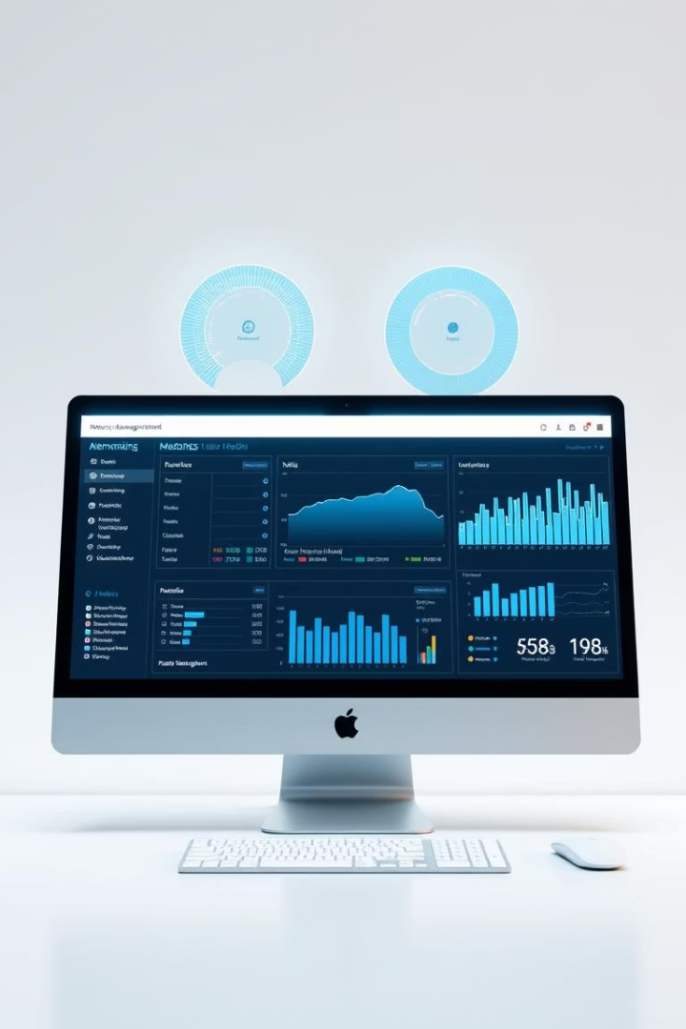
Conclusion and Future Enhancements
Project Success
The visualizer effectively demonstrates paging and segmentation, providing an interactive educational tool for memory management concepts.
Future Scope
Plans include enhancing UI with GUI frameworks, adding more page replacement algorithms like Optimal and Clock, implementing variable-sized partitions, and developing a web-based version.

Slide 9
Project Resources and References
GitHub Repository
Academic References
https://github.com/srijanp56/CSE316/tree/main
Moreta & Telea (2007) on visualizing dynamic memory allocations.
Contains source code, documentation, and revision history for the project.
Neso Academy videos on page replacement algorithms.
GATE Smashers and KnowledgeGate tutorials on segmentation and paging.

Slide 10
Thank You!

