Slide 1
Image Processing Project
“Adaptive Mammographic Image Enhancement Using First Derivative and Local Statistics”.
Rushikesh Ghule - 2017218
Srijan Singh - 2017259

Slide 2
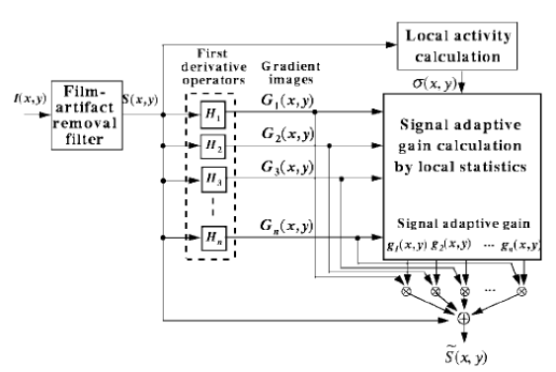
Adaptive Mammographic Image Enhancement Using First Derivative and Local Statistics
This project implements the paper which proposes an adaptive image enhancement method for mammographic images, which is based on the first derivative and the local statistics.
The adaptive enhancement method consists of three processing steps.
• The first step is to remove the film artifacts which may be misread as micro calcifications.
• The second step is to compute the gradient images by using the first derivative operators.
• The third step is to enhance the important features of the mammographic image by adding the adaptively weighted gradient images.

Slide 3
Algorithm
Algorithm:
1) Read the image to I.
2) Compute mean values of each pixel, A(x,y), of the surrounding region with a window.
3) If mod(I(x,y)-A(x,y)) > T, then S(x,y) = A(x,y).
Else S(x,y)=A(x,y).
4) S1 = [-1 -2 -1;0 0 0;1 2 1], S2 = [-1 0 1;-2 0 2; -1 0 1].
5) G1 = Convolution of S and S1, G2 = Convolution of S and S2.
6) e=edge(S,’Sobel’).
7) Sig1 = Standard deviation of G1;
8) Sig2 = Standard deviation of G2.
9) Sig = Standard deviation of S.
10) Mean1= Mean of G1;
11) Mean2 = Mean of G2;
12) If ( Mean1(x,y)-Sig1(x,y)<=G1(x,y)<=Mean1(x,y)+Sig1(x,y))
g1max(x,y)=Sigmax/Sig1(x,y)+Sig1(x,y)/(Sig1(x,y)+Sig2(x,y);
else
g1max(x,y)=Sigmax/Sig1(x,y).
13) Repeat step 12 for g2max(x,y) as well.
14) g1 = -(g1max(x,y)-1)*Sig(x,y)/max(Sig)+Sig1(x,y);
15) if(e==1)
Sfin = S+g1.*G1+g2.*G2;
else
Sfin = S+G1+G2;
16) Sfin is the final output image.

Slide 4
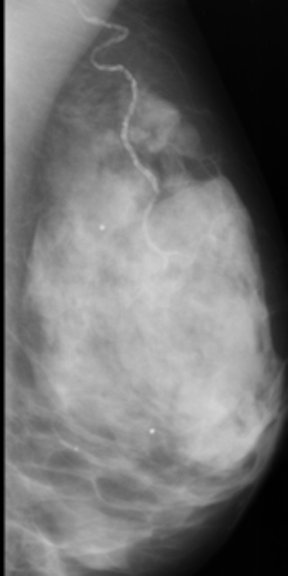
First Step
We implemented the first step to remove film artifacts. A 3X3 and 5X5 windows are used with different threshold values, T. The output image becomes more smooth as window size increases for same T. It was observed that as the Threshold value increases, the output image looks close to the input image, but this may lead to preserving the film artifacts and other phantom features which may look similar to real mammographic lesions. So, the threshold value has to be negotiated such that the output image looks as close to as the input image with film artifacts and phantom features suppressed. Finally a 5x5 averaging kernel and value of 3 is chosen for T

Slide 5
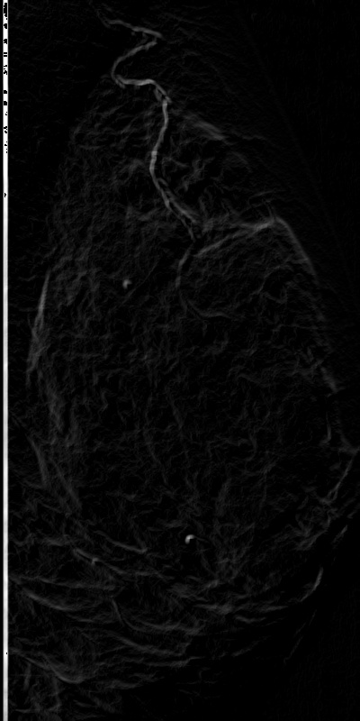
Second Step
We implemented the first step to remove film artifacts. A 3X3 and 5X5 windows are used with different threshold values, T. The output image becomes more smooth as window size increases for same T. It was observed that as the Threshold value increases, the output image looks close to the input image, but this may lead to preserving the film artifacts and other phantom features which may look similar to real mammographic lesions. So, the threshold value has to be negotiated such that the output image looks as close to as the input image with film artifacts and phantom features suppressed. Finally a 5x5 averaging kernel and value of 3 is chosen for T

Slide 6
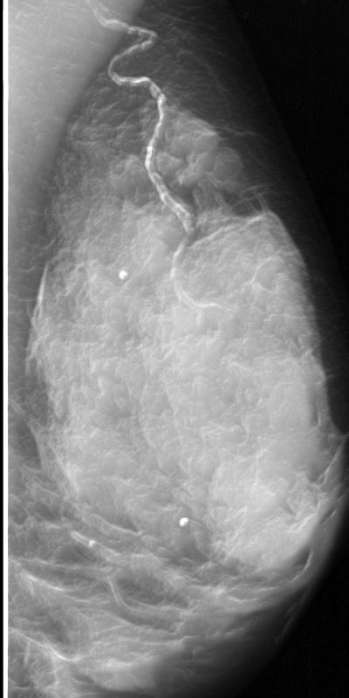
Third Step
The signal adaptive gain is calculated for both the gradient images based on local statistics and multiplied elementwise with the gradient images.

Slide 7
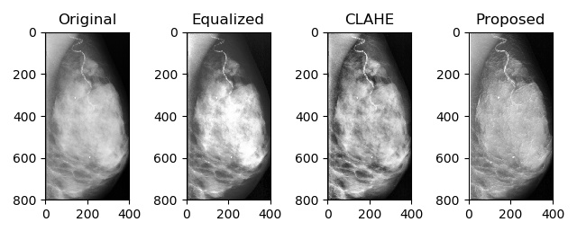
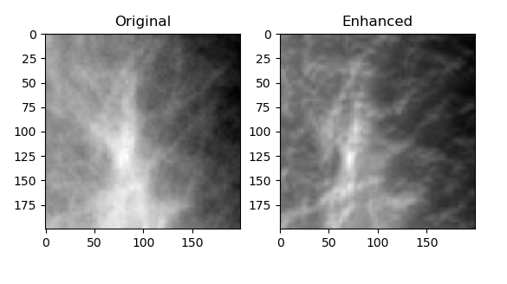
Results
Comparison done with different existing techniques like Global histogram equalization and CLAHE.
A zoomed section of the abnormal mammogram magnified by bilinear interpolation.

