Slide 1
Hydrological Impact of Sir Arthur Cotton Barrage
BTP PHASE 2
Presented by
S. Lakshmi Srija
Roll No: 2201CE63 | B.Tech 4th Year
Civil & Environmental Engineering, IIT Patna
Supervisor
Dr. Om Prakash
Assistant Professor
Civil & Environmental Engineering, IIT Patna

Slide 2
Table of Contents
01
Introduction
06
Methodology
02
Literature Review
07
Results & Discussion
03
Research Gap
08
Conclusions
04
Study Area
09
Limitations & Future Scope
05
Data Collection
10
References
1

Slide 3
01 | Introduction
Background
Water resources systems across the world face significant stress due to the combined influence of climate variability and human-induced changes. Rainfall-runoff processes are highly complex and non-linear, with behavior determined by rainfall characteristics, soil moisture, vegetation cover, and antecedent catchment conditions. The Godavari River Basin (≈3.13 lakh km²), the second largest in India, sustains millions through agriculture, domestic supply, hydropower, and irrigation.
Climate Variability
LULC Changes
SACB Concern
Irregular rainfall, extreme storms & droughts
Higher flood occurrences, lower base flows
Increasing non-stationarity of hydrology
Urbanization, deforestation & agriculture expansion
Increased impervious area → higher runoff
Reduced infiltration capacity
SAC Barrage (1852/1982) — lifeline of Godavari Delta
Irrigates 10+ lakh acres in Andhra Pradesh
Hydrological changes threaten long-term sustainability
Objectives of the Study
Analyze long-term rainfall trends using Sen's Slope & Mann-Kendall test (1988–2024)
Map LULC changes (2017–2024) and their hydrological implications using ArcGIS
Estimate surface runoff using SCS-Curve Number method with GIS-integrated soil data
Develop LSTM and Genetic Programming (GP) models for daily inflow prediction at SACB
2

Slide 4
02 | Literature Review
Author & Year | Methodology | Key Conclusion
Yokoo et al. (2021) | LSTM Deep Learning — spatially distributed rainfall inputs | LSTM-SWAT hybrid improved NSE from 0.72 to 0.89, LSTM effectively learnt catchment strong generalization ability.
Liong et al. (2002) | Genetic Programming (GP) for rainfall–runoff modelling | GP equations are physically interpretable with accuracy comparable to neural networks
Verma et al. (2021) | SCS-CN improved models for direct surface runoff | Modified CN approach reduces error; integrates LULC and soil groups for better estimation
Potapov et al. (2022) | Global forest/cropland change analysis (2000–2020) | Deforestation and agri-expansion increase peak discharge and reduce groundwater recharge
Subramanya (2008) | SCS-CN method — Engineering Hydrology textbook review | SCS-CN remains the standard empirical method for runoff estimation in Indian basins
Antar et al. (2006) | ANN feedforward models — Blue Nile catchment streamflow | ANNs outperform regression; handle non-linearity but miss temporal memory
Bhadra et al. (2009) | SCS-CN and continuous simulation(Himalayan basin) | Fixed CN underestimates antecedent moisture variability, proposed modified AMC thresholds for high- altitude monsoon catchments
Hochreiter & Schmidhuber (1997) | LSTM architecture — gated memory for time-series | Gated LSTM solves vanishing gradient problem; effective for long-term temporal dependencies
3

Slide 5
03 | Research Gap
Why This Study is Needed
GAP 1
GAP 2
Limited Spatial Rainfall Modeling
Absent LSTM Studies for Indian Barrages
Most Indian river basin studies rely on lumped conceptual or linear regression models that cannot account for spatial rainfall variability and non-linear inflow dynamics.
Application of LSTM models for inflow forecasting in Indian barrages using distributed antecedent precipitation data has not been adequately addressed.
GAP 3
GAP 4
No GP vs. LSTM Comparison in India
No Integrated Framework for SACB
A rigorous comparison between Genetic Programming and LSTM for rainfall-runoff analysis has not been carried out in the Indian hydrological context.
No comprehensive framework considers the combined impact of LULC alteration, soil characteristics, and rainfall trends specifically on the Sir Arthur Cotton Barrage.
4

Slide 6
04 | Study Area
Godavari River Basin
Location: Peninsular India, spanning Maharashtra, Andhra Pradesh, Telangana, Chhattisgarh, Odisha, Madhya Pradesh, Karnataka Area: ≈ 3,02,065 km² (9.5% of India's total area) - Second largest basin in India River length: ≈ 1,465 km, from Western Ghats (Nashik) to Bay of Bengal Rainfall: Average 1,096 mm/year; 80%+ during SW monsoon (June–October) Data: 49 rain gauge stations; daily rainfall & inflow data 1988–2024
STUDY AREA
3,02,065 km²
1,465 km
Basin Area
River Length
49 Stations
7 States
Sir Arthur Cotton Barrage (SACB)
Rain Gauges
States Covered
Location
Dowleswaram, East Godavari, AP | 17.00°N, 81.80°E
≈ 1,096 mm
3592.6 m
Constructed
1852 (original anicut); Reconstructed 1982 as modern barrage
Annual Rainfall
Barrage Length
Length
≈ 3592.6m across Godavari River
10 lakh ha
1988–2024
Capacity
Handles flood flows exceeding 3.5 million cusecs
Irrigated Area
Data Period
Irrigation
Approximately 10 lakh hectares across East Godavari, West Godavari & Krishna districts
Significance
Integrating node for entire upstream 3.02 lakh km² Godavari catchment
5

Slide 7
05 | Data Collection
Dataset | Source | Spatial Resolution | Temporal Coverage | Application
Daily Rainfall | IMD (India Met. Dept.) | 3° x 3° | 1988–2024 | Trend analysis, ML model input
SAC Inflow Data | Barrage Authority | Point (barrage site) | 2006–2023 | LSTM & GP model target variable
LULC Map | NRSC Bhuvan Portal | 56m (multi-class) | 2017 (Kharif) | Land cover baseline for SCS-CN
SRTM DEM | USGS Earth Explorer portal. | 30m resolution | 2000 (static) | Drainage delineation, basin boundary
Soil Data (HSG) | NBSSLUP | 1:250,000 scale | Static | Hydrological Soil Group classification
6

Slide 8
06 | Methodology- Framework
1
2
3
4
→
→
→
→
Data
Collection
Rainfall Trend
Analysis
SCS-CN Method
LSTM model
5
6
7
8
Genetic Programming Model
→
Inflow
Prediction
→
Performance
Evaluation
→
Sustainability
Assessment
Outputs
Trend maps &
Sen's Slope values
LULC change
statistics & maps
Composite CN
& Runoff trends
LSTM & GP model
performance
Inflow forecasts
& sustainability index
7

Slide 9
06 | Methodology- Rainfall Trend Analysis
Sen's Slope Estimator
Sen's Slope Estimator
Purpose
Robust non-parametric slope estimator; resistant to outliers
Formula
Qᵢ = (xⱼ – xₖ)/(j – k) for all j > k pairs
Sen's Slope β:
β = Median of all N slope estimates Qᵢ
Confidence Int.:
95% CI computed using normal approximation of Qᵢ values
Interpretation:
β > 0 → increasing trend; β < 0 → decreasing trend
Advantage:
More reliable than linear regression for non-normal data
8

Slide 10
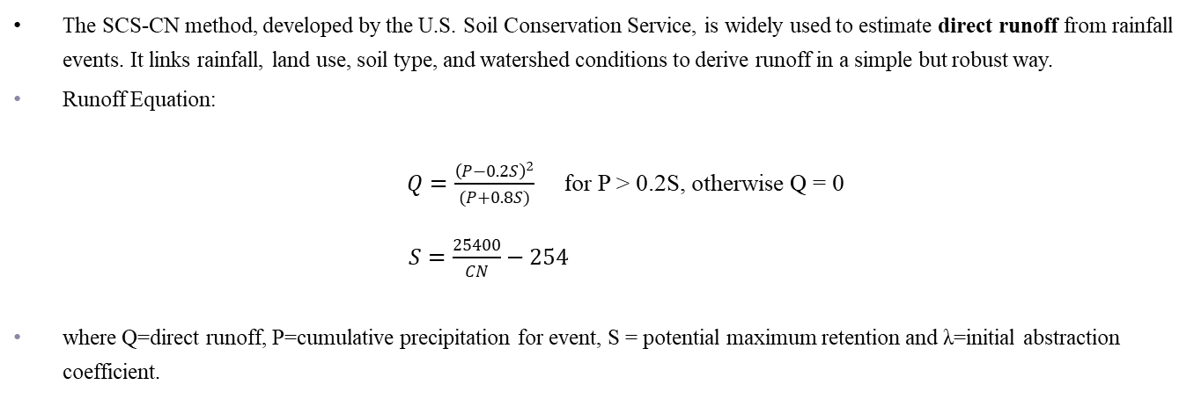
06 | Methodology- SCS Curve Number Method
The SCS-CN method, developed by the U.S. Soil Conservation Service, is widely used to estimate direct runoff from rainfall events. It links rainfall, land use, soil type, and watershed conditions to derive runoff in a simple but robust way.
Runoff Equation:
$Q=\frac{{\left(P−0.2S\right)}^{2}}{(P+0.8S)}$ for P > 0.2S, otherwise Q = 0
$S=\frac{25400}{CN}−254$
where Q=direct runoff, P=cumulative precipitation for event, S = potential maximum retention and λ=initial abstraction coefficient.
9

Slide 11
06 | Methodology- LSTM
① Data Preparation
② LSTM Network Architecture
1
Raw Inputs
INPUT TENSOR
49 rainfall stations · Daily inflow (1988–2024)
(20 days × 98 features)
▼
2
API5 Computation
LSTM Layer 1 — 64 neurons
5-day antecedent rainfall sum per station → soil wetness
Captures broad temporal patterns(multi-week rainfall trends)
▼
3
Feature Matrix
Dropout (rate = 0.20)
98 features per day: 49 rainfall + 49 API5 values
Randomly drops 20% of neurons prevents overfitting to training data
▼
4
20-Day Lag Window
LSTM Layer 2 — 32 neurons
Sliding window → each sample: 20 days × 98 features
Refines patterns into fine-detail (peak flow, recession limb)
▼
5
Min-Max Normalise
Dropout (rate = 0.20)
Scale all values to [0,1] — equal weight to all inputs
Second regularisation layer
▼
6
80:20 Train/Test
Dense Output — 1 neuron
Chronological split — no data leakage
Linear activation → outputs single daily inflow value (cusecs)
10

Slide 12
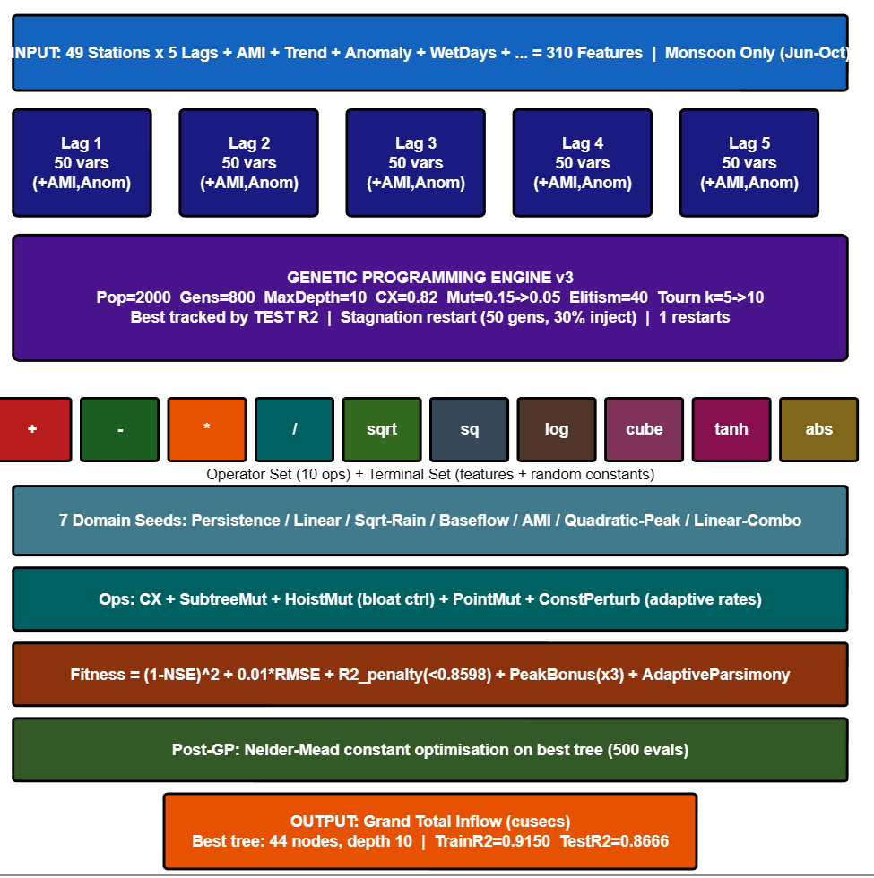
06 | Methodology- Genetic Programming (GP)
62 Engineered Features (each lagged t−1 to t−5)
Basin Avg Rainfall
Spatially averaged rainfall across all 49 stations for each day
Rain3, Rain5, Rain7
Cumulative accumulated rainfall over past 3, 5, and 7 days
RainMax
Maximum rainfall recorded at any single station on that day
RainStd
Spatial standard deviation of rainfall across all 49 stations
WetDays
Count of stations recording >1 mm rainfall on that day
AMI (Antecedent Moisture)
Exponential decay moisture index: AMIₜ = k×AMIₜ₋₁ + Rₜ₋₁
RainAnom
Deviation of daily basin rainfall from monsoon climatological mean
BaseFlow
5-day running mean of previous inflow values at SAC Barrage
InflowTrend (ΔQ)
Change in inflow from previous day: Qₜ − Qₜ₋₁
Total features: 49 + 12 additional lag variants
62 × 5 = 310 features per sample
11

Slide 13
05 | Methodology- Genetic Programming (GP)
GP Programming Engine
1
INITIALIZE POPULATION
Ramped half-and-half method (full + grow trees at varying depths)
Seed trees injected: persistence, rainfall-runoff linearity, AMI interaction, base flow recession
▼
2
EVALUATE FITNESS (each tree)
Composite: F = (1−NSE)² + 0.01×RMSE + F_penalty + F_peak + F_parsimony
Minimized each generation. Best tracked by test R².
▼
3
ADAPTIVE TOURNAMENT SELECTION
Tournament size increases over generations → higher selection pressure.
Mutation probability decreases (explore early → exploit later).
▼
4
GENETIC OPERATORS (per individual)
Crossover: swap subtrees between parents Subtree mutation: replace node with random tree |
Hoist: simplify Point mutation: replace node | Constant perturbation
▼
5
ELITISM & STAGNATION RESTART
Best trees passed to next generation (elitism).
If no improvement over N generations → inject random individuals (diversity).
12

Slide 14
06 | Methodology- Performance Evaluation
Metric
Full Name
Formula
Ideal
RMSE
Root Mean Square Error
√[ Σ(Qo − Qp)² / n ]
0
MAE
Mean Absolute Error
Σ|Qo − Qp| / n
0
MAPE
Mean Abs. Percentage Error
( Σ|Qo − Qp| / Qo ) × 100 / n
0
NSE
Nash–Sutcliffe Efficiency
1 − Σ(Qo−Qp)² / Σ(Qo−Q̄o)²
1.0
R²
Coefficient of Determination
1 − Σ(Qo−Qp)² / Σ(Qo−Q̄o)²
1.0
Corr
Pearson Correlation
Σ(Qo−Q̄o)(Qp−Q̄p) / ( σo · σp · n )
1.0
Bias
Percent Bias
Σ(Qo − Qp) / ΣQo × 100
0 %
13

Slide 15
06 | Methodology- Sensitivity Analysis
One At Time
1
Fix all features at original values
Sensitivity Formula
2
Perturb one feature by ±10%
Si = 1⁄2 × [ |ŷ⁺ − ŷbase| + |ŷ⁻ − ŷbase| ]
3
Record change in model output
ŷbase
— model output at original feature values
ŷ⁺ / ŷ⁻
— output when feature f_i is varied by +10% / −10%
‾ (bar)
— average over all test samples
4
Repeat for each feature
14

Slide 16
07 | Results & Discussion — Rainfall Trend Analysis
Key Findings
Annual Rainfall
+2.58 mm/yr
Significant increasing trend (p<0.05)
Monsoon Rainfall
>80% annual
Clear positive trend; dominant runoff driver
Extreme Events
Increasing
Higher intensity storms & erratic patterns
Since >80% of annual rainfall occurs in the monsoon, even small increases in monsoon rainfall significantly amplify runoff entering the SAC Barrage. This directly translates to higher flood risk and greater operational demands on barrage gates.
15

Slide 17
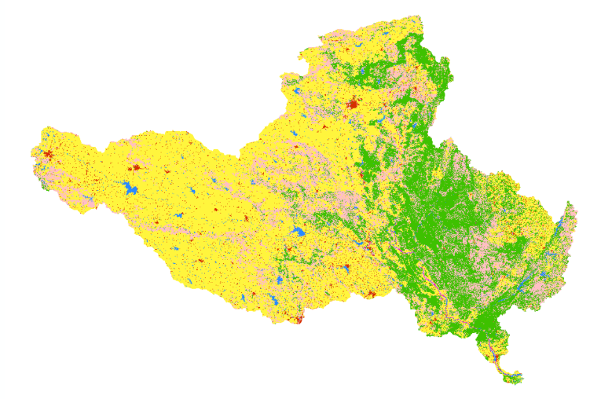
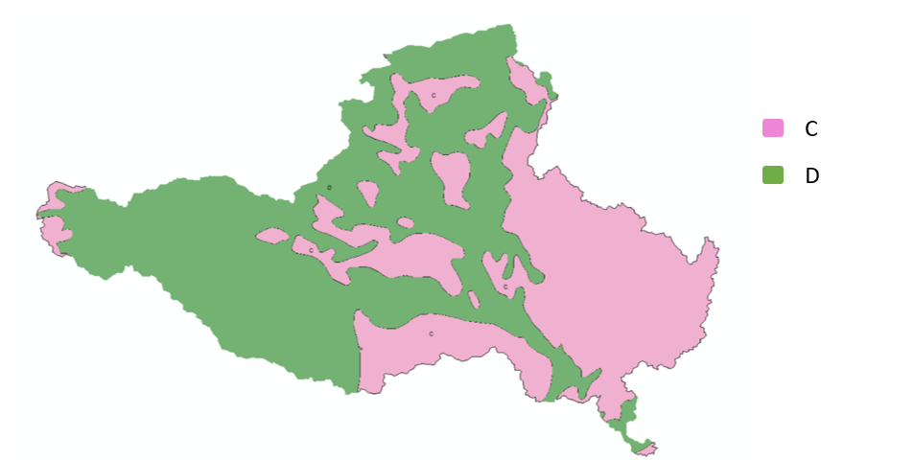
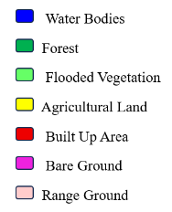
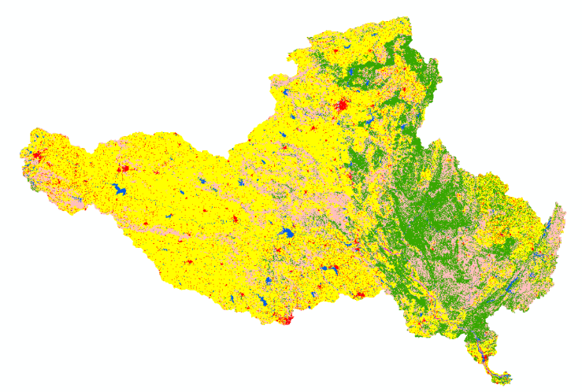
07 | Results & Discussion — LULC Change & Soil Type
LULC change maps for Godavari Basin - 2017 (top) and 2024 (Bottom).
Soil Classification and Hydrologic Soil Group Map of Godavari Basin
16

Slide 18
07 | Results & Discussion — LULC Change & Soil Type
LULC | HSG | AREA_2017_km² | AREA_2024_km² | Change in area_km² | overall change_km² | Curve number | CN_2017 | CN_2024
water bodies | C | 1963.35 | 2276.79 | 313.44 | 460.98 | 100 | 0.62 | 0.72
water bodies | D | 4239.29 | 4386.84 | 147.54 |  | 100 | 1.34 | 1.39
forest | C | 36160.50 | 33036.98 | -3123.52 | -12550.92 | 70 | 8.03 | 7.34
forest | D | 34183.48 | 24756.08 | -9427.40 |  | 77 | 8.35 | 6.05
flooded vegetation | C | 60.67 | 37.58 | -23.09 | -51.00 | 100 | 0.02 | 0.01
flooded vegetation | D | 111.07 | 83.15 | -27.91 |  | 100 | 0.04 | 0.03
Agricultral | C | 16433.00 | 18275.97 | 1842.97 | 5453.88 | 82 | 4.27 | 4.75
Agricultral | D | 150295.09 | 153906.00 | 3610.91 |  | 86 | 41.00 | 41.99
bulit up | C | 2598.67 | 3616.92 | 1018.25 | 3740.73 | 94 | 0.77 | 1.08
bulit up | D | 5679.57 | 8402.05 | 2722.48 |  | 95 | 1.71 | 2.53
bare ground | C | 114.37 | 61.21 | -53.16 | -204.39 | 79 | 0.03 | 0.02
bare ground | D | 409.85 | 258.63 | -151.22 |  | 84 | 0.11 | 0.07
rangeground | C | 27740.43 | 29054.27 | 1313.84 | 3148.09 | 74 | 6.51 | 6.82
rangeground | D | 35252.95 | 37087.20 | 1834.25 |  | 80 | 8.95 | 9.41
 |  | 315242.29 | 315239.67 |  |  |  | 81.76 | 82.20
17

Slide 19
07 | Results & Discussion – Curve Number and Runoff Trends
SCS-CN Runoff Estimation
Composite CN & Impact
Weighted Composite CN:
81.76
82.20
2017
2024
+0.44 ↑
CN Increase
Higher CN → Basin more runoff-prone due to forest loss, urban growth & agriculture intensification
↑
Higher rainfall × higher CN = significantly amplified peak inflows at SACB during monsoon
Sustainability Implication: Increasing runoff, higher CN values, and rising rainfall collectively elevate pond levels at SACB faster during monsoon - posing greater risks to gate operations, downstream scour, sediment deposition, and structural safety. Continuous AI/ML-based forecasting is essential.

Slide 20
07 | Results & Discussion - LSTM
Performance Evaluation
Metric | Value | Interpretation
R² — Training | 0.935 | Very good training fit
R² — Testing | 0.621 | Moderate performance
ΔR² (Gap) | 0.314 | Significant overfitting
RMSE | 253,829 cusecs | High prediction error
MAE | 161,083 cusecs | Large deviation
Bias | +20,905 cusecs | Slight over-prediction
NSE | 0.621 | Marginally acceptable
Key Observation
Testing performance remained below acceptable threshold (R² < 0.65)
Indicates limited generalization capability

Slide 21
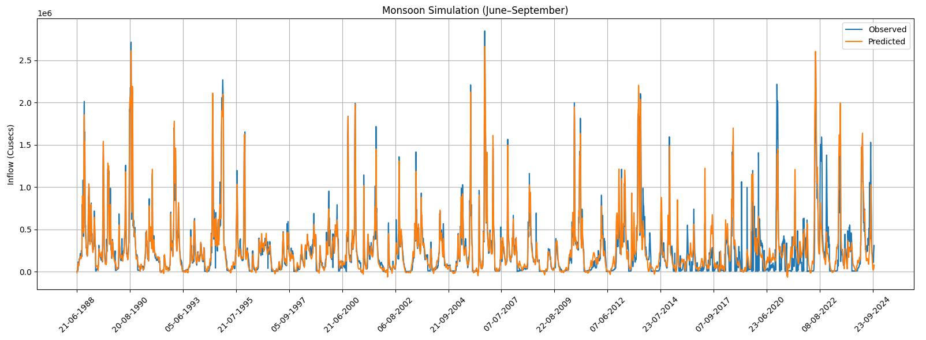
06 | Results & Discussion - LSTM
Training Phase Results
Training R² = 0.935
Excellent fitting during training phase
Model captured approximately:
93.5% variance in observed inflow
Observed (blue) vs Predicted Inflow(orange) -Training Phase (1988-2017)

Slide 22
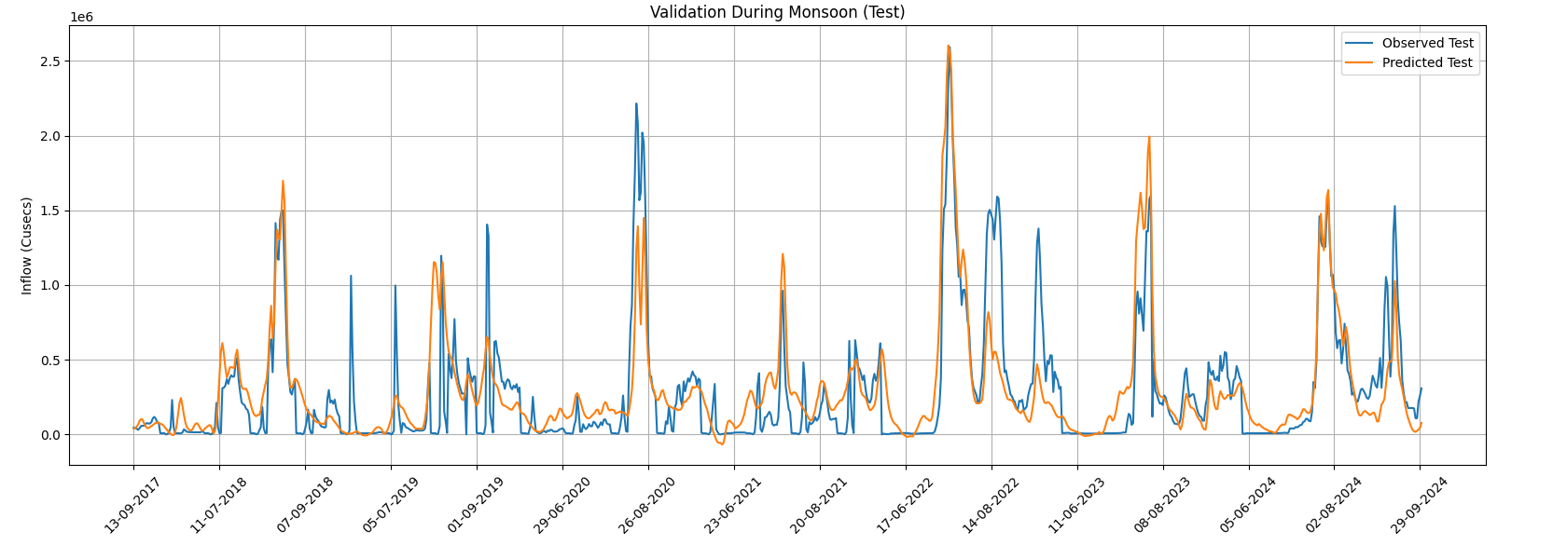
07 | Results & Discussion - LSTM
Testing Phase Performance
Testing R² = 0.621
R² <0.65 is not recommended
Evidence of Overfitting
Training–Testing Gap:
ΔR² = 0.314
Strong memorization of training data
Weak generalization to unseen data
Extreme monsoon events are:
Highly nonlinear
Non-stationary
Difficult to model using standard LSTM architecture
Observed (blue) vs Predicted Inflow(orange) -Testing Phase (2017-2024)

Slide 23
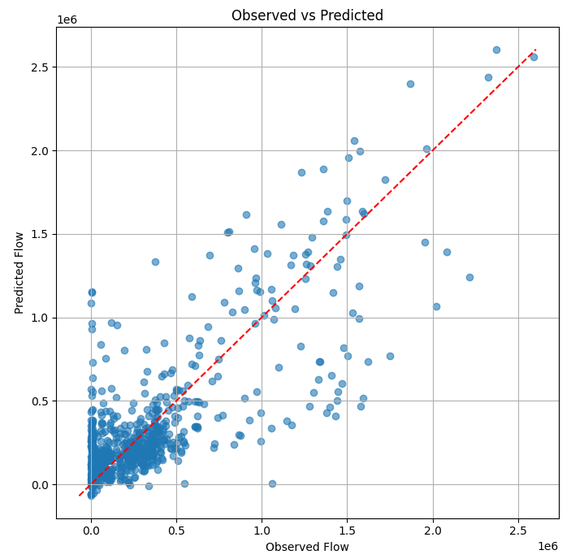
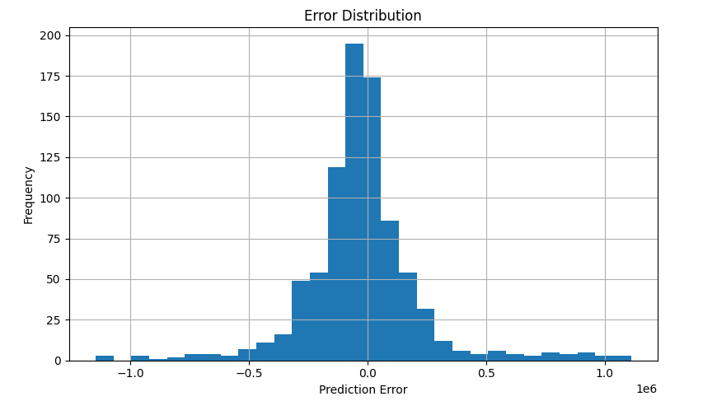
07 | Results & Discussion - LSTM
Error Distribution - LSTM Test Phase
Scatter Plot — Observed vs Predicted Inflow
Key Findings
Low and moderate flows has closely aligned with 1:1 line and better prediction accuracy
High discharge region large scatter observed and significant prediction errors
Interpretation
LSTM performs well under normal hydrological conditions
Performance degrades during Flood events and Extreme monsoon inflows
Distribution Characteristics
Approximately bell-shaped distribution and centered near zero
Limitation
Long tails extending to ±1 × 10⁶ cusecs
Indicates presence of large outlier errors and poor prediction during extreme flood events

Slide 24
07 | Results & Discussion – Genetic Programming
Model Development
GP model evolved using:
Population-based symbolic regression -2000
Evolutionary optimization
Total optimization iterations:
800 generations
Further refined using:
Nelder–Mead constant optimization
Best-Fit GP Symbolic Equation
f(X) = (0.0547 × ((√|√|−0.0827|| × (X₆₁ + |−1.3866|)) + X₆₀)) + √|(((( √|−0.0899| × (X₅₀ + X₅₀)) + √|√|−0.0278||) × ((X₅₃ + √|((√|−1.3662| × |X₁₅₄|) + (√|X₁₇₇| × |X₅₀|))|)) × √|−0.0821|)) × −0.0341)|
Variable | Hydrological Meaning
X60 | Previous inflow (lag 1)
X61 | Inflow trend (lag 1)
X50 | Basin rainfall (lag 1)
X53 | 5-day accumulated rainfall (lag 1)
X154 | Baseflow ( lag3)
X177 | 5 day accumulated rainfall (lag 3)
Final Model Characteristics
Best symbolic equation:
44-node mathematical expression
Selected based on:
Maximum testing R²
Minimum complexity penalty

Slide 25
07 | Results & Discussion - Genetic Programming
GP Model Performance
Metric | Training | Testing
RMSE | 1,04,176.75 | 1,52,361.95
MAE | 60,345.95 | 80,227.66
R² | 0.915 | 0.867
NSE | 0.915 | 0.867
Bias | 1,616 | 8,110
Correlation | 0.9566 | 0.9337
Performance Category
According to Moriasi et al. (2007):
R² ≥ 0.85 → Very Good
Key Findings
Excellent testing performance
Very small train-test gap:
ΔR² = 0.048
Indicates:
Strong generalization
Negligible overfitting

Slide 26
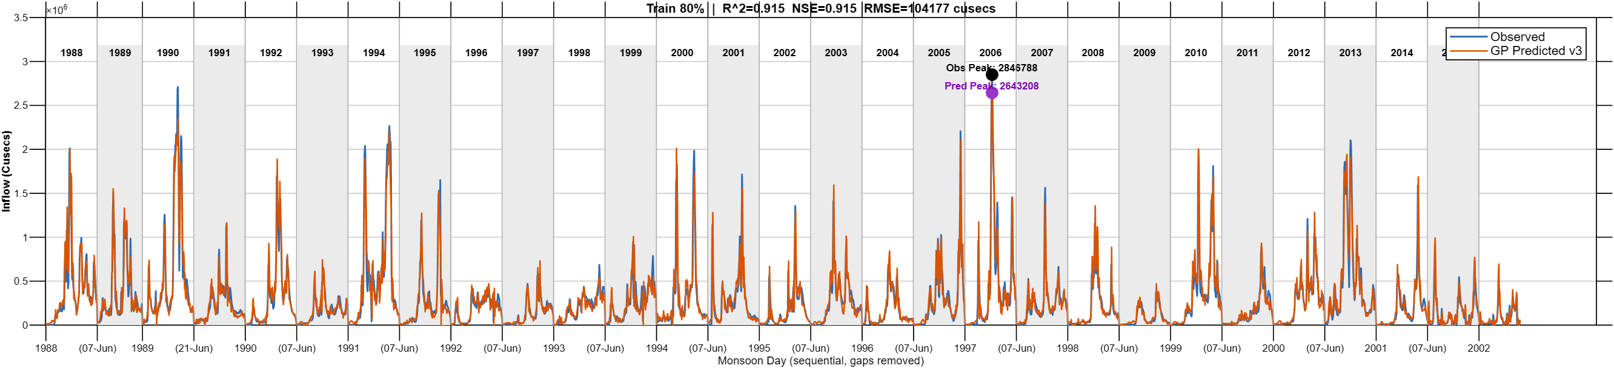
07 | Results & Discussion - Genetic Programming
The GP model accurately captured overall basin hydrology, including low flows, high flows, and seasonal monsoon variability, achieving strong training performance with R² = 0.915, NSE = 0.915, and RMSE = 1,04,177 cusecs.
The model successfully reproduced major flood events, including the 2006 peak monsoon inflow, with only ~7.2% prediction error, demonstrating excellent capability in simulating rainfall–runoff dynamics.
Training Phase - Observed (blue) vs GP Predicted Inflow(orange)

Slide 27
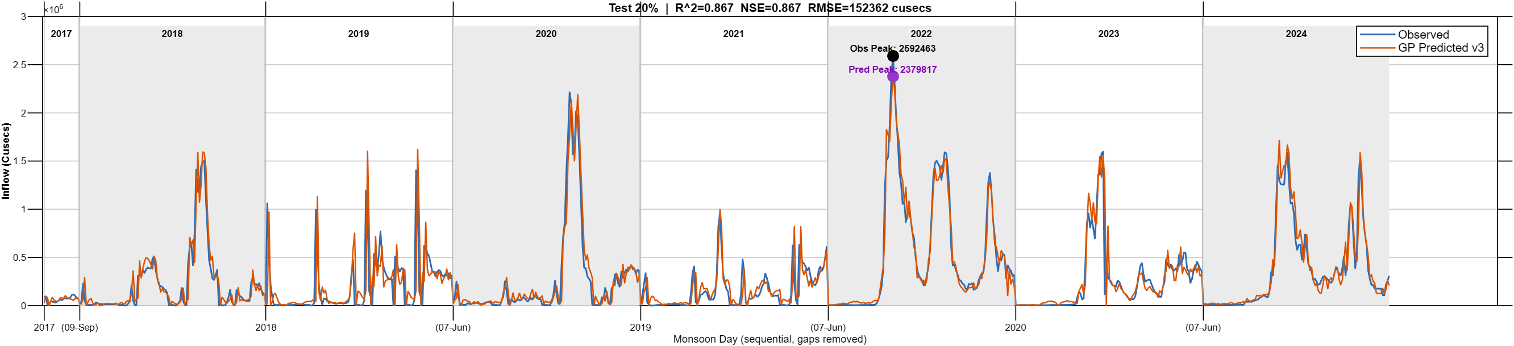
07 | Results & Discussion - Genetic Programming
The GP model demonstrated strong generalization capability by accurately reproducing inter-annual inflow variability and extreme monsoon events under independent test conditions, achieving R² = 0.867 and NSE = 0.867.
During the extreme 2022 monsoon event, the model predicted a peak inflow of 2,379,817 cusecs against the observed 2,592,463 cusecs, resulting in only ~8.2% error.
Testing Phase - Observed (blue) vs GP Predicted Inflow(orange)

Slide 28
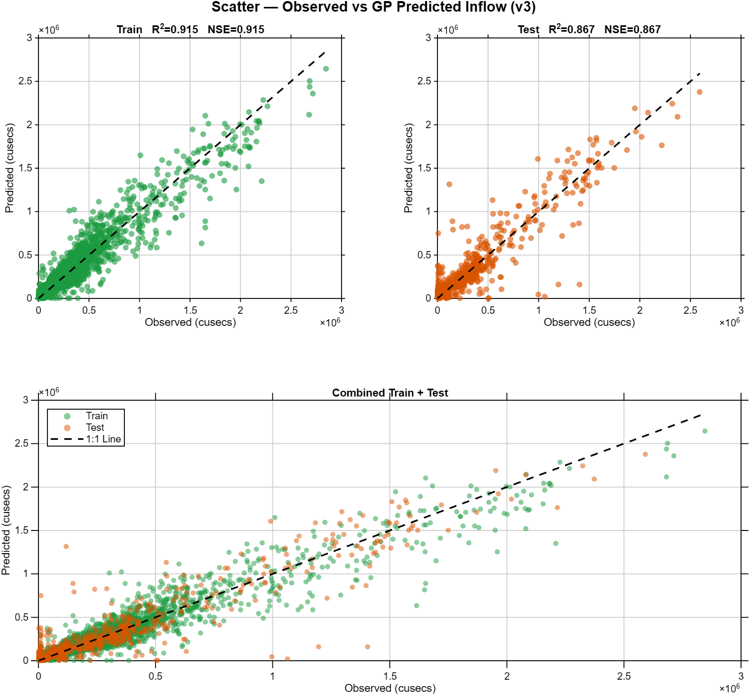
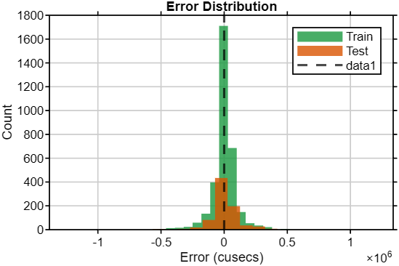
07 | Results & Discussion - Genetic Programming
Error Distribution
Scatter Plot — Observed vs GP Predicted Inflow
The error distribution is approximately normal and centered around zero, indicating stable model performance with no significant systematic prediction bias.
The scatter plot shows that most observed and GP-predicted inflow values lie close to the 1:1 reference line, indicating high prediction accuracy and strong model generalization across both normal and extreme flow conditions.

Slide 29
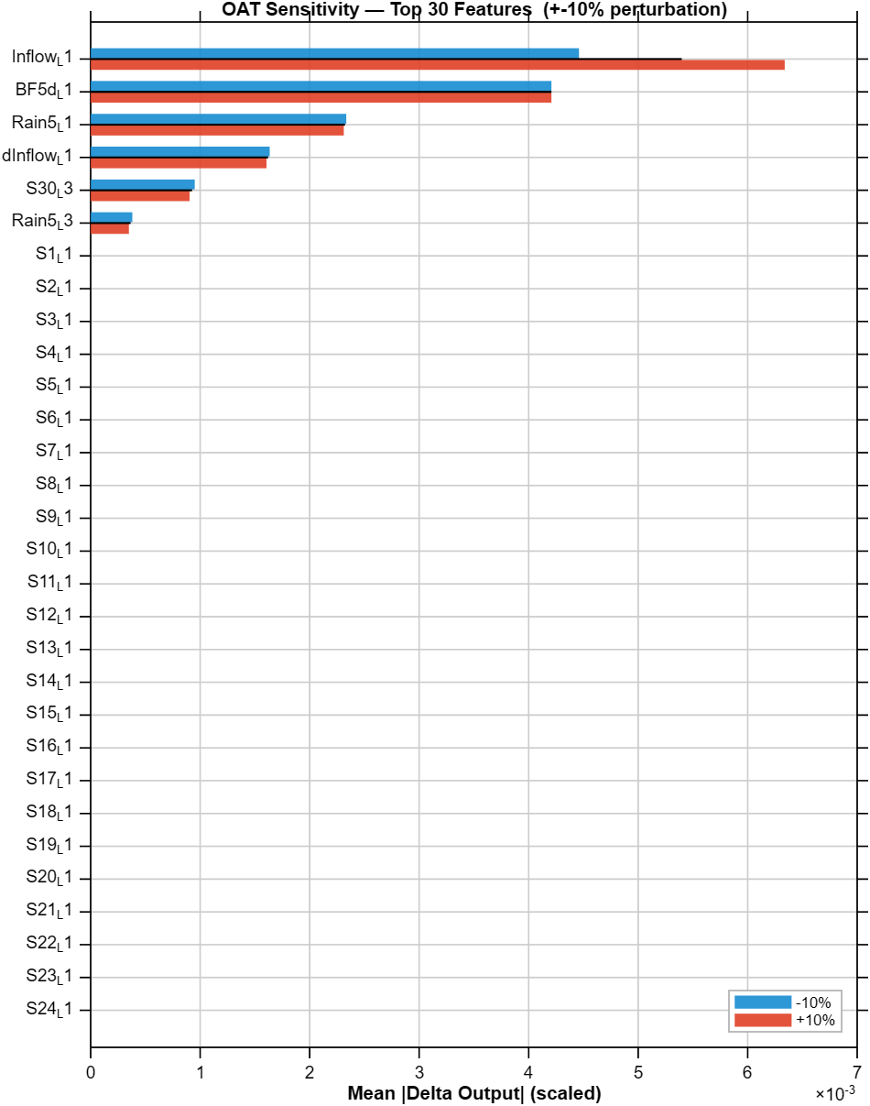
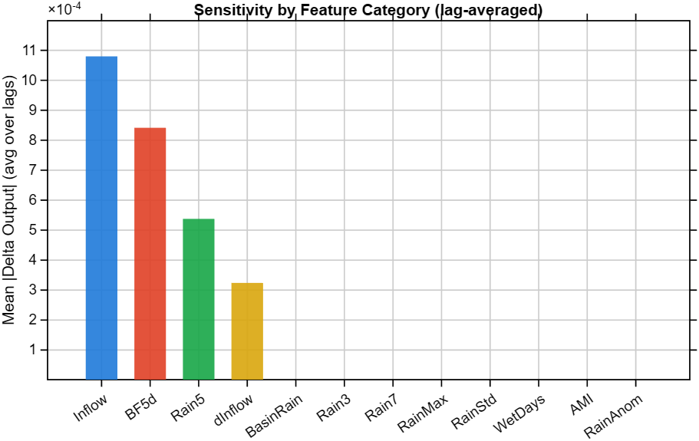
07 | Results & Discussion - Genetic Programming
The OAT sensitivity analysis identified previous day inflow, baseflow, 5-day rainfall, and inflow trend as the most influential predictors controlling inflow at the barrage.
Sensitivity results showed that lag-1 variables contributed more than 90% of the total model sensitivity, while higher-order lags had minimal influence.
The analysis confirms that inflow prediction is strongly governed by flow persistence, antecedent rainfall, and reservoir storage dynamics.
Sensitivity by Feature Category
OAT Sensitivity (+10% red, -10% blue)

Slide 30
07 | Results & Discussion – Comparison of LSTM and GP Models
Metric | LSTM | GP | Improvement
Test R² | 0.621 | 0.867 | +39.6%
ΔR² | 0.314 | 0.048 | Reduced 84.7%
RMSE | 2,53,829 | 1,52,362 | -40%
MAE | 1,61,083 | 80,228 | -50.2%
NSE | 0.621 | 0.867 | +39.6%
Overfitting | Severe | Negligible | Resolved
Interpretability | Black-box | Explicit Equation | Significant
Major Findings
GP significantly outperformed LSTM
Overfitting issue resolved
Better flood prediction capability
Fully interpretable mathematical model

Slide 31
08 | Conclusions
Spatial rainfall trend analysis (1988–2024) revealed heterogeneous and non-stationary monsoon behaviour across the Godavari Basin, with most stations showing decreasing rainfall trends.
LULC analysis (2017–2024) showed expansion of agricultural and built-up areas, increasing runoff generation potential within the catchment.
The LSTM model effectively captured nonlinear rainfall–runoff relationships and produced strong inflow predictions using antecedent hydrological features.
The GP model generated physically interpretable rainfall–runoff equations, helping identify dominant hydrological controls governing inflow behavior.
Sensitivity analysis identified previous inflow, 5-day accumulated rainfall, and inflow trend as the most influential variables affecting SAC Barrage inflow.
Comparative analysis showed that LSTM achieved higher predictive accuracy, especially during high-flow monsoon periods, while GP provided better interpretability and operational transparency.

Slide 32
09 | Limitations
Model Generalization
Rainfall Representation
L1
Limited future generalization due to non-stationary monsoon behavior and dependence on historical training data.
L2
Use of 49 rain gauge stations over a very large basin may introduce interpolation uncertainty in some sub-basins.
Physical Process Exclusion
GP Functional Limitation
L3
Models do not explicitly include reservoir operations, Groundwater interaction, Evapotranspiration which may affect low-flow prediction accuracy.
L4
GP may struggle to learn highly nonlinear threshold-based relationships that are better handled by LSTM memory mechanisms.

Slide 33
10 | Future Scope
Future inflows at the SAC Barrage can be predicted for the period 2025–2075 by integrating LSTM and GP models with CMIP6 climate change scenarios, helping assess long-term climate impacts on water resources in the Godavari Basin.
The developed data-driven models can be combined with process-based hydrological models such as SWAT to incorporate physical processes including groundwater recharge, evapotranspiration, and upstream reservoir operations.
Future studies can investigate long-term land-use and land-cover changes using remote sensing datasets such as Landsat and Sentinel-2 to understand interactions between climatic variability and catchment dynamics.

Slide 34
09 | References
1
Antar, M.A., et al. (2006). Rainfall–runoff modelling using artificial neural networks technique: Blue Nile catchment case study. Hydrological Sciences Journal, 51(6), 1012–1025.
2
Central Water Commission & NRSC. (2014). Godavari Basin Report, Version 2.0. Government of India.
3
Hochreiter, S. & Schmidhuber, J. (1997). Long Short-Term Memory. Neural Computation, 9(8), 1735–1780.
4
Koza, J. (1992). Genetic Programming: On the Programming of Computers by Means of Natural Selection. MIT Press.
5
Liong, S.Y., et al. (2002). Genetic programming: A new paradigm in rainfall–runoff modeling. Journal of the American Water Resources Association, 38(3), 705–718.
6
Mann, H.B. (1945). Nonparametric tests against trend. Econometrica, 13(3), 245–259.
7
Potapov, P., et al. (2022). Global maps of cropland extent and change show accelerated cropland expansion in the twenty-first century. Nature Food, 3, 19–28.
8
Savic, D.A., et al. (1999). Genetic programming technique for calibrating rainfall-runoff models. Nordic Hydrology, 30(3), 233–250.
9
Sen, P.K. (1968). Estimates of the regression coefficient based on Kendall's tau. Journal of the American Statistical Association, 63(324), 1379–1389.
10
Subramanya, K. (2008). Engineering Hydrology (3rd ed.). Tata McGraw-Hill, New Delhi.
11
Verma, R.K., et al. (2021). SCS-CN-based improved models for direct surface runoff estimation. Water Resources Management, 35, 2151–2167.
12
Yokoo, K., et al. (2021). Exploration of LSTM model for rainfall-runoff with catchment properties. Water, 13(22), 3193.

Slide 35
Thank You

