Slide 1

Hydrological Impact Analysis on Sir Arthur Cotton Barrage
BTP PHASE 1
Name: S.Lakshmi Srija
Roll no: 2201CE63
B.tech 4th Year
Civil and Environmental Engineering
Indian Institute of Technology, Patna
Supervisor
Dr. Om Prakash
Assistant Professor
Indian Institute of Technology, Patna

Slide 2
TABLE OF CONTENTS
Introduction
Literature Review
Methodology
Results
Conclusion

Slide 3
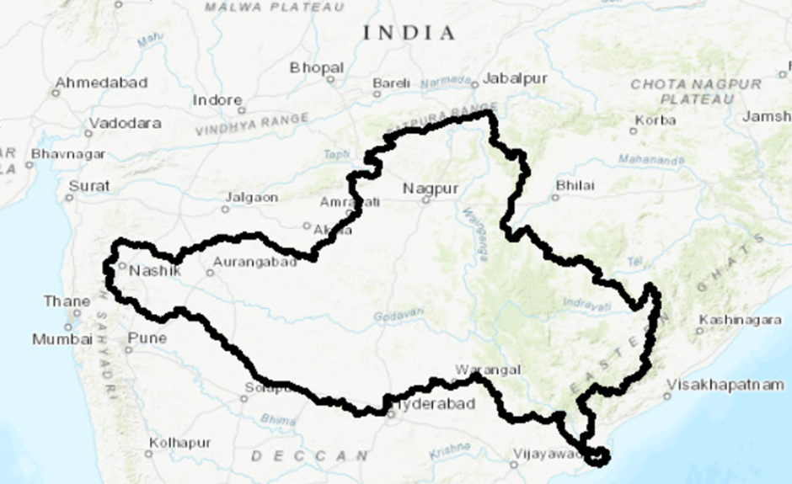
INTRODUCTION
IMPORTANCE OF CATCHMENT & SIR ARTHUR COTTON BARRAGE
The Godavari River Basin (≈3.13 lakh km²), the second largest in India, covers multiple states and sustains millions of people through agriculture, domestic water supply, industry, hydropower, and irrigation. The catchment plays a vital role in controlling how rainfall transforms into runoff, sediment transport, and downstream inflows.

Slide 4
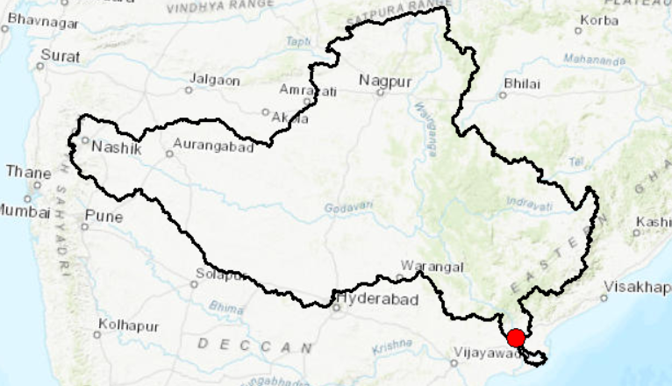
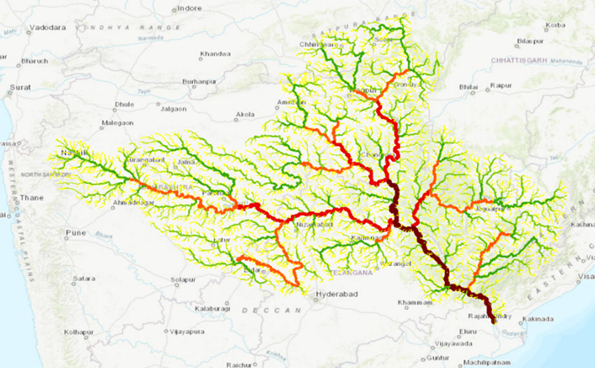
At the basin’s downstream end lies the Sir Arthur Cotton Barrage (SACB) at Dowlaiswaram, located in the East Godavari District of Andhra Pradesh at 16°56'15" N latitude and 81°46'12" E longitude. Originally constructed as an anicut in 1852 and later reconstructed as a modern barrage in 1982, SACB serves as the lifeline of the Godavari Delta. It supports irrigation across more than 10 lakh acres, regulates monsoon floods, and sustains the agricultural and socioeconomic systems of the delta. Any changes in rainfall patterns, monsoon intensity, or land use/land cover (LULC) within the upstream catchment directly influence the barrage’s inflows, sediment load, flood behavior, operational safety, and long-term sustainability.
Understanding catchment processes is therefore essential for predicting future water availability, flood risks, sedimentation patterns, and the long-term functioning of SACB.

Slide 5
WHAT IS HAPPENING TO CLIMATE AND LAND USE AND LAND COVER?
The Godavari Basin has been experiencing significant climatic variability and land use transformation in recent decades. More than 80% of the annual rainfall occurs during the monsoon, and studies show increasing extreme rainfall events, higher rainfall intensities, and changing monsoon behavior driven by climate change.
Simultaneously, the basin is undergoing rapid Land Use/Land Cover (LULC) changes, including agricultural expansion, urbanization, deforestation, and wetland reduction. These shifts reduce infiltration, increase impervious areas, raise Curve Numbers (CN), and accelerate surface runoff.
Together, climate change and LULC alterations modify the natural hydrological balance, increase flood peaks, and alter sediment transport directly affecting the water flow reaching the Sir Arthur Cotton Barrage.

Slide 6
SUSTAINABILITY CONCERNS
SACB is 43 years old (1982–2025).
Increasing runoff threatens:
Gate operations
Pond-level regulation
Downstream scour protection
Sediment deposition upstream
Structural safety
Long-term sustainability requires:
Understanding future rainfall
Predicting LULC impacts
Estimating future runoff
Forecasting pond-level variations
Adopting AI/ML models for runoff and pond level prediction

Slide 7
LITERATURE REVIEW
WHY IS THIS STUDY NEEDED?
Climate change and catchment modifications significantly alter rainfall intensity, runoff generation, sediment load, and river hydrology, all of which directly influence barrage operations.
Studies on the Godavari Basin exist on geophysical features, streamflow–sediment decline, and temperature changes and rainfall trends, LULC, SCS-CN runoff, and dam hydrology exist for other river basins , but none integrate rainfall trends, LULC, SCS-CN runoff, and SAC Barrage hydrology into one comprehensive analysis.
Despite its importance, limited research exists on how future climate change, evolving LULC patterns, and runoff changes will impact SACB.
Because no earlier study brings all these factors together, we truly need a detailed hydrological assessment that helps us understand what is happening today, what risks may arise in the future, and how we can protect the long-term sustainability of the Sir Arthur Cotton Barrage.

Slide 8
OBJECTIVES OF THE STUDY
CLIMATE TREND ANALYSIS
Analyze long-term rainfall patterns.
Use statistical methods: Sen’s Slope.
Understand how climate variability is altering basin hydrology.
LULC CHANGE DETECTION
Use ArcGIS to derive LULC maps.
Detect changes in urbanization, agriculture, forests, and water bodies.
Examine how these changes modify infiltration and runoff potential.
RUNOFF ESTIMATION USING SCS–CURVE NUMBER METHOD
Assign Curve Numbers based on year-wise LULC and soil groups.
Compute runoff and analyze long-term patterns.
Quantify hydrological shifts affecting barrage inflow.
FORECASTING WATER-LEVEL CHANGES IN SACB
Use statistical or AI/ML models (ANN/LSTM/GRU) to predict future pond levels.
Evaluate combined effects of climate change + LULC modifications on SACB

Slide 9
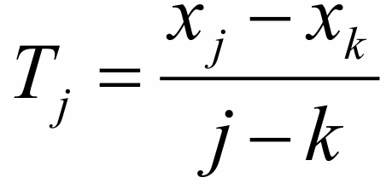
METHODOLOGY
To understand how climate change is affecting the Godavari Basin, we analyze both annual rainfall and monsoon seasonal rainfall (>80% of total rainfall). We use IMD gridded rainfall data and apply Sen’s Slope Test to detect long-term trends.
Why Sen’s Slope? Sen’s Slope is a robust, non-parametric method that calculates the rate of change in rainfall over time. Using all pairwise slopes:
The median of these slopes gives the trend (increase or decrease). This helps quantify whether rainfall is rising, falling, or stable over decades.
CLIMATE CHANGE (RAINFALL) ANALYSIS

Slide 10
LAND USE & LAND COVER ANALYSIS
To study how the catchment is physically changing, we perform a GIS-based LULC analysis using ArcGIS.
.
This helps us observe how urbanization, agriculture expansion, and deforestation influence infiltration and runoff potential.
What we do in ArcGIS:​
Process satellite images for different years (e.g: 2017, 2024)​
Classify into land categories: Forest, Agriculture, Built-up, Waterbodies, Barren ground, Range ground.​
Generate change-detection maps​
Extract area statistics for each class​
Calculate Curve Numbers (CN) based on LULC + soil groups

Slide 11
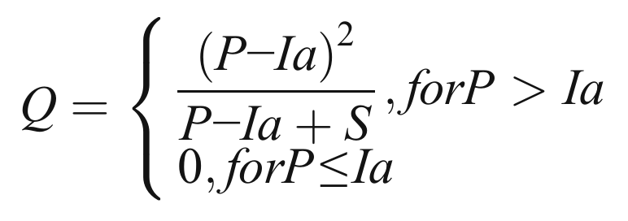
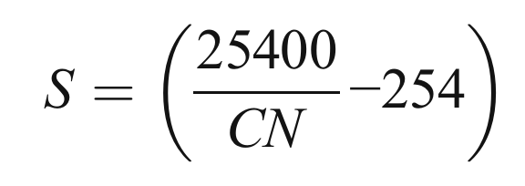

RUNOFF ANALYSIS
The SCS-CN method, developed by the U.S. Soil Conservation Service, is widely used to estimate direct runoff from rainfall events. It links rainfall, land use, soil type, and watershed conditions to derive runoff in a simple but robust way.
Runoff Equation:
where Q=direct runoff,P=cumulative precipitation for event, S = potential maximum retention and λ=initial abstraction coefficient.

Slide 12
RESULTS
ANNUAL RAINFALL TREND (SEN’S SLOPE ANALYSIS)
Increasing Trend

Slide 13
MONSOON RAINFALL

Slide 14
WHY MONSOON RAINFALL ONLY?
More than 80% of total annual rainfall occurs during the monsoon season (June–September).
Thus, monsoon rainfall is the dominant driver of runoff generation in the Godavari Basin.
Non-monsoon rainfall contributes very little and does not significantly affect annual flow into SAC Barrage.
Therefore, monsoon-only rainfall is used for a more accurate hydrological trend analysis.
Clear positive trend in monsoon seasonal rainfall over the decades.

Slide 15
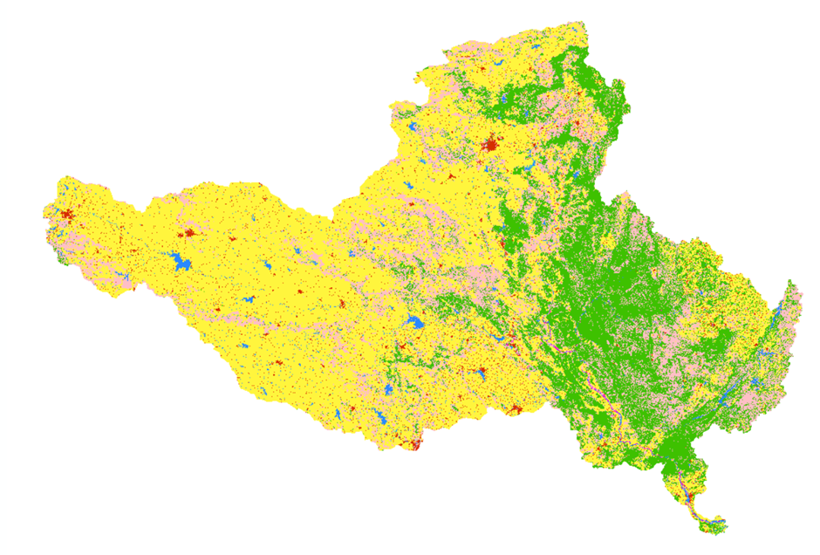
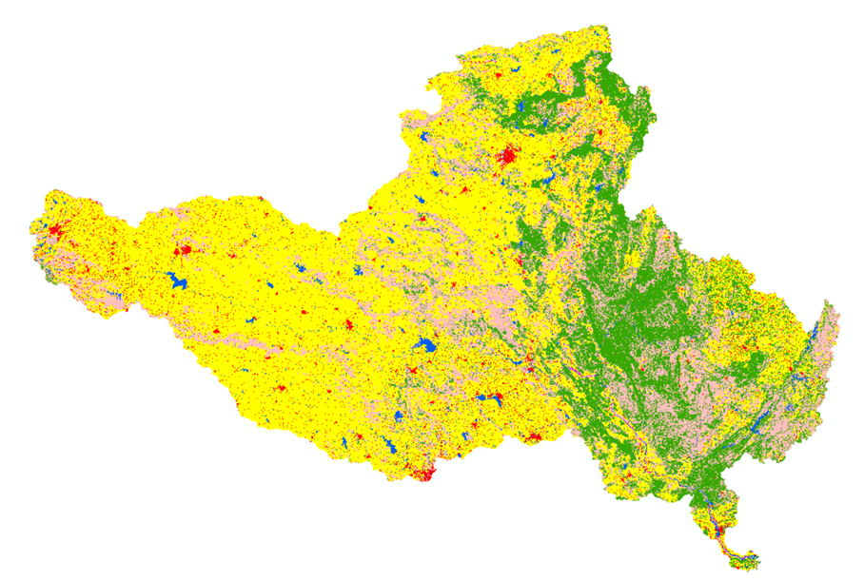
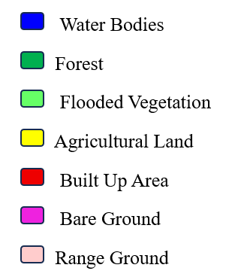
2017 AND 2024 LAND COVER AND LAND USE
2017
2024

Slide 16
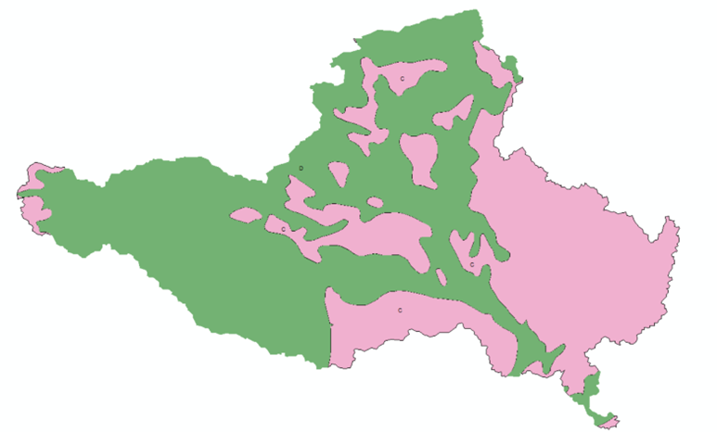
HYDROLOGICAL SOIL GROUPS
Godavari basin has significant HSG C & D, contributing to runoff.
These have low infiltration → higher runoff.

Slide 17
OBSERVATIONS FROM LCLU, HSG AND ESTIMATE CURVE NUMBER
LULC | HSG | AREA_2017_km² | AREA_2024_km² | Change in area_km² | overall change_km² | Curve number | CN_2017 | CN_2024
water bodies | C | 1963.35 | 2276.79 | 313.44 | 460.98 | 100 | 0.62 | 0.72
water bodies | D | 4239.29 | 4386.84 | 147.54 |  | 100 | 1.34 | 1.39
forest | C | 36160.50 | 33036.98 | -3123.52 | -12550.92 | 70 | 8.03 | 7.34
forest | D | 34183.48 | 24756.08 | -9427.40 |  | 77 | 8.35 | 6.05
flooded vegetation | C | 60.67 | 37.58 | -23.09 | -51.00 | 100 | 0.02 | 0.01
flooded vegetation | D | 111.07 | 83.15 | -27.91 |  | 100 | 0.04 | 0.03
Agricultral | C | 16433.00 | 18275.97 | 1842.97 | 5453.88 | 82 | 4.27 | 4.75
Agricultral | D | 150295.09 | 153906.00 | 3610.91 |  | 86 | 41.00 | 41.99
bulit up | C | 2598.67 | 3616.92 | 1018.25 | 3740.73 | 94 | 0.77 | 1.08
bulit up | D | 5679.57 | 8402.05 | 2722.48 |  | 95 | 1.71 | 2.53
bare ground | C | 114.37 | 61.21 | -53.16 | -204.39 | 79 | 0.03 | 0.02
bare ground | D | 409.85 | 258.63 | -151.22 |  | 84 | 0.11 | 0.07
rangeground | C | 27740.43 | 29054.27 | 1313.84 | 3148.09 | 74 | 6.51 | 6.82
rangeground | D | 35252.95 | 37087.20 | 1834.25 |  | 80 | 8.95 | 9.41
 |  | 315242.29 | 315239.67 |  |  |  | 81.76 | 82.20

Slide 18
CURVE NUMBER (SEN'S SLOPE ANALYSIS)
CN values were computed using combined LULC + hydrological soil groups.
.
Higher CN values mean the catchment is becoming more runoff-generating.
Results show a steady increase in weighted CN, driven by:
Loss of natural vegetation
Urban growth
Intensification of agriculture
Increasing Trend

Slide 19
RUNOFF ESTIMATION USING SCS-CN METHOD
Runoff values will be calculated using SCS-CN equations:
Rainfall data (P)
CN values for each year
Initial abstraction (Ia = 0.2S)
Retention parameter (S from CN)
Expected outcomes:
Higher rainfall and higher CN gives significantly higher runoff
Increased inflow peaks at SACB during monsoon

Slide 20
CONCULSION
Rainfall analysis shows an increasing trend, leading to higher inflow peaks. Since more than 80% of the annual rainfall occurs during the monsoon, even small increases in monsoon rainfall significantly increase runoff entering the barrage.
LULC change has increased impervious areas and raised Curve Numbers, making the catchment more runoff-prone. In addition, a significant decrease in forest cover has reduced infiltration capacity, further contributing to higher runoff generation.
Runoff (SCS-CN) is rising due to the combined effects of climate change + LULC modification, and the growth of impervious surfaces is further amplifying this increase. Higher runoff is likely to elevate pond levels at SACB faster during monsoon.
Future comparison of predicted runoff and forecasted pond levels will help identify potential flood risks and operational challenges for SACB. We are also exploring whether isolated sub-catchments within the basin are not contributing to runoff peaks.
Overall, hydrological pressures on SACB are increasing, making continuous monitoring and forecasting essential for long-term sustainability.

Slide 21
REFERENCES
Central Water Commission & NRSC. (2014). Godavari Basin Report Version 2.0. Government of India. LINK
Subramanya, K. (2008). Engineering Hydrology (3rd ed.). Tata McGraw-Hill.
Sudarsan, G., & Lasitha, A. (2023). Rainfall trend analysis using Mann–Kendall and Sen’s slope test: A case study for Kerala. E3S Web of Conferences, 405, 04013. Source
Verma, R., Verma, S., Mishra, S., & Pandey, A. (2021). SCS–CN based improved models for direct surface runoff estimation. Water Resources Management, 35, 2151–2167. Source
Walch, G. T. (1870). The Engineering Works of the Godavari Delta. Government of Madras.

