Slide 1


IBM PBEL (Project-Based Experiential Learning) Virtual Training
Loan Approval
Prediction System
A Machine Learning Approach to Automated, Consistent, and Transparent Lending Decisions
Submitted by: Srijeta Sahu
Under the guidance of: Mr. Shubham Pathak
18 July 2026
Notes:
1.7.2013
Good morning/afternoon everyone. My name is Srijeta Sahu, and today I'll be presenting my capstone project from the AIML Summer Internship 2026 at IIHMF, MNNIT Allahabad - the Loan Approval Prediction System, developed under the guidance of Mr. Subhash Chaganti. This project applies machine learning to one of the most common financial decisions banks make every day - whether to approve or reject a loan application.
1
‹#›

Slide 2


INTRODUCTION
Why Automate Loan Approval?
1
Loan officers traditionally review documents, verify income, and assess credit history manually
2
Manual review is slow, costly, and inconsistent across officers
AI & ML in Finance
3
Human bias can creep into decisions, creating fairness and legal concerns
Predictive models can analyze many variables at once, spot complex patterns in historical data, and deliver consistent, repeatable decisions at scale — making ML a natural fit for automating loan approvals.
4
Growing application volumes make manual review difficult to scale
Loan Approval Prediction System
2
Notes:
1.7.2013
Let's start with why this problem matters. Banks process loan applications every single day, and traditionally this is a manual process — loan officers review documents, verify income sources, and check credit history by hand. This has real limitations: it's slow, it's expensive to staff, different officers can evaluate the same application differently, and unconscious human bias can creep in. As application volumes grow, this simply doesn't scale. That's where machine learning comes in — it can look at many variables simultaneously and make fast, consistent, data-driven decisions.
2
‹#›

Slide 3


THE CHALLENGE
Problem Statement & Objectives
The Problem
Project Objectives
Processing delays of days to weeks
Conduct thorough EDA on the dataset
Inconsistent officer-to-officer decisions
Preprocess data: handle missing values & encoding
Unconscious bias & legal exposure
Train & compare 3 classification algorithms
Poor scalability, high operating cost
Evaluate using accuracy, precision, recall, F1
No transparency for applicants
Deploy the best model as a Streamlit web app
Loan Approval Prediction System
3
Notes:
1.7.2013
So what exactly are the problems we're solving? On the left, you can see the key pain points in traditional loan processing — delays, inconsistency, bias, scalability issues, and a lack of transparency for applicants. On the right are our project objectives: we wanted to conduct thorough exploratory data analysis, properly preprocess the data, train and compare three different classification algorithms, evaluate them rigorously, and finally deploy the best-performing model as a usable web application.
3
‹#›

Slide 4
METHODOLOGY
Dataset Overview
614
13
68.7%
7 of 13
Applicant Records
Total Features
Approved (Y)
Columns with Missing Values
Source: Kaggle Loan Prediction Dataset (by altruistdelhite04)
Demographic:
Gender, Married, Dependents, Education, Self-Employed
Financial:
Applicant Income, Co-applicant Income, Loan Amount, Loan Term, Credit History
Property:
Property Area (Urban / Semiurban / Rural)
Loan Approval Prediction System
4
Notes:
1.7.2013
We used the Kaggle Loan Prediction Dataset — 614 applicant records with 13 features, mixing demographic, financial, and property-related attributes, with the target being loan approval status. Roughly 69% of applications in the dataset were approved, so there was a mild class imbalance. Seven of the thirteen columns had missing values that we needed to handle carefully before modeling.
4
‹#›

Slide 5


METHODOLOGY
Data Preprocessing & Algorithms
Preprocessing Pipeline
1
Missing values: mode imputation for categorical columns, median for LoanAmount (robust to outliers)
2
Label encoding: converted all categorical variables to numeric form
3
Train-test split: 80/20 split → 491 training, 123 test samples (random_state = 42)
Three Algorithms Compared
Logistic Regression
Random Forest
XGBoost
Sigmoid-based probability model; efficient & interpretable
Ensemble of decision trees; robust to overfitting
Sequential boosted trees with regularization
Loan Approval Prediction System
5
Notes:
1.7.2013
For preprocessing, we handled missing values using mode imputation for categorical columns and median imputation for loan amount, since median is more robust to outliers. All categorical variables were label-encoded into numeric form, and we split the data 80-20 into training and test sets. We then trained and compared three classification algorithms: Logistic Regression, Random Forest, and XGBoost — all using the same features and split for a fair comparison.
5
‹#›

Slide 6
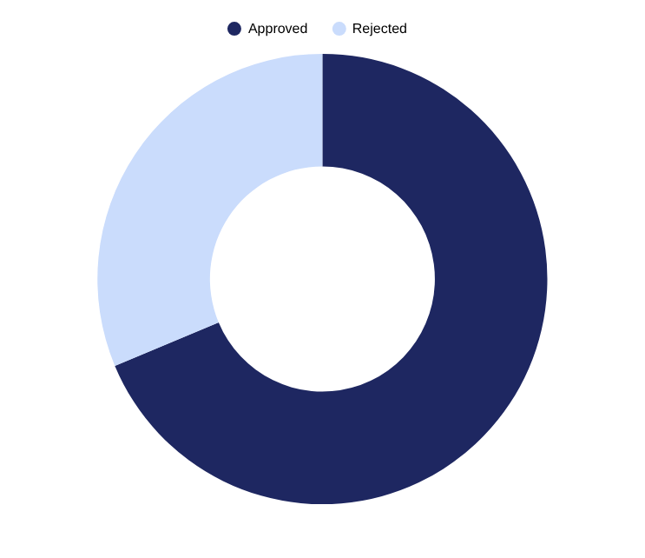

IMPLEMENTATION
Exploratory Data Analysis — Key Insights
Credit History Dominates
Strongest correlation with approval — 0.54; good-credit applicants show 79%+ approval rate
Education Matters
Graduate applicants show meaningfully higher approval rates than non-graduates
Property Area
Semiurban applicants show slightly higher approval rates
Income Distribution
Applicant income and loan amount are right-skewed; most applicants earn under ₹10,000/month
Loan Approval Prediction System
6
Notes:
1.7.2013
Our exploratory analysis revealed some clear patterns. About 69% of applications in the dataset were approved. The single strongest predictor of approval was credit history — it had a correlation of 0.54 with loan status, and applicants with good credit history had a 79% or higher approval rate. Education level also mattered — graduates had noticeably higher approval rates. Property area played a smaller role, with semiurban applicants doing slightly better. Both income and loan amount were right-skewed, meaning most applicants had modest incomes.
6
‹#›

Slide 7
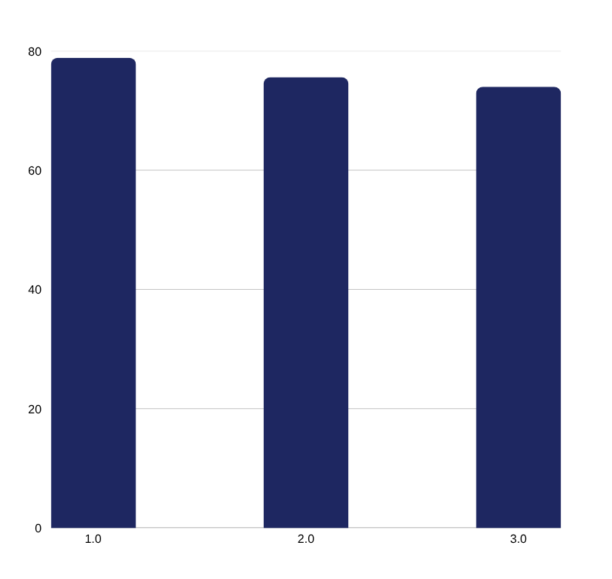
RESULTS
Model Performance Comparison
Model | Accuracy | Precision | Recall | F1 Score
Logistic Regression | 78.86% | 0.83 | 0.79 | 0.76
Random Forest | 75.60% | 0.80 | 0.76 | 0.73
XGBoost | 73.98% | 0.78 | 0.74 | 0.71
Logistic Regression achieved the best overall performance — evaluated on a held-out test set of 123 samples.
Loan Approval Prediction System
7
Notes:
1.7.2013
Here are the head-to-head results on our held-out test set of 123 samples. Logistic Regression came out on top with 78.86% accuracy, followed by Random Forest at 75.6%, and XGBoost at just under 74%. It also led on precision, recall, and F1-score. This might be a bit surprising, since XGBoost and Random Forest are generally considered more powerful models — I'll explain why the simpler model won on the next slide.
7
‹#›

Slide 8

RESULTS
Why the Simpler Model Won
Classification Report — Logistic Regression
Comparative Analysis
Class | Precision | Recall | F1 | Support
0 (Rejected) | 0.95 | 0.42 | 0.58 | 43
1 (Approved) | 0.76 | 0.99 | 0.86 | 80
Overall Accuracy | 0.83 | 0.79 | 0.79 | 123
Small dataset (614 records) limits ensemble methods from reaching full potential
Complex models like XGBoost can overfit — learning noise instead of patterns
The loan approval task is approximately linearly separable
Note: Recall for rejected loans (0.42) is a known limitation — the model favors approving loans, missing some true rejections.
Linear models naturally outperform non-linear ones in this case
Loan Approval Prediction System
8
Notes:
1.7.2013
Why did Logistic Regression win? Two main reasons. First, with only 614 training samples, the dataset is quite small — ensemble methods like Random Forest and XGBoost need more data to realize their full potential, and can actually overfit on smaller datasets by learning noise rather than real patterns. Second, the loan approval task turns out to be approximately linearly separable, meaning a straight decision boundary does a good job separating approved from rejected applications — which favors linear models like Logistic Regression. Looking at the detailed classification report, one honest limitation is recall on rejected loans — only 0.42 — meaning the model tends to lean toward approving loans and misses some applications that should be rejected. That's an important caveat for real-world deployment.
8
‹#›

Slide 9


IMPLEMENTATION
Deployment — Streamlit Web Application
From Notebook to Production
What the App Does
Interactive form with dropdowns & number inputs for all 11 features
Two-column layout for efficient use of screen space
Real-time predictions with green / red visual indicators
Train Model
Serialize (pickle)
Streamlit App
Live Prediction
Numerical probability score with confidence progress bar
Run locally with: python -m streamlit run app.py
Modern gradient background, frosted-glass card design
Model: Logistic Regression, 78.86% accuracy — serialized with Python pickle
Built-in tip highlighting the importance of credit history
Loan Approval Prediction System
9
Notes:
1.7.2013
The final model was deployed as an interactive Streamlit web application. Users fill in an applicant's details through dropdowns and number inputs, and the app returns a real-time prediction — approved or rejected — along with a probability score and a confidence bar. The pipeline is straightforward: train the model, save it with Python's pickle library, load it in the Streamlit app, and serve live predictions. This turns a notebook experiment into something an actual bank employee or loan officer could use.
9
‹#›

Slide 10

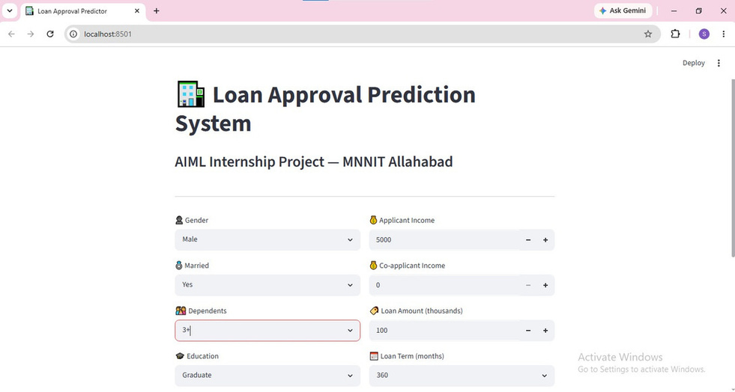
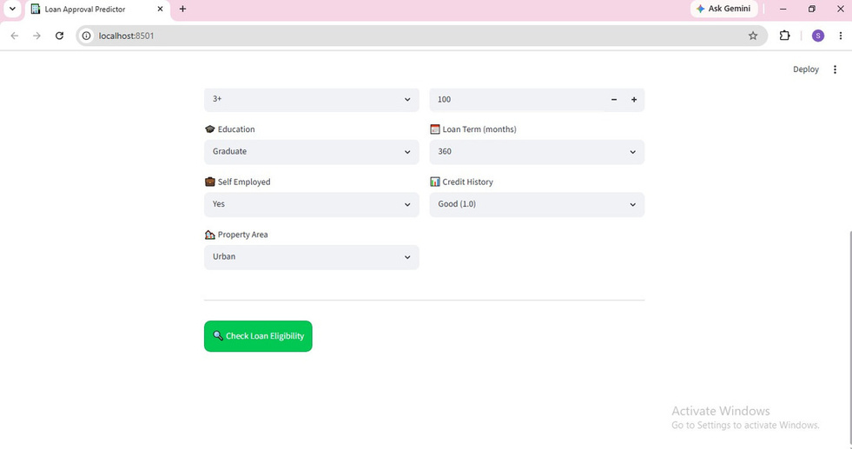
IMPLEMENTATION
Live Demo — Filling the Application
Applicant details — top of form
Remaining fields + Check Loan Eligibility button
Running locally at localhost:8501 — Streamlit form lets users select applicant details via dropdowns and steppers for each of the 11 input features.
Loan Approval Prediction System
10
Notes:
1.7.2013
Here's the actual application running locally on my machine at localhost:8501. On the left you can see the top portion of the input form — gender, marital status, dependents, income fields. On the right is the rest of the form — education, self-employment, credit history, property area — along with the Check Loan Eligibility button. The form uses simple dropdowns and number steppers, so it's easy for a non-technical user, like an actual loan officer, to fill in an applicant's details.
10
‹#›

Slide 11
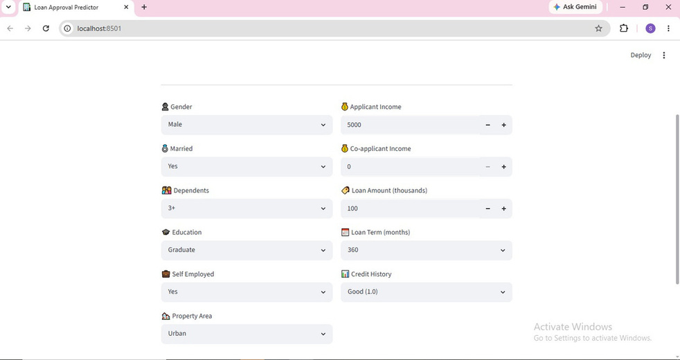
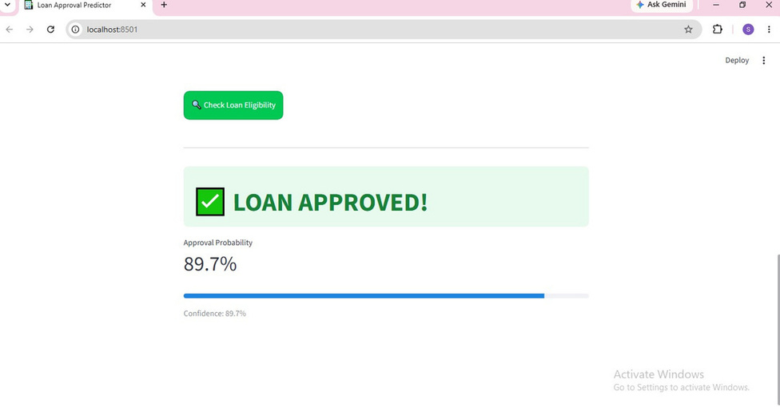
IMPLEMENTATION
Live Demo — Prediction Result
Completed form — all 11 fields filled in
Prediction output — Approved, 89.7% confidence
The model correctly leans toward approval here — strong credit history and graduate education are the two biggest positive signals from our analysis.
Loan Approval Prediction System
11
Notes:
1.7.2013
After clicking Check Loan Eligibility, the app returns a real-time prediction. On the left is the fully completed form — you can see all 11 fields filled in, including good credit history and urban property area. On the right is the result: Loan Approved, with an 89.7% approval probability shown alongside a confidence bar. This lines up with our analysis — strong credit history and graduate education are the two strongest positive signals for approval, so a high-confidence approval here is exactly what we'd expect from the trained model.
11
‹#›

Slide 12



DISCUSSION
Key Findings
Credit History Dominance
Education Impact
Income Synergy
0.54 correlation with approval — good-credit applicants are ~4x more likely to be approved
Graduate applicants show significantly higher approval rates
Combined applicant + co-applicant income matters more than either alone
Property Location
Model Complexity
Semiurban properties show the highest approval rates (better collateral value)
For small, structured datasets, simpler interpretable models can match or beat complex ensembles
Loan Approval Prediction System
12
Notes:
1.7.2013
To summarize the key findings: credit history is by far the dominant predictor — good-credit applicants are roughly four times more likely to be approved. Education level matters too, with graduates seeing higher approval rates. Interestingly, it's the combined income of applicant and co-applicant that matters most, not just one person's income. Semiurban properties saw the highest approval rates, likely due to collateral value. And the broader takeaway: for small, structured datasets like this one, simpler and more interpretable models can match or even outperform complex ensemble methods.
12
‹#›

Slide 13

WRAP-UP
Conclusion & Future Scope
Future Scope
Conclusion
This project demonstrated the complete ML lifecycle — from raw data to a deployed web application. Logistic Regression achieved the best performance at 78.86% accuracy, reinforcing that model complexity should match dataset size. Credit history emerged as the dominant predictive factor, and the Streamlit app provides a real, usable foundation for a loan pre-screening tool.
Short-term:
Hyperparameter tuning, SMOTE for class imbalance, debt-to-income feature, k-fold CV
Medium-term:
CIBIL score integration, cloud deployment, SHAP-based explainability
Long-term:
Live banking API integration, deep learning, regional-language & mobile support
Loan Approval Prediction System
13
Notes:
1.7.2013
In conclusion, this capstone project successfully covered the full machine learning lifecycle — from raw data all the way to a deployed, interactive web application. Logistic Regression was the best performer at 78.86% accuracy, reinforcing an important principle: match model complexity to your dataset size. Credit history stood out as the single most important predictive factor. Looking ahead, there's a clear roadmap: short-term improvements like hyperparameter tuning and handling class imbalance with SMOTE; medium-term work like integrating real CIBIL scores and deploying to the cloud; and a longer-term vision involving live banking API integration, deep learning, and mobile and regional-language support to make this accessible to a much wider audience.
13
‹#›

Slide 14
Thank You
Srijeta Sahu
IBM PBEL Virtual Training (Batch :4)
Notes:
1.7.2013
Thank you for listening. That concludes my presentation on the Loan Approval Prediction System. I'm happy to take any questions — whether about the modeling choices, the results, or the deployment.
14
‹#›

