Slide 1

BME 573- iPhone Programming for Medical Applications
BLE GROUP
Srijita Banerjee
Scott Dow
Shambhavi Sharma
Nikita Yadunath

Slide 2
Overview
Progress so far (as of last Friday, 11/11/16)
Programmed Simblee via Arduino to send fake ECG data
Future plans
Program various BLE modules to send data in order to compare performance

Slide 3
Fake ECG Program Overview:
Continually loop through the list of 241 fake ECG values that Dr. Strey provided
Store each value in a 10 data points long= buffer (or 20 bytes long, since unsigned ints take up 2 bytes)
When buffer is full, send it and clear it for the next batch of values

Slide 4
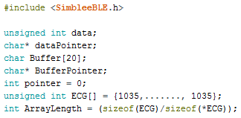
Initialization
data is an unsigned int which holds each incoming value.
dataPointer points to data. Char so that we can focus byte by byte on data.
Buffer is a 20 byte character array which can store 10 unsigned ints.
BufferPointer points to an element of Buffer. Which element depends – we iterate over Buffer.
pointer is an int used to keep track of which element BufferPointer points to.
ECG is a list of fake ECH values.
ArrayLength is the length of ECG.

Slide 5
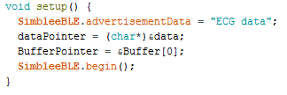
Set Up
Name advertisement data.
Make dataPointer point to data.
Make BufferPointer point to the first element of Buffer (it needs a starting point before being incremented).
Tell the Simblee to begin advertising.

Slide 6
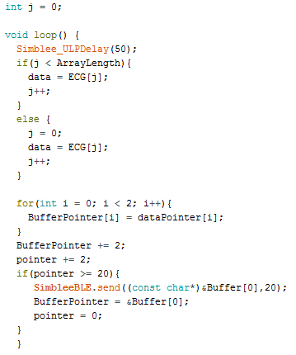
Loop
Delay 50 milliseconds (20 data points per second, or 1 buffer per second)
Starting from j = 0, iterate over j, and if j is less than ArrayLength (241), set data = to ECG[j]. Otherwise, set j = 0 and repeat the process.
Byte by byte, read the data from the data pointer into the the buffer pointer.
Move to the next position in the buffer by incrementing it by 2.
When 10 points have been stored, send, reinitialize, then repeat.

Slide 7

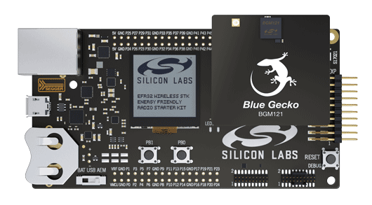
THINGS TO BE DONE IN THE NEAR FUTURE
BGM 121-
Look into BGM 121 because of the following advantages
Smaller size of the headband
Reliable high performance
Low power consumption

Slide 8


TIMER-
To optimize power consumption and system response time in presence of false alarm, timer peripherals can be employed.
LETIMER –
16-bit timer that is available in energy mode EM2 Deep Sleep in addition to EM1 Sleep and EM0 Active.
To perform simple tasks when power consumption is at an absolute minimum.

Slide 9

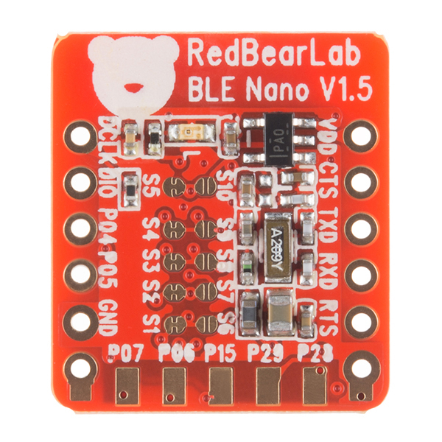
For timing and output generation when powered down.
To output a variety of waveforms with minimal software intervention.
To start counting on compare matches from the Real Time Counter and Calendar
We are also looking into programming
for BLE-Micro and RedBear BLE-Nano.

Slide 10

THANK YOU!!

