Slide 1
Twitter Sentiment Analysis
Sagar Negi 346/CO/12
Shrey Gupta 363/CO/12
Vipul Khullar 393/CO/12

Slide 2
Contents
What is sentiment analysis?
Why is Sentiment Analysis Important?
Using twitter sentiment analysis
Challenges
Approach
Workflow
Requirements

Slide 3
What is Sentiment Analysis?
It is classification of the polarity of a given text in the document, sentence or phrase
The goal is to determine whether the expressed opinion in the text is positive, negative or neutral.

Slide 4
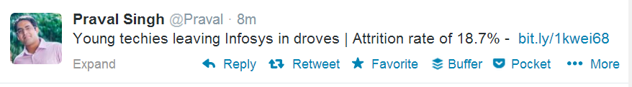
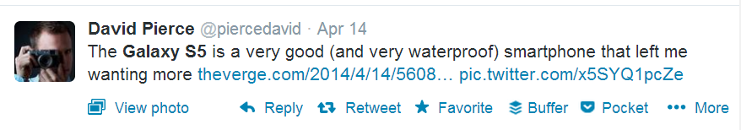
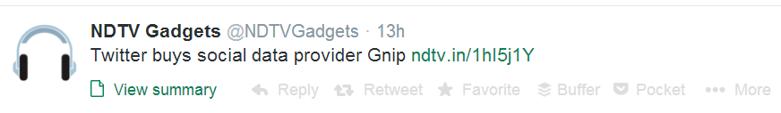
Negative
Positive
Neutral

Slide 5
Why is Sentiment Analysis Important?
Microblogging has become popular communication tool
Opinion of the mass is important
Political party may want to know whether people support their program or not.
Before investing into a company, one can leverage the sentiment of the people for the company to find out where it stands.
A company might want find out the reviews of its products

Slide 6
Using Twitter for Sentiment Analysis
Popular microblogging site
Short Text Messages of 140 characters
240+ million active users
500 million tweets are generated everyday
Twitter audience varies from common man to celebrities
Users often discuss current affairs and share personal views on various subjects
Tweets are small in length and hence unambiguous

Slide 7
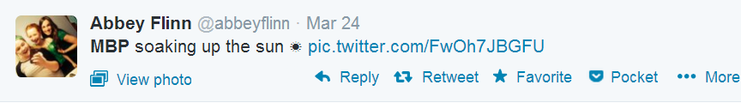
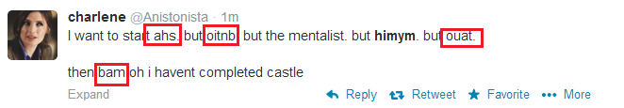
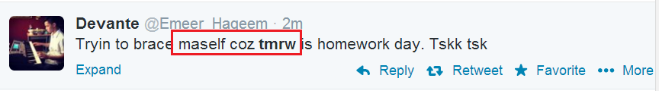
Challenges
Tweets are highly unstructured and also non-grammatical
Out of Vocabulary Words
Lexical Variation
Extensive usage of acronyms like asap, lol, afaik

Slide 8
Approach
Tweet Downloader
Tokeniser
Preprocessing
Feature Extractor
SVM Classifier and Prediction

Slide 9
Approach
Tweet Downloader
Download the tweets using Twitter API
Tokenisation
Twitter specific POS Tagger developed
Preprocessing
Removing non-English Tweets
Replacing Emoticons by their polarity
Remove URL, Target Mentions, Hashtags, Numbers.
Replace Negative Mentions
Replace Sequence of Repeated Characters eg. ‘coooooooool’ by ‘coool’
Remove Nouns and Prepositions

Slide 10
Approach
Feature Extractor
Polarity Score of the Tweet
Number of Positive/Negative Capitalised Words
Number of Positive/Negative Hashtags
Number of Positive/Negative/Extremely Positive/Extremely Negative Emoticons
Number of Negation
Positive/Negative special POS Tags Polarity Score
Number of special characters : ?,!,*
Number of special POS

Slide 11
Classifier and Prediction
The features extracted are next passed on to SVM classifier.
The model built is used to predict the sentiment of the new tweets.

Slide 12
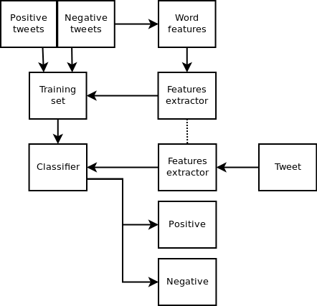
Workflow

Slide 13
Requirements
Python,javascript.
Machine Learning algorithm like naïve Bayes network algorithm, SVM classifiers.
Natural Language Processing Techniques.
Twitter REST API 1.1v.
Oauth API
Flask

