Slide 1

Business Analysis and Solution for IBM Employee Solution
Team Members: -
Aayush Aggarwal (x21232911@student.ncirl.ie)
Karan Kohli (x21179212@student.ncirl.ie )
Rajat Deepak Agrawal (x21172030@student.ncirl.ie )
Srijon Datta (x21225265@student.ncirl.ie )
Supervisor:-
Prof. Vikas Sahni (vikas.sahni@ncirl.ie )

Slide 2
Objective
We have been hired by IBM company to analyse their high attrition problem and provide some business solutions which are both scalable and affordable.
The primary objective of the study is to find out appropriate information about employee attrition in IBM and to study the diverse reasons which are responsible for employee attrition.
To analyze the data collected by exit interview, through structured questionnaires and draw out conclusions.
To ascertain the level of employee engagement, so that sensitive areas prone to attrition could be known.

Slide 3
What is Attrition?
Attrition is decrease in number of employees over times as they leave due to personal reasons or retire.
Every company desires low attrition as it implies that the employees are satisfied with the work environment and it also indicates the strength of company in market.
Disadvantages of Attrition
Decrease in overall performance.
Bad impact on workplace effectiveness and plan of growth in future.
Difficulty in managing tasks(If critical employee leaves).
Increased cost of training for new employees.
Lack of knowledgeable people

Slide 4
Data
We have been hired by the IBM organization as business analysts to analyse the major reasons for the increase in the company's attrition rate and to provide a solution to control that.
Our team has been given the attrition data of the company starting from January 2022 to November 2022.
Our team has been given the company’s attrition data in the form of four different CSV files.
1. Basic information about the employees
2. Employee Company relationship
3. Attrition Factors
4. Employee Feedback

Slide 5
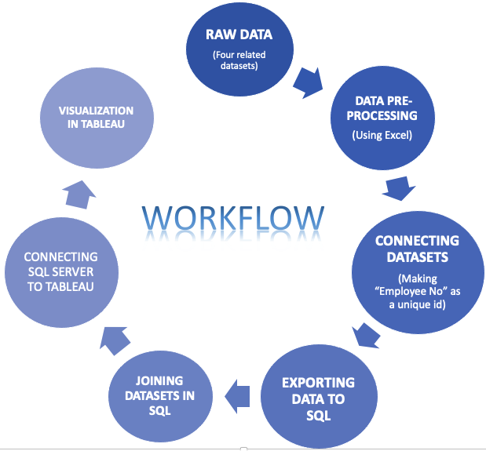
Workflow

Slide 6
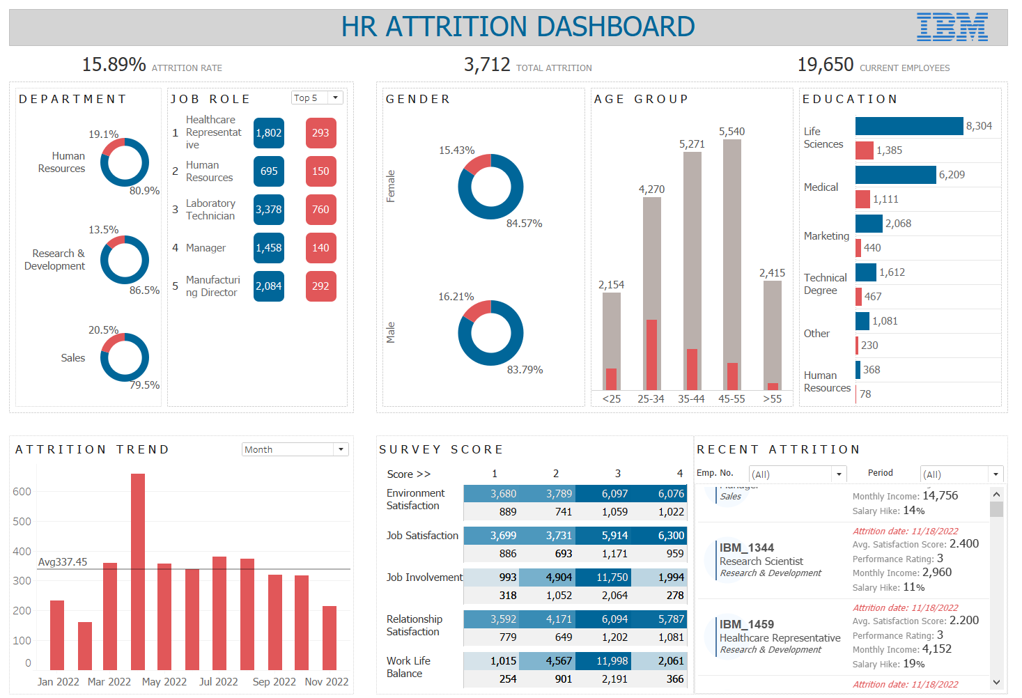
Dashboard

