Slide 1

Application of Data Mining and Machine Learning Models
Presented By –
SRIJON DATTA (x21225265@student.ncirl.ie)
Supervisor:-
Prof. MICHAEL BRADFORD
(Michael.bradford@ncirl.ie )

Slide 2
Objectives :
Build 5 machine learning models (4 classifications and 1 regression) on three different large datasets.
To do a comparison study between the models based on their performances and prediction accuracies for the corresponding dataset.
To identify the best-performed model and how that can be used for prediction analysis in future.

Slide 3
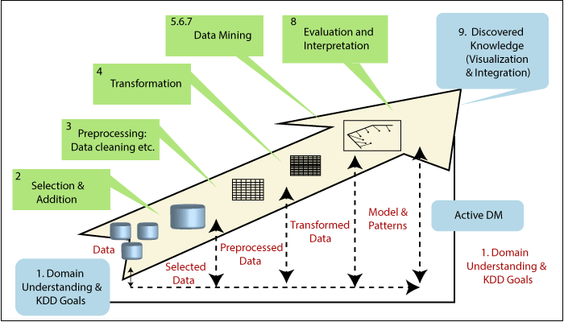
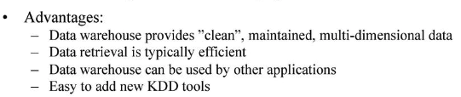
Which Data Mining Methodology has been used?
KDD
(Knowledge Discovery in Databases)

