Slide 1
GAME ANALYSIS ON SQL

Slide 2
What is SQL?
SQL (Structured Query Language) is a standardized programming language used to manage and manipulate relational databases. It enables users to perform various operations such as querying data, inserting new records, updating existing records, and deleting data from databases.
SQL is crucial in database management and plays a pivotal role in data-driven decision-making across industries. Its importance lies in its ability to efficiently retrieve and organize large volumes of data, facilitate data analysis, ensure data integrity through constraints and transactions, and support the development of robust, scalable, and secure database systems, making it an essential tool for businesses and organizations to store, retrieve, and manage their data effectively.

Slide 3
What is this presentation about?
As a part of the internship task at MENTORNESS, we analyzed a dataset related to a game to get an understanding of the involvement of different players and their performances at different levels and stages. We queried the database to answer 15 different problems through which we tried to get an idea about users' performances.
This presentation is not about how we query the database using SQL but identifying the key learnings that we have gained through the task. To understand how we wrote the SQL commands to get the required data table, please refer the SQL file named as ‘GameAnalysisQuery.sql’ written in PostgreSQL using pgadmin4.

Slide 4
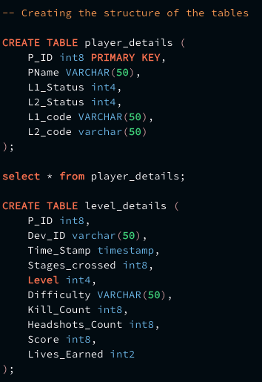
Key learnings
We learned how to change the defined datatypes of a particular field in a database by creating a temporary staging table and then mapping the values to the existing one in the same database.
In our case, the ‘Time_Stamp’ field was defined as the timestamp datatype in the level_details table this contains date and start time of the game for a particular player. But the problem is, the default format of the timestamp datatype in postgresql is ‘YYYY-MM-DD HH:MM:SS’ where as we wanted the format of ‘DD-MM-YY HH:MM’.
To solve this

Slide 5
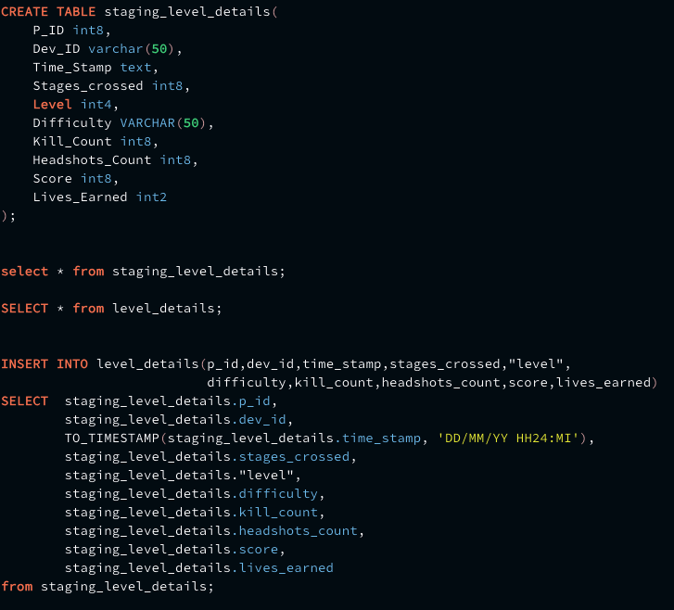
We created a temporary table named ‘staging_level_details’ and defined the datatype of the Time_Stamp as text whereas we kept the datatypes for the other fields same.
Then we changed the datatype from text to timestamp
as per our required format for the time_stamp field and inserted all the data points to the corresponding field in the level_details
table.

Slide 6
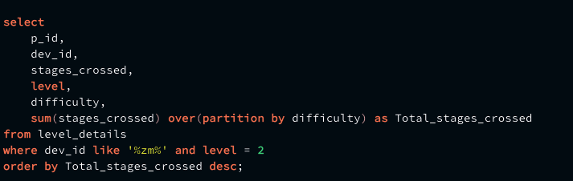
Key learnings
Effective use of the Window Functions in the query. Window functions offer significant advantages such as the ability to calculate running totals, moving averages, rankings, and cumulative sums without requiring self-joins or subqueries, thus improving query efficiency and readability. Window functions also facilitate partitioning data into groups based on specific criteria, allowing for comparisons within these groups.
Here is a simple example where we have
used window function ‘sum’ over the
different ‘difficulty levels’ and
filtered out the data for only Level 2
with players using 'zm_series' devices.

Slide 7
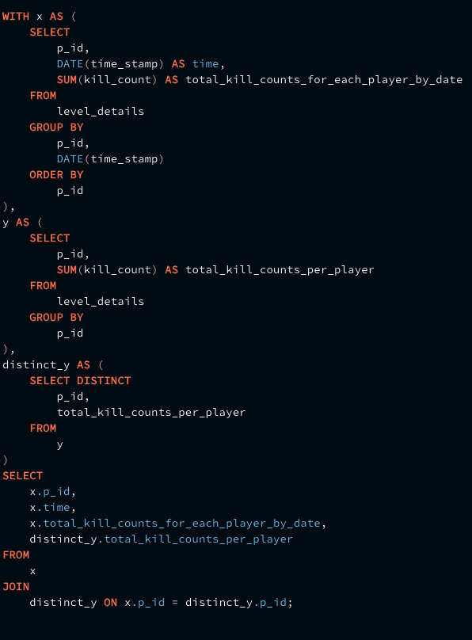
Key learnings
Using multiple CTEs (Common Table Expressions) effectively in a single query.
Here is an example where we have used 3 different
CTEs to get the number of ‘kill_counts’ for each
‘player’ and ‘date’.

Slide 8
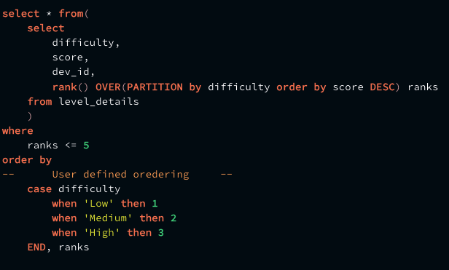
Key learnings
How to use User Defined Ordering.
Here we tried to get top 5 ‘scores’ based on each difficulty level where we want to order the output as the ‘low’ difficulty first, followed by the ‘Medium’ and ‘High’ levels.

Slide 9
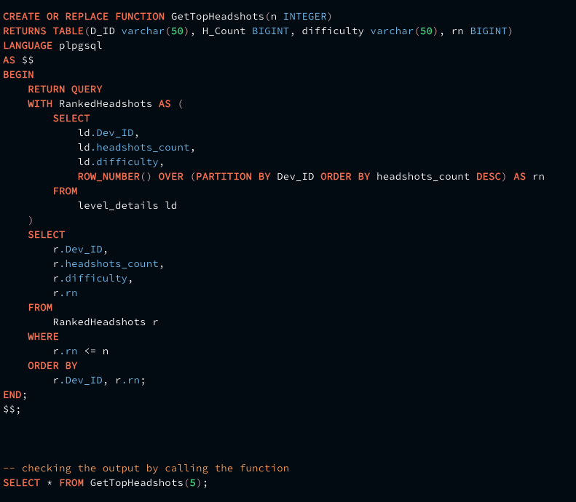
Key learnings
How to create a User Defined Function in SQL.
We created a user-defined function, named as
‘GetTopHeadShots’ to get the top ‘n’ number of `headshots_count` based on each `Dev_ID` and ranked them in increasing order of `Row_Number`.

Slide 10
THANK YOU

