Slide 1

Capstone Project Presentation
Srinivas Jagarlamudi, Mar 2022 Cohort
Mar 2022

Slide 2
Inputs used
Crude Oil Production by Country
Crude Flows from Country to Country for major exporters and importers
Refinery Runs for major refiners
Lost Production capacity due to Refinery Turnarounds (Crude Distillation Unit maintenance)
Inventory levels
Prices for Crude, Naphtha, Gasoil, Gasoline, RBOB and JET (products)

Slide 3
Expected Outputs
The outright Crude prices are difficult to predict. The front month spread, which is the difference between the front month Brent Crude futures contract and the second month Brent futures contract react to the short and medium term supply demand fundamentals in the market.
Hence the column in the data set ‘Brent_Diff’ is chosen as the target variable.
The model is being developed to see if changes in any of the above inputs such as Crude Production, refinery runs, product prices etc can be used to predict this Front month spread.

Slide 4
Types of Models used
The following deep learning models are used to train and predict Brent Differential between the first and second months.
LSTM (Long Short Term Model)
GRU (Gated Recurrent units)
Both of the above are part of the wider Recurrent Neural Networks (RNNs) that can be used for processing sequential data

Slide 5
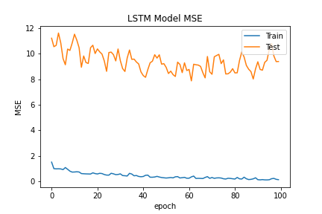
LSTM – Training and Validation Losses

Slide 6
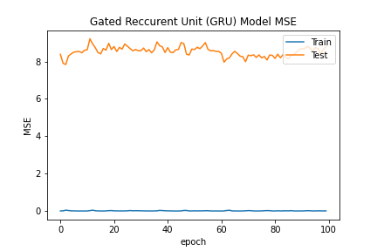
GRU – Training and Validation Losses

Slide 7
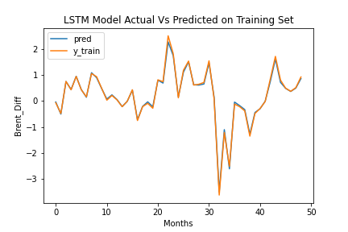
Predictions on Training Set - LSTM
Notes:
Base Line Error: 0.1703

Slide 8
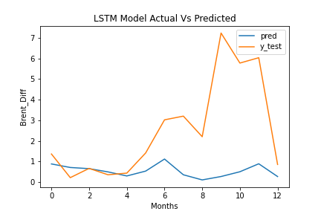
Predictions on Test Set - LSTM
Notes:
Base Line Error: 0.1703

Slide 9
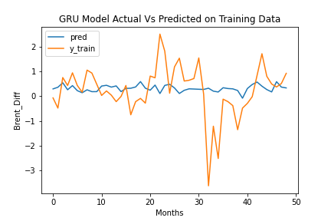
Predictions on Training Set - GRU
Notes:
Base Line Error: 0.1703

Slide 10
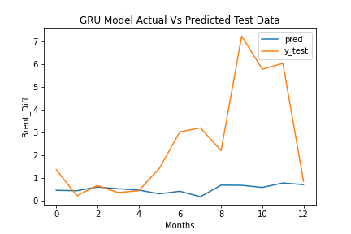
Predictions on Test Set - GRU

Slide 11
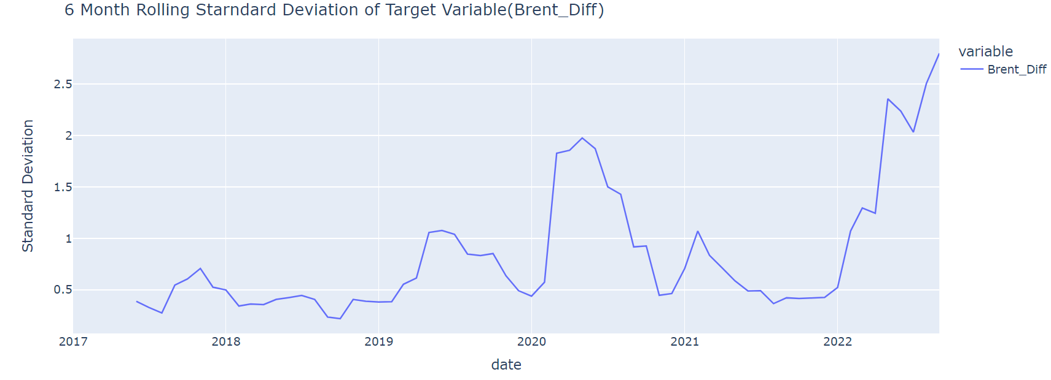
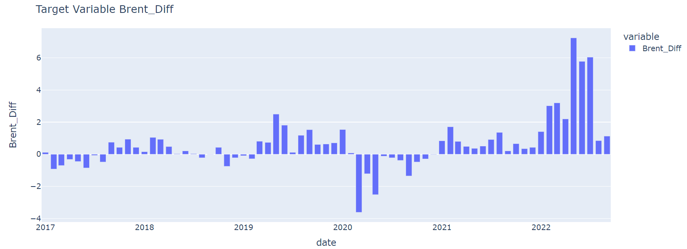
Target Variable Brent Diff volatility has spiked due to the Ukraine war recently

Slide 12
Conclusions
The data is monthly and is only from 2017 to 2022.
Hence there were only 69 monthly data points and hence the training was very limited to the kind of learning the model is expected to do.
The test set includes the period when the Ukraine war started
This may be an outlier event causing the models to underperform on test data
Further improvements can be done with daily granularity, so the model has longer periods to learn and generalize.

