Slide 1
Advanced Linux Sound Architecture

Slide 2
Contents
What is alsa
Drawbacks of OSS
How alsa overcome OSS
ALSA Architecture
Audio Setup
Drawback of ALSA
Sound Servers (Pulse Audio)
Audio Flow using ALSA

Slide 3
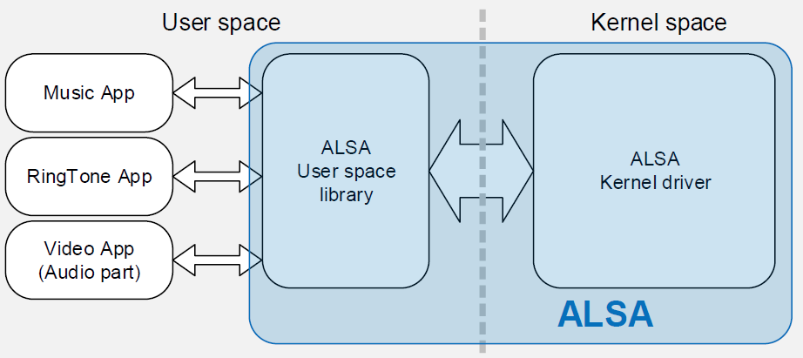
What is ALSA
What is ALSA?
ALSA (Advanced Linux Sound Architecture) is the sound subsystem for Linux.
Provides low-level access to audio devices.
Supports PCM, mixers, and sound cards.
Replaces the older OSS (Open Sound System).
Why ALSA?
Better hardware support
Supports multiple sound streams
Provides APIs for developers
Works with PulseAudio & PipeWire

Slide 4
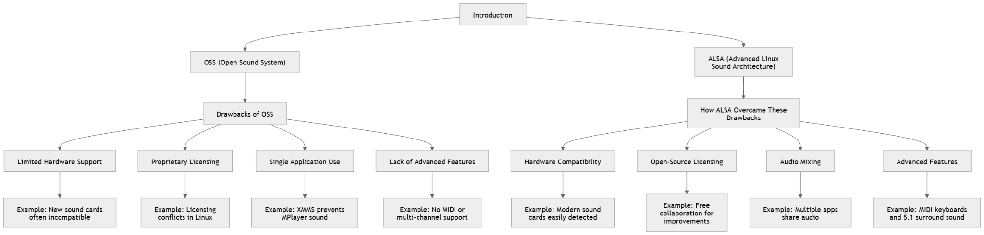
Drawbacks of OSS

Slide 5
How ALSA Overcome These Drawbacks

Slide 6
Real Time Example
Imagine you're a Linux user in the late 1990s:
You're running a Linux system with OSS.
You try to connect a modern sound card, but your system doesn't recognize it (hardware issue).
When you play music , you can't simultaneously hear sounds from a video in VLC (single-app limitation).
You attempt to enjoy 5.1 surround sound in a movie, but it only plays in stereo (no multi-channel support).
Now fast forward to a Linux system with ALSA:
Your new sound card is immediately detected and works flawlessly.
You can play music in the background while watching a tutorial video.
Your home theater setup delivers immersive 5.1 surround sound.

Slide 7
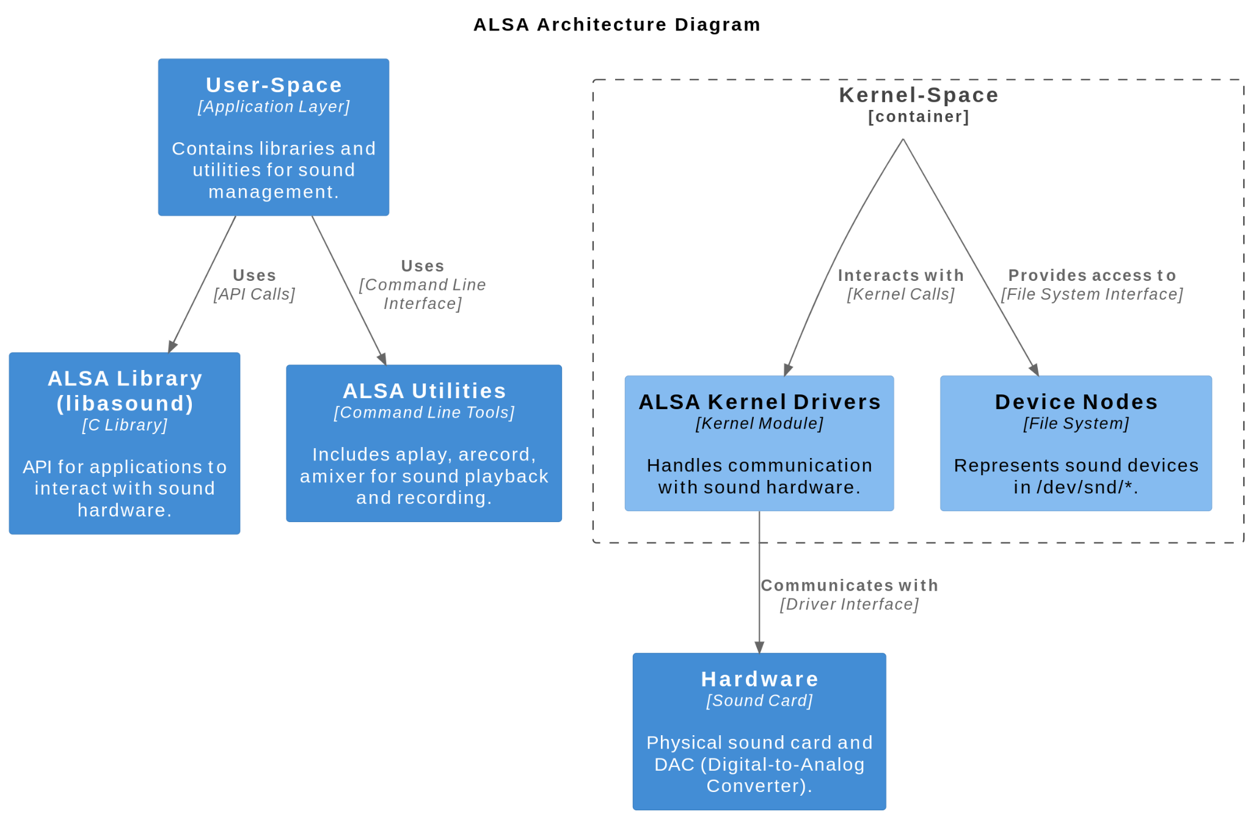
ALSA Architecture
User Space – Where applications interact with ALSA. Examples: VLC, Audacity.
ALSA Library – Bridges applications & kernel drivers.
Function: Simplifies audio management.
ALSA Utilities – Tools for managing sound settings.
Examples: alsamixer, aplay, arecord.
ALSA Plugins: Provides features like mixing, resampling, and filtering(dmix).
Kernel Space:
Kernel Drivers – Communicates with hardware.
Function: Transfers audio signals.
Sound Hardware – Physical audio devices.
Examples: Speakers, microphones, sound cards.

Slide 8
ALSA Command Utilities (e.g., aplay, arecord)
Command-line tools that use alsa-lib to communicate with ALSA kernel drivers.
aplay plays audio files, while arecord records audio.
These utilities simplify the user interaction with ALSA's audio features.
ALSA-lib (User-space Library)
A library that abstracts the low-level details of kernel drivers.
Provides APIs for applications to interact with the ALSA kernel drivers.
Allows user applications to manage audio tasks like playback, recording, and volume control.
ALSA Kernel Drivers (Low-level)
Responsible for managing communication with the sound hardware (e.g., Realtek, Intel sound cards).
Manages tasks such as playback, recording, mixing, and routing of audio data.
Communicates directly with the sound hardware.
Command | Function
aplay | Plays an audio file
arecord | Record an audio file
alsamixer | Volume control GUI
amixer | Volume control cmd line

Slide 9
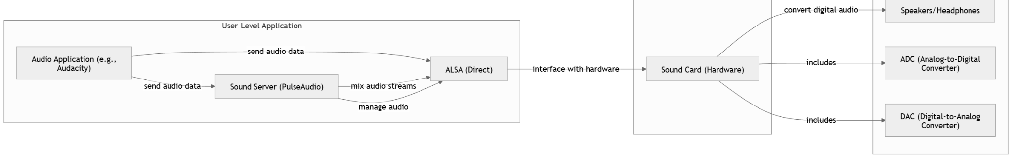
Audio Setup

Slide 10
Application (User-Level)
This is the software processing audio, such as Audacity, VLC, or a game.
Applications send audio data to the sound server or directly to ALSA.
Sound Server (PulseAudio / PipeWire)
Acts as an audio mixer and manager.
A sound server like PulseAudio or Pipe Wire is needed because it allows multiple applications to play audio simultaneously by mixing audio streams before sending them to ALSA.
If used, it communicates with ALSA to send audio data.

Slide 11
ALSA (Advanced Linux Sound Architecture)
A kernel-level driver responsible for interfacing with the hardware.
Provides APIs for applications to access sound devices.
If no sound server is used, applications can talk directly to ALSA.
Sound Card (Hardware)
The physical device that converts digital audio into an analog signal.
Includes components like ADC, DAC (Digital-to-Analog Converter) and amplifiers.
The final audio signal is sent to speakers or headphones.

Slide 12
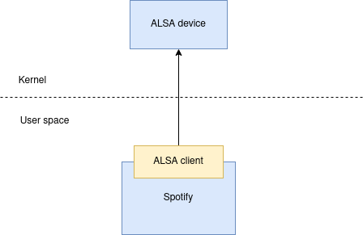
Why PulseAudio
ALSA consists of client/server model.
The server is ALSA drivers in kernel
The client being the user space ALSA library in apps like Spotify and Firefox to talk to ALSA kernel drivers.
Consider one program playing audio:Lets think of you are playing audio file in spotify.

Slide 13
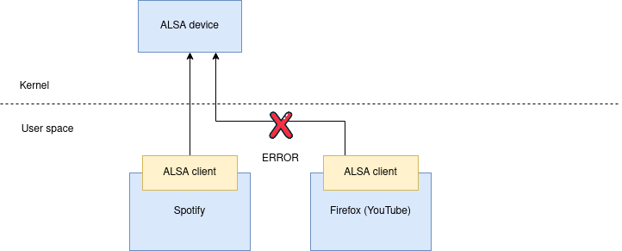
Drawback of ALSA
One weakness in ALSA was that it couldn’t support support multiple programs simultaneously playing audio.
PulseAudio
Since the world was already using ALSA, PulseAudio was added as a plugin to the ALSA client libraries, so now existing apps who think they’re talking to ALSA actually talk indirectly to PulseAudio (which supports many inputs natively):

Slide 14
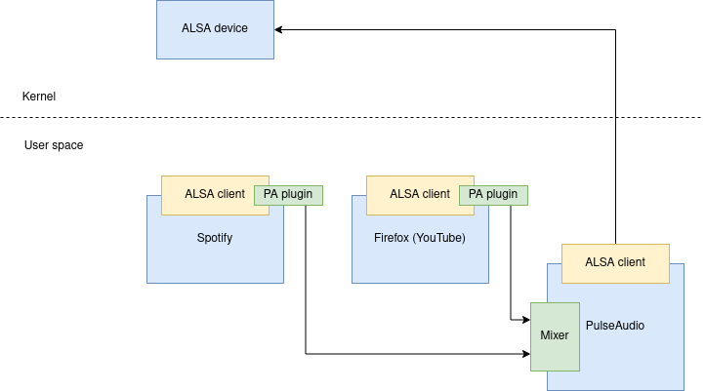
Pulse Audio
PulseAudio handles the audio output from both Spotify and also YouTube running in Firefox.
It receives audio streams from both applications and mixes them together.
The mixed audio is routed to the appropriate output device (e.g., speakers or headphones).
PulseAudio manages volume control and applies any audio effects.
ALSA communicates with the hardware, while PulseAudio provides advanced features like mixing and management.
Example : playing videos in two youtube tabs in Google Chrome acts like two different alsa client

Slide 15
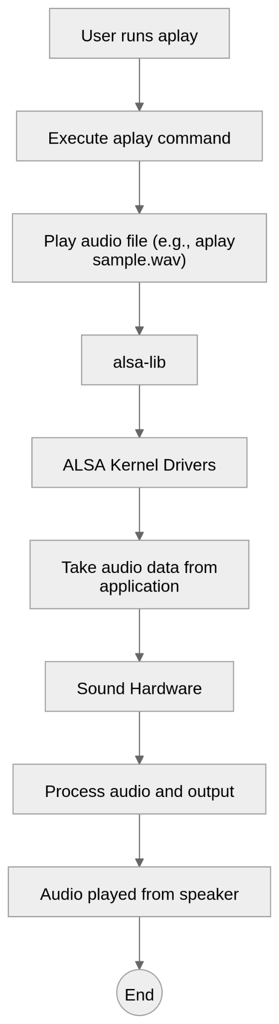
ALSA Audio Flow Using aplay utility
User runs aplay: You execute the aplay command to play an audio file (e.g., aplay sample.wav).
alsa-lib: aplay relies on alsa-lib to handle communication with the ALSA kernel drivers.
ALSA Kernel Drivers: ALSA kernel drivers take the audio data from the application and send it to the sound hardware.
Sound Hardware: The sound hardware (sound card, speaker, etc.) processes the audio and outputs it to the speakers or headphones.
Speaker :Audio will be played from speaker

Slide 16
Understanding with Example
Understanding the WAVE (.wav) File Format
A WAVE file contains:
Header Information (metadata):
Sample Rate: e.g., 8000 Hz, 44100 Hz.
Bit Depth: e.g., 16-bit, 24-bit.
Number of Channels: Mono (1), Stereo (2).
Encoding Format: PCM, ADPCM, etc.
Audio Data: Raw sound samples.
Components Involved
aplay: A command-line tool to play audio.
alsa-lib: Provides APIs for audio management.
PulseAudio (optional): Processes and enhances audio.
ALSA Kernel Driver: Communicates with hardware.
Sound Card: The physical device that plays the audio.

Slide 17
Steps Involved
Step 1: aplay Calls ALSA-lib API
Role: Sends audio data to ALSA sound system.
Uses alsa-lib functions:
snd_pcm_open(): Opens a PCM device.
snd_pcm_hw_params(): Configures hardware parameters (e.g., sample rate, channels).
snd_pcm_writei(): Sends raw PCM data to the sound card.
Step 2: ALSA-lib Processing
Without PulseAudio:
Audio is directly sent to the ALSA kernel driver for playback.
With PulseAudio:
ALSA-lib redirects audio to PulseAudio via the PulseAudio ALSA plugin (alsa-plugins).
The plugin replaces the default ALSA device with a virtual PulseAudio device.
Command | How alsa-lib Works
aplay sample.wav | Alsa-lib automatically selects the default sound device and applies necessary conversions.
aplay -D hw:1,0 sample.wav | Alsa-lib bypasses software processing and sends raw data directly to the hardware.
aplay -D plughw:1,0 sample.wav | Alsa-lib enables the plug plugin to resample and convert formats if needed.

Slide 18
Step 3: PulseAudio Processes the Audio
Mixing: Allows multiple applications to play audio simultaneously.
Resampling: Adjusts sample rates if needed.
Volume Control: Manages per-application audio levels.
Routing: Dynamically directs audio to various output devices.
Step 4: Audio Sent to Hardware
PulseAudio sends the processed audio to the ALSA kernel driver.
The ALSA kernel driver communicates with the sound card to play the audio.

Slide 19
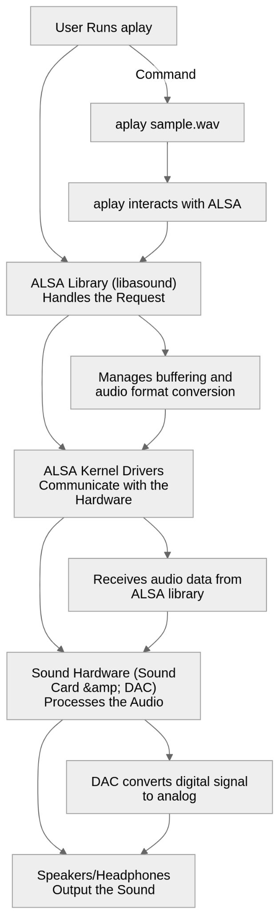
Case 1: aplay Without PulseAudio (Direct ALSA)

Slide 20
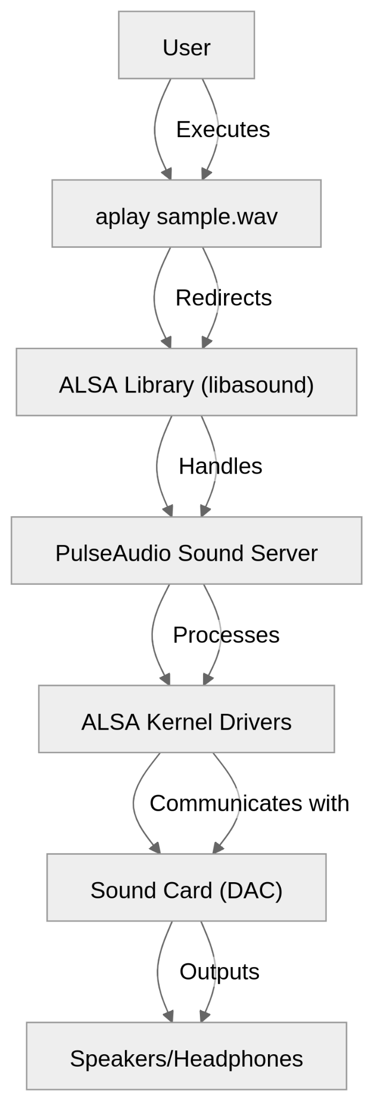
Case 2: aplay With PulseAudio (-D pulse or Default)

Slide 21
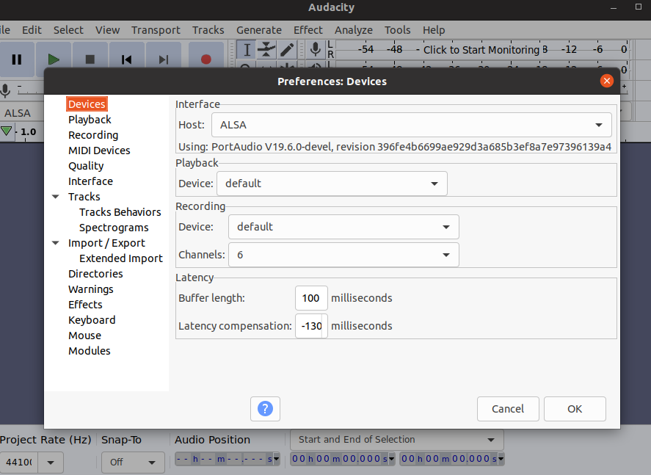
Audacity Example
Open Audacity:
You start by opening Audacity on your Linux machine.
Load Audio File:
You load an audio file into Audacity, either by importing an existing file or recording new audio.
Configure Audio Device:
In Audacity, you can select ALSA as your audio host (usually in the preferences). This tells Audacity to use ALSA for audio playback.
Audio Playback:
When you press the play button, Audacity sends the audio data to ALSA's user-space library (libasound).
ALSA configures the audio parameters (e.g., sample rate, bit depth) according to Audacity's settings.

Slide 22
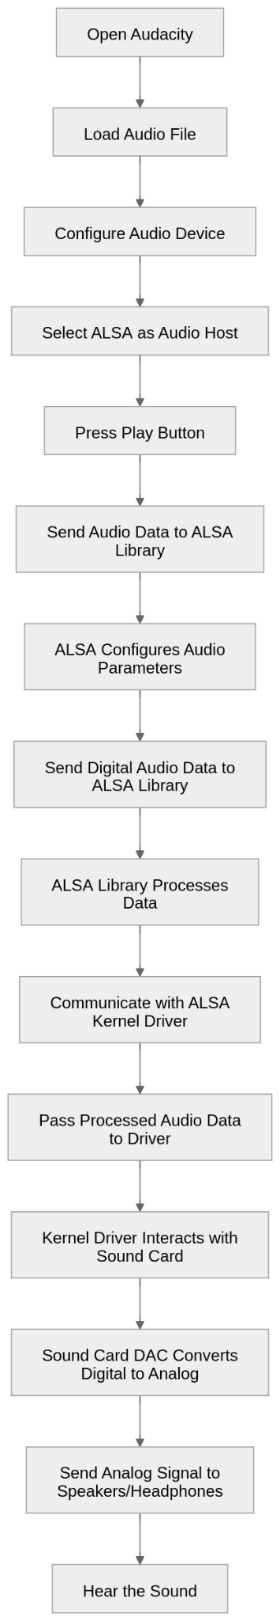
Send Audio Data to ALSA:
Audacity sends the digital audio data to the ALSA library.
The ALSA library processes this data and prepares it for playback.
Communication with Kernel Driver:
The ALSA library communicates with the ALSA kernel driver, passing the processed audio data to the driver.
The kernel driver is responsible for interacting with the sound card hardware.
Audio Conversion and Playback:
The sound card DAC (Digital-to-Analog Converter) converts the digital audio data into an analog signal.
The analog signal is sent to your speakers or headphones, allowing you to hear the sound.

Slide 23
ALSA TESTING

Slide 24
1. Check ALSA Installation
$which aplay
If aplay is not present install ALSA utilities using :
$sudo apt install alsa-utils
2.Check ALSA Kernel Modules
$lsmod | grep snd
It will list the ALSA Kernel Modules present in the system.
3. List Available Sound Devices
$aplay -l
It will list the sound cards detected by ALSA.

Slide 25
4. List Recording Devices
$arecord -l
It will list the recording devices detected by ALSA.
5.Check ALSA logs for Errors
$dmesg | grep -i snd
It should not display errors like device busy or unable to open PCM device.
6.Test Audio Playback
$speaker-test -c 2 -t sine
Options : -c 2 channel (stereo), -t sine wave
If it plays sound, ALSA is working fine.

Slide 26
7. Play Wav File
$aplay /path/to/file.wav
The above command plays a wav file.
Note : aplay only works with wav files
8.Test Audio Record and Playback
$arecord -d 5 test.wav
Options : -d 5 Record for 5 seconds
The above command records audio for 5 seconds
$aplay test.wav
Plays the recorded audio file

Slide 27
9. Check and Adjust Volume
$alsamixer
Use arrow keys to increase/decrease volume
Press M to mute/unmute
Press F6 to select a different sound card
For Command Line Volume control amixer is used
$amixer set Master 70% sets master volume to 70%.

Slide 28
Links
https://docs.google.com/spreadsheets/d/1Oyn8DZYl4r2alg_vzuF8YJA6syH7MIlgA5i-eSSTyDA/edit?gid=0#gid=0

