Slide 1
RISC-V Memory Model

Slide 2
Memory consistency model
A memory consistency model is a set of rules that defines the order in which memory operations (such as reads and writes) appear to execute from the perspective of different threads or processors in a multiprocessor system. It dictates how and when the changes made by one processor to the memory are visible to other processors.
The RISC-V ISA (Reduced Instruction Set Computer - Five Instruction Set Architecture) by default uses a memory model called “RVWMO” (RISC-V Weak Memory Ordering).

Slide 3
RVWMO
The RVWMO memory model is defined in terms of the global memory order, a total ordering of the memory accesses produced by all harts. In general, a multithreaded program will have many different possible executions, and each execution will have its its own corresponding global memory order.
The global memory order is defined in terms of the primitive load(s) and/or store(s) generated by each memory instruction.
RISC-V has chosen the RVWMO memory model, a variant of release consistency. This places it in between the two extremes of the memory model spectrum. It is neither as strict as Sequential Consistency (SC) nor as relaxed as some of the weakest models.
Release Consistency (RC): Divides operations into acquire and release, allowing greater flexibility by enforcing ordering only at synchronization points.

Slide 4
Litmus tests
Litmus tests are small, focused programs designed to test specific behaviors of a memory model. In the context of memory consistency models, litmus tests help illustrate how different memory operations might interact under various conditions.
A litmus test source has three main sections:
1. The initial state defines the initial values of registers and memory locations. Initialisation to zero may be omitted.
2. The code section defines the code to be run concurrently — above there are two threads.
3. The final condition applies to the final values of registers and memory locations.
X86 SB
"Fre PodWR Fre PodWR"
{ x=0; y=0; }
P0 | P1;
MOV [x],$1 | MOV [y],$1 ;
MOV EAX,[y] | MOV EAX,[x] ;
locations [x;y;]
exists (0:EAX=0 /\ 1:EAX=0)

Slide 5
Edge | Full Name (and explanation)
rf | Reads From (from each store to the loads that return a value written by that store)
co | Coherence (a total order on the stores to each address)
fr | From-Reads (from each load to co-successors of the store from which the load returned a value)
ppo | Preserved Program Order
fence | Orderings enforced by a FENCE instruction
addr | Address Dependency
ctrl | Control Dependency
data | Data Dependency

Slide 6
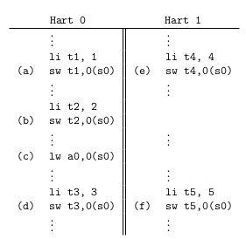
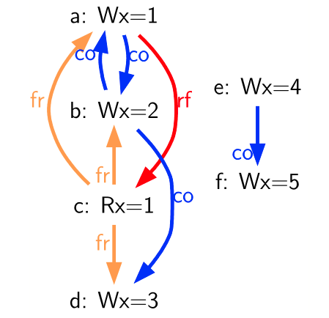
Sample Litmus test

Slide 7
Preserved Program Order (PPO) and Global Memory Order (GMO)
Preserved Program Order (PPO) represents a subset of the program order that must be respected within the Global Memory Order (GMO). In other words, certain operations from the same hart (hardware thread) must appear in the same order to other harts as they do in the program order.
The GMO is the conceptual order in which memory operations (loads and stores) appear to execute globally. It represents how memory operations from different harts are interleaved into a single, globally agreed-upon sequence.

Slide 8
Load value axiom
Each byte of each load i returns the value written to that byte by the store that is the latest in global memory order among the following stores:
Stores that write that byte and that precede i in the global memory order
Stores that write that byte and that precede i in program order
Among all stores (from both global and program order considerations), the store with the latest write to the byte in the global memory order is selected. The load operation returns the value written by this store.
In many memory models, preserved program order does not require a strict ordering between a store followed by a load to the same address within the same hart.This flexibility arises because of the common use of store buffers in modern processors.
Store Buffers are hardware mechanisms that temporarily hold store operations before they are written to globally visible memory. This allows the processor to continue executing subsequent instructions without waiting for the store to complete.
When a load follows a store to the same address, the load can bypass waiting for the store to write to memory by forwarding the value directly from the store buffer. This is an optimization technique improves performance by reducing the latency that would otherwise occur if the load had to wait.

Slide 9
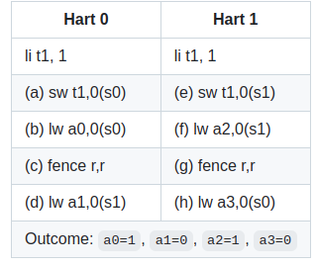
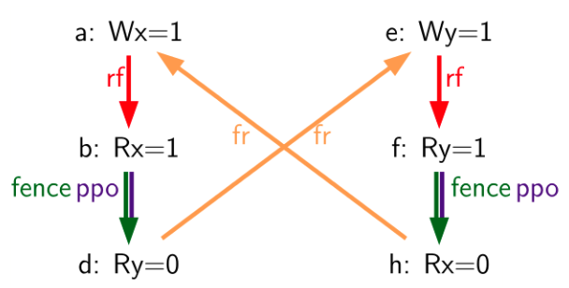
Store buffer forwarding litmus test

Slide 10
Atomicity Axiom
Statement : If r and w are paired load and store operations generated by aligned LR and SC instructions in a hart h, s is a store to byte x, and r returns a value written by s, then s must precede w in the global memory order, and there can be no store from a hart other than h to byte x following s and preceding w in the global memory order.
The instructions LR (Load-Reserved) and SC (Store-Conditional) are used to implement atomic read-modify-write sequences. The LR loads a value from memory and reserves the memory address, while the SC attempts to store a new value back to that address.

Slide 11
LR/SC pairs and AMOs
RISC-V contains two types of atomics:
LR/SC pairs
LR/SC pairs involve two separate operations:
First, a load (LR) that reads a value from memory and establishes a reservation on the memory location
The SC then checks if the reservation is still valid (i.e., no other hart has written to the memory location since the LR). If the reservation is valid, the SC writes the new value to memory and succeeds; if not, it fails and the operation must be retried
AMOs
These are single atomic operations that perform a read-modify-write sequence directly in memory
An AMO reads a value from memory, applies an operation (e.g., addition), and writes the result back to memory—all as a single atomic transaction.
Examples include atomic addition (amoadd), bitwise operations, and other

Slide 12
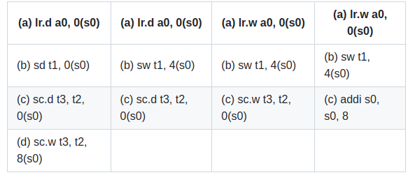
LR/SC instructions examples

Slide 13
Progress axiom
Statement : No memory operation may be preceded in the global memory order by an infinite sequence of other memory operations.
Explanation : Stores from one hart (processor core) will eventually become visible to other harts within a finite time. This guarantees that memory operations are not indefinitely delayed and that data will eventually be visible to other parts of the system.
Usage:
Visibility of stores by forwarding
Avoiding Infinite Delay

Slide 14
RVWMO rules (Rule 1-13)

Slide 15

Overlapping-Address orderings
Rule 1: Store ordering [ppo:->st]
Statement: If b is a store and a and b access overlapping memory addresses, then a (if it is a load) cannot be reordered with b.
Explanation: A store operation b to a memory address must be visible to any subsequent load operation a accessing the same address. This means that if a store to an address is performed, any subsequent load to that address must see the value written by that store, preserving the ordering of stores relative to loads.

Slide 16
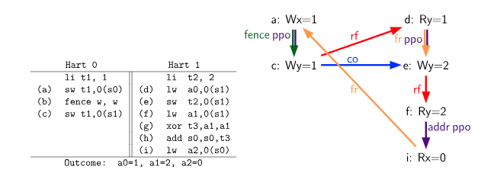
Example of Rule 1:

Slide 17

Rule 2: Load-Load Ordering [ppo:rdw]
Statement : a and b are loads, x is a byte read by both a and b, there is no store to x between a and b in program order, and a and b return values for x written by different memory operations
Explanation :
Both a and b are loading from the same memory location s0.
In a straightforward execution, a and b return the same value since they read from the same address.
However, if a returns a different value than b, This could happen in a system with a relaxed memory consistency model, where loads might see different values depending on how memory operations are interleaved and executed.
This rule ensures the principle of Coherence for Read-Read pairs (CoRR), means a younger load cannot return a value older than what was returned by an older load.

Slide 18
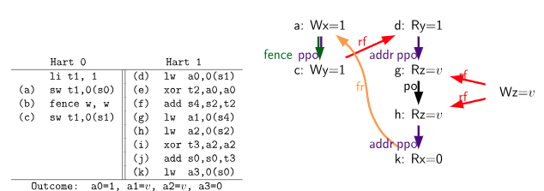
Example of Rule 2:

Slide 19
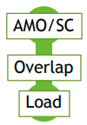
Rule 3: AMO/SC Ordering [ppo:amoforward]
Statement : If a is an AMO (Atomic Memory Operation) or SC (Store Conditional) instruction, and b is a load that returns a value written by a.
Explanation: This rule ensures that if a load operation returns a value written by an AMO or SC instruction, the AMO or SC operation must have occurred before the load in the global memory order.

Slide 20
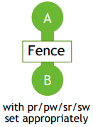
Rule 4: Fences [ppo:fence]
Statement : There is a FENCE instruction that orders a before b (fence [r][w][i][o],[r][w][i][o])
Explanation:
Specifically, it ensures that all memory operations (loads and stores) that appear before the FENCE instruction in program order are observed to occur before those that appear after the FENCE in global memory order.
This helps synchronize memory operations, especially in a multi-core or multi-threaded environment.

Slide 21
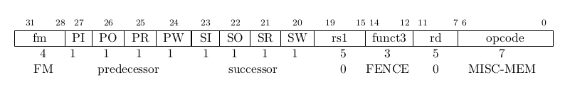
FENCE Bits and Their Function
The FENCE instruction includes several control bits that allow for fine-tuning of its ordering behavior. These bits restrict which memory operations are included in the ordering constraints
PR: previous reads. SR: subsequent reads
PW: previous writes. SW: subsequent writes
PI: previous I/O reads. SI: subsequent I/O reads
PO: previous I/O writes. SO: subsequent I/O writes

Slide 22
Non-Trivial Combinations of PR, PW, SR, and SW Bits
The FENCE encoding currently has nine non-trivial combinations of the four bits PR, PW, SR, and SW, plus one extra encoding FENCE.TSO
FENCE RW, RW (PR=1, PW=1, SR=1, SW=1)
FENCE RW, W (PR=1, PW=1, SR=, SW=1)
FENCE R, RW (PR=1, PW=0, SR=1, SW=1)
FENCE R, R (PR=1, PW=0, SR=1, SW=0)
FENCE W, W (PR=0, PW=1, SR=0, SW=1)
FENCE W, RW (PR=0, PW=1, SR=1, SW=1)
FENCE RW, R (PR=1, PW=1, SR=1, SW=0)
FENCE W, R (PR=0, PW=1, SR=1, SW=0)
FENCE R, W (PR=1, PW=0, SR=0, SW=1)
Of the ten non-trivial options, only six are commonly used in practice:
FENCE RW,RW
FENCE.TSO
FENCE RW,W
FENCE R,RW
FENCE R,R
FENCE W,W
FENCE.TSO encoding can be used to map acquire and release semantics to ensure that all memory operations before the fence are visible to all operations that follow it. This helps in implementing a memory model similar to TSO (Total Store Order), where stores are globally ordered and loads can be reordered with respect to stores.

Slide 23
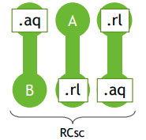
Explicit Synchronization
Rule 5: acquire annotation [ppo:acquire]
Statement : An acquire operation ensures that all memory operations following it in program order (i.e., in the program's instruction sequence) will also follow it in the global memory order (the order observed by all processors in a system)
Acquire ordering can be enforced in one of two ways:
with an acquire annotation, which enforces ordering with respect to just the synchronization variable itself. This method is often used with atomic operations or specific synchronization primitives
with a FENCE R,RW, which enforces ordering with respect to all previous loads

Slide 24
Rule 6: Release Annotation [ppo:release]
Statement : A release operation ensures that all memory operations preceding it in program order will also precede it in the global memory order.
Release semantics require all loads and stores preceding the release operation in program order to also precede the release operation in the global memory order.
Release semantics can be enforced by two ways
with a release annotation on a specific instruction (like a store)
using a FENCE RW,W, which ensures that all preceding loads and stores are completed before any subsequent stores

Slide 25
acquire and release annotations using atomics
sd x1, (a1) # Arbitrary unrelated store
ld x2, (a2) # Arbitrary unrelated load
li t0, 1 # Initialize swap value.
again:
amoswap.w.aq t0, t0, (a0) # Attempt to acquire lock.
bnez t0, again # Retry if held.
# ...
# Critical section.
# ...
amoswap.w.rl x0, x0, (a0) # Release lock by storing 0.
sd x3, (a3) # Arbitrary unrelated store
ld x4, (a4) # Arbitrary unrelated load
amoswap.w.aq : performs an atomic swap. It exchanges the value in t0 with the value in the memory location pointed to by a0(lock variable : it is zero if it free or 1 if it held by some other thread) .aq (acquire) suffix ensures that any loads and stores following this instruction in program order will also follow it in the global memory order.
amoswap.w.rl : releases lock , where the .rl (release) suffix ensures that all operations within the critical section appear before the lock release in the global memory order.

Slide 26
acquire and release annotations using fences
sd x1, (a1) # Arbitrary unrelated store
ld x2, (a2) # Arbitrary unrelated load
li t0, 1 # Initialize swap value.
again:
amoswap.w t0, t0, (a0) # Attempt to acquire lock.
fence r, rw # Enforce "acquire" memory ordering
bnez t0, again # Retry if held.
# ...
# Critical section.
# ...
fence rw, w # Enforce "release" memory ordering
amoswap.w x0, x0, (a0) # Release lock by storing 0.
sd x3, (a3) # Arbitrary unrelated store
ld x4, (a4) # Arbitrary unrelated load
In this case, even though the AMOSWAP does not enforce ordering with an aq bit, the fence nevertheless enforces that the acquire AMOSWAP appears earlier in the global memory order than all loads and stores in the critical section.
The lock is acquired using amoswap.w without the .aq suffix. This means the atomic swap itself does not enforce any specific memory ordering
FENCE r,rw ,This fence ensures that all loads (r) that appear before it in the program order will appear before any subsequent loads or stores (rw) in the global memory order.
Before releasing the lock, a FENCE rw,w instruction is used. This fence ensures that all loads and stores within the critical section (rw) are completed before any stores (w) that follow the fence in program order.
The lock is released using amoswap.w

Slide 27
Rule 7: RCsc Annotations [ppo:rcsc]
Statement : A release that precedes an acquire in program order also precedes it in global memory order i.e., the RCsc (Release Consistency with Sequential Consistency ) variant of release consistency
Why RCsc annotation is preferred over Rcpc (Release Consistency with Partial Consistency ) ?
RCpc annotation | RCsc annotation
The ordering between store and load operations is more relaxed. | provides stronger memory ordering guarantees.
A store-release operation may not immediately be visible to a load-acquire operation on another thread | A store-release operation in one thread is guaranteed to be visible to any load-acquire operation in another thread
In RCpc, even if a thread performs a store with release semantics, another thread performing a load with acquire semantics may not immediately observe the result of that store | In RCsc, if a thread performs a store with release semantics, another thread performing a load with acquire semantics will observe the result of that store

Slide 28
Rule 8: Paired Operations [ppo:pair]
Statement : This rule refers to a scenario where two operations are explicitly paired, such as in the case of Load-Reserved (LR) and Store-Conditional (SC) operations. Paired operations ensure that specific sequences of operations are treated atomically.
Explanation :
Often used in atomic operations where the pairing of a load and store ensures that the memory location being accessed is not modified by other operations in between the pair.
Indicates that an SC must appear after its paired LR in the global memory order. This will follow read-modify-write operation due to the inherent data dependency.
It guarantee that the memory location remains unchanged by other harts between the paired operations.

Slide 29
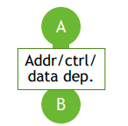
Syntactic dependencies
Rule 9: Address dependency [ppo:addr]
Statement : A memory operation b has a syntactic address dependency on a previous instruction a if the address used by b depends on the result of a
Example :
ld a1, 0(s0) # Load the value at address (s0) into register a1
xor a2, a1, a1 # XOR a1 with itself and store the result in a2 (which will be 0)
add s1, s1, a2 # Add the value in a2 (which is 0) to s1, effectively leaving s1 unchanged
ld a5, 0(s1) # Load the value at address (s1) into register a5
Here, there is a syntactic address dependency from the memory operation generated by the first instruction to the memory operation generated by the last instruction , even though a1 XOR a1 is zero and hence has no effect on the address accessed by the second load.

Slide 30
Rule 10 : Data Dependency [ppo:data]
Statement : The result of one instruction (A) influences the execution or outcome of another instruction (B).
Example :
Specifically, in the context of store operations, if A produces a value that is used by B (a store operation), there is a data dependency between these two instructions.

Slide 31
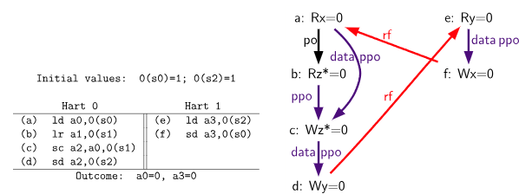
Example of Rule 10:

Slide 32
Rule 11 : Control dependency [ppo:ctrl]
Statement : The execution of one instruction depends on the outcome of a preceding branch instruction. Also ensures that no store operation can override or affect the result of the SC operation before the SC operation has been globally observed.
Example:
lw x1, 0(x2) # (1) Load from address x2 into x1
bne x1, x0, next # (2) Branch to 'next' if x1 is not equal to x0
sw x3, 0(x4) # (3) Store x3 to address x4
next: sw x5, 0(x6) # (4) Label 'next': Store x5 to address x6
The sw x5, 0(x6) at the next label has a control dependency on the lw x1, 0(x2) instruction. This is because the branch outcome affects whether next is reached. Even though the branch may or may not be taken, the control dependency ensures that sw x5, 0(x6) is not executed until after the branch decision is made.

Slide 33
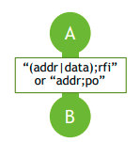
Pipeline Dependencies
Rule 12 : Load with Address or Data Dependency [ppo:addrdararfi]
Statement : If b is a load instruction, and there exists some store m between a and b in program order such that m has an address or data dependency on a, and b returns a value written by m, then the ordering of a and b must be preserved in the pipeline.
Explanation:
Address Dependency: The address used by m depends on the result of a.
Data Dependency: The value written by m depends on the result of a.
Pipeline Ordering: This rule ensures that the load (b) sees the value written by the store (m) and maintains the correct ordering between a and b.

Slide 34
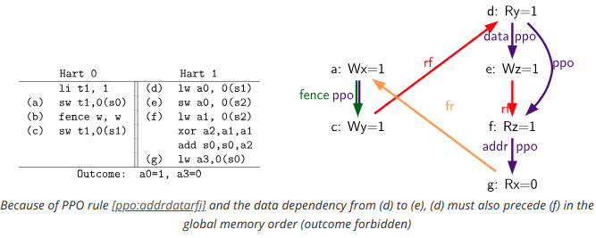
Example of Rule 12:

Slide 35
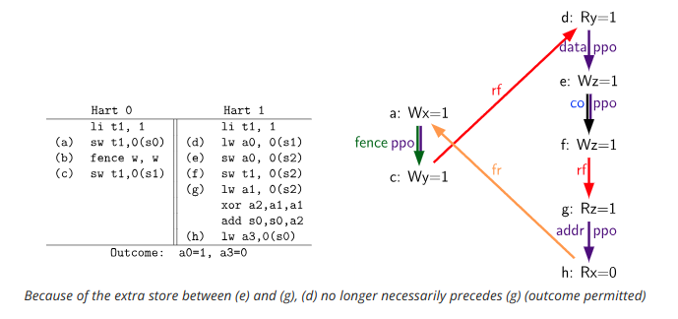

Slide 36
Rule 13: Store with Address Dependency [ppo:addrpo]
Statement : If b is a store instruction, and there exists some instruction m between a and b in program order such that m has an address dependency on a, then the ordering of a and b must be preserved in the pipeline
Explanation :
A store cannot be performed at memory until all previous loads that might access the same address have themselves been performed. Such a load must appear to execute before the store, but it cannot do so if the store were to overwrite the value in memory before the load had a chance to read the old value.
Address Dependency: The address used by b or the value it stores depends on the result of a.
Pipeline Ordering: This rule ensures that the store (b) follows the correct order relative to the computation in a, maintaining the proper sequence in the pipeline.

Slide 37
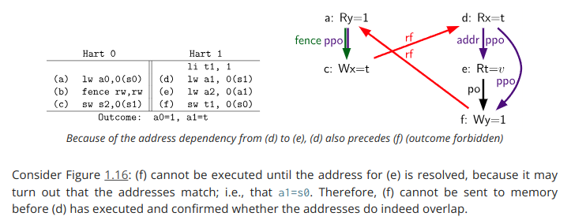
Example of rule 13:

Slide 38
THANK YOU
Presented By: S.Lochani vilehya
Emp ID:43317

