Slide 1
To predict pH values based on the GOMEC dataset using machine learning models.
SRI KALYAN REDDY AKITI

Slide 2
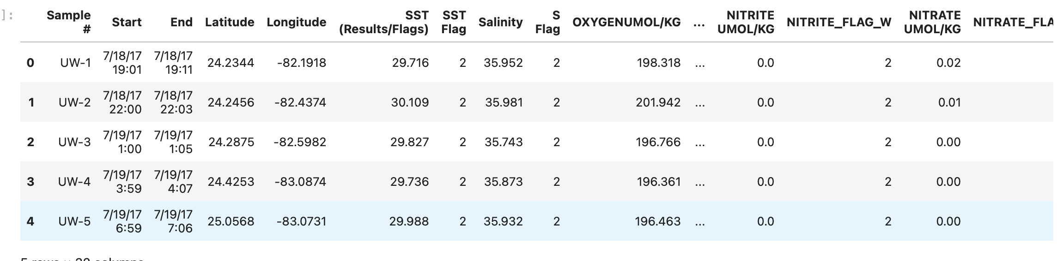
Dataset Overview
Source: GOMEC (Third Gulf of Mexico Ecosystems and Carbon Cycle(GOMECC-3) Cruise)
Total Samples: 150

Slide 3
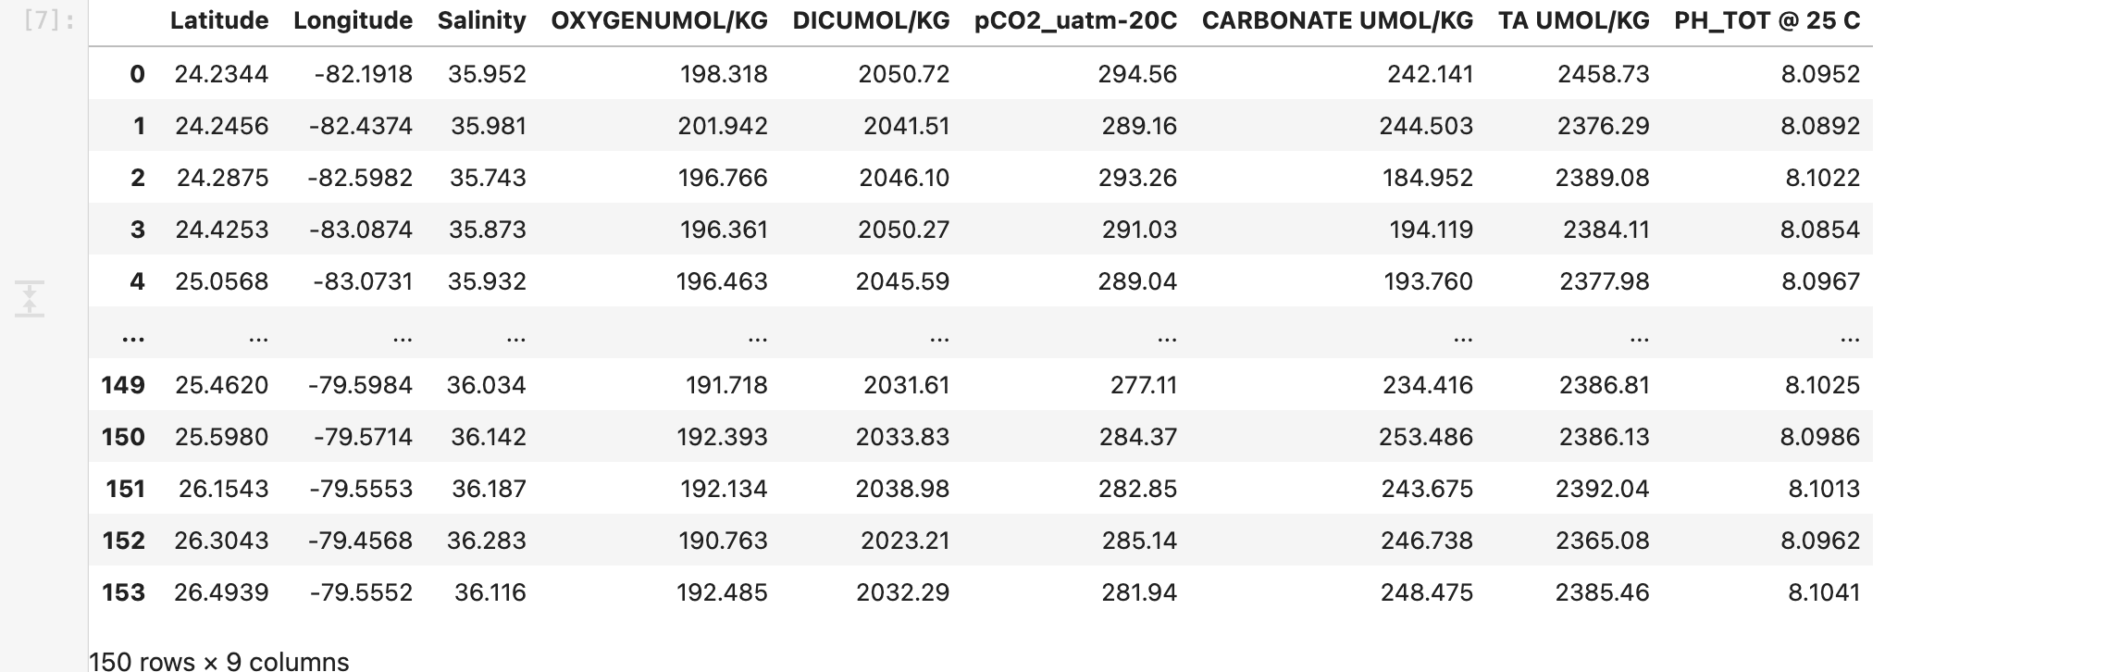
Data Cleaning
Removed invalid values (-999, 999) using numpy
Selected key features for analysis:
Latitude, Longitude, Salinity, Oxygen, DIC, pCO2, Carbonate, TA, pH.
Dropped rows with missing values.

Slide 4
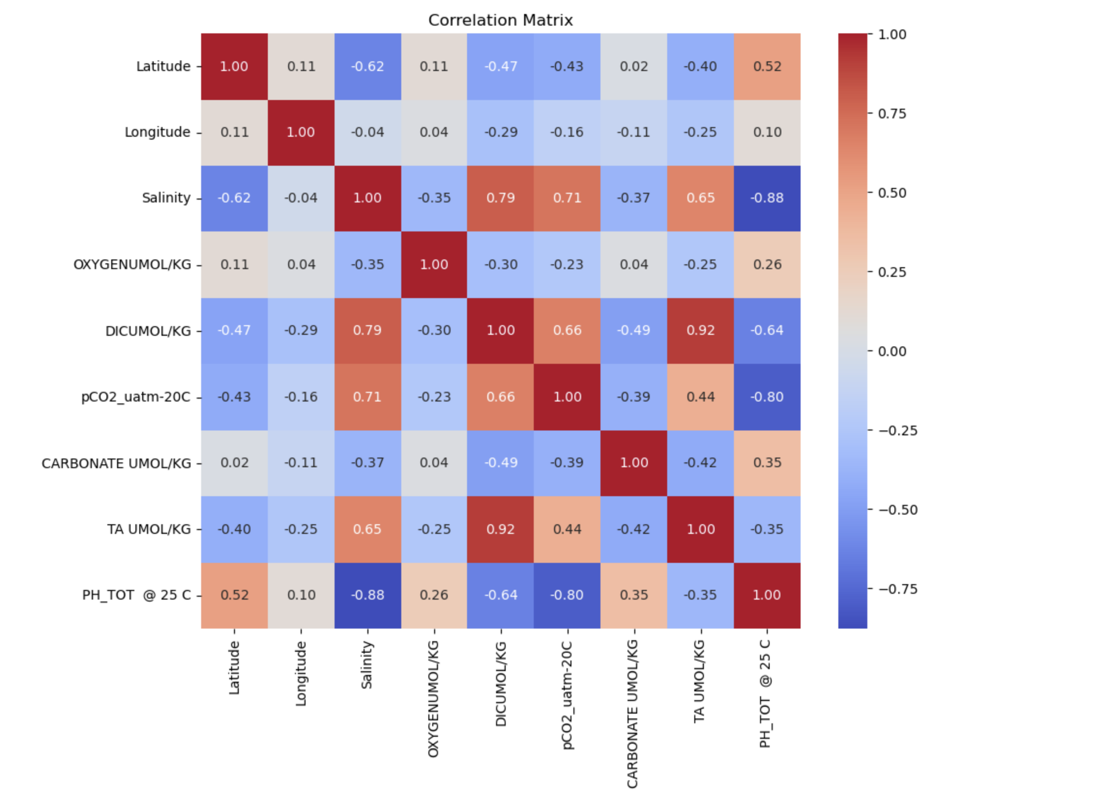
Exploratory Data Analysis

Slide 5
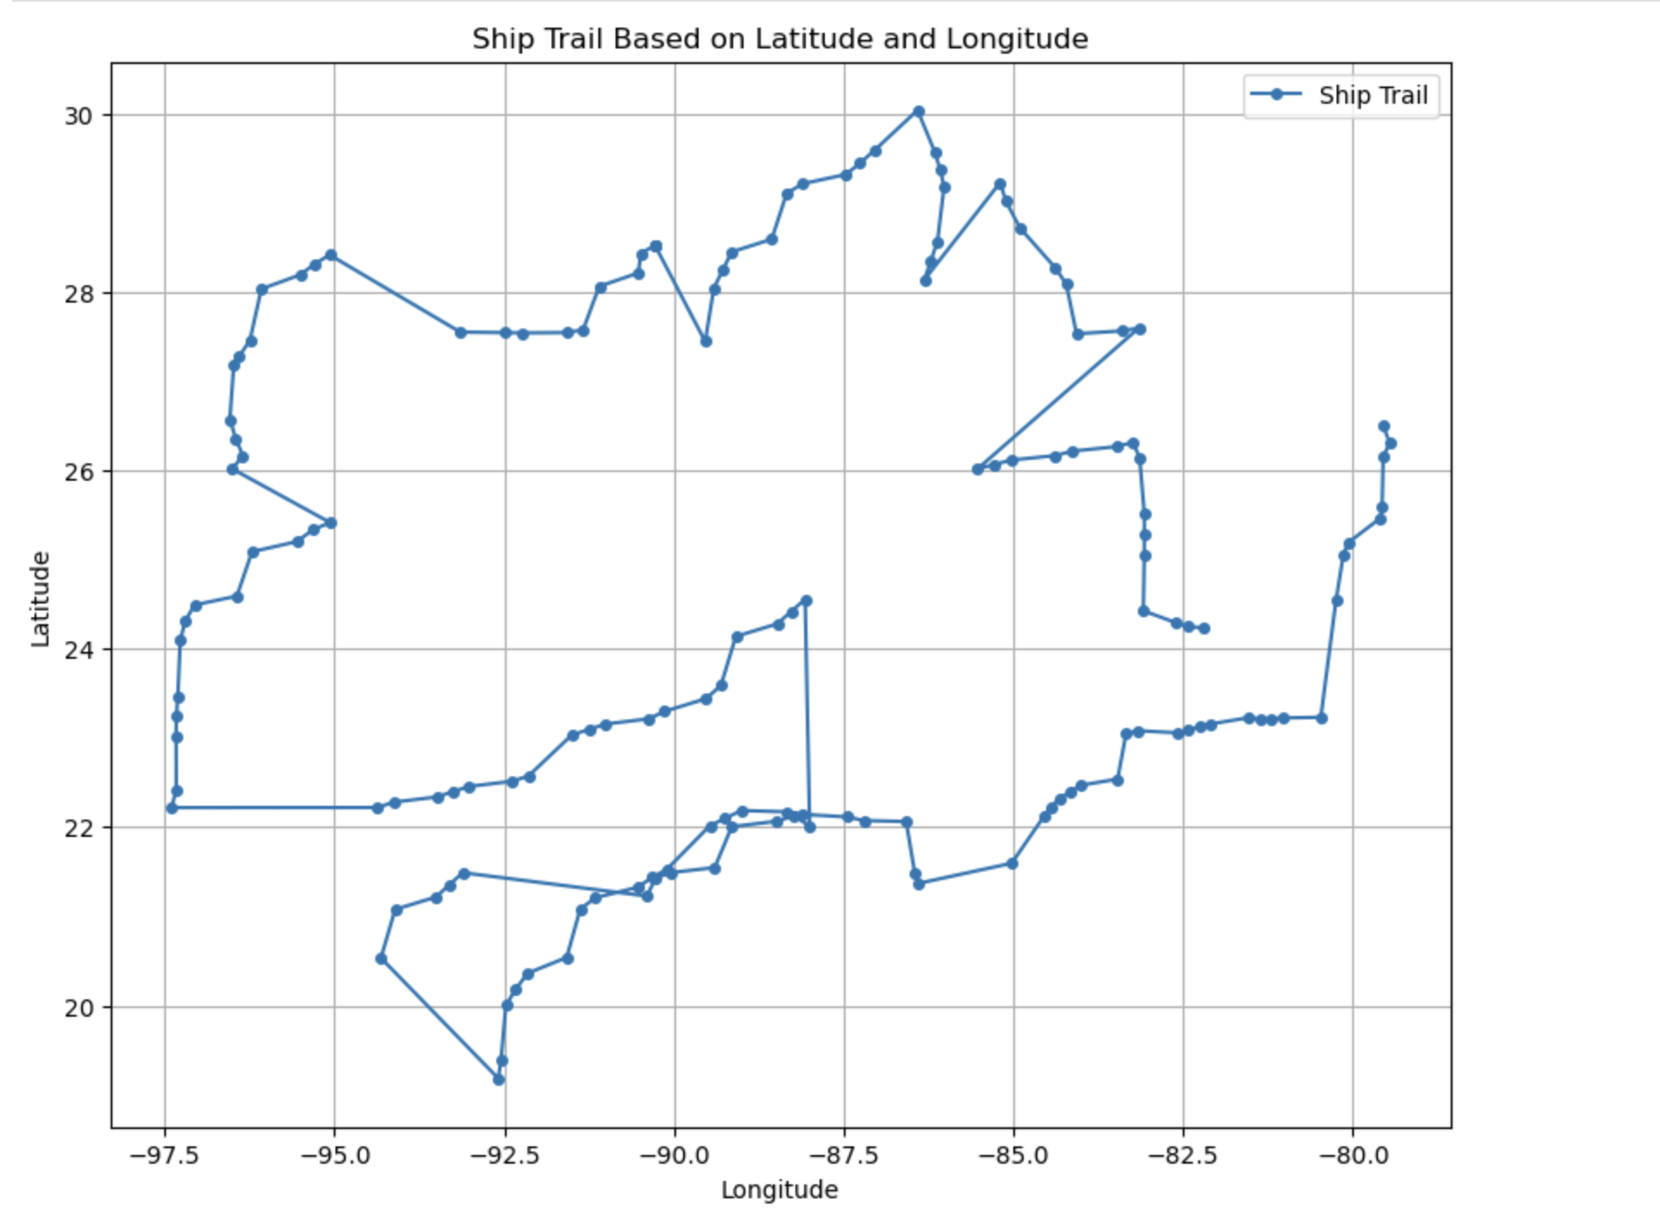
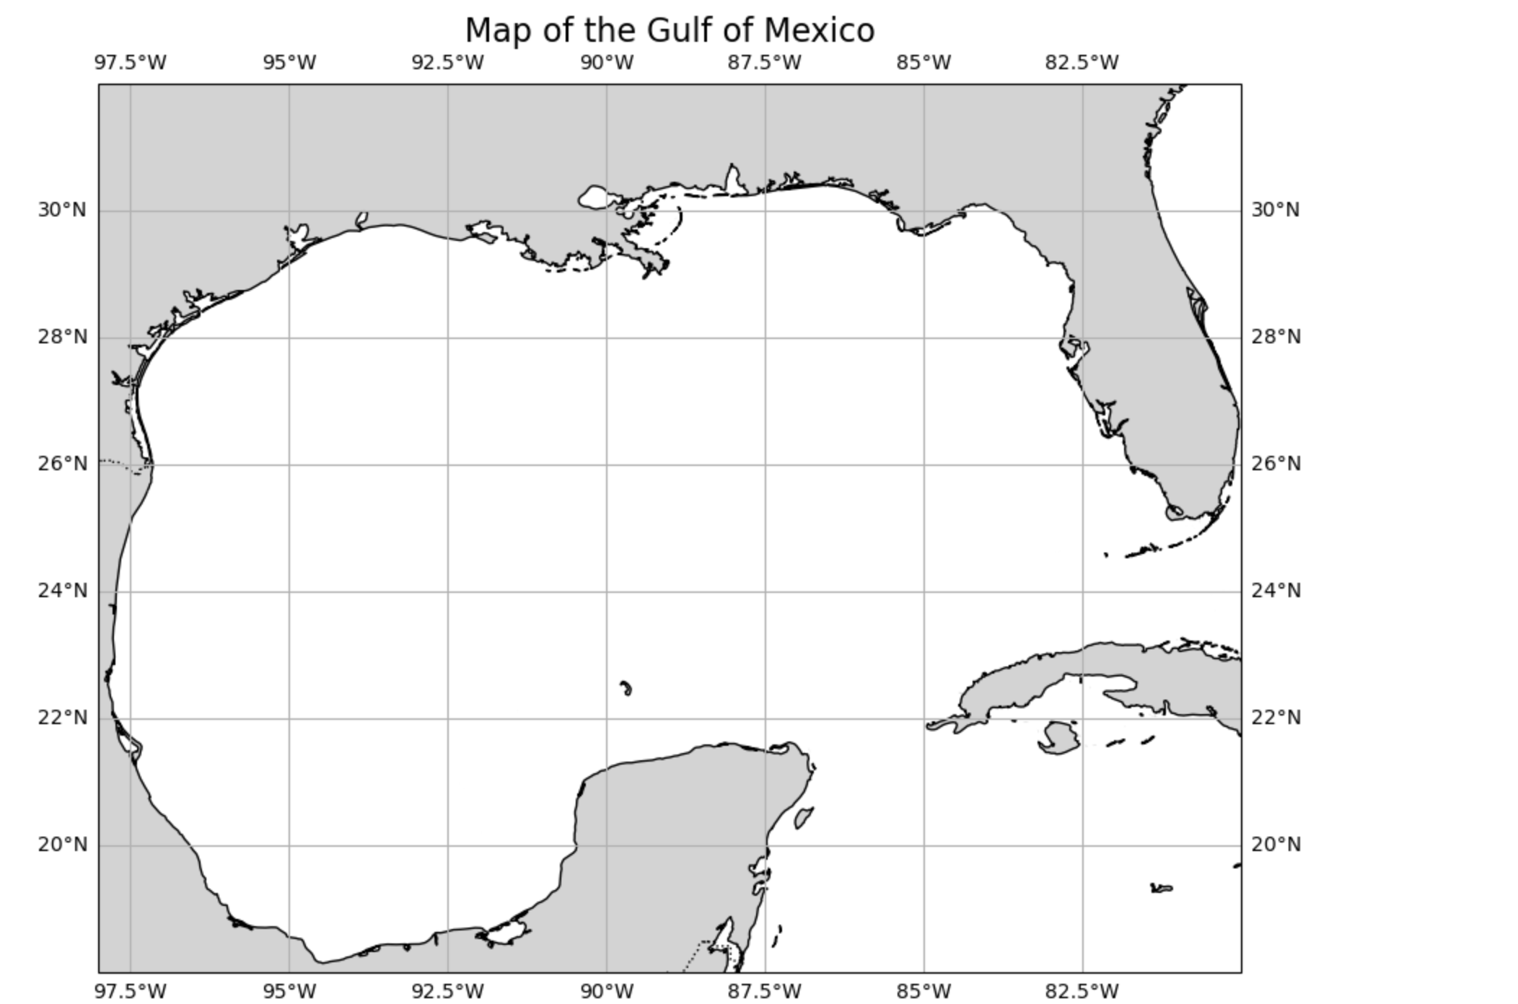
Ship Trail:

Slide 6
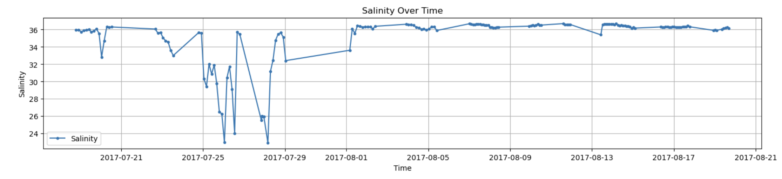
Time Series Analysis:

Slide 7
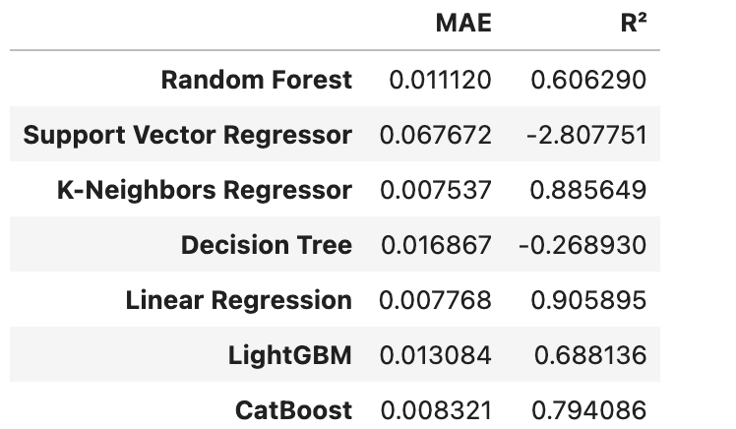
Model Performance

Slide 8
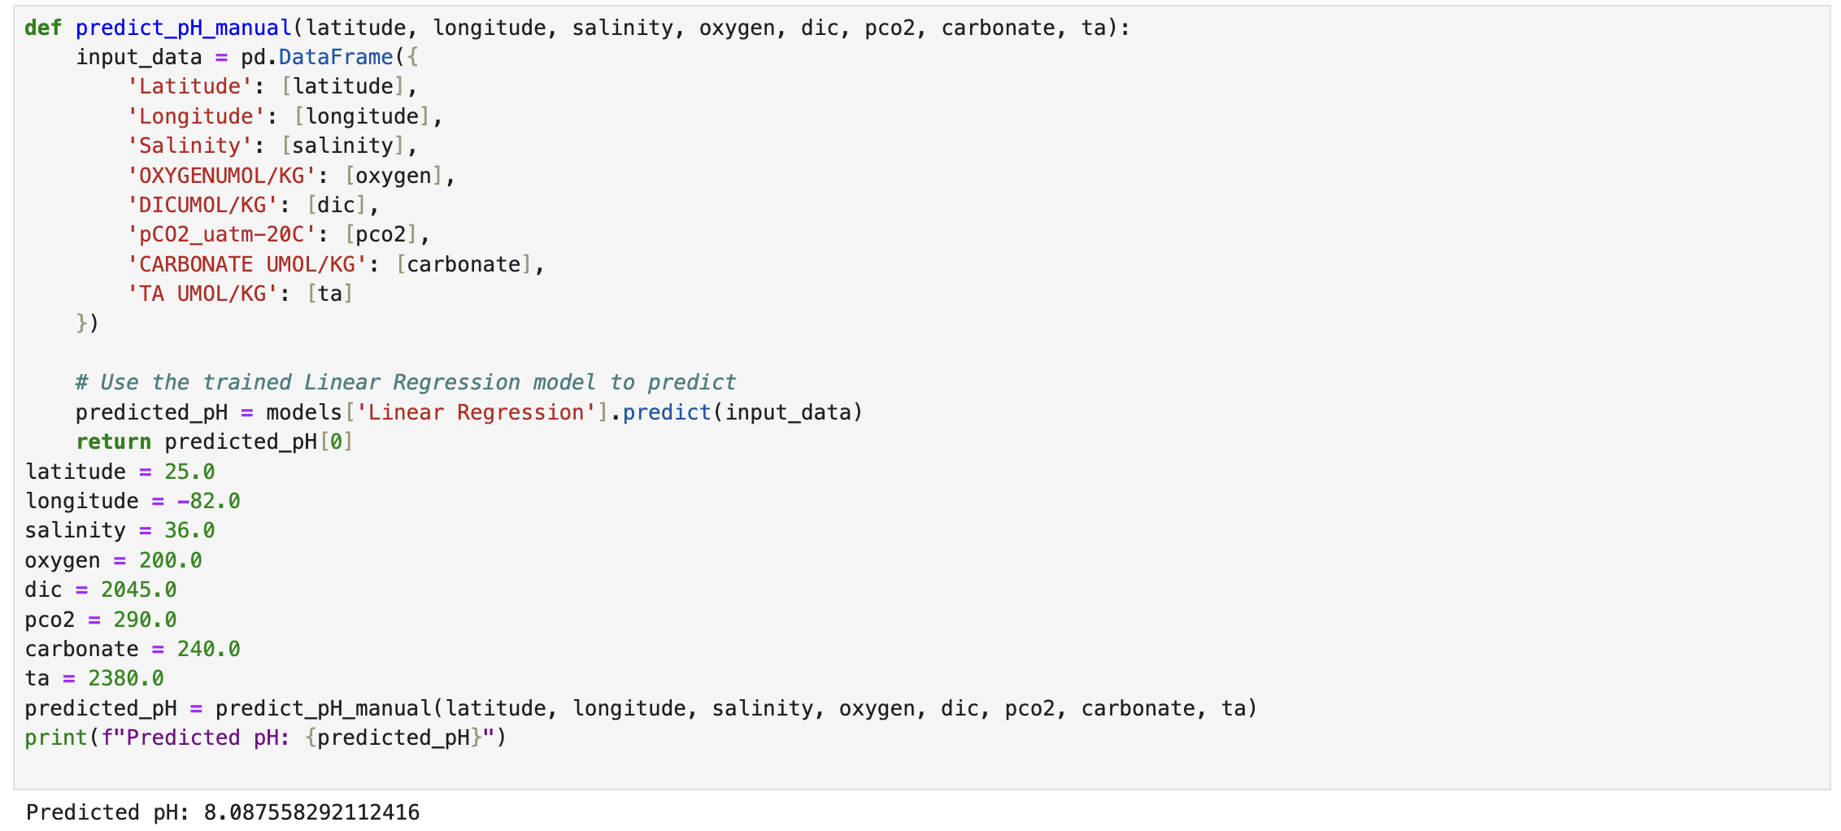
Validation

Slide 9

Conclusion
Linear Regression is a robust model for predicting pH values.
Provides a user-friendly method for manual testing and validation.

Slide 10

Thankyou

