Slide 1
Cross-Selling Marketing Strategy
Presented by Srikant Behera

Slide 2
Cross Selling Marketing Strategy:
Cross-selling is the action or practice of selling an additional product or service to an existing customer. In practice, businesses define cross-selling in many different ways.
Elements that might influence the definition might include the size of the business, the industry sector it operates within and the financial motivations of those required to define the term.

Slide 3
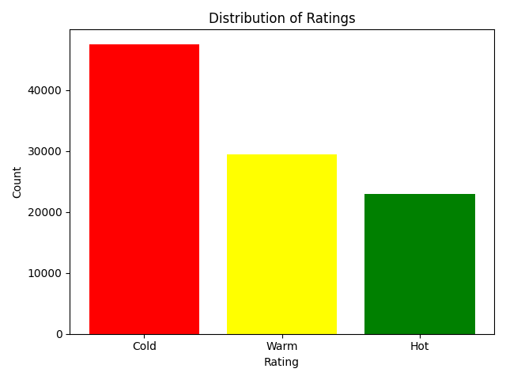
Distribution of Ratings:
Cold leads are the highest, meaning most customers show low initial interest and need more awareness and personalized premium discounts.. Hot leads are the fewest, so the sales team should prioritize them because they convert the fastest.

Slide 4
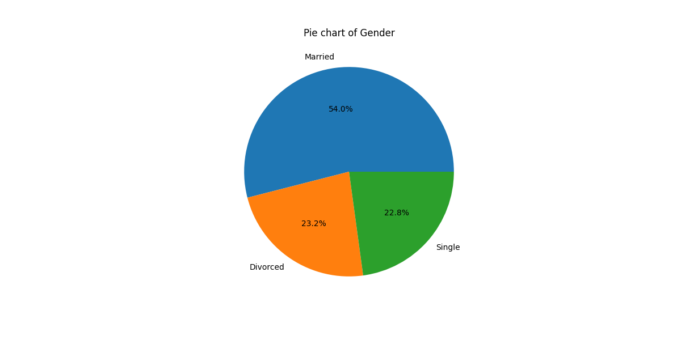
Marital Status impact on target:
Focus marketing on married customers because they are the biggest group. Promote family protection plans or child future plans for married people. For single customers offer simple, low-cost protection or investment starter plans. For divorced customers promote financial security products like health cover or retirement plans.

Slide 5
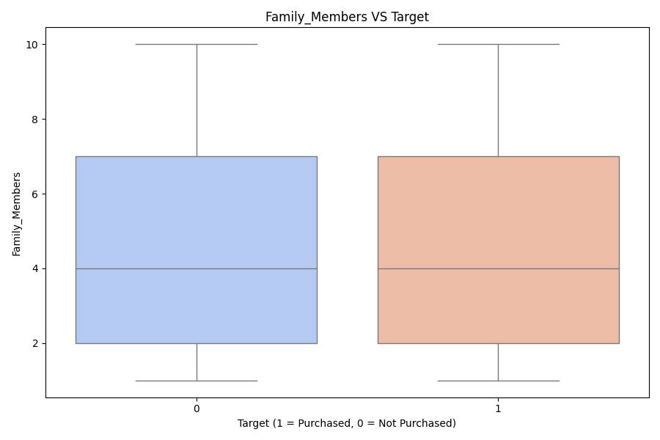
Impact of family members on Purchase:
Most customers have families of 3–5 members. Cross-sell family health insurance, child education, or life protection bundles. Large family groups (>6) can be approached with group or senior plans.

Slide 6
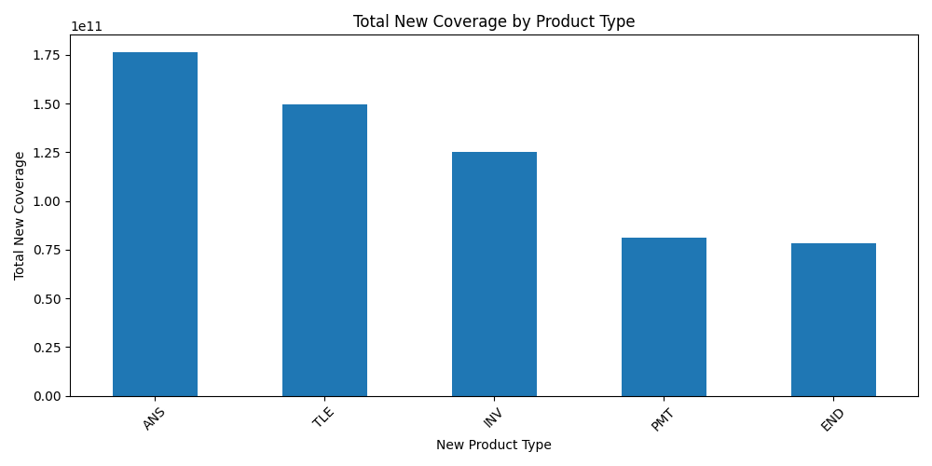
Product wise new coverage:
The Products ANS & TLE contributes the highest coverage so we can focuses on this products type and providing discounts, offers on ANS and TLE.

Slide 7
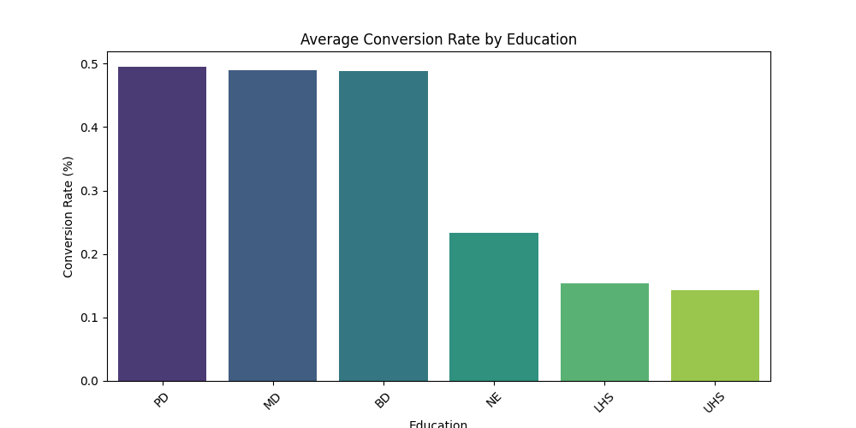
Income Insight Visualizatio
Education wise conversion rate:
Educated people buy more, so target them first. For less-educated groups, use simple explanations, guidance, and small offers to increase their interest

Slide 8
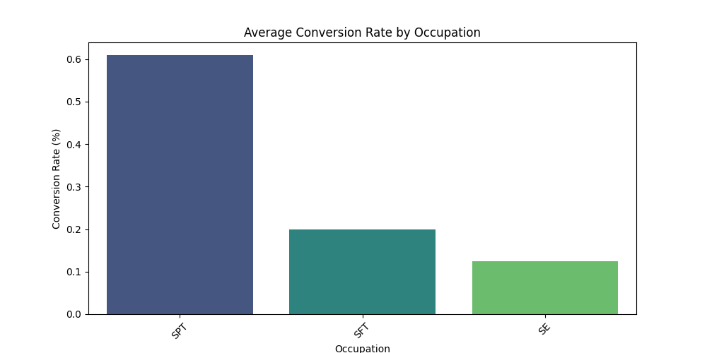
Occupation wise conversion rate:
Give ‘SPT’ to low-cost protection plans, ‘SE’ to saving or retirement plans. for SFT (Software Employees) offer long-term investment or tax-saving plans

Slide 9
Conclusion
Insights highlight key customer behavior segments. Cross-selling success improves with targeting, satisfaction, and product awareness.

Slide 10
Thank YOU!

