Slide 1
Customer Churn Analysis
Presented By : Srikant Behera

Slide 2
Dataset Overview & Key Observations
The dataset contains customer orders, delivery timelines, product details, and churn status.
Includes ~100k orders across multiple states.
Key features used: delivery delay, freight value, product price, customer location.
Initial checks show many late deliveries and high shipping ratios for low-value items.
Churn labels are clearly defined, enabling accurate churn analysis.
Delivery performance varies heavily by state.
Several extreme delivery delays (outliers) were identified.
Freight cost is inconsistent, especially for low-value items.

Slide 3
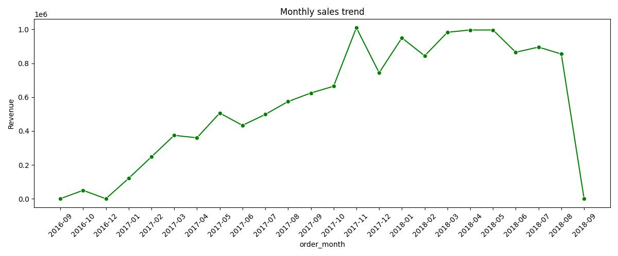
Monthly Sales Trend (Revenue)
The sales trend shows strong month-over-month growth with a major revenue spike during seasonal events such as Black Friday or holiday sales etc. To leverage this momentum, the business should invest in seasonal promotions, improve demand forecasting, optimize inventory and strengthen customer retention strategies.

Slide 4
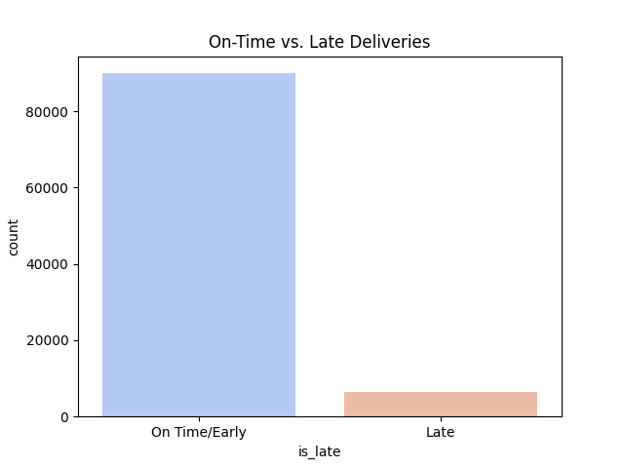
On-Time vs. Late Deliveries
With 8% late deliveries impacting nearly 8k customers per 100k orders, give an apology message to customers, provide accurate and realistic delivery dates, and build a more reliable logistics network.

Slide 5
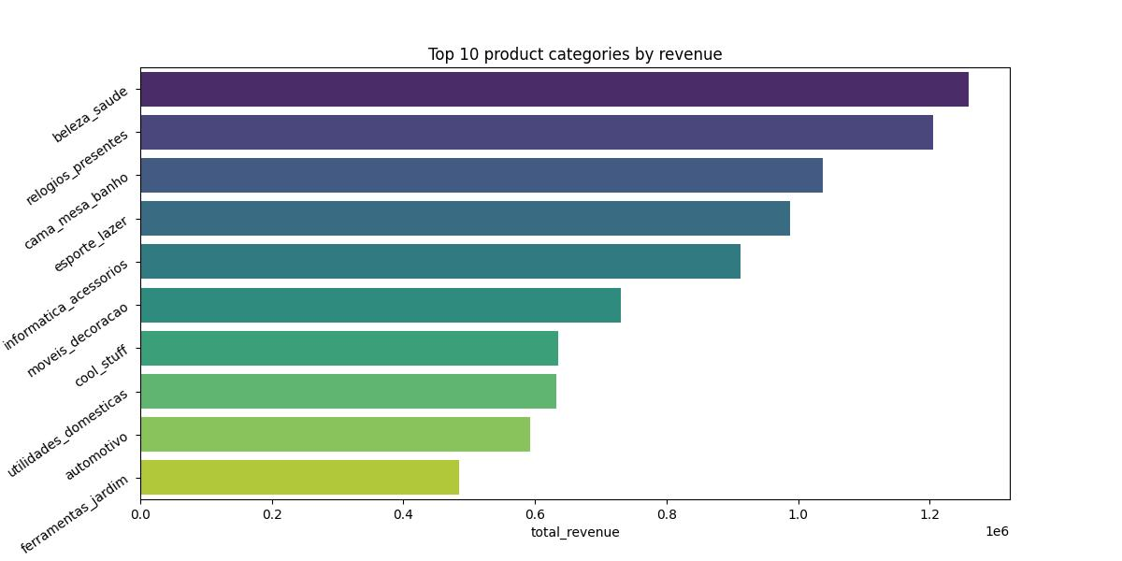
Top 10 Product Categories by Revenue
The top-performing categories provide a strong opportunity for targeted marketing, efficient inventory planning, and customer-focused promotions. By strengthening supplier partnerships and investing in high-demand categories, the business can significantly increase total revenue and maintain long-term customer loyalty.

Slide 6
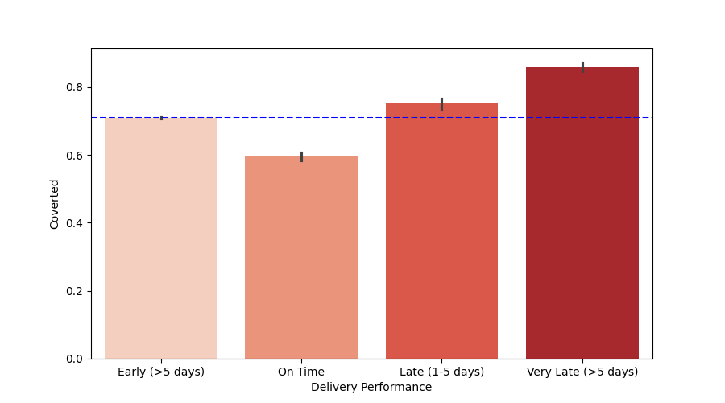
Impact of Delivery Delays on Customer Churn
When deliveries are delayed by more than 5 days, Olist risks losing long-term customer relationships. By improving logistics speed, enhancing seller performance, using predictive delivery models, and establishing customer recovery programs, Olist can protect customer loyalty and strengthen its position in the market.

Slide 7
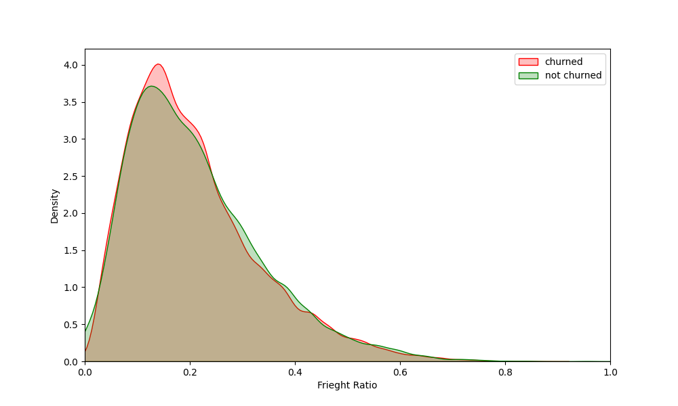
Freight Cost Sensitivity: Churned vs Retained
When a customer buys a cheap product but pays high shipping, they feel the deal is unfair. To fix this, you should try to get cheaper delivery rates for small items or ask customers to buy a minimum amount to get free or low-cost shipping.

Slide 8
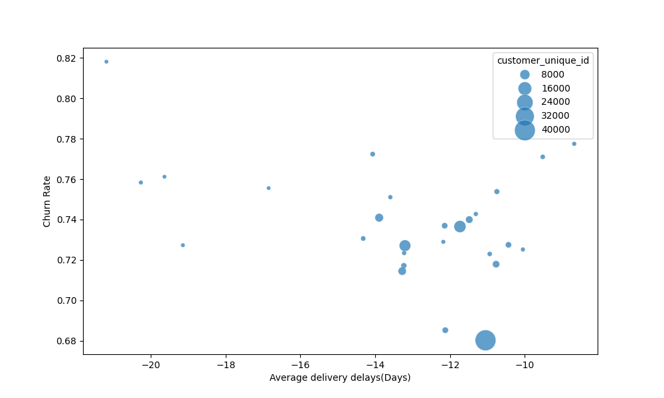
Churn Rate vs Delivery Delay by State
Some regions get much worse delivery service. Because of this, we are losing customers in the North and Northeast since our delivery partners there are not doing a good job. Stop marketing in states where delivery takes more than 5 extra days until we fix logistics. Otherwise, we spend money to get customers who will not come back.

Slide 9
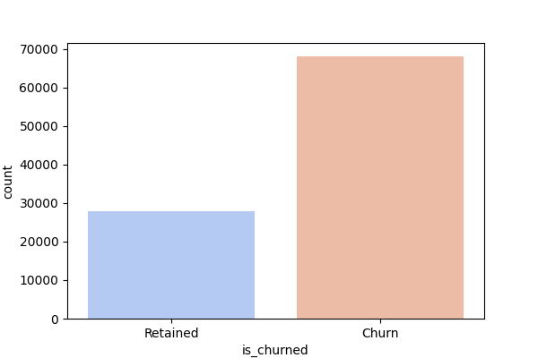
Distribution of Churned vs. Retained Customers
Only 29% of customers stay with us, and 71% leave. This means most customers are not coming back, which is a serious retention problem. So fix delivery problems first, reduce high shipping costs, improve customer experience. Give discounts, free shipping, cashback, or “welcome back” coupons.

Slide 10
Conclusion
My analysis shows that customer churn is mainly driven by delivery problems and high freight costs. Only 29% of customers return, while 71% churn, meaning most customers are not satisfied with the service.
Recommendation:
Improve delivery speed and partner with better logistics providers.
Reduce shipping charges or give free shipping above a minimum order value.
Provide offers or discounts to bring churned customers back.
Pause marketing in regions with extremely slow delivery to avoid wasting money.

Slide 11
Thank you!

