Slide 1
HR Analytics
Dataset Overview & Key Observations
The dataset contains employee-level information from a large MNC across multiple departments and regions.
The dataset includes 54808 employee records and 14 features.
The target variable is ‘is_promoted’ and performance indicators are ‘Previous year rating’,’ KPIs met >80%’,’ Awards won’.
Promotion rate is low (~8.5%), making early identification critical.
Technology & Analytics show highest leadership demand.
The dataset provides a comprehensive view of employee performance and development, enabling predictive and fair promotion decision-making.

Slide 2
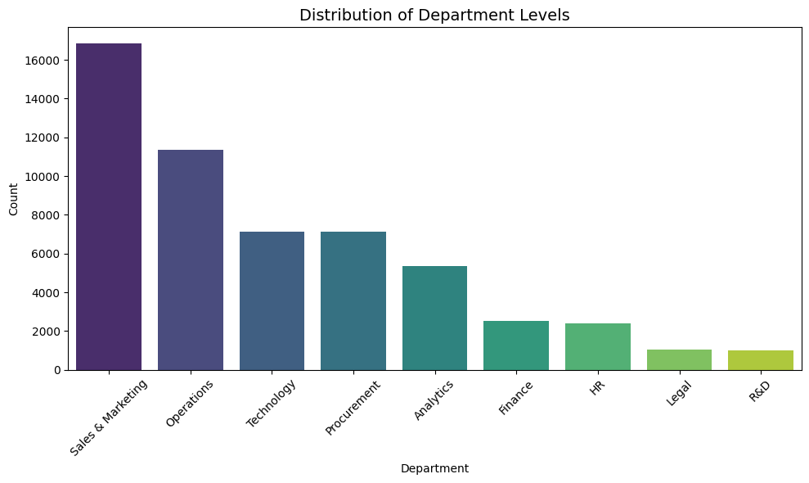
Distribution of Department
Evaluate Sales & Marketing and Operations for role efficiency and workload balance due to their very high headcounts.
Develop targeted talent strategies for HR and Legal, which currently have the lowest promotion rates, potentially due to flatter organizational structures.
Direct additional training resources into large departments to improve the depth of the leadership pipeline.

Slide 3
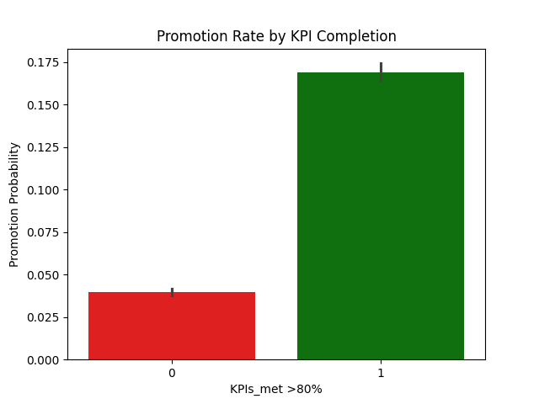
Promotion Rate by KPI Completion
Employees who did NOT meet >80% KPIs have a promotion probability of ~4%.
Employees who met >80% KPIs have a much higher promotion probability (around 17%).
KPI completion is the strongest driver of promotion decisions and acts as a mandatory eligibility filter in the promotion process.

Slide 4
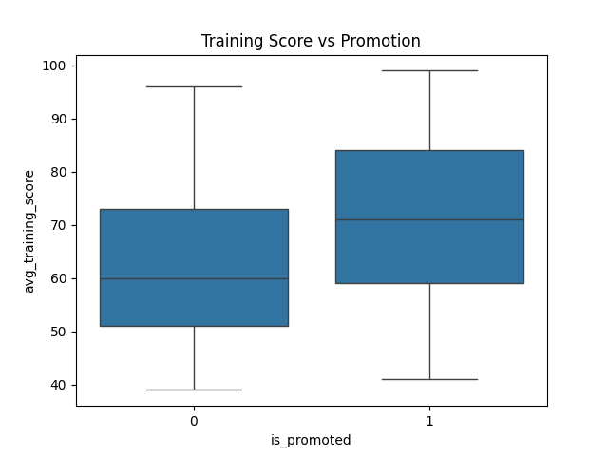
Training Score vs Promotion
Employees who were not promoted (0) generally have lower training scores, with a median around 60.
Employees who were promoted (1) show higher training scores, with a median around 70+.
Set a minimum training score threshold (e.g., 70+) for promotion eligibility. Use training scores as a key input feature in promotion prediction models.

Slide 5
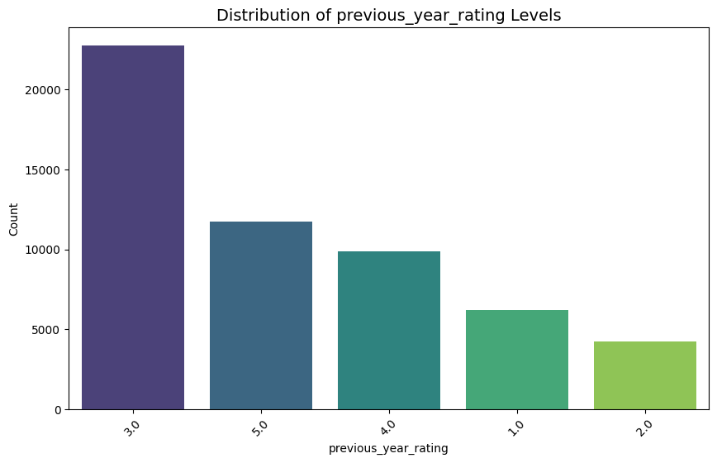
Distribution of Previous Year Performance Ratings
Most employees fall into average performance (Rating 3), forming the largest segment of the workforce.
A significant number of employees are rated 4 and 5, indicating a strong pool of high performers and future leaders.
Prioritize employees with ratings 4 and 5 for promotion and leadership programs. Combine rating with KPI and training score for early promotion prediction.

Slide 6
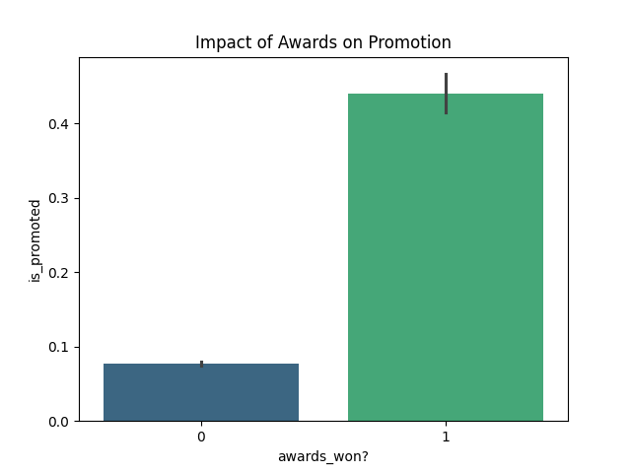
Impact of Awards on Promotion
Employees who did not win any awards have a very low promotion rate (around 7–8%).
Award winners are ~5× more likely to be promoted (≈45% vs 8%).
Awards act as a powerful accelerator for promotions, signaling leadership readiness and high organizational impact.

Slide 7
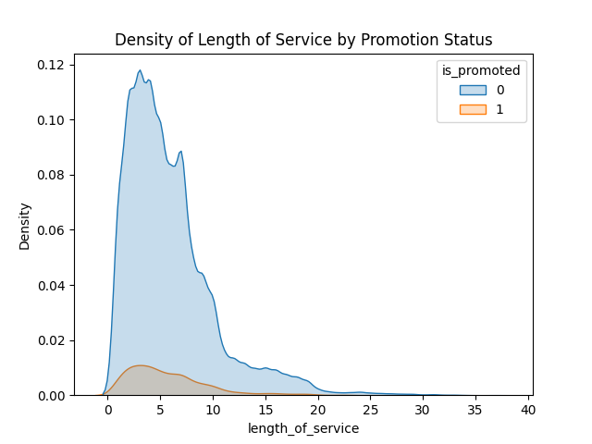
Length of Service vs Promotion
Both promoted and non-promoted employees are concentrated in the early years of service
(≈2–8 years).
The promotion density peaks around 3–6 years of service. Very few promotions occur after (~10–12 years) of service.
Early-career employees may not yet have enough experience, while employees who stay too long in the same role may stop growing or have fewer promotion opportunities.

Slide 8
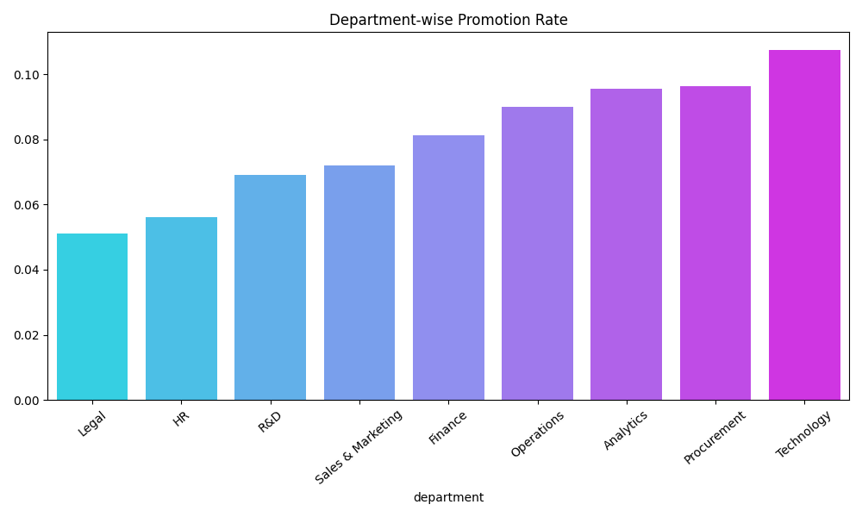
Department-wise Promotion Rate
Technology shows the highest promotion rate, reflecting strong demand for technical leadership and skill-based growth. Procurement and Analytics also demonstrate above-average promotion rates, highlighting their strategic importance.
HR and Legal have the lowest promotion rates, suggesting flatter organizational structures and fewer leadership layers.
Department-wise promotion analysis enables targeted talent strategies, reduces attrition risk, and ensures fair growth opportunities.

Slide 9
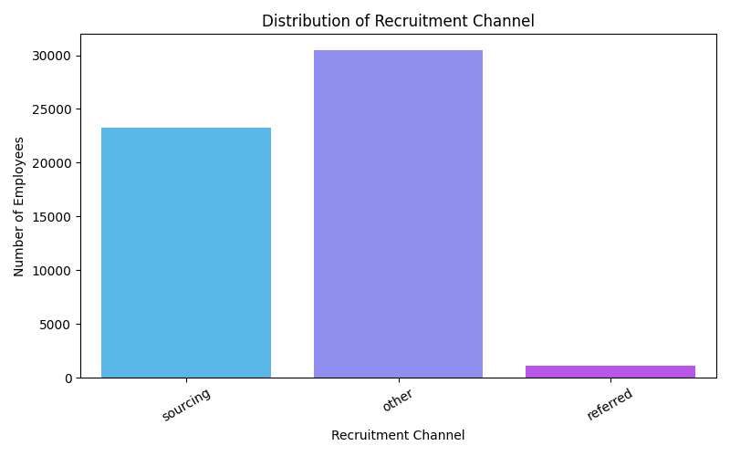
Distribution of Recruitment Channel
The majority of employees are hired through the “Other” recruitment channel, making it the dominant hiring source.
The Referral channel contributes very few hires, despite being typically high-quality.
Introduce referral incentives and recognition programs. Referrals typically reduce hiring costs and onboarding time.

Slide 10
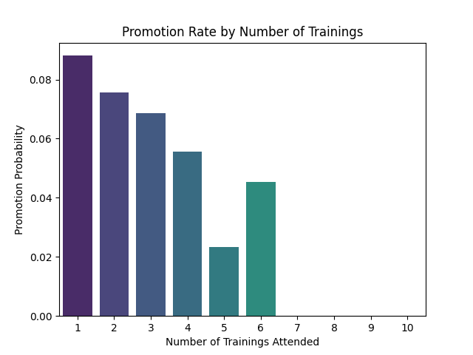
Promotion Rate by Number of Trainings
Employees with 1–2 trainings have the highest promotion probability(~7–9%). Employees attending more than 3 trainings show lower promotion rates.
Employees attending 5–6 trainings show very low promotion probability, despite higher learning exposure.
Initial trainings are effective and aligned with promotion criteria. Excessive trainings may indicate skill gaps or performance issues, where employees are repeatedly trained but not yet promotion-ready.

Slide 11
Conclusion
Use KPI >80%, awards, and training scores as mandatory promotion filters.
Set a minimum training score threshold (70+) for promotion eligibility.
Review repeated trainings (5–6) to identify unresolved skill gaps.
Strengthen referral hiring through incentives and recognition.

Slide 12
Thank you!

