Slide 1
ScrapYard
Group Members – B SRIKANT (220343120020)
ABHISHEK MAGDUM (220343120002)
PRATIK JADHAV (220343120038)
PRADIP SONAWANE(220343120078)
Project Guide – Mrs. Harshita Maheshwari

Slide 2
Contents
Introduction
Choice of topic
Proposed System
Methodology
Proposed System Model
Proposed Approach
Screenshot
System Requirements
Applications
Advantages & Limitations
Conclusion
Future Scopes
References

Slide 3
Introduction
ScrapYard is a user friendly web application in which anybody can sell their scrap to us on an amazing value.
It provides Admin, Customer, Collector login.
Customer can add different scrap-material to their own dump cart.
Collector will get the details of the customer from where to scrap is to be collected.
Admin will have the power to make changes on the server side.

Slide 4
Choice of topic
Through this project Customer ensure great profitability.
Easy & Fast
Scrap Differentiation
There is a delay to start the process of Recycling of scraps so that the cost of Recycled Products becomes very high. Which is not at all preferred.
To maximize resource value and minimize environmental impact.

Slide 5
Proposed System
AIM:
The primary Objective of developing this Website is to provide a user-friendly way to sell customers scrap from different regions and also we provide easy way for recycling company to connect with us and give their requirement to us
Proposed System:
1. Digitalize Scrap selling
2. Communication can take place even through mobile
3. Eliminate Intermediates
4. Recycling Companies can directly place their requirements to us.

Slide 6
Methodology
The objective is to create a web site that can perform the following:-
Connecting to an HTTPS site through GPRS/WIFI.
Opening the relevant JSX page using HTTPS POST PUT DELETE & GET methods .
Read the data logically into customer, collector and admin.
Creating a local database for the website.
Calling required method in SpringBoot for Authentication of User.
Interactive And Simple experience to place order.

Slide 7
Proposed System Model
There are three main modules:
Admin Customer Collector
1 .Home 1. Home 1. Home
2. Admin Page 2. Scrap Materials 2. Collection Details
3. Log Out 3. Dump Cart 3. Log Out
4. Add Scrap to cart
5. Log Out

Slide 8
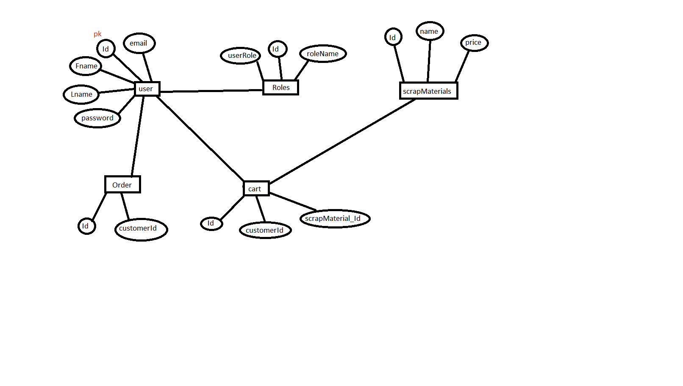
Proposed Approach

Slide 9
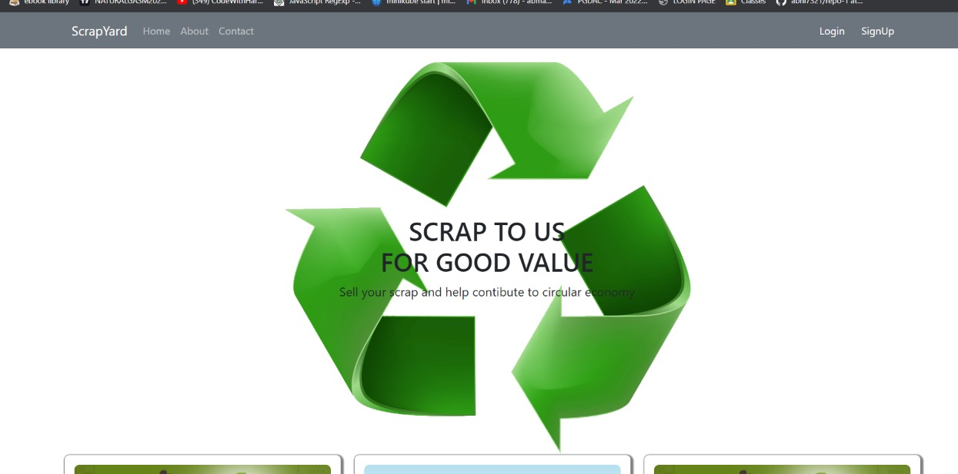
Screenshots

Slide 10
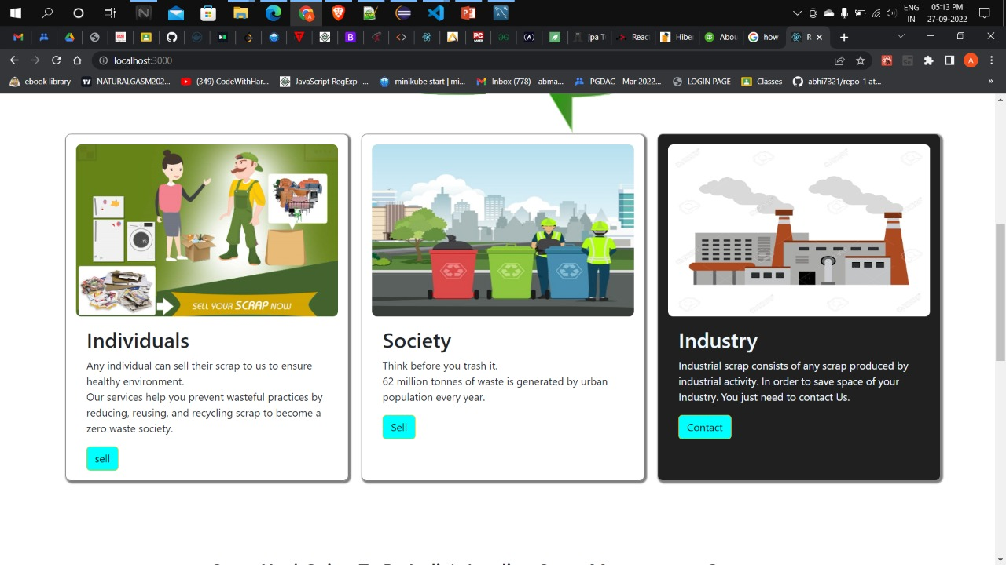

Slide 11
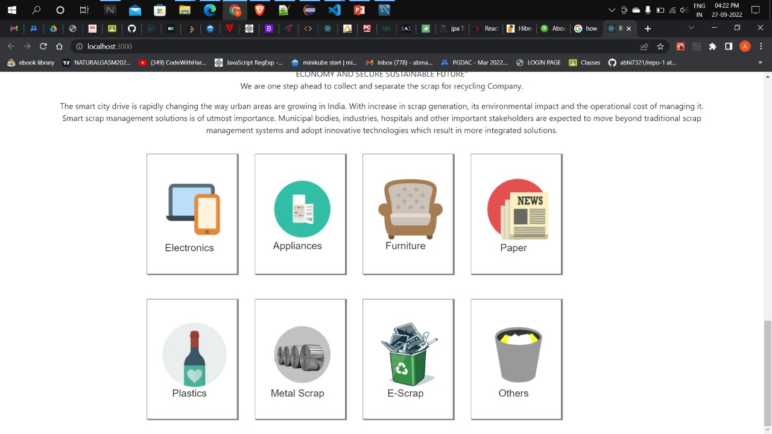

Slide 12
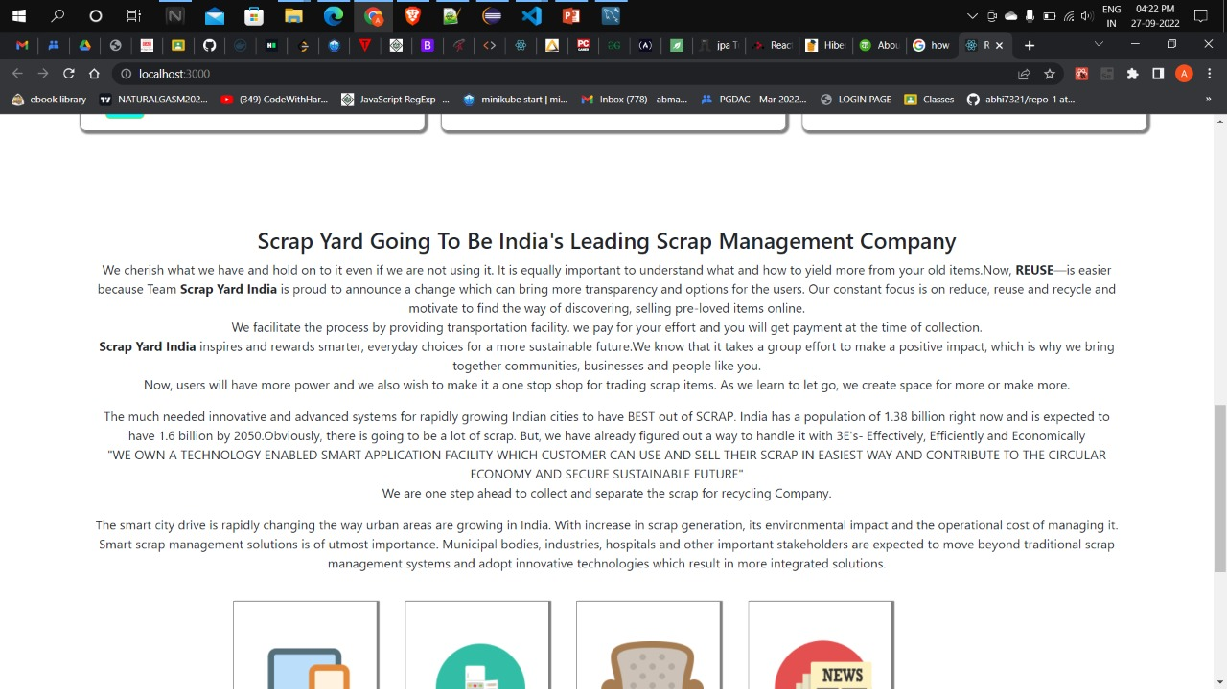

Slide 13
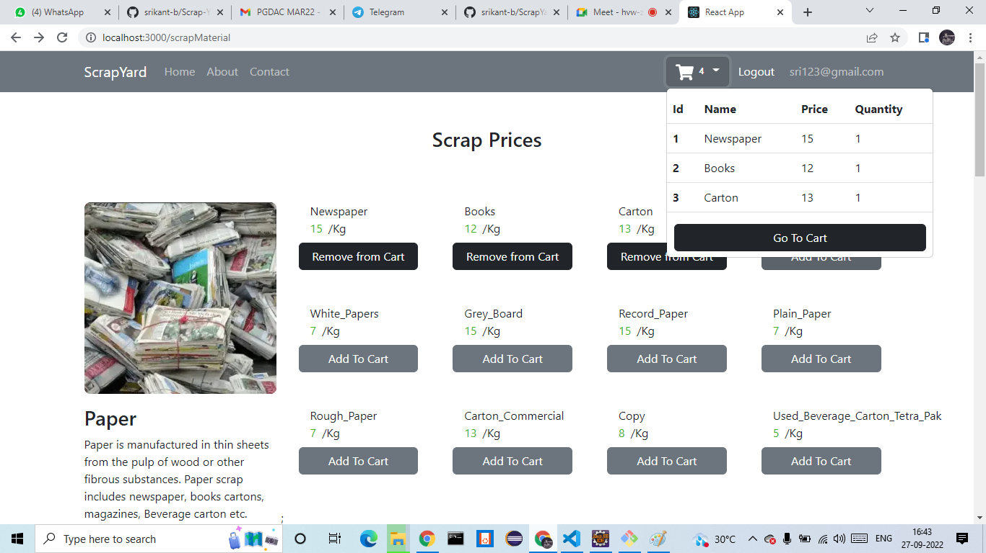

Slide 14
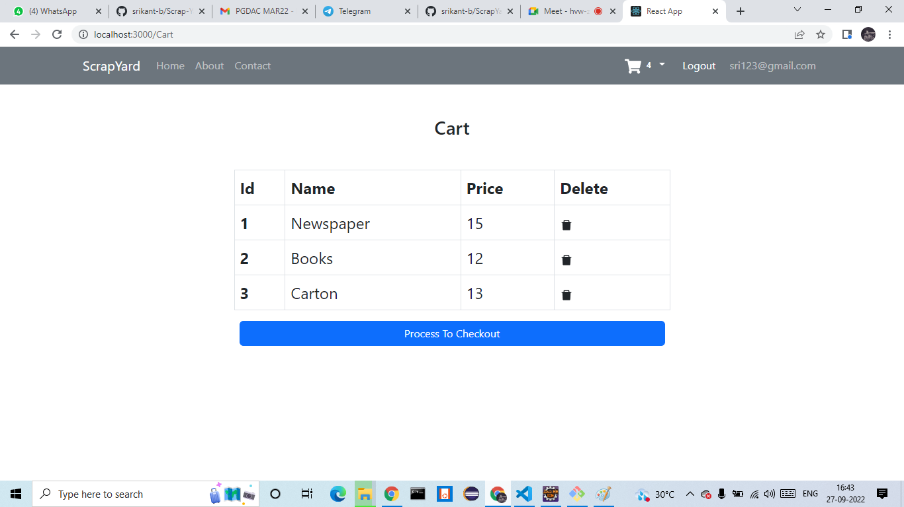

Slide 15
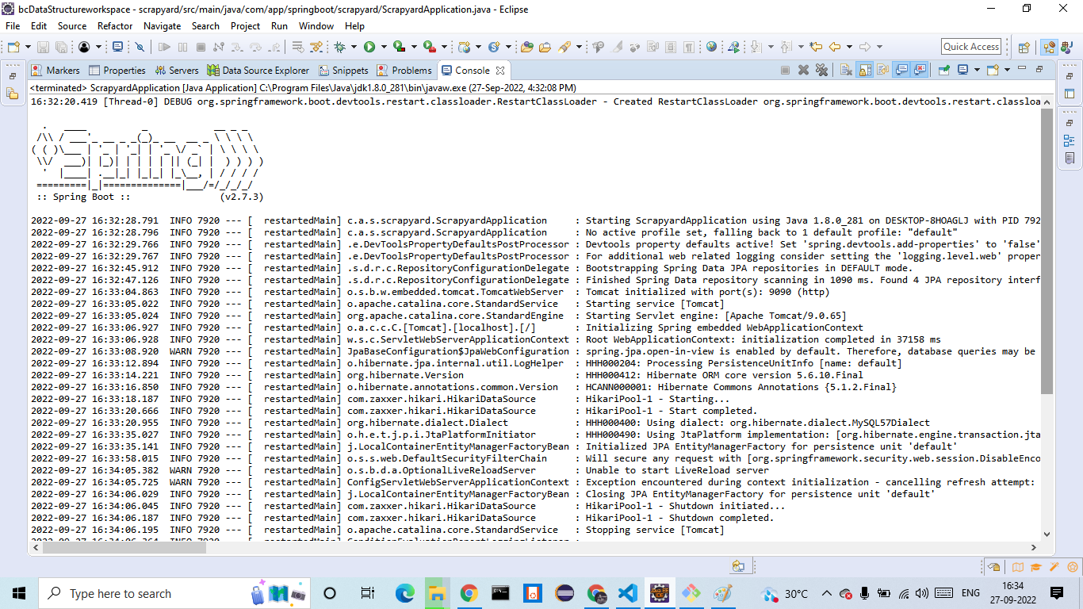

Slide 16
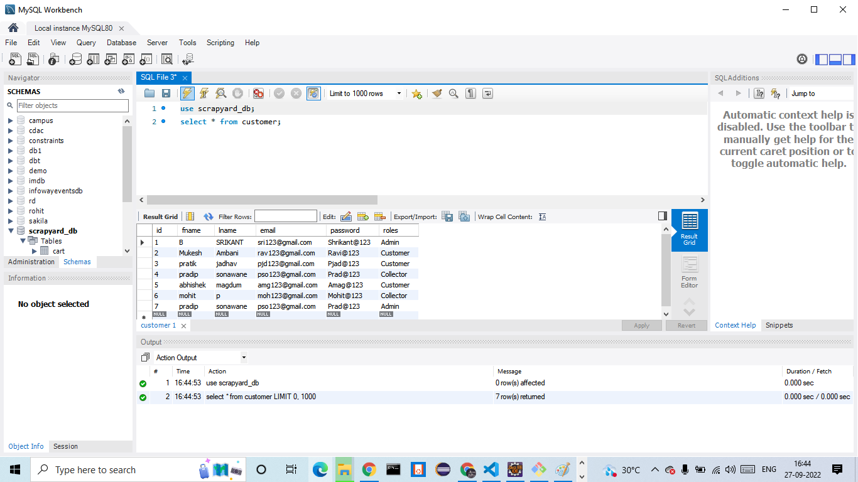

Slide 17
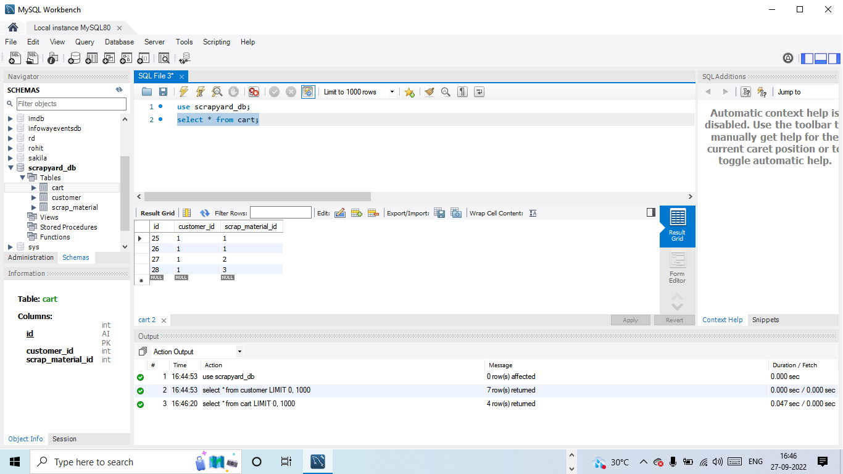

Slide 18
System Requirements
Software Requirements:
• Windows (All Versions)
• Tomcat 9
• Eclipse, MySQL, VS Code
Hardware Components:
• Processor – i3
• Hard Disk – 5 GB
• Memory – 1GB RAM

Slide 19
Technologies Used
React-Js: All front end logic has been written in JSX
CSS : Used for all designing part.
React Bootstrap: All Validation task and animations.
SpringBoot : All the business logic has been written in SpringBoot.
MySQL : MySQL database has been used as database to save every useful data.
Tomcat : Project will run using Tomcat server.

Slide 20
Applications
Digitalizes Scrap Selling.
Good for eco-system.
Recycling Companies can place their requirements to us.

Slide 21
Advantages
Transparency in the system.
Saves Time and energy of customer.
Customers can sell their Scrap online.
Customers get good price of their Scrap-material.

Slide 22
Limitations
1. Internet is mandatory to place order.
2. Industries generate scrap in large amount, so there is limitations in transportation.

Slide 23
Conclusion
The ScrapYard Web Application will be designed and developed to overcome the drawbacks of old manual system and meet the requirement of modern age. This system will digitalize the recycling industry and give more profit to customers as well as RECYCLING companies. Companies can FOCUS on their Core part of their buisness. They Dont Need To Worry About the seperation and collection of scrap. It will save Environment and also time of the company . Lastly it can be improved in future according to rising demand of users.

Slide 24
Future Scope
Improvement can be done in payment method .
Improvement in design of collector Api.
Mobile Application.
Tracking System.
Advertisements Zone for Recycling companies.
Recycled Products e-commerce
Chat BOT

Slide 25
References
https://docs.spring.io/
https://react-bootstrap.github.io/
https://github.com/
https://dev.mysql.com/doc/

Slide 26
Not Just A ThankFul Note
Mr. Saleel Bagde for MySQL database.
Mrs. Harshita Maheshwari for HTML REACT BOOTSTRAP & CSS also she is our project guide.
Mrs. Mayuri Fakipure for SPRINGBOOT.
A special thanks to Mrs. Ulka Joshi (Assistant General Manager - Operations at DesignTech System Pvt Ltd.) and the whole Infoway Management who did every great thing to us.

Slide 27
THANK YOU

