Slide 1
Image Fusion
-Srikant nayak

Slide 2
content
Definition
Type of levels
Algorithm
Application

Slide 3

Fusion Imaging
It is defined as the “Set of methods, tools and means of using data from two or more different images to improve the quality of information”

Slide 4
Goal
Combine higher spatial information in one band with higher spectral information in another dataset to create higher resolution multispectral datasets and images

Slide 5
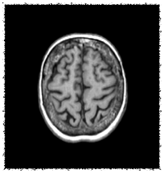

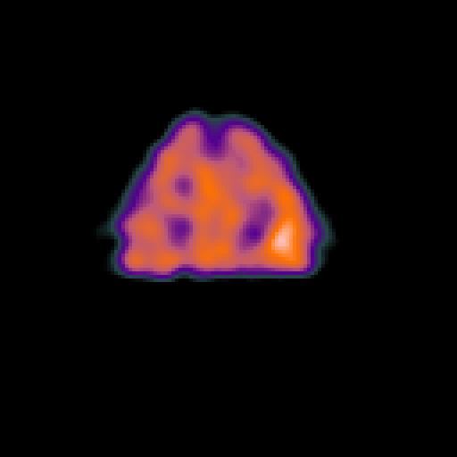
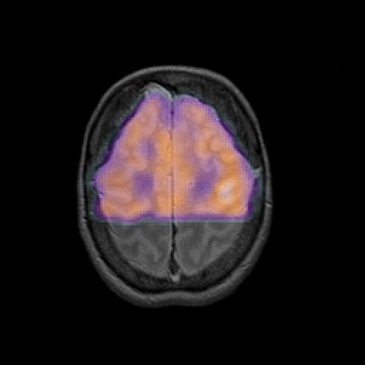
Why to fuse?
Sharper Image Resolution and
Improved classification

Slide 6

Image fusion can be performed at different levels
Signal level
Pixel level
Feature level
Symbol level

Slide 7
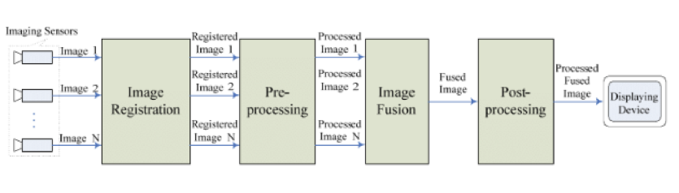
Generic pixel-level image fusion architecture

Slide 8
Fusion Algorithms
Principal Component Analysis
Wavelet Transform

Slide 9
principal component analysis(PCA)
Principal component analysis is a statistical procedure that uses an orthogonal transformation to convert a set of observations of possibly correlated variables into a set of values of linearly uncorrelated variables called principal components.

Slide 10
The first principal component is taken to be along the direction with the maximum variance.
The second principal component is constrained to lie in the subspace perpendicular to the 1st principal component and so on…..

Slide 11
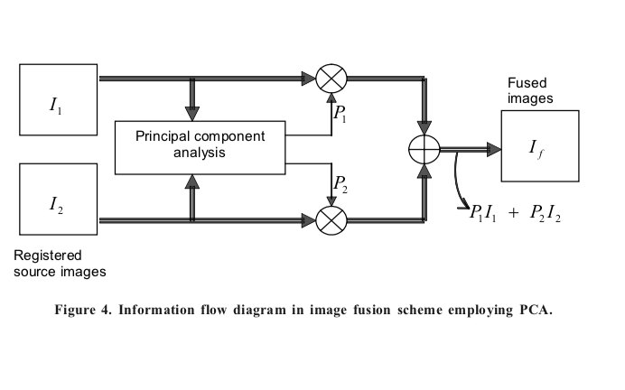
Principal Component Analysis (PCA)

Slide 12
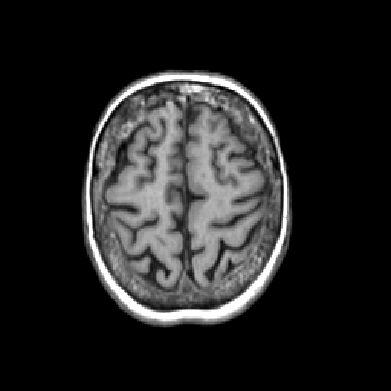

Slide 13
Wavelet transform

Slide 14
Why wavelet not fourier?
1. In Fourier theory , the signal is decomposed into sine and cosine but in wavelet the signal is projected on a set of wavelet function
2. The abrupt change can analysis by. Wavelet transform but in Fourier transform it can’t

Slide 15
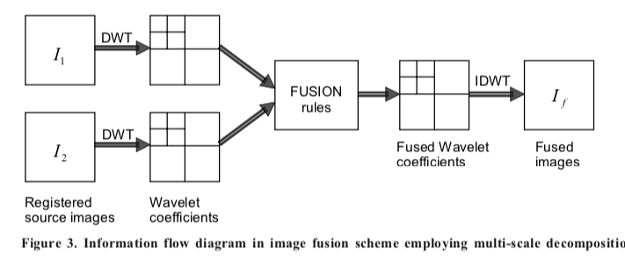

Slide 16
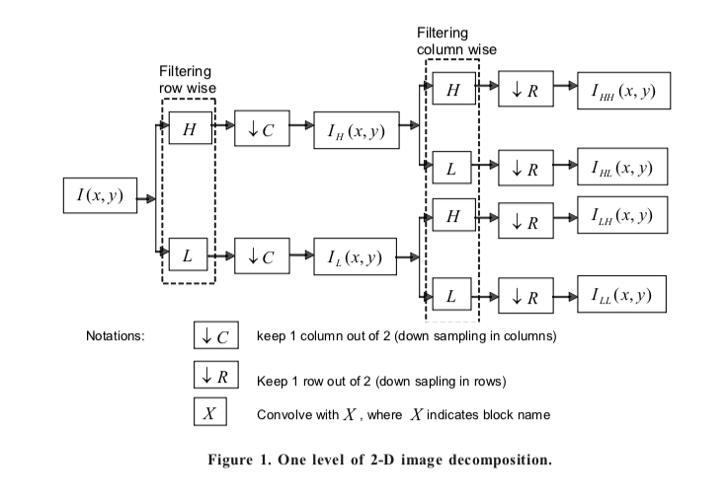
Wavelet Transform

Slide 17
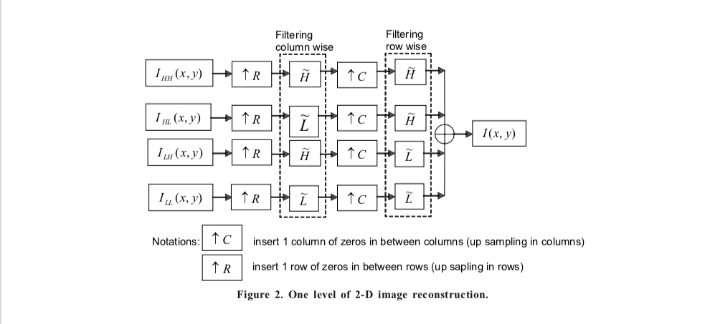

Slide 19
Application
1. medical imaging
2. for remote sensing and medical application
3. recognising a air force vehicle
4. In the field of satellite

