Slide 1


“Library Management System Project”
Submitted by: Srikanta kakarla
Submission type : Individual
Name: Library Management System
Batch : B12
LMS Id : srikantask03@gmail.com
Program : Axis School of Fintech
Date: 01/06/2023

Slide 2

Git Link: https://github.com/srikanta1998/Library_Management_System.git

Slide 3
Table of contents
Introduction
Project Overview
Architecture Design
User Interface Design
Back-end Development
Front-end Development
Conclusion
Future Work
References

Slide 4
Introduction
A library management system is a software project designed to streamline and automate various tasks involved in managing a library. The system typically allows librarians to add, update, and delete books from the library catalog, along with their details such as title, author, publication, and availability status. It enables easy search and retrieval of books based on different criteria, making it convenient for library users to find the resources they need.
Furthermore, the library management system facilitates the circulation process, including issuing and returning books, tracking due dates, and managing fines for late returns. It also maintains member records, allowing librarians to manage user accounts, Additionally, the system may include features like reservation, inter-library loan management, and integration with online databases for seamless access to digital resources. Reporting functionalities provide insights into library usage, popular books, and overdue items, aiding in decision-making and resource planning.

Slide 5
Project Overview
This project consists of various functionalities, and technologies being used :
Technologies :
Back-End
1. SpringBoot Framework
2. Spring MVC Framework
3. REST API
4. REST Template
4. JPA Repository, Hibernate
5. Lombok, spring web, DevTools
Technologies :
Front-End
1. ReactJS Framework
2. axios library
3. React Router JS Framework
4. useNavigation, useLocation Hooks
5. UseState, useEffect Hooks
6. localstorage object
7. Boostrap, CSS

Slide 6
Project Overview
This project consists of various functionalities, and technologies being used :
Functionalities :
1. Login and Logout,
2. Validations,
3. CRUD Operations,
4. Searching,
5. Routing,
6. Api's Communication,
7. Securing pages with check-in functionality
Technologies :
DataBase
1. MySql database
2. SQLyog Workbench
Tools
1. Postman
Server
1. Tomcat

Slide 7
Project Overview
This project consists of various functionalities, and technologies being used :
Annotations :
Springframework
- @SpringBootApplication, @Bean, @Autowired, @Repository
- @CrossOrigin, @RestController, @RequestMapping
- @PostMapping, @PutMapping,
@GetMapping, @DeleteMapping
Annotations :
lombok
- @Data, @NoArgsConstructor,
@AllArgsConstructor
jakarta
- @Entity, @Id, @Table, @Column

Slide 8
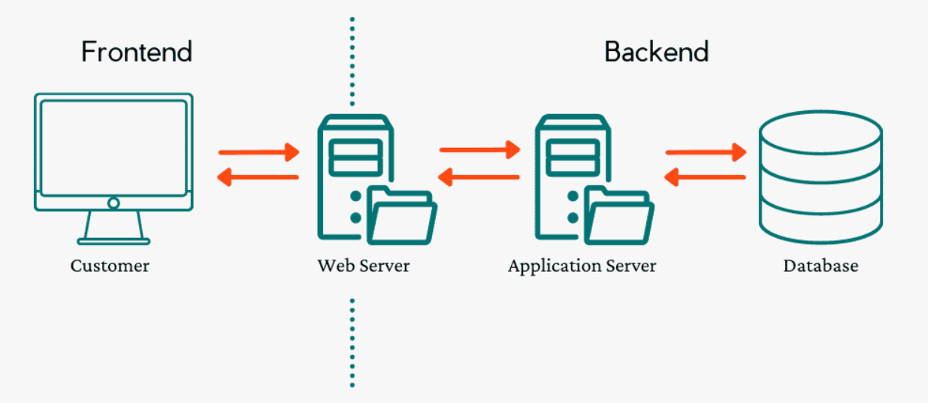
Architecture Design

Slide 9
User Interface Design
User Module
Login
&
Logout
View
&
Update Details
Search all Books
Reserve Books
Borrow Books
View due_date & Fines.

Slide 10
User Interface Design
Admin Module
Login
&
Logout
User
CRUD
Books
CRUD
View
Reservation
View Borrowings
View Fines, return & Due Dates

Slide 11



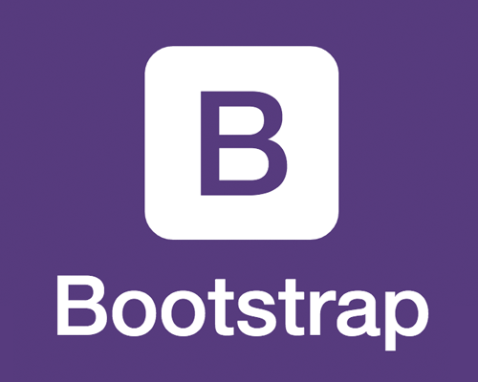
Front-end Development
HTML is used to define the structure and layout of the user interface components.
ReactJS is used to develop the front-end web applications that runs on web server.
Bootstrap is mainly used to style the UI-elements and layouts of the structure.
CSS is used to style and customize the appearance of components and elements.

Slide 12



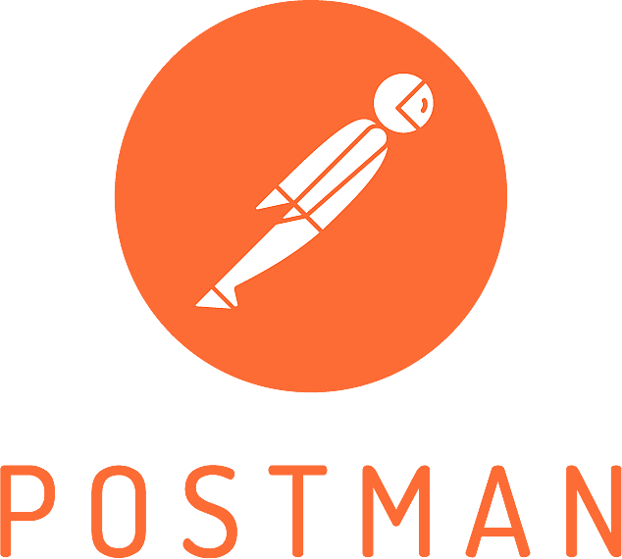
Back-end Development
Java 8 is features are used in the application to achieve some of its features.
SpringBoot is a framework to develop web applications, api’s and microservices.
MySQL is used as database which stores data in the tables with fixed schemas.
Postman is a api development and testing tool mainly used to communicating with api’s.

Slide 13
Conclusion
By implementing a library management system, libraries can benefit from several advantages. Firstly, it simplifies the task of cataloging and maintaining an organized database of books, journals, and other materials. It allows for efficient searching and retrieval of library resources, enhancing user experience and reducing manual effort. Additionally, it enables librarians to manage user accounts, track borrowing history, and handle fines or penalties more effectively.
Moreover, a library management system facilitates the implementation of reservation systems, enabling users to reserve books or request interlibrary loans. It also supports reporting and analytics, providing insights into library usage, popular titles, and user preferences.

Slide 14
Future Work
Junit Testing
Payment Gateway
JWT Token
Cloud

Slide 15
References
https://exlibrisgroup.com/products/alma-library-services-platform/
https://koha-community.org/
https://evergreen-ils.org/
https://www.sirsidynix.com/symphony/

Slide 16
Thank You

