Slide 1
Meshless Deformations Based on Shape Matching
CSE528 – Computer Graphics
Srikant Aggarwal

Slide 2

Shape Matching
x_{i} = R(x_{i}⁰ – t₀) + t
Needs to find R, t₀, t. Applying least square minimization
Minimizing Σm_{i} [R(x_{i}⁰ – t₀) + t- x_{i}]²
t₀ = Σ m_{i} x_{i}⁰ / Σm_{i} = x_{cm}⁰ (Center of mass for original shape)
t = Σm_{i} x_{i} / Σm_{i} = x_{cm} (Center of mass for current shape)
Σm_{i} [R(x_{i}⁰ – t₀) + t- x_{i}]² -> Σm_{i} (Aq_{i} - p_{i})²
where, q_{i} = x_{i}⁰ - x_{cm}⁰, p_{i} = x_{i} – x_{cm}, A = (Σm_{i}p_{i}q_{i}^{T})(Σm_{i}q_{i}q_{i}^{T})⁻¹ = A_{pq}A_{qq}
Solving for optimal R, A_{pq} = R S, S = (A_{pq}^{T}A_{pq})^{1/2},
R = AS⁻¹, Goal Position, g_{i} = R (x_{i}⁰ – x_{cm}⁰) + x_{cm}

Slide 3
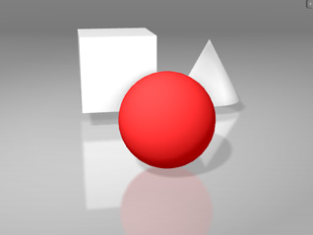
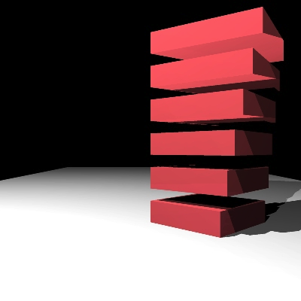
Dynamics
v = v(t) = v(t+h) + h F_{ext} / m + α (g(t) – x(t)) / h
x(t+h) = x(t) + v(t+h)*h
Rigid Body : Setting α= 1
Linear Deformation : g_{i} = (βA + (1-β)R)(x_{i}⁰ – x_{cm}⁰) + x_{cm}
Ensure volume is conserved: A / (det(A))^{1/3}
Advantages : Games, Animation industry, real time controllable

