Slide 1
Cyber Threat Detection Based on Artificial Neural Networks Using Event Profiles
Under the guidence of : a.uday kiran
B. sai kumar[197r1a05c9]
G. srikanth[197r1a05e0]
j. Sainath reddy[197r1a05e2]

Slide 2
ABSTRACT
One of the major challenges in cyber security is the provision of an automated and effective cyber-threats detection technique. In this project, we present an AI technique for cyber-threats detection, based on artificial neural networks. The proposed technique converts multitude of collected security events to individual event profiles and use a deep learning-based detection method for enhanced cyber-threat detection. For this work, we developed an AI-SIEM system based on a combination of event profiling for data preprocessing and different artificial neural network methods, including FCNN, CNN, and LSTM.

Slide 3
To evaluate the performance comparison with existing methods, we conducted experiments using the five conventional machine-learning methods (SVM, k-NN, RF, NB, and DT). Consequently, the experimental results of this study ensure that our proposed methods are capable of being employed as learning-based models for network intrusion-detection, and show that although it is employed in the real world, the performance outperforms the conventional machine-learning methods. With the emergence of artificial intelligence (AI) techniques, learning-based approaches for detecting cyber attacks, have become further improved, and they have achieved significant results in many studies. However, owing to constantly evolving cyber attacks, it is still highly challenging to protect IT systems against threats and malicious behaviors in networks. Because of various network intrusions and malicious activities, effective defenses and security considerations were given high priority for finding reliable solutions.

Slide 4
EXISTING SYSTEM
Cyber security has recently received enormous attention in today’s security concerns, due to the popularity of the Internet-of-Things (IoT), the tremendous growth of computer networks, and the huge number of relevant applications. Thus, detecting various cyber-attacks or anomalies in a network and building an effective intrusion detection system that performs an essential role in today’s security is becoming more important. However, many previous studies used benchmark dataset, which, though accurate, are not generalizable to the real world because of the insufficient features. To overcome these limitations, an employed learning model requires to evaluate with datasets that are collected in the real world. Third, using an anomaly-based method to detect network intrusion can help detect unknown cyber threats; whereas it can also cause a high false alert rate.

Slide 5
DISADVANTAGES OF EXISTING SYSTEM
Data leakage is take place using Cyber attacks.
It is less Secured from cyber attacks.

Slide 6
PROPOSED SYSTEM
we present an AI technique for cyber-threats detection, based on artificial neural networks. The proposed technique converts multitude of collected security events to individual event profiles and use a deep learning-based detection method for enhanced cyber-threat detection. For this work, we developed an AI-SIEM system based on a combination of event profiling for data preprocessing and different artificial neural network methods, including FCNN, CNN, and LSTM. The system focuses on discriminating between true positive and false positive alerts, thus helping security analysts to rapidly respond to cyber threat. we conducted experiments using the five conventional machine-learning methods (SVM, k-NN, RF, NB, and DT). Consequently, the experimental results of this study ensure that our proposed methods are capable of being employed as learning-based models for network intrusion-detection.

Slide 7
ADVANTAGES OF PROPOSED SYSTEM
It is employed in the real world, the performance outperforms the conventional machine-learning methods.
In this project data is secured from attacker.

Slide 8
SYSTEM REQUIREMENTS
SOFTWARE REQUIREMENTS
Operating System : Windows 10
Python IDE : python 3.2.7,pycharm
HARDWARE REQUIREMENTS
RAM : 4GB and Higher
Processor : i3processor
Hard Disk : 500GB

Slide 9
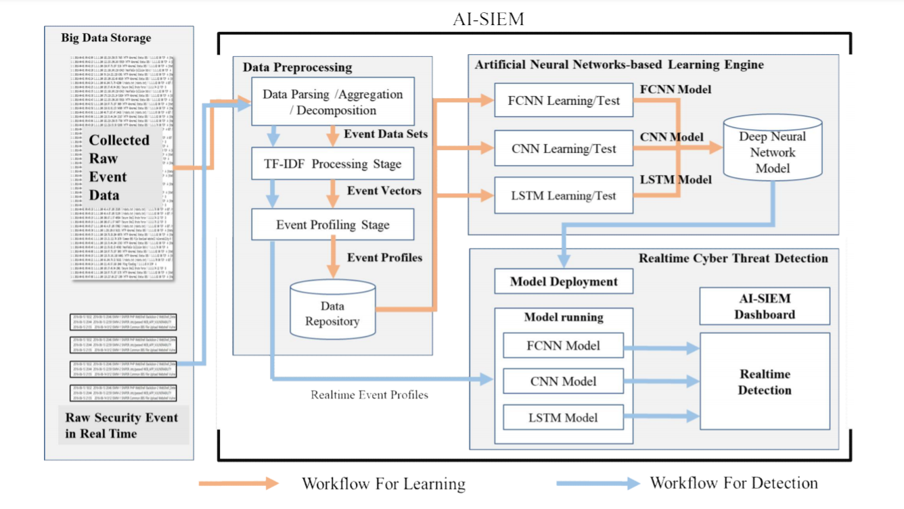
PROJECT ARCHITECTURE

Slide 10
MODULES
Upload Train Dataset
Run Preprocessing TF-IDF Algorithm
Generate Event Vector
Neural Network Profiling
Run SVM Algorithm
Run KNN Algorithm
Run Naive Bayes Algorithm
Run Decision Tree Algorithm
Accuracy Comparison Graph
Precision Comparison Graph
Recall Comparison Graph
FMeasure Comparison Graph

Slide 11
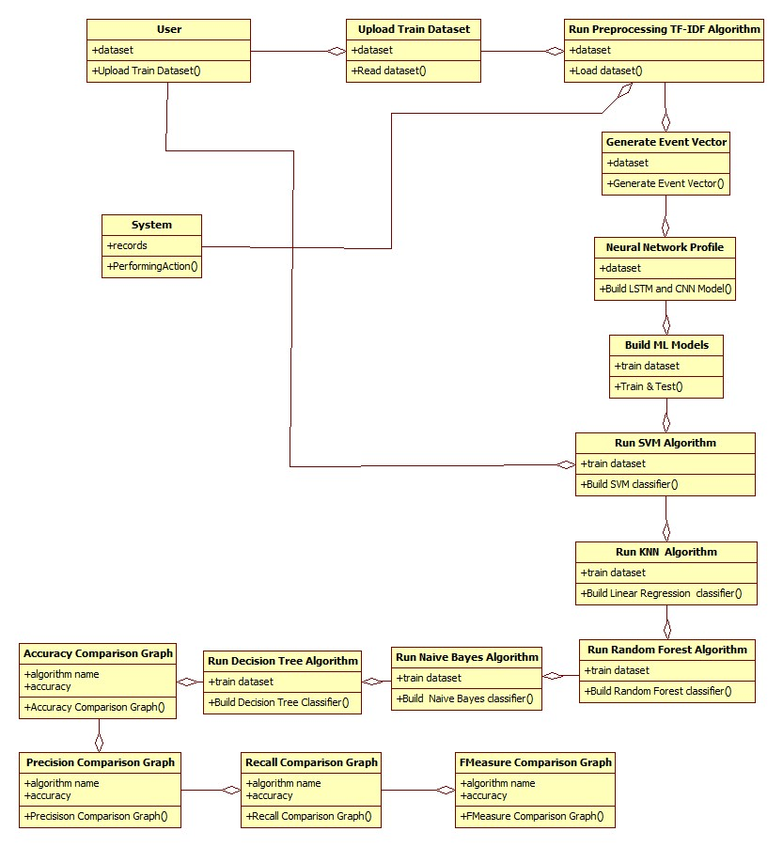
UML DIAGRAMS
CLASS DIAGRAM

Slide 12
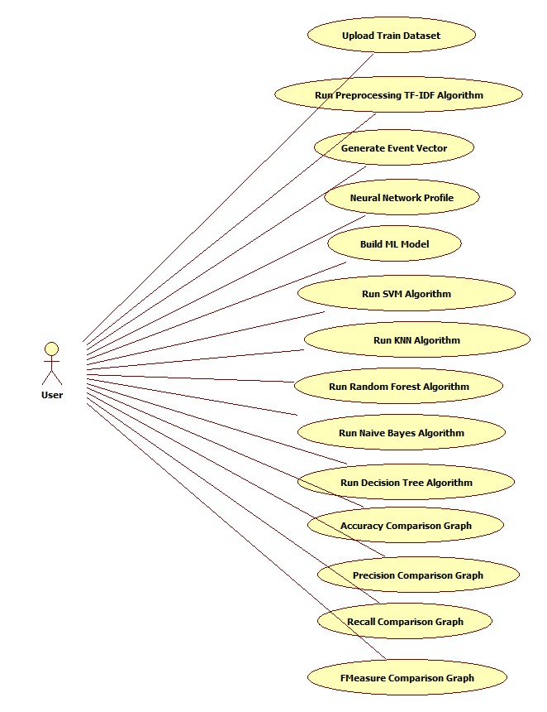
USECASE DIAGRAM

Slide 13
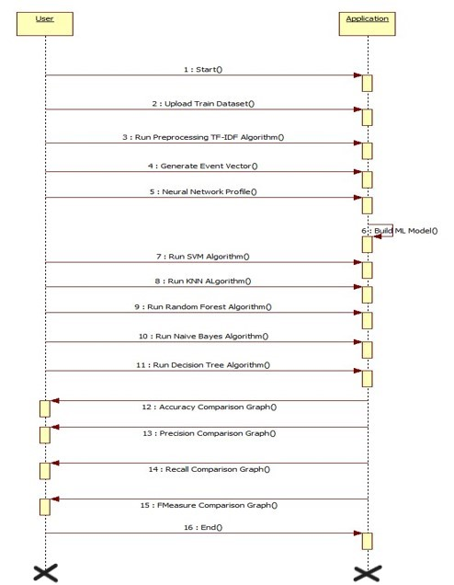
SEQUENCE DIAGRAM

Slide 14
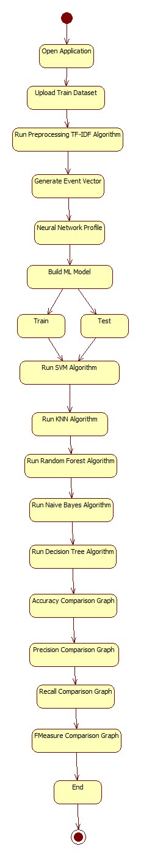
ACTIVITY DIAGRAM

Slide 15
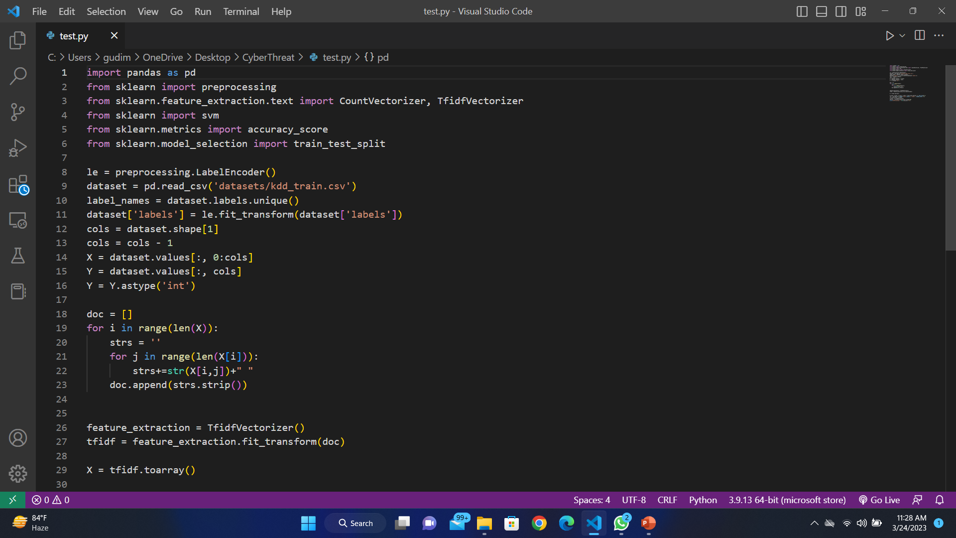
SAMPLE CODE

Slide 16
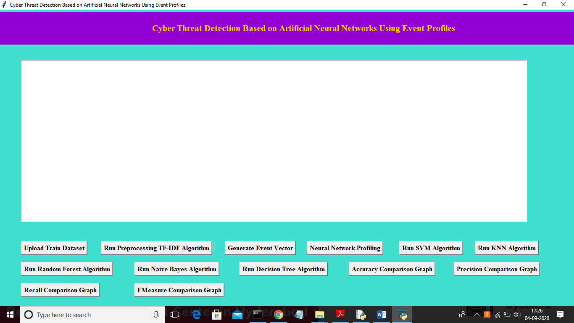
RESULTS
To run project double click on ‘run.bat’ file to get below screen

Slide 17
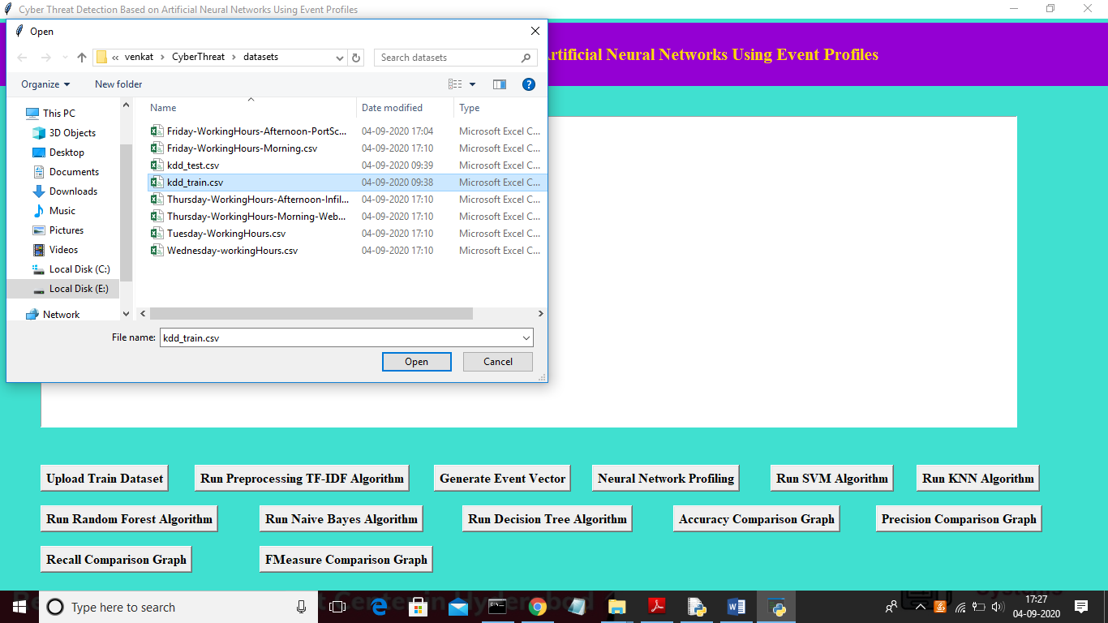
In above screen click on ‘Upload Train Dataset’ button and upload dataset.

Slide 18
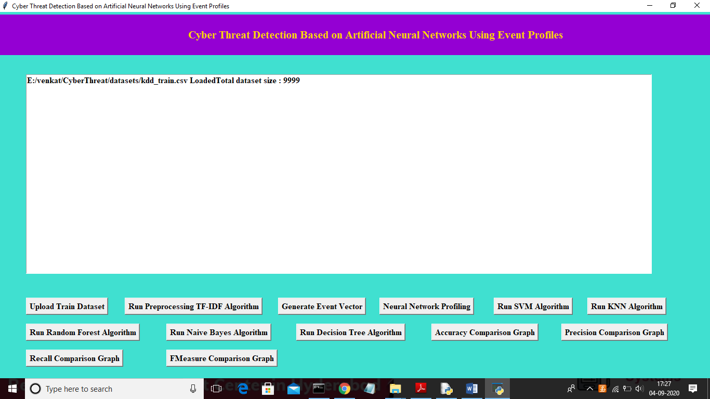
In above screen uploading ‘kdd_train.csv’ dataset and after upload will get below screen

Slide 19
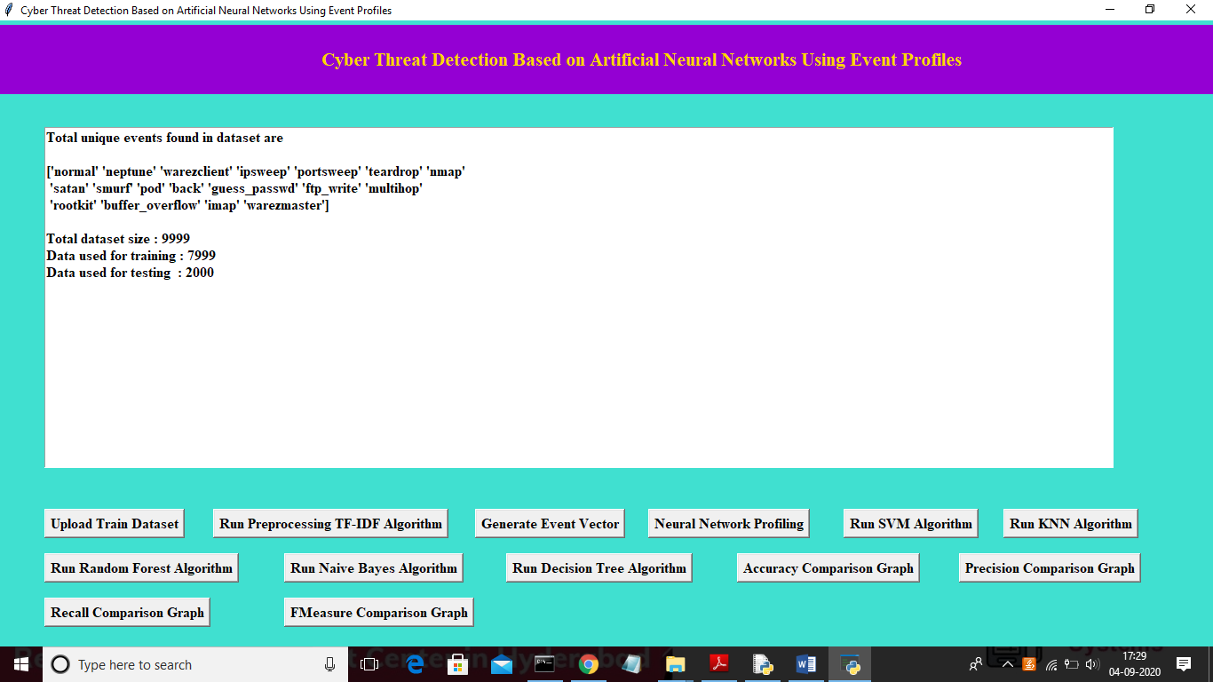
In above screen we can see total different unique events names and in below we can see dataset total size and application using 80% dataset (7999 records) for training and using 20% dataset (2000 records) for testing. Now dataset train and test events model ready and now click on ‘Neural Network Profiling’ button to create LSTM and CNN model

Slide 20
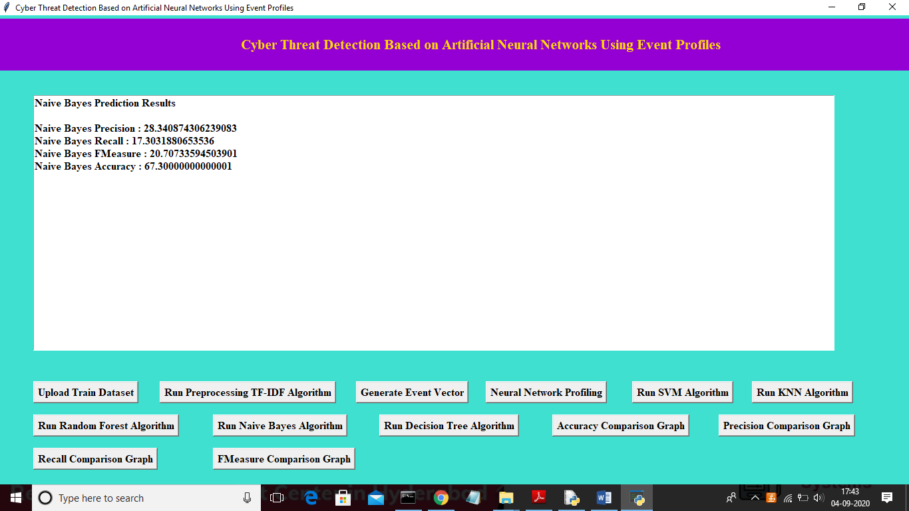
In above screen we can see Naïve Bayes algorithm output values and now click on ‘Run Decision Tree Algorithm’ to run Decision Tree Algorithm

Slide 21

Now click on ‘Accuracy Comparison Graph’ button to get accuracy of all algorithms

Slide 22
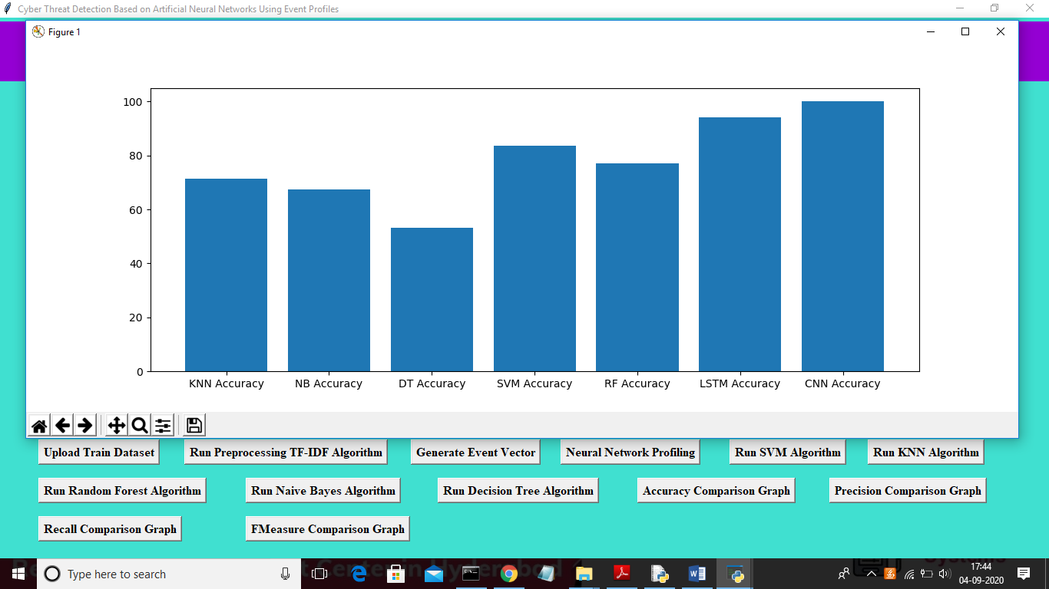
In above graph x-axis represents algorithm name and y-axis represents accuracy of those algorithms and from above graph we can conclude that LSTM and CNN perform well. Now click on Precision Comparison Graph’ to get below graph

Slide 23
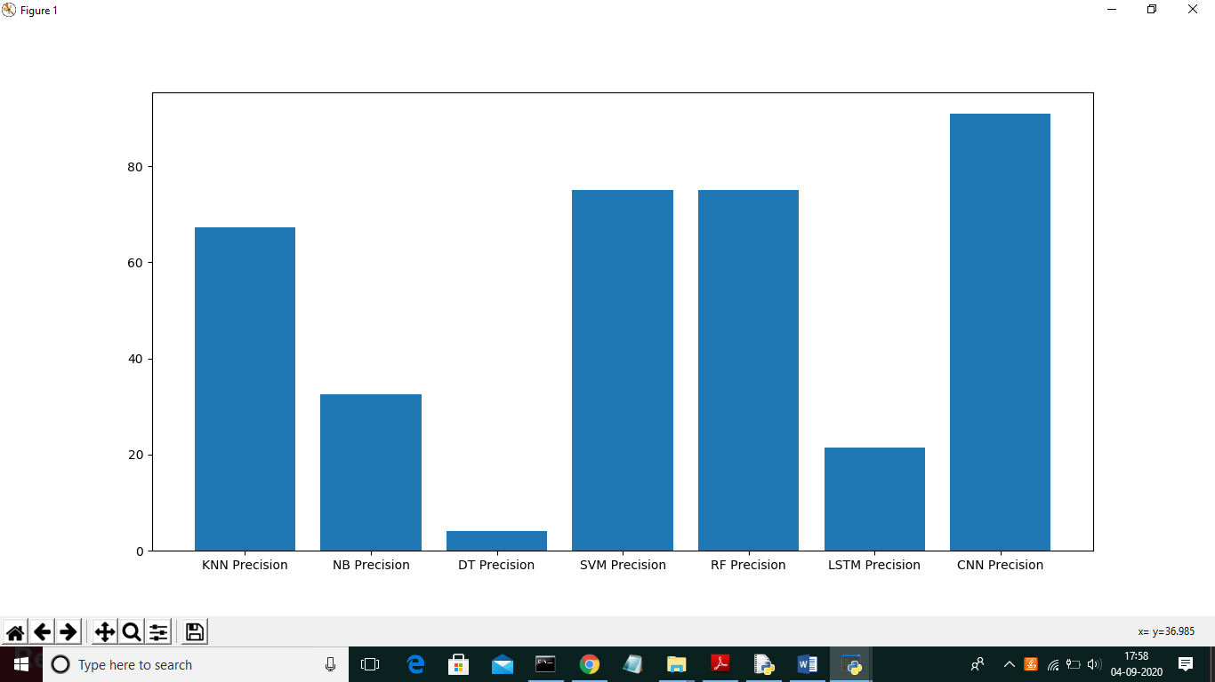
In above graph CNN is performing well and now click on ‘Recall Comparison Graph’

Slide 24
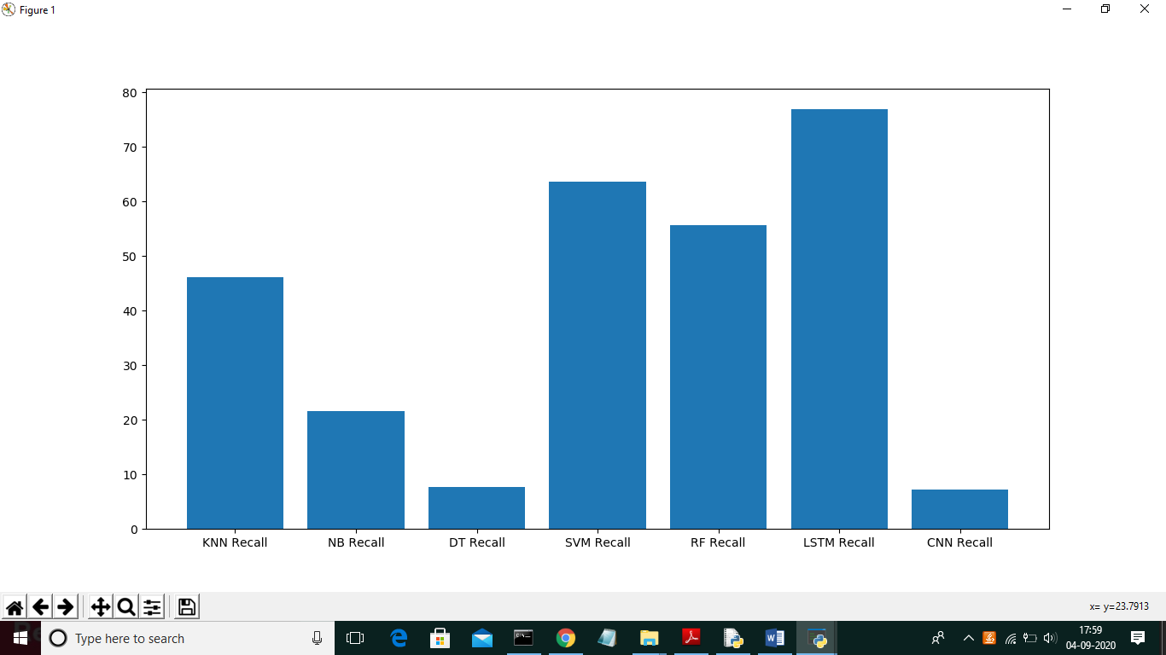
In above graph LSTM is performing well and now click on FMeasure Comparison Graph button to get below graph

Slide 25
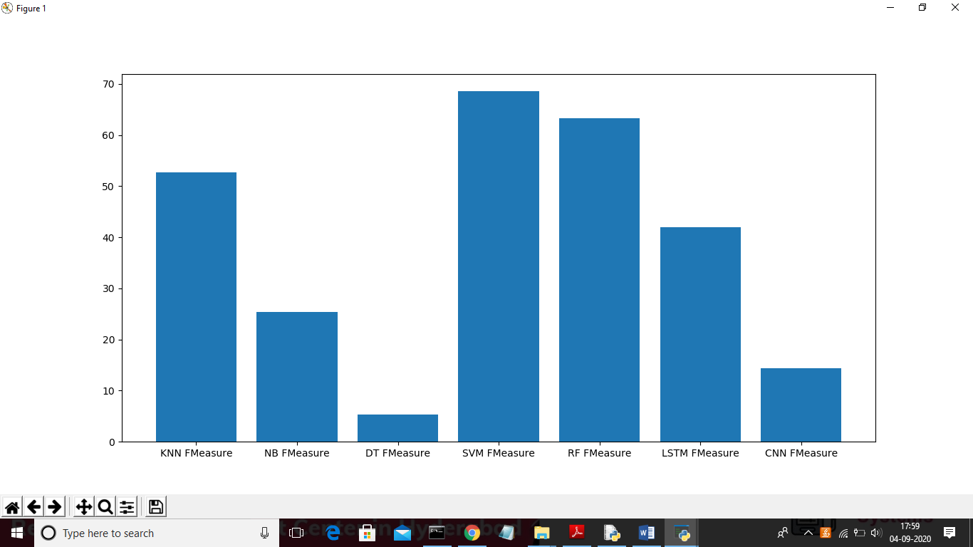
From all comparison graph we can see LSTM and CNN performing well with accuracy, recall and precision.

Slide 26
CONCLUSION
In this project, we have proposed the AI-SIEM system using event profiles and artificial neural networks. The novelty of our work lies in condensing very large-scale data into event profiles and using the deep learning-based detection methods for enhanced cyber-threat detection ability. The AI-SIEM system enables the security analysts to deal with significant security alerts promptly and efficiently by comparing long term security data. By reducing false positive alerts, it can also help the security analysts to rapidly respond to cyber threats dispersed across a large number of security events.

Slide 27


