Slide 1
Cyber Threat Detection Based on ArtificialNeural Networks Using Event Profiles

Slide 2
ABSTRACT
One of the major challenges in cyber security is the provision of an automated and effective cyber-threats detection technique. In this paper, we present an AI technique for cyber-threats detection, based on artificial neural networks. The proposed technique converts multitude of collected security events to individual event profiles and use a deep learning-based detection method for enhanced cyber-threat detection. For this work, we developed an AI-SIEM system based on a combination of event profiling for data preprocessing and different artificial neural network methods, including FCNN, CNN, and LSTM. The system focuses on discriminating between true positive and false positive alerts,thus helping security analysts to rapidly respond to cyber threats. All experiments in this study are performed by authors using two benchmark datasets (NSLKDD and CICIDS2017) and two datasets collected in the real world. To evaluate the performance comparison with existing methods, we conducted experiments using the five conventional machine-learning methods (SVM, k-NN, RF, NB, and DT). Consequently, the experimental results of this study ensure that our proposed methods are capable of being employed as learning-based models for network intrusion-detection, and show that although it is employed in the real world, the performance outperforms the conventional machine-learning methods.

Slide 3
INTRODUCTION
MOTIVATION:
With the emergence of artificial intelligence (AI) techniques, learning-based approaches for detecting cyber attacks, have become further improved, and they have achieved significant results in many studies. However, owing to constantly evolving cyber attacks, it is still highly challenging to protect IT systems against threats and malicious behaviors in networks. Because of various network intrusions and malicious activities, effective defenses and security considerations were given high priority for finding reliable solutions.

Slide 4
PROBLEM DEFINITION
The SIEM is the most common and dependable solution among various security operations solutions to analyze the collected security events and logs. Moreover, security analysts make an effort to investigate suspicious alerts by policies and threshold, and to discover malicious behavior by analyzing correlations among events, using knowledge related to attacks.
Nevertheless, it is still difficult to recognize and detect intrusions against intelligent network attacks owing to their high false alerts and the huge amount of security data. Hence, the most recent studies in the field of intrusion detection have given increased focus to machine learning and artificial intelligence techniques for detecting attacks. Advancement in AI fields can facilitate the investigation of network intrusions by security analysts in a timely and automated manner. These learning-based approaches require to learn the attack model from historical threat data and use the trained models to detect intrusions for unknown cyber threats.

Slide 5
OBJECTIVE
For this work, we developed an AI-SIEM system based on a combination of event profiling for data preprocessing and different artificial neural network methods, including FCNN, CNN, and LSTM. The system focuses on discriminating between true positive and false positive alerts, thus helping security analysts to rapidly respond to cyber threats. All experiments in this study are performed by authors using two benchmark datasets (NSLKDD and CICIDS2017) and two datasets collected in the real world. To evaluate the performance comparison with existing methods, we conducted experiments using the five conventional machine-learning methods (SVM, k-NN, RF, NB, and DT).

Slide 6
LITERATURE SURVEY
Network Intrusion Detection Based on Directed Acyclic Graph and Belief Rule Base
Abstract: Intrusion detection is very important for network situation awareness. While a few methods have been proposed to detect network intrusion, they cannot directly and effectively utilize semi‐quantitative information consisting of expert knowledge and quantitative data. Hence, this paper proposes a new detection model based on a directed acyclic graph (DAG) and a belief rule base (BRB). In the proposed model, called DAG‐BRB, the DAG is employed to construct a multi‐layered BRB model that can avoid explosion of combinations of rule number because of a large number of types of intrusion. To obtain the optimal parameters of the DAG‐BRB model, an improved constraint covariance matrix adaption evolution strategy (CMA‐ES) is developed that can effectively solve the constraint problem in the BRB. A case study was used to test the efficiency of the proposed DAG‐BRB. The results showed that compared with other detection models, the DAG‐BRB model has a higher detection rate and can be used in real networks.

Slide 7
LITERATURE SURVEY
HAST-IDS: Learning hierarchical spatial-temporal features using deep neural networks to improve intrusion detection
Abstract:The development of an anomaly-based intrusion detection system (IDS) is a primary research direction in the field of intrusion detection. An IDS learns normal and anomalous behavior by analyzing network traffic and can detect unknown and new attacks. However, the performance of an IDS is highly dependent on feature design, and designing a feature set that can accurately characterize network traffic is still an ongoing research issue. Anomaly-based IDSs also have the problem of a high false alarm rate (FAR), which seriously restricts their practical applications. In this paper, we propose a novel IDS called the hierarchical spatial-temporal features-based intrusion detection system (HAST-IDS), which first learns the low-level spatial features of network traffic using deep convolutional neural networks (CNNs) and then learns high-level temporal features using long short-term memory networks. The entire process of feature learning is completed by the deep neural networks automatically; no feature engineering techniques are required. The automatically learned traffic features effectively reduce the FAR. The standard DARPA1998 and ISCX2012 data sets are used to evaluate the performance of the proposed system. The experimental results show that the HAST-IDS outperforms other published approaches in terms of accuracy, detection rate, and FAR, which successfully demonstrates its effectiveness in both feature learning and FAR reduction.

Slide 8
EXISTING SYSTEM
Cyber security has recently received enormous attention in today’s security concerns, due to the popularity of the Internet-of-Things (IoT), the tremendous growth of computer networks, and the huge number of relevant applications. Thus, detecting various cyber-attacks or anomalies in a network and building an effective intrusion detection system that performs an essential role in today’s security is becoming more important. However, many previous studies used benchmark dataset, which, though accurate, are not generalizable to the real world because of the insufficient features. To overcome these limitations, an employed learning model requires to evaluate with datasets that are collected in the real world. Third, using an anomaly-based method to detect network intrusion can help detect unknown cyber threats; whereas it can also cause a high false alert rate.

Slide 9
DISADVANTAGES OF EXISTING SYSTEM
Data leakage is take place using Cyber attacks.
It is less Secured from cyber attacks

Slide 10
PROPOSED SYSTEM
we present an AI technique for cyber-threats detection, based on artificial neural networks.
The proposed technique converts multitude of collected security events to individual event profiles and use a deep learning-based detection method for enhanced cyber-threat detection.
For this work, we developed an AI-SIEM system based on a combination of event profiling for data preprocessing and different artificial neural network methods, including FCNN, CNN, and LSTM.
The system focuses on discriminating between true positive and false positive alerts, thus helping security analysts to rapidly respond to cyber threat. we conducted experiments using the five conventional machine-learning methods (SVM, k-NN, RF, NB, and DT). Consequently, the experimental results of this study ensure that our proposed methods are capable of being employed as learning-based models for network intrusion-detection.

Slide 11
ADVANTAGES OF PROPOSED SYSTEM
it is employed in the real world, the performance outperforms the conventional machine-learning methods.
In this project data is secured from attacker.

Slide 12
SYSTEM REQUIREMENTS
SOFTWARE REQUIREMENTS
Operating System : Windows 10
Python IDE : python 3.2.7,pycharm
HARDWARE REQUIREMENTS
RAM : 4GB and Higher
Processor : i3processor
Hard Disk : 500GB

Slide 13
FUNCTIONAL REQUIREMENTS
1.Data Collection
2.Data Preprocessing
3.Training And Testing
4.Modiling
5.Predicting

Slide 14
NON FUNCTIONAL REQUIREMENTS
NON-FUNCTIONAL REQUIREMENT (NFR) specifies the quality attribute of a software system. They judge the software system based on Responsiveness, Usability, Security, Portability and other non-functional standards that are critical to the success of the software system. Example of nonfunctional requirement, “how fast does the website load?” Failing to meet non-functional requirements can result in systems that fail to satisfy user needs. Non- functional Requirements allows you to impose constraints or restrictions on the design of the system across the various agile backlogs. Example, the site should load in 3 seconds when the number of simultaneous users are > 10000. Description of non-functional requirements is just as critical as a functional requirement.
Usability requirement
Serviceability requirement
Manageability requirement
Recoverability requirement
Security requirement
Data Integrity requirement
Capacity requirement
Availability requirement
Scalability requirement
Interoperability requirement
Reliability requirement
Maintainability requirement
Regulatory requirement
Environmental requirement

Slide 15
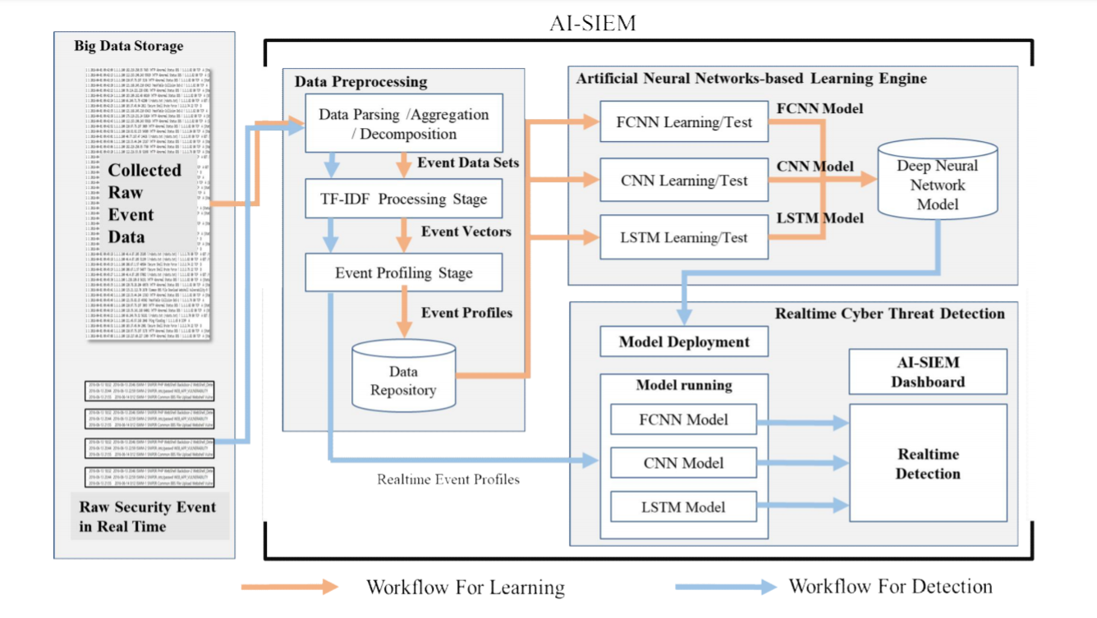
SYSTEM ARCHITECTURE
The workflow and architecture for the developed artificial intelligent (AI)-based SIEM system. The AI-SIEM system comprises three main phases: The data preprocessing, artificial neural networks-based learning engine, and real-time threat detection phase. The first preprocessing phase in the system, termed event profiling, aims at providing concise inputs for various deep neural networks by transforming raw data. In the data preprocessing phase, data aggregation with parsing, data normalization stage using TF-IDF mechanism, and event profiling stage are consecutively performed in the AI-SIEM system. Each stage generates event data sets, event vectors, and event profiles, respectively, and the output is utilized in next each stage, as shown in Figure.

Slide 16
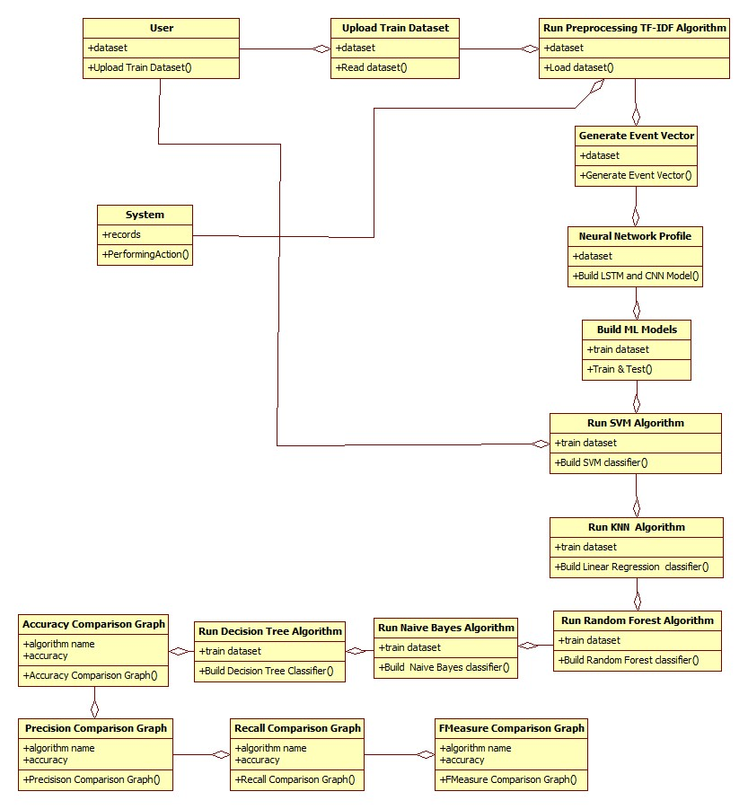
UMLS
CLASS DIAGRAM:

Slide 17
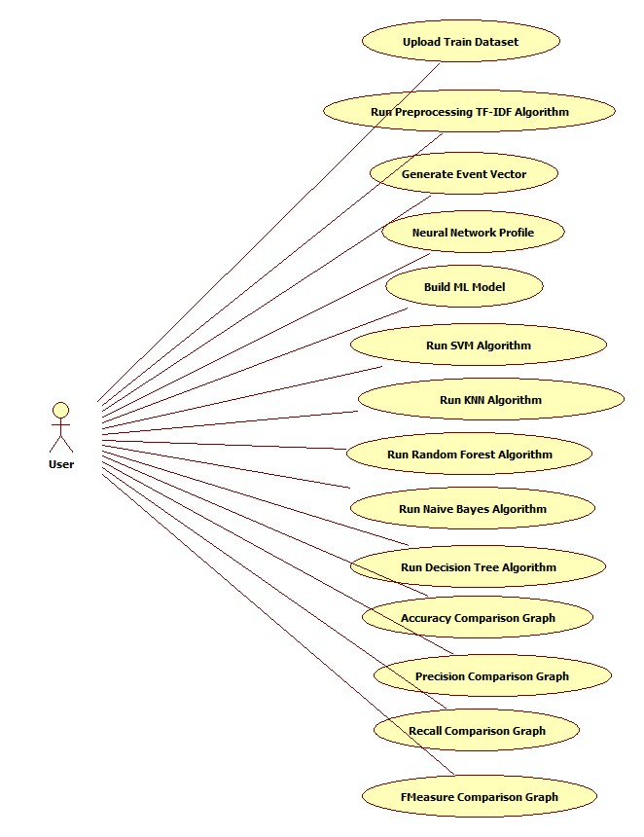
UMLS
USECASE DIAGRAM:

Slide 18
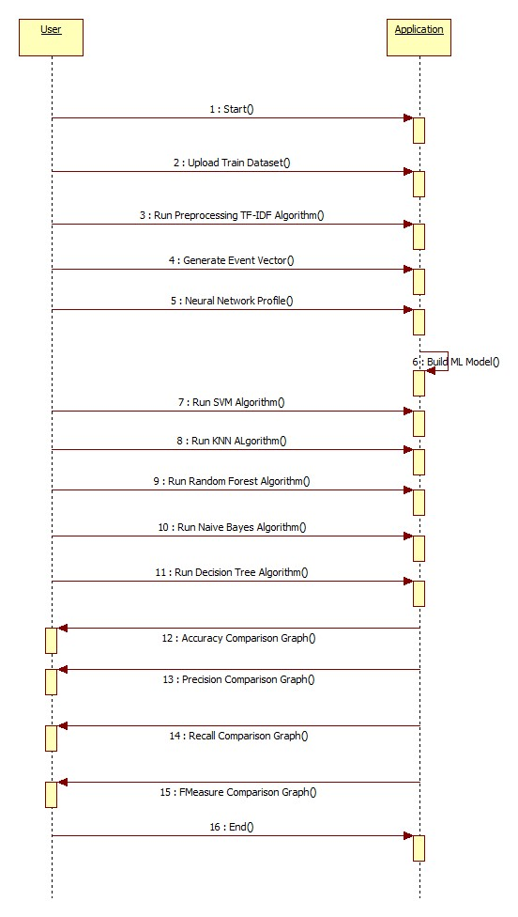
UMLS
SEQUENCE DIAGRAM:

Slide 19
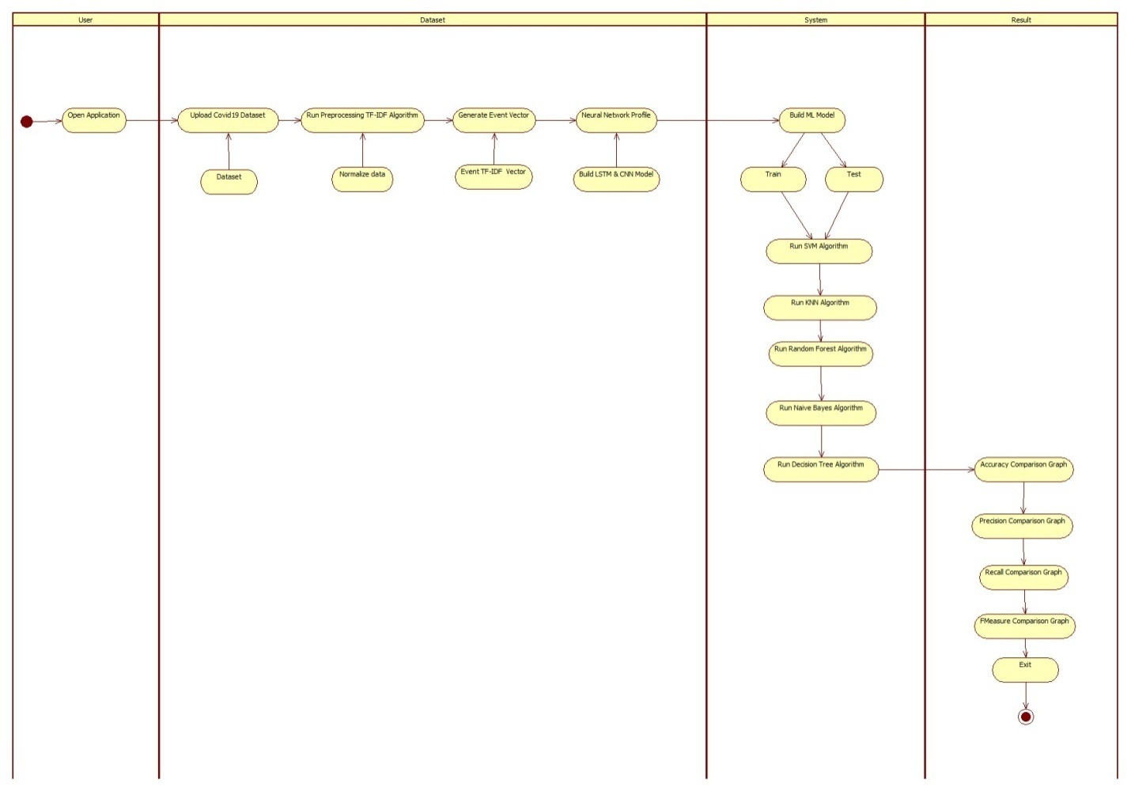
UMLS
ACTIVITY DIAGRAM:

Slide 20
MODULES
Upload Train Dataset
Run Preprocessing TF-IDF Algorithm
Generate Event Vector
Neural Network Profiling
Run SVM Algorithm
Run KNN Algorithm
Run Naive Bayes Algorithm
Run Decision Tree Algorithm
Accuracy Comparison Graph
Precision Comparison Graph
Recall Comparison Graph
FMeasure Comparison Graph

Slide 21
Data Parsing: This module take input dataset and parse that dataset to create a raw data event model
TF-IDF: using this module we will convert raw data into event vector which will contains normal and attack signatures
Event Profiling Stage: Processed data will be splitted into train and test model based on profiling events.
Deep Learning Neural Network Model: This module runs CNN and LSTM algorithms on train and test data and then generate a training model. Generated trained model will be applied on test data to calculate prediction score, Recall, Precision and FMeasure. Algorithm will learn perfectly will yield better accuracy result and that model will be selected to deploy on real system for attack detection.
Datasets which we are using for testing are of huge size and while building model it’s going to out of memory error but kdd_train.csv dataset working perfectly but to run all algorithms it will take 5 to 10 minutes. You can test remaining datasets also by reducing its size or running it on high configuration system.

Slide 22
Python Libraries
NumPy: Base n-dimensional array package
SciPy: Fundamental library for scientific computing
Matplotlib: Comprehensive 2D/3D plotting
IPython: Enhanced interactive console
Sympy: Symbolic mathematics
Pandas: Data structures and analysis
Extensions or modules for SciPy care conventionally named SciKits

Slide 23
ALGORITHMS
SVM
KNN
Random Forest
Naive Bayes
Decision Tree
CNN -LSTM

Slide 24
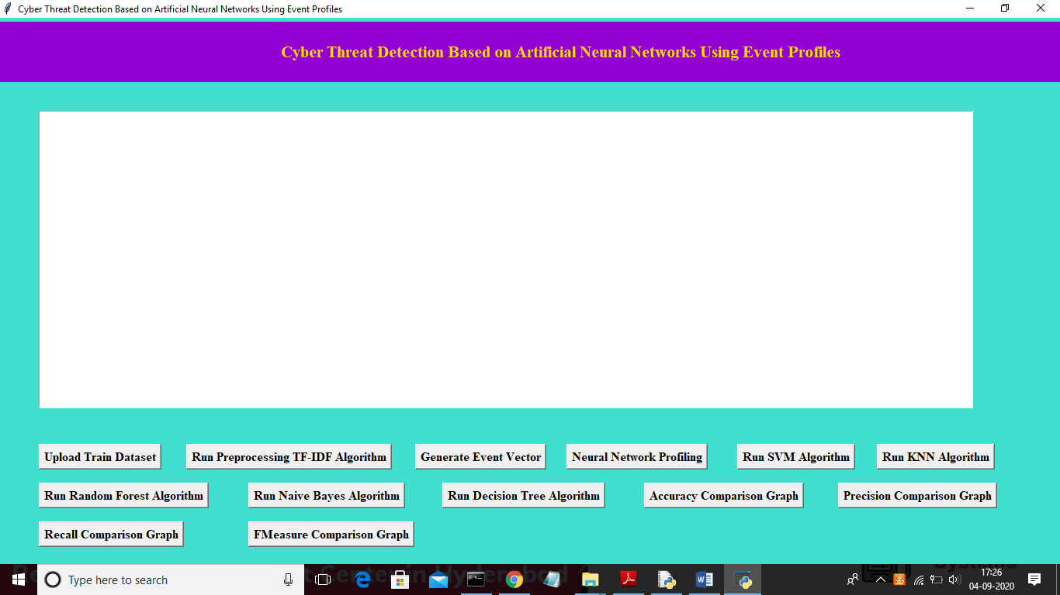
SCREEN
To run project double click on ‘run.bat’ file to get below screen

Slide 25
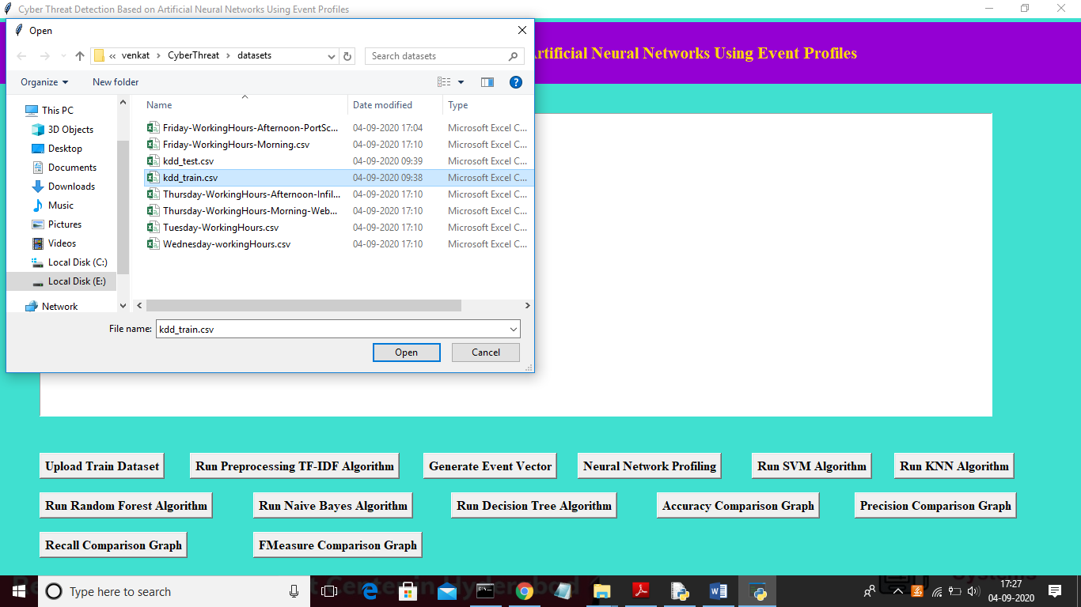
SCREEN
In above screen click on ‘Upload Train Dataset’ button and upload dataset.

Slide 26
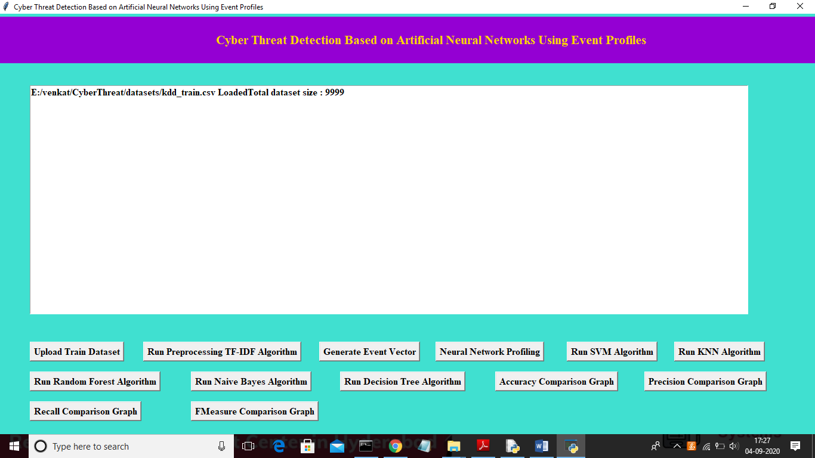
SCREEN
In above screen uploading ‘kdd_train.csv’ dataset and after upload will get below screen

Slide 27
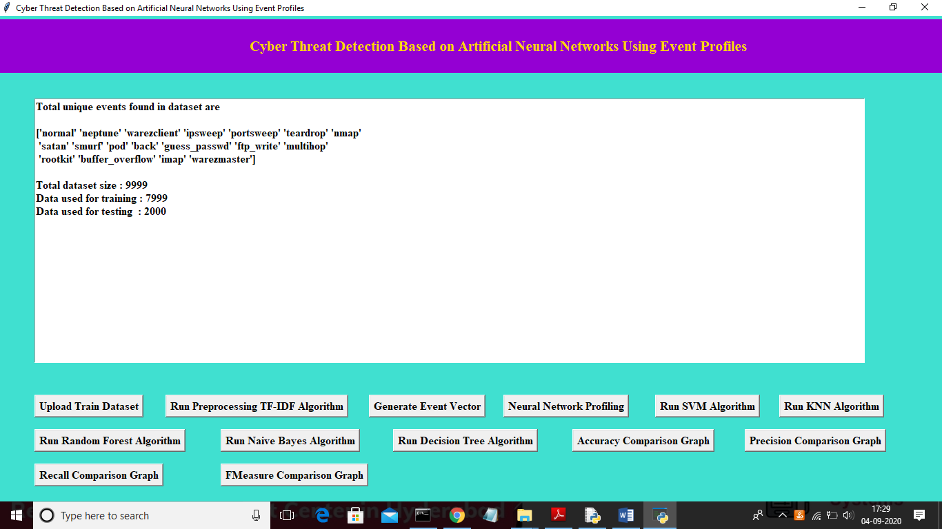
SCREEN
In above screen we can see total different unique events names and in below we can see dataset total size and application using 80% dataset (7999 records) for training and using 20% dataset (2000 records) for testing. Now dataset train and test events model ready and now click on ‘Neural Network Profiling’ button to create LSTM and CNN model

Slide 28
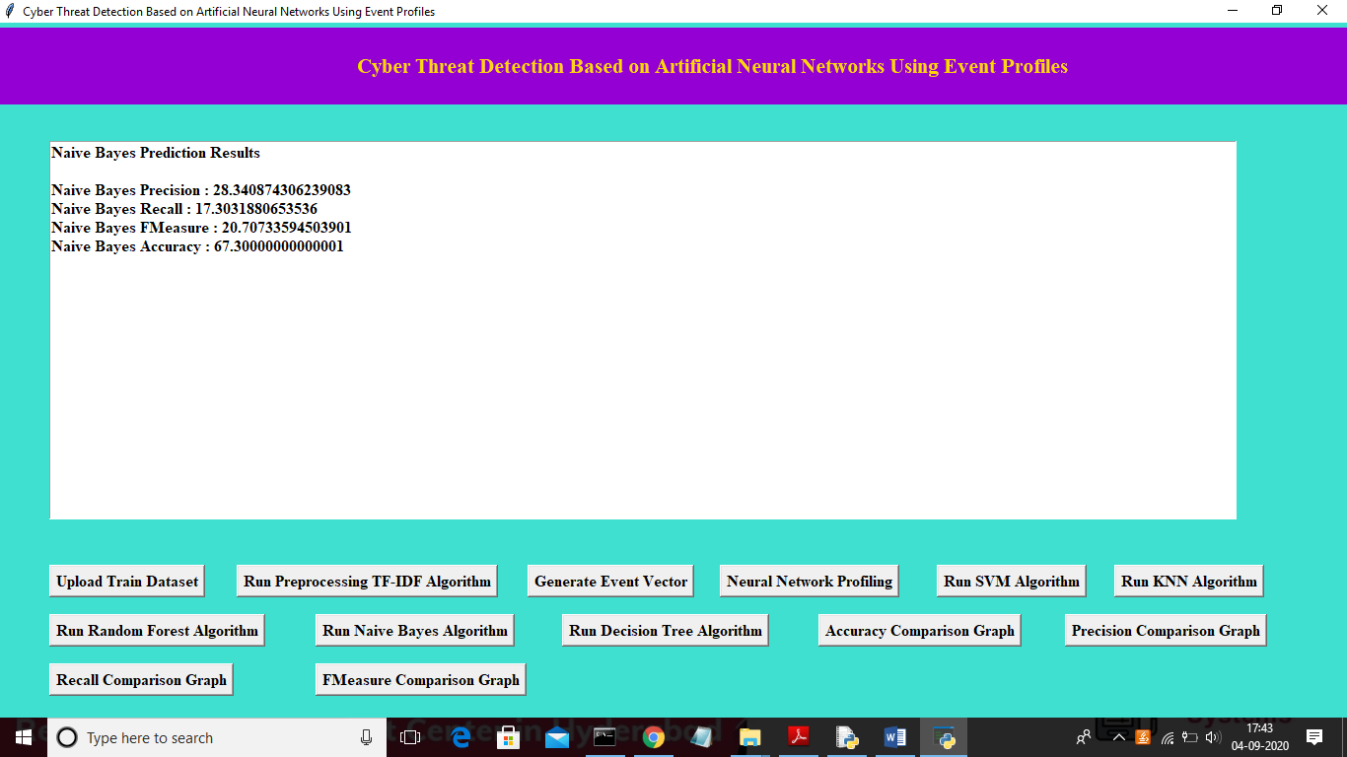
SCREEN
In above screen we can see Naïve Bayes algorithm output values and now click on ‘Run Decision Tree Algorithm’ to run Decision Tree Algorithm

Slide 29

SCREEN
Now click on ‘Accuracy Comparison Graph’ button to get accuracy of all algorithms

Slide 30
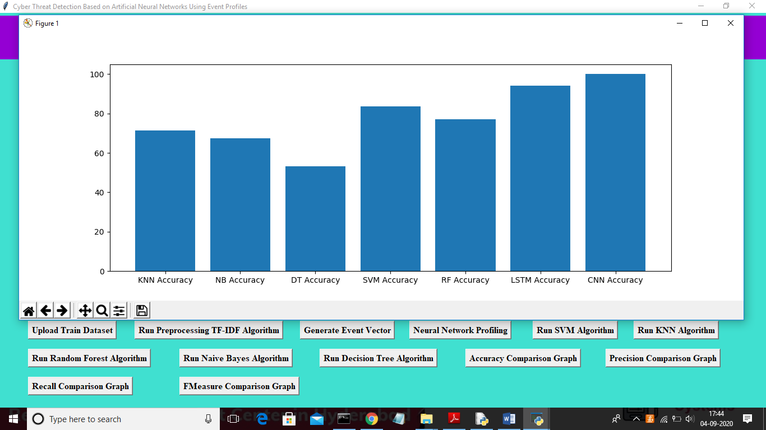
SCREEN
In above graph x-axis represents algorithm name and y-axis represents accuracy of those algorithms and from above graph we can conclude that LSTM and CNN perform well. Now click on Precision Comparison Graph’ to get below graph

Slide 31
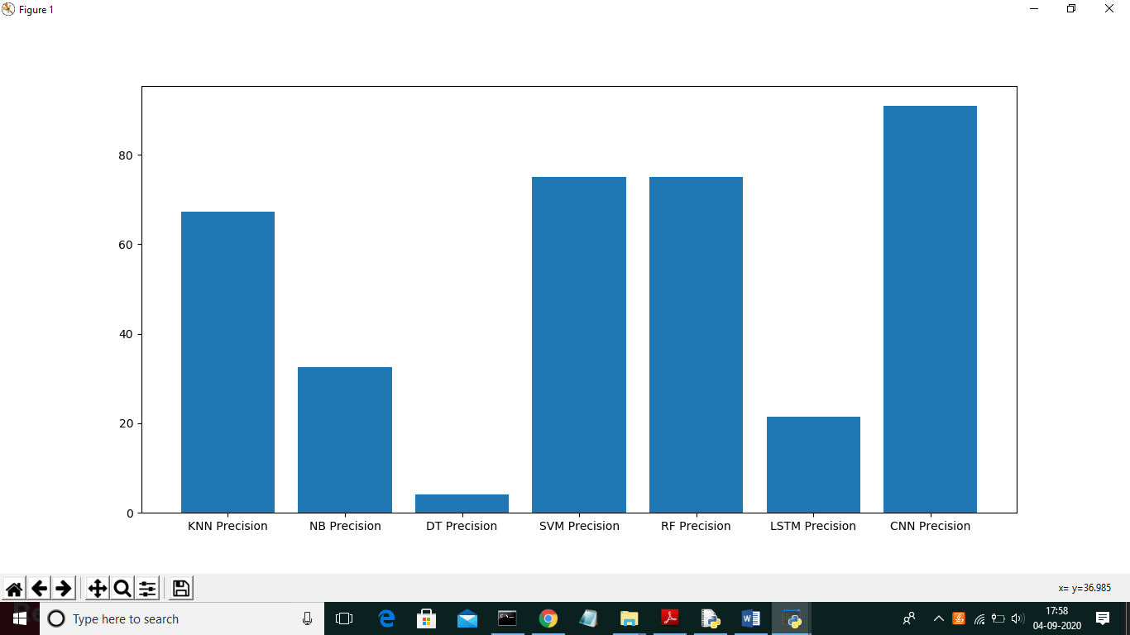
SCREEN
In above graph CNN is performing well and now click on ‘Recall Comparison Graph’

Slide 32
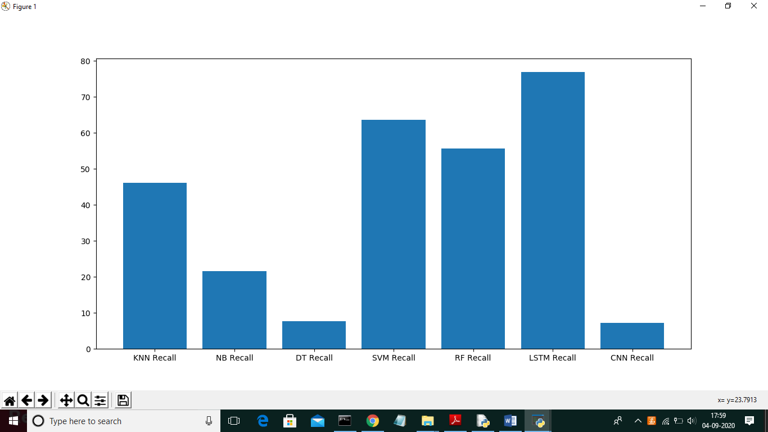
SCREEN
In above graph LSTM is performing well and now click on FMeasure Comparison Graph button to get below graph

Slide 33
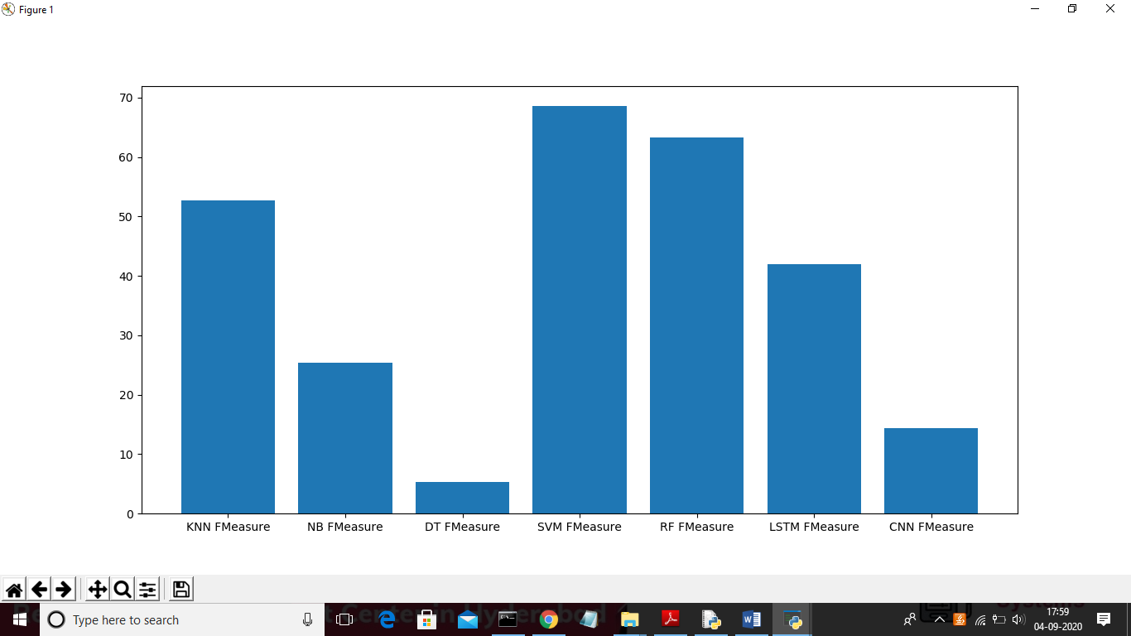
SCREEN
From all comparison graph we can see LSTM and CNN performing well with accuracy, recall and precision.

Slide 34
CONCLUSION
In this paper, we have proposed the AI-SIEM system using event profiles and artificial neural networks. The novelty of our work lies in condensing very large-scale data into event profiles and using the deep learning-based detection methods for enhanced cyber-threat detection ability. The AI-SIEM system enables the security analysts to deal with significant security alerts promptly and efficiently by comparing longterm security data. By reducing false positive alerts, it can also help the security analysts to rapidly respond to cyber threats dispersed across a large number of security events.
For the evaluation of performance, we performed a performance comparison using two benchmark datasets (NSLKDD, CICIDS2017) and two datasets collected in the real world. First, based on the comparison experiment with other methods, using widely known benchmark datasets, we showed that our mechanisms can be applied as one of thelearning-based models for network intrusion detection. Second, through the evaluation using two real datasets, we presented promising results that our technology also outperformed conventional machine learning methods in terms of accurate classifications.

Slide 35
FUTURE ENHANCEMENT
In the future, to address the evolving problem of cyber attacks, we will focus on enhancing earlier threat predictions through the multiple deep learning approach to discovering the long-term patterns in history data. In addition, to improve the precision of labeled dataset for supervised-learning and construct good learning datasets, many SOC analysts will make efforts directly to record labels of raw security events one by one over several months.

Slide 36
REFERENCE
TEXTBOOKS:
Programming Python:-Mark Lutz
Head First Python:-Paul Barry
Core Python Programming:-R. Nageswara Rao
Learning with Python:-Allen B. Downey
JOURNALS:
[1] S. Naseer, Y. Saleem, S. Khalid, M. K. Bashir, J. Han, M. M. Iqbal,K. Han, "Enhanced Network Anomaly Detection Based on DeepNeural Networks," IEEE Access, vol. 6, pp. 48231-48246, 2018.
[2] B. Zhang, G. Hu, Z. Zhou, Y. Zhang, P. Qiao, L. Chang, "NetworkIntrusion Detection Based on Directed Acyclic Graph and Belief RuleBase", ETRI Journal, vol. 39, no. 4, pp. 592-604, Aug. 2017
[3] W. Wang, Y. Sheng and J. Wang, "HAST-IDS: Learning hierarchicalspatial-temporal features using deep neural networks to improveintrusion detection," IEEE Access, vol. 6, no. 99, pp. 1792-1806,2018.
[4] M. K. Hussein, N. Bin Zainal and A. N. Jaber, "Data security analysisfor DDoS defense of cloud based networks," 2015 IEEE StudentConference on Research and Development (SCOReD), KualaLumpur, 2015, pp. 305-310.
[5] S. Sandeep Sekharan, K. Kandasamy, "Profiling SIEM tools andcorrelation engines for security analytics," In Proc. Int. Conf.Wireless Com., Signal Proce. and Net.(WiSPNET), 2017, pp. 717-721.
[6] N.Hubballiand V.Suryanarayanan,‘‘False alarm minimizationtechniques in signature-based intrusion detection systems: Asurvey,’’ Comput. Commun., vol. 49, pp. 1-17, Aug. 2014.
WEBSITES:
https://www.w3schools.com/python/
https://www.tutorialspoint.com/python/index.htm
https://www.javatpoint.com/python-tutorial
https://www.learnpython.org/
https://www.pythontutorial.net/

Slide 37
THANK YOU

