Slide 1
Analyze Food Delivery Demand Across Regions to Inform Market Expansion & Logistics (FoodTech)
A Data Analytics Project
Presented by : Srikanth S
Mentor : Jaya Pandey
Course : Data Analytics with GenAI
Batch code : DA724S27

Slide 2
Project Introduction and Overview
1
Introduction
2
Project Overview
The FoodTech industry is growing rapidly due to the increasing adoption of online food ordering and digital payment platforms. As customer expectations rise, businesses must analyze customer behavior, regional demand, restaurant performance, and delivery efficiency to remain competitive.
Data analytics transforms operational data into actionable insights that support strategic decision-making.
This capstone project analyzes FoodTech data related to customers, restaurants, delivery partners, and orders.
Using SQL, Python, Excel, and Power BI, the project examines:
Customer purchasing and loyalty patterns
Regional demand and market expansion opportunities
Restaurant and cuisine performance
Delivery efficiency and logistics performance
Statistical relationships and predictive insights using machine learning

Slide 3

Business Problem Statement
Difficulty identifying regions with high customer demand and revenue potential.
Challenges in evaluating restaurant and cuisine performance using revenue, customer ratings, and operational metrics.
Limited visibility into customer purchasing behavior, spending patterns, and loyalty
Difficulty identifying business trends and using data to improve market expansion, logistics planning, and operational decision-making.
Lack of clear performance benchmarking for delivery partners across vehicle types and regions.
Absence of an integrated reporting system that provides a consolidated view of business performance.

Slide 4
Business Objectives and Analytical Scope
Objective 1: Identify Market Expansion Opportunities
Analyze regional demand, revenue potential, customer segments and cuisine preferences to identify high-potential markets for expansion
Key analysis areas:
* Regional Revenue and Demand
* Customer segment contribution
* Cuisine performance
Objective 2: Improve Delivery and Logistics Efficiency
Evaluate delivery time, vehicle performance, delivery partner efficiency, and operational factors affecting delivery performance.
Key analysis areas:
*Delivery-time categories
* Vehicle-wise performance
* Delivery speed and efficiency
Objective 3: Understand Customer Behavior and Loyalty
Examine customer purchasing patterns, spending behavior, ratings and segment level performance to support customer retention.
Key analysis areas:
* Customer spending patterns
* Customer segment
* Ratings and engagement
Objective 4: Evaluate overall business performance
Assess restaurant, cuisine, delivery and monthly business trends to support operational planning and strategic decision-making
Key analysis areas:
* Restaurant performance
* Revenue and order trends
* Operational performance
🌍
🛵
👥
📊

Slide 5
Dataset Overview
The FoodTech dataset consists of four related tables containing customer, order, restaurant, and delivery partner information. Together, these tables support analysis of customer behavior, regional demand, business performance, restaurant operations, and delivery efficiency.
Customers
Key attributes: Customer type, Age group, City, Total Orders, Average spend, Preferred cuisine
Business use: Customer Segmentation, Spending behavior and loyalty analysis
Orders
Key attributes: Order value, Final amount, Region, Delivery Time, Rating, Payment method, Festival Flag
Business use: Revenue, Demand, Delivery and seasonal trend analysis
Restaurants
Key attributes: Cuisine Type, Average rating, Preparation time, Daily Capacity
Business use: Restaurant performance and operational efficiency analysis
Delivery Partners
Key attributes: Vehicle type, Delivery speed, Successful/Delayed Deliveries, Customer rating, Efficiency score
Business use: Delivery performance and Logistics analysis
👥
🛒
🛵
🍽️

Slide 6
Project Workflow
🐍
📐
💡
🧹
Business insights & recommendations
Data Cleaning & Preprocessing
Exploratory Data Analysis
Statistical Analysis
Market expansion, customer retention, logistics and operational recommendations
Missing values, duplicates, data types, and feature preparation
Data visualization, business analysis and operational pattern identification
Probability, Sampling distribution and hypothesis testing
02
04
06
08
01
03
05
07
📂
🗄️
📊
🤖
Raw Data Collection
SQL Database Design & Analysis
Dashboard development
Machine Learning
Customer, Order, Restaurant, and Delivery Partner datasets
Excel & Power Bi dashboards for interactive performing monitoring
Simple and Multiple Linear Regression and Logistic Regression
Tables, ER diagram, Relationships, Views, Triggers and Stored procedures

Slide 7
Data Cleaning & Preprocessing
Short introduction
The raw FoodTech datasets were checked and prepared to improve data quality, ensure consistency, and support reliable SQL, dashboard, statistical, and machine learning analysis.
Process | Action | Purpose
Dataset Structure Review 🗂️ | Checked the number of rows & columns Reviewed column names and data types Used df.info() and df.shape | Understand the structure and quality of each dataset
Missing-value Analysis 🔍 | Identified missing value using df.isnull().sum() Reviewed missing-value counts across all datasets Verified whether missing values required treatment | Prevent incomplete data from affecting the analysis
Duplicate-Record Analysis 🔁 | Checked duplicate records using df.duplicated().sum() Verified whether duplicate rows existed Removed duplicates only where required | Avoid double-counting orders, customers or operational records
Data-type Validation 🔢 | Reviewed data types using df.dtypes Converted date fields to datetime format Verified numeric columns for calculations and analysis | Ensure accurate calculations, time analysis, and model preparation
Data Standardization &Feature Preparation ⚙️ | Standardized column names where required Checked categorical values for consistency Prepared analysis-ready datasets for SQL, dashboards, statistics, and machine learning | Create consistent and reliable data for downstream analysis

Slide 8
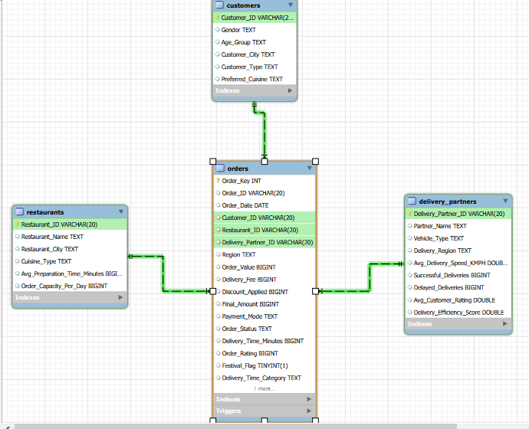
Data Design and ER Diagram
Short introduction
The FoodTech data was organized into related tables using primary and foreign keys to maintain data integrity and support efficient business analysis.
Normalized data structure to organize customer, restaurant, order, and delivery information.
Orders act as the central transaction table, linking customers, restaurants, and delivery partners.
Foreign keys connect related business entities and maintain referential integrity.
Primary keys uniquely identify records in each table.

Slide 9

SQL Implementation and Automation
Introduction on Views
Business reporting often requires the same complex queries to be executed repeatedly. To simplify reporting and improve query reusability, multiple SQL views were created for frequently used FoodTech business reports.
VIEWS | Purpose
vw_region_performance | Identify high-demand regions and evaluate profitability, customer satisfaction, and operational efficiency
vw_delivery_partner_performance | To evaluate delivery partner efficiency and logistics routes to improve service quality.
vw_customer_insights | To understand customer behavior and loyalty patterns to strengthen retention
vw_restaurant_performance | To assess profitability and efficiency across restaurants
vw_monthly_business_performance | Provides a monthly business performance summary for trend analysis, management reporting, and decision making

Slide 10
9.1 Introduction on Stored Procedures
Several business operations required reusable SQL logic with minimal manual effort. Stored procedures were created to automate these operations and improve execution consistency.
Stored Procedures ⚙️ | Purpose
sp_customer_profile | Retrieve purchase behavior and loyalty information for a specific customer.
sp_delivery_partner_summary | Retrieve the performance of a delivery partner
sp_monthly_summary | Returns monthly business performance for the specified year and month
sp_restaurant_summary | Retrieve profitability and operational performance for a specific restaurant.
sp_top_restaurants | Retrieve the Top N restaurants based on revenue and customer rating

Slide 11
9.2 Introduction on Triggers
Maintaining an audit trail of important database changes is essential for ensuring data integrity. SQL triggers were implemented to automatically record database activities in dedicated audit tables whenever specified events occurred.
Triggers ⚡ | Event | On table | Purpose
trg_order_insert_audit | INSERT | Orders | Automatically records newly inserted orders in the audit table, storing the Order Key, Order ID, action, and timestamp for auditing and traceability.
trg_order_status_update | UPDATE | Orders | Automatically records order status changes, storing the previous status, new status, Order Key, Order ID, and timestamp in the audit table.
trg_order_delete_audit | DELETE | Orders | Automatically records deleted orders in the audit table, preserving the Order Key, Order ID, deletion action, and timestamp for auditing and traceability.

Slide 12
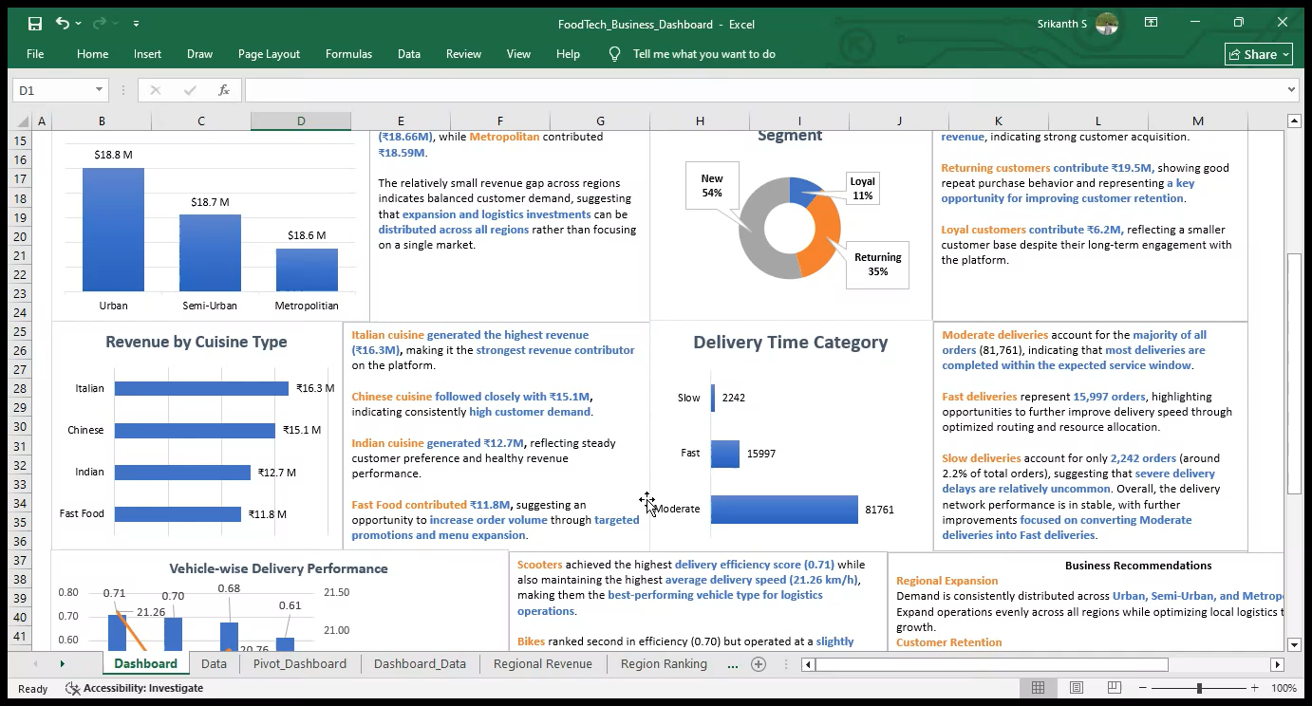
Excel Dashboard (FoodTech Analytics)
Urban and Semi-Urban regions generate nearly equal revenue (~₹18.6–18.8M), indicating balanced demand across major markets.
New customers contribute 54% of revenue (₹30.3M), highlighting strong customer acquisition, while repeat customer retention remains an opportunity.
Italian cuisine generates the highest revenue (₹16.3M), followed closely by Chinese cuisine (₹15.1M), showing strong customer preference.
Moderate deliveries account for over 81% of total orders, while the on-time delivery rate remains high at 87.52%, indicating stable logistics performance.
Scooters and bikes demonstrate better delivery efficiency and speed than cars, making them more suitable for urban operations.
Key Recommendations
Expand marketing efforts in Urban and Semi-Urban regions to maximize growth.
Improve customer retention strategies through loyalty programs and personalized offers.
Prioritize Italian and Chinese cuisine partners while promoting lower-performing cuisines.
Increase the proportion of fast deliveries by optimizing delivery routes and resource allocation.
Deploy more two-wheelers for dense urban deliveries to improve efficiency and reduce delivery time.

Slide 13




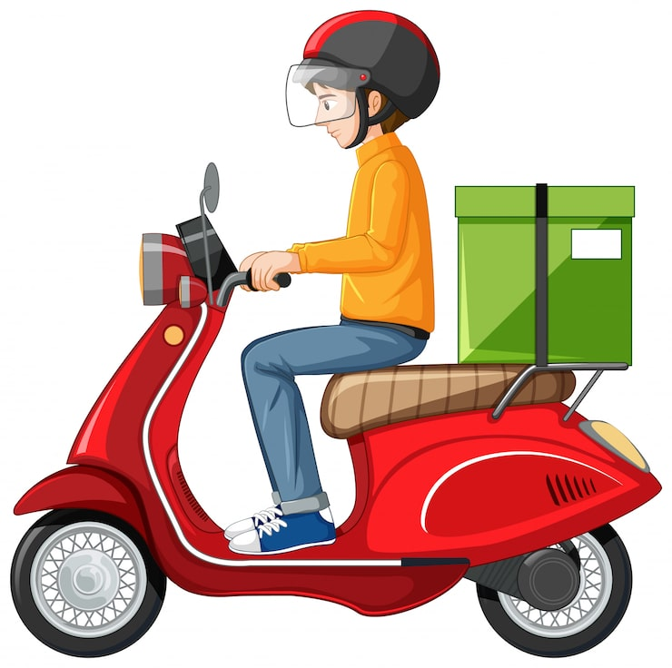

Power BI Dashboard Overview
Executive Overview
Monitor overall business KPIs, revenue, customer segments, regional demand, and order status.
Customer Insights
Analyze customer demographics, spending behavior, loyalty, and preferences
Business Trends & Performance
Track revenue trends, order patterns, customer ratings, and seasonal business performance.
Evaluate restaurant revenue, cuisine performance, customer ratings, and delivery efficiency.
Restaurant Performance
Delivery Partner Performance
Assess delivery partner efficiency, vehicle performance, customer ratings, and logistics operations.

Slide 14
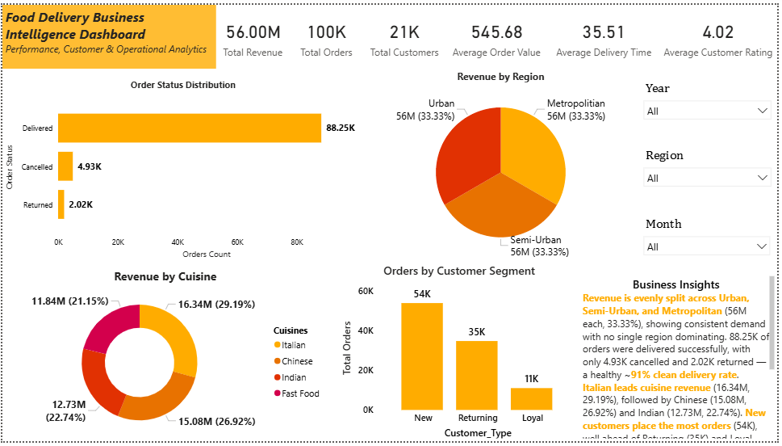
Executive Overview
The platform generated ₹ 56M revenue from 100K orders (avg. order value ₹ 545.68), with a strong 88.25% order success rate (only 4.93K cancelled, 2.02K returned).
Revenue is evenly split across Urban, Semi-Urban, and Metropolitan regions (₹ 56M each), showing balanced demand across all markets.
Italian leads cuisine revenue (₹ 16.34M), followed by Chinese (₹ 15.08M) — strong customer preference for both.
New customers drive the most orders (54K), while Loyal customers account for only 11K — a clear retention gap.
Business Recommendations
Sustain the strong delivery success rate while expanding evenly across all regions given their balanced demand; promote top cuisines like Italian and Chinese while boosting lower performers, and launch loyalty programs to convert New and Returning customers into Loyal ones for stronger long-term value.

Slide 15
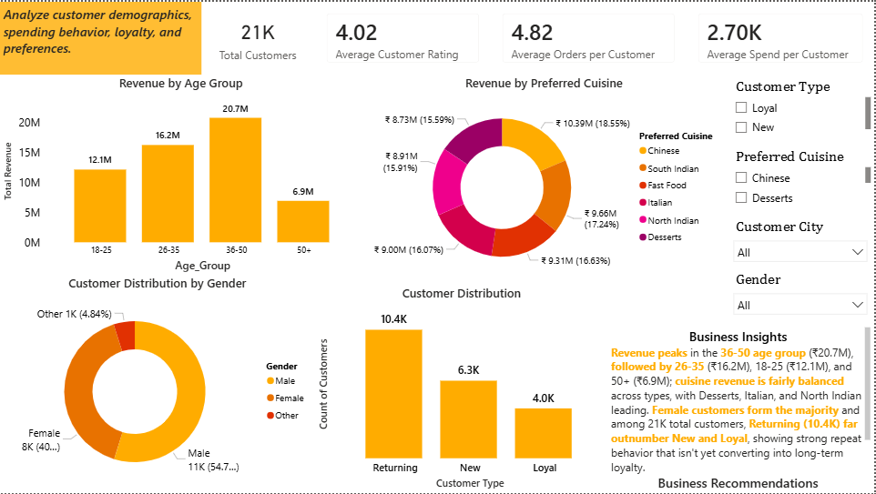
Customer Insights
The 36–50 age group drives the highest revenue (₹20.7M), followed by 26–35 (₹16.2M) — middle-aged customers are the core revenue base.
Customer base is ~55% male, ~40% female — a fairly balanced split with slight male skew.
Returning customers (10.4K) far outnumber New (6.3K) and Loyal (4.0K) — strong repeat behavior, weak conversion to loyalty.
Cuisine revenue is well-balanced, led by Chinese (₹10.39M), followed closely by South Indian, Fast Food, and Italian.
Business Recommendations
Target the 26–50 age segment with personalized offers, since it drives the most revenue.
Launch a loyalty program to convert Returning customers (10.4K) into long-term Loyal ones.
Keep promoting top cuisines while running targeted campaigns for lower performers.
Use customer segmentation (age, spend, cuisine) to personalize offers and sustain the 4.82 avg. orders/customer and 4.02 avg. rating.

Slide 16
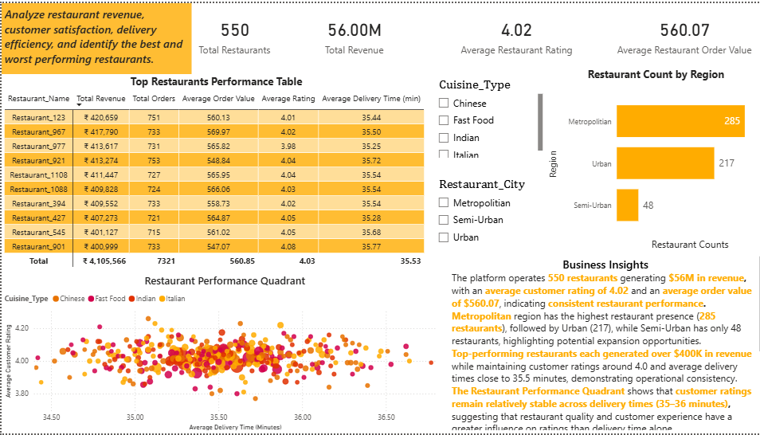
Restaurant Performance
550 restaurants generated ₹56M revenue with an average rating of 4.02, reflecting consistent restaurant performance.
Metropolitan region has the highest restaurant presence (285), while Semi-Urban has only 48 restaurants, indicating expansion opportunities.
Top restaurants each generated over ₹400K revenue while maintaining stable ratings and delivery times.
Customer ratings remain consistent across delivery times, suggesting restaurant quality influences satisfaction more than delivery speed.
Business Recommendations
Expand restaurant partnerships in Semi-Urban regions to increase market coverage.
Replicate best practices from top-performing restaurants across lower-performing outlets.
Focus on improving food quality and customer experience to maintain high ratings.
Continuously monitor restaurant KPIs to identify improvement opportunities.

Slide 17
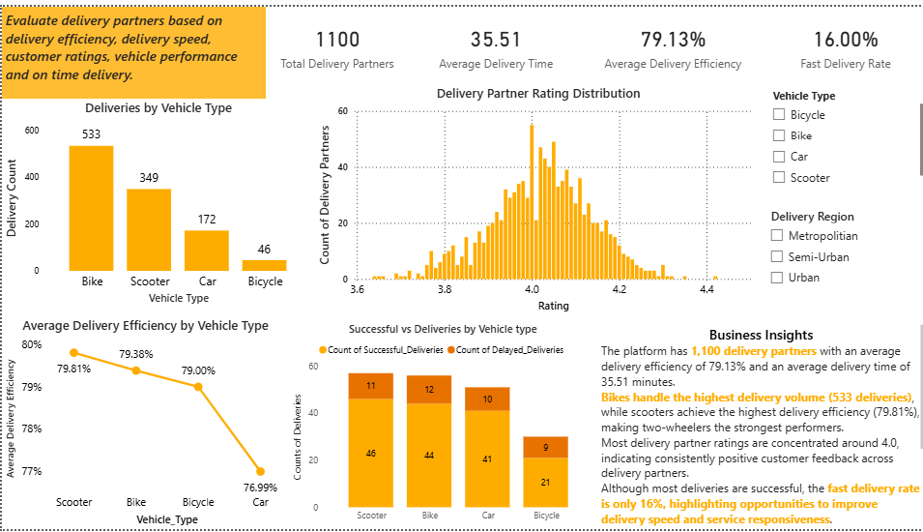
Delivery Partner Performance Performance
The platform has 1,100 delivery partners with an average delivery efficiency of 79.13% and an average delivery time of 35.51 minutes.
Bikes handle the highest delivery volume (533 deliveries), while scooters achieve the highest delivery efficiency (79.81%), making two-wheelers the strongest performers.
Most delivery partner ratings are concentrated around 4.0, indicating consistently positive customer feedback across delivery partners.
Although most deliveries are successful, the fast delivery rate is only 16%, highlighting opportunities to improve delivery speed and service responsiveness.
Business Recommendations Rely more on bikes and scooters for deliveries since they're both faster and more efficient than cars, while investigating Bicycle's disproportionately high delay rate (30%) despite low volume — it may not be a good fit for longer or time-sensitive routes. Most urgently, focus on improving the low 16% Fast Delivery Rate, since this remains the biggest gap between partner ratings and actual delivery performance.

Slide 18
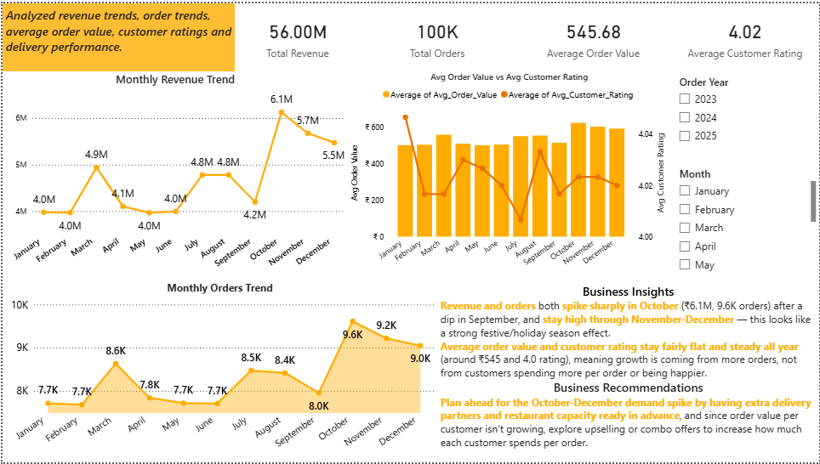
Business Trends & Performance
Revenue and order volume show a clear seasonal trend, with both peaking in October and remaining strong through November and December, indicating high festive-season demand.
Average Order Value remains stable at around ₹546 throughout the year, suggesting consistent customer spending patterns despite fluctuations in order volume.
Average Customer Rating stays close to 4.0 across all months, indicating consistently positive customer satisfaction and service quality.
Business growth is primarily driven by higher order volumes during peak months rather than significant changes in customer spending or ratings.
Business Recommendations Plan ahead for the October–December demand spike by having extra delivery partners and restaurant capacity ready in advance; since order value per customer isn't growing, explore upselling or combo offers to increase spend per order, and look into February's rating dip to rule out a recurring seasonal service issue.

Slide 19
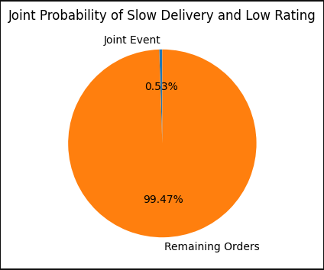
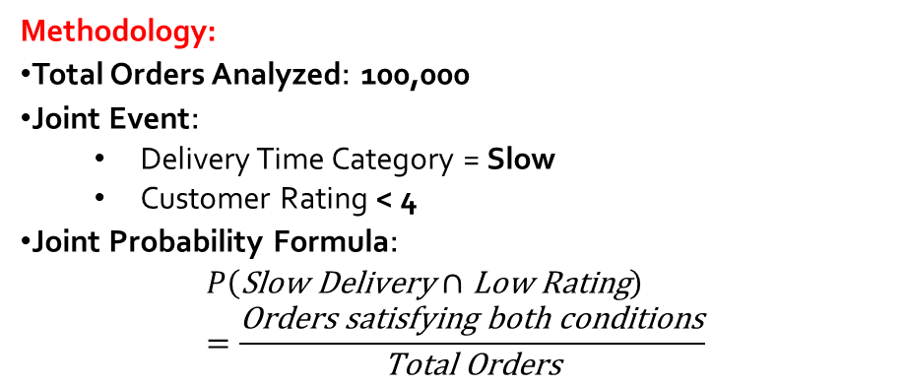
Statistical Analysis – Joint Probability
Business question : What is the probability that an order experiences both a slow delivery and a low customer rating?
Methodology:
Total Orders Analyzed: 100,000
Joint Event:
Delivery Time Category = Slow
Customer Rating < 4
Joint Probability Formula:
$$P\left(\text{Slow} \text{Delivery}∩\text{Low} \text{Rating}\right)=\frac{\text{Orders} \text{satisfying} \text{both} \text{conditions}}{\text{Total} \text{Orders}}$$
Metric | Value
Total Orders | 1,00,000
Slow Delivery + Rating < 4 | 527
Joint Probability | 0.53 %
Business Insights
Only 0.53% of all orders experienced both slow delivery and a low customer rating.
This indicates that the combined event is rare.
Most delayed deliveries did not result in poor customer ratings.
Customer satisfaction is influenced by additional factors such as food quality, order accuracy, and service experience.
Business Recommendation
Continue monitoring delayed deliveries as an operational KPI.
Focus improvement efforts on food quality, order accuracy, and customer service, as these appear to have a greater impact on customer satisfaction.

Slide 20
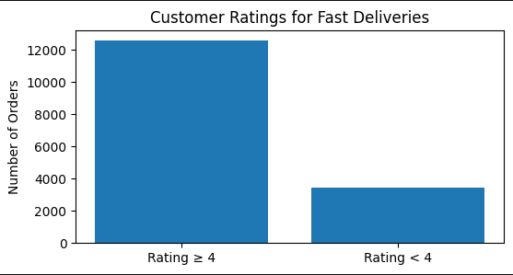
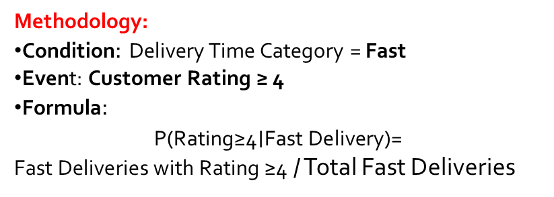
Statistical Analysis – Conditional Probability
Business question : What is the probability of receiving a customer rating of 4 or above, given that the order was delivered in the Fast delivery category?
Methodology:
Condition: Delivery Time Category = Fast
Event: Customer Rating ≥ 4
Formula:
$$\text{P}\text{(}\text{Rating}\text{≥}\text{4}\text{∣}\text{Fast} \text{Delivery}\text{)=}$$
$\text{Fast} \text{Deliveries} \text{with} \text{Rating} \text{≥}\text{4​}$ / Total Fast Deliveries
Metric | Value
Total Fast Deliveries | 15,997
Fast Deliveries with rating ≥ 4 | 12,567
Conditional Probability | 78.56 %
Business Insights :
78.56% of fast deliveries receive a customer rating of 4 or above, indicating a strong relationship between faster deliveries and higher customer satisfaction.
However, 21.44% of fast deliveries still receive ratings below 4, showing that delivery speed alone does not guarantee a positive customer experience.
Factors such as food quality, packaging, and order accuracy also influence customer ratings.
Business Recommendation
Continue improving delivery speed while maintaining food quality and order accuracy.
Analyze low-rated fast deliveries to identify recurring service issues.
Use customer feedback to improve the overall delivery experience, not just delivery time.

Slide 21
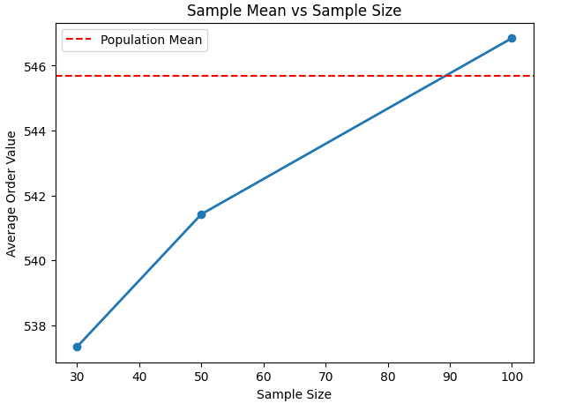
Statistical Analysis – Sampling Distribution
Business question : How does sample size affect the accuracy of estimating the average order value?
Objective: Sampling is widely used in business analytics when analyzing an entire population is impractical. This analysis compares sample means across different sample sizes to evaluate how closely they represent the overall average order value.
Sample Size | Sample Mean
30 | 537.33
50 | 541.42
100 | 546.85
Population Mean | 545.68
Business Insights
As the sample size increased, the sample mean moved closer to the population mean (₹545.68).
The sample of 100 provided the most accurate estimate.
Larger samples reduce sampling error and produce more reliable business insights.
Business Recommendation
Use sufficiently large random samples when analyzing customer spending or sales performance.
Avoid making strategic decisions based on very small samples, as they may not accurately represent overall business performance.

Slide 22
Statistical Analysis – Two Sample Z-Test
Business question : Is there a statistically significant difference in the average delivery time between Urban and Metropolitan regions?
Objective : Compare the average delivery time of Urban and Metropolitan regions to determine whether regional delivery performance differs significantly.
Hypothesis
H₀ (Null Hypothesis): There is no significant difference in the average delivery time between Urban and Metropolitan regions.
H₁ (Alternative Hypothesis): There is a significant difference in the average delivery time between Urban and Metropolitan regions.
Metric | Urban | Metropolitan
Average Delivery Time | 35.51 min | 35.50 min
Sample Size | 33,421 | 33,230
Business Insights
The average delivery time differs by only 0.01 minute between the two regions.
Since p = 0.8293 > 0.05, the difference is not statistically significant.
Delivery performance is consistent across Urban and Metropolitan regions.
Business Recommendation
Continue using a common logistics strategy for both regions.
Focus operational improvements on delivery efficiency, delayed deliveries, and customer satisfaction rather than regional delivery time differences.
Test Statistics | Value
Z Statistic | 0.2156
p-value | 0.8293
Significance level | 0.05
Decision | Fail to reject H₀

Slide 23
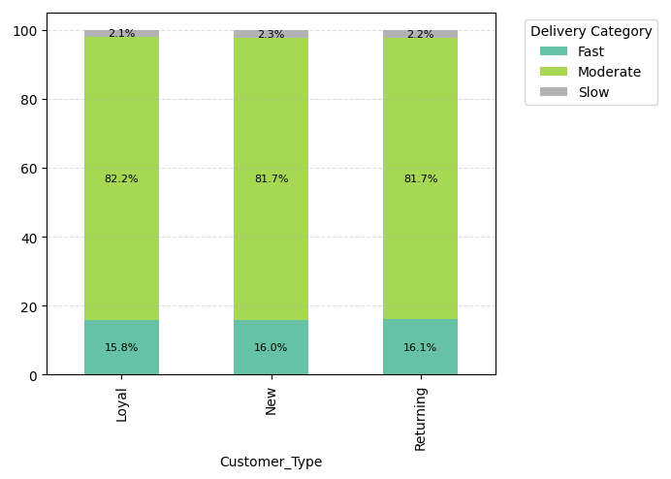
Statistical Analysis – Chi-Square test
Business question : Is there a significant association between Customer Type and Delivery Time Category?
Objective: The Chi-Square Test of Independence is used to determine whether customer type and delivery time category are statistically associated. This analysis helps identify whether different customer segments experience different levels of delivery performance.
Hypothesis
H₀ (Null Hypothesis): There is no significant association between Customer Type and Delivery Time Category.
H₁ (Alternative Hypothesis): There is a significant association between Customer Type and Delivery Time Category.
Metric | Value
Chi-Square Statistic | 4.2525
Degrees of Freedom | 4
p-value | 0.3729
Significance level | 0.05
Decision | Fail to reject H₀
Business Insights
Delivery performance is consistent across New, Returning, and Loyal customers.
No customer segment experiences significantly faster or slower deliveries.
Customer type does not influence delivery speed, indicating fair logistics operations.
Business Recommendations
Continue maintaining uniform delivery standards for all customer segments.
Improve route optimization, restaurant preparation time, and delivery partner performance to enhance overall delivery efficiency rather than focusing on specific customer groups.

Slide 24
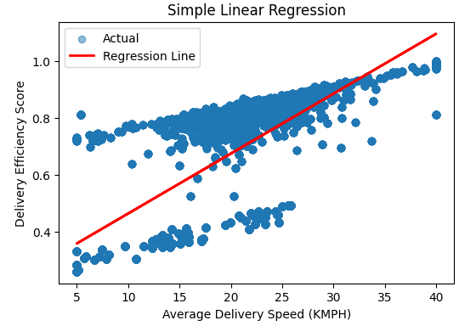
Machine Learning – Simple Linear Regression
Business question : Can delivery efficiency score be predicted using Average Delivery Speed?
Objective : Evaluate whether delivery speed alone is a good predictor of delivery efficiency.
Model
Target Variable - Delivery Efficiency Score
Predictor - Average Delivery Speed (KMPH)
Model Performance
Metric | Value
Mean Absolute Error (MAE) | 0.13
Root Mean Squared Error (RMSE) | 0.16
R² Score | 0.4358
Business Insights
Delivery speed has a positive relationship with delivery efficiency.
Every 1 km/h increase in delivery speed increases efficiency by approximately 0.021.
Delivery speed alone explains about 44% of delivery efficiency.
Business Recommendation
Improve delivery speed through better route planning.
Include additional operational factors to improve prediction accuracy.

Slide 25
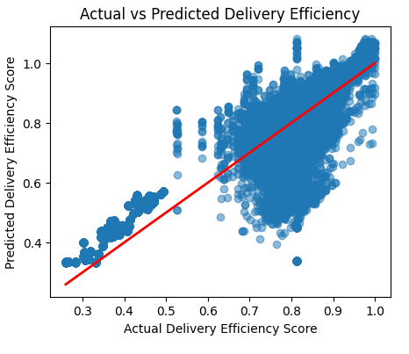
Machine Learning – Multiple Linear Regression
Business question : Can delivery efficiency score be predicted more accurately using multiple operational factors?
Objective : Predict delivery efficiency using multiple business variables simultaneously.
Variable | Coefficient | Impact
Avg Preparation Time | -0.016776 | Strong negative
Avg Delivery Speed | +0.011311 | Positive
Order Capacity | +0.000532 | Slight positive
Festival Flag | +0.000350 | Minimal
Model Performance
Metric | Value
Mean Absolute Error (MAE) | 0.0684
Root Mean Squared Error (RMSE) | 0.0946
R² Score | 0.7926
Business Insights
Prediction accuracy improved from 44% to 79%.
Restaurant preparation time has the strongest impact on delivery efficiency score
Combining multiple variables provides a much better predictive model.
Business Recommendation
Reduce restaurant preparation time.
Use multiple operational metrics for logistic planning.

Slide 26
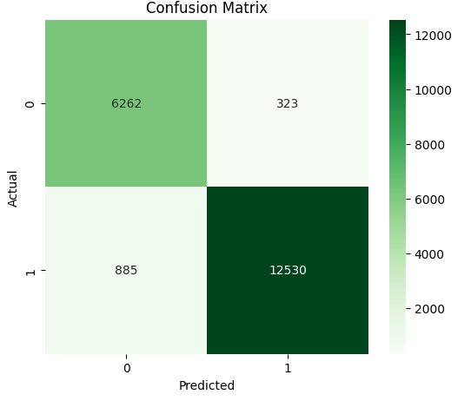
Machine Learning – Logistic Regression
Business Question: Can operational factors predict whether a delivery will achieve High Delivery Efficiency?
Objective: Classify deliveries as High Efficiency or Low Efficiency.
Feature | Coefficient | Impact
Avg_Delivery_Speed_KMPH | 0.152433 | Strong positive
Avg_Preparation_Time_Minutes | -0.355569 | Strong negative
Order_Capacity_Per_Day | 0.002928 | Low
Festival_Flag | 0.015455 | Minimal
Model Performance
Metric | Value
Accuracy | 93.96 %
Precision | 97 %
Recall | 93 %
F1 Score | 95 %
Business Insights
The model predicts high delivery efficiency with 94 % accuracy.
Restaurant preparation time has the strongest impact on delivery efficiency score
Delivery speed significantly increases the probability of high delivery efficiency score.
Business Recommendation
Optimize restaurant preparation processes
Improve delivery routing and vehicle allocation.

Slide 27
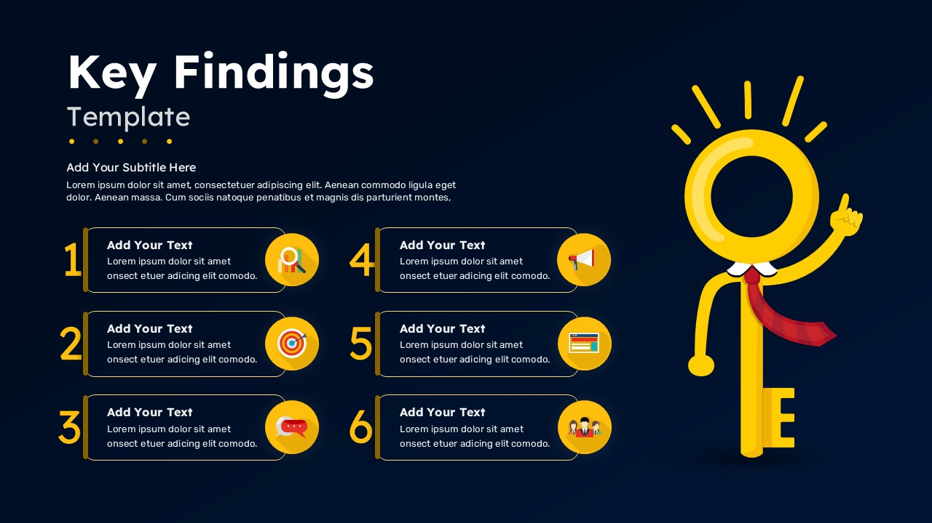
Customer Insights
New customers generated the highest number of orders and revenue, indicating strong customer acquisition.
Customer satisfaction remained consistent across different customer types, reflecting a reliable delivery experience.
Restaurant Performance
Restaurant preparation time was identified as the most influential factor affecting delivery efficiency.
Highly rated restaurants generally maintained better operational performance and customer satisfaction.
Delivery & Logistics
Urban and Metropolitan regions showed similar average delivery times, indicating consistent logistics performance.
Delivery speed positively influenced efficiency, while preparation delays significantly reduced operational performance
Operational Analytics
Restaurant preparation time was identified as the strongest factor affecting delivery efficiency.
Multiple Linear Regression explained 79.26% of the variation in delivery efficiency.
Logistic Regression predicted high delivery efficiency with 93.96% accuracy, supporting proactive logistics planning.

Slide 28

Business Recommendations
⏱ Reduce restaurant preparation time through better kitchen planning and order management.
🚚 Optimize delivery routes and partner allocation to maintain faster and more efficient deliveries.
📍 Expand operations in high-demand regions with strong revenue potential.
❤️ Strengthen customer retention programs through personalized offers and loyalty initiatives.
📊 Monitor operational KPIs using interactive Excel and Power BI dashboards.
🤖 Leverage predictive models to identify potential delivery delays and improve logistics planning.

Slide 29

Thank You
Analyze Food Delivery Demand Across Regions to Inform Market Expansion & Logistics
Prepared by
Srikanth S

