Slide 1

SEVAONE
Citizen App
Mobile screen overview
A crisp walkthrough of the current SevaOne experience — from splash to support.
14 core screens
Karnataka citizen services
22 September 2026
SevaOne Citizen App
01 / 15
Notes:
SevaOne mobile screen overview. Images captured from the current Android build on 22 September 2026.

Slide 2
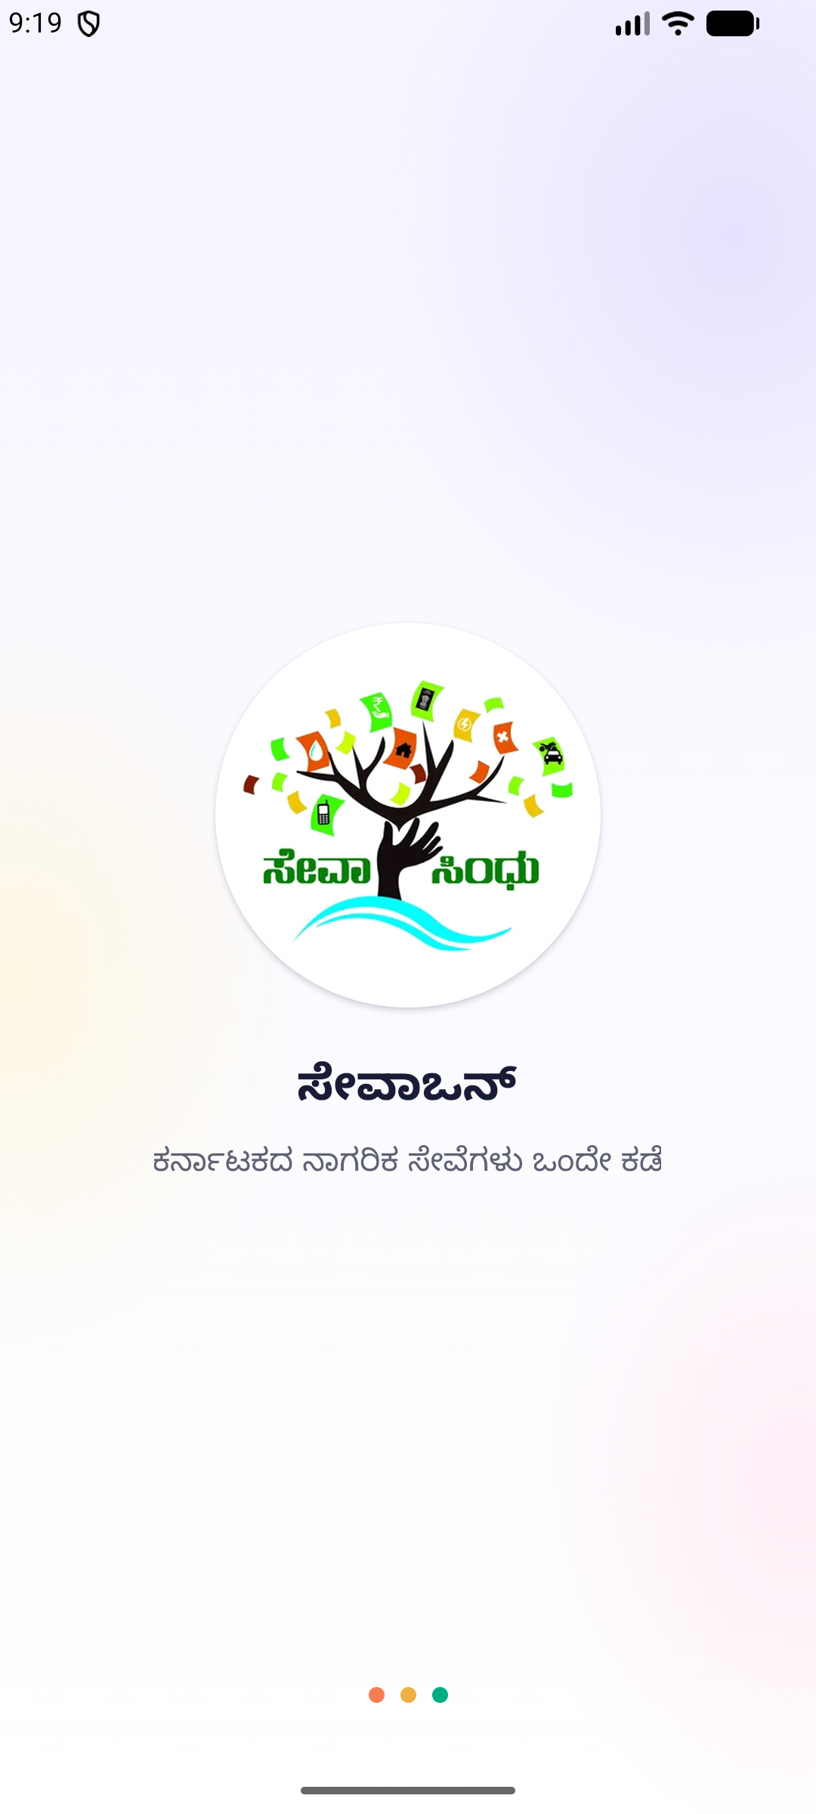
SEVAONE / MOBILE EXPERIENCE
BRAND ENTRY
A calm, branded start
The splash screen introduces SevaOne with the Karnataka citizen-services promise.
Launch
SevaOne Citizen App
02 / 15
Notes:
Route: app launch. Captured from the current Android build.

Slide 3
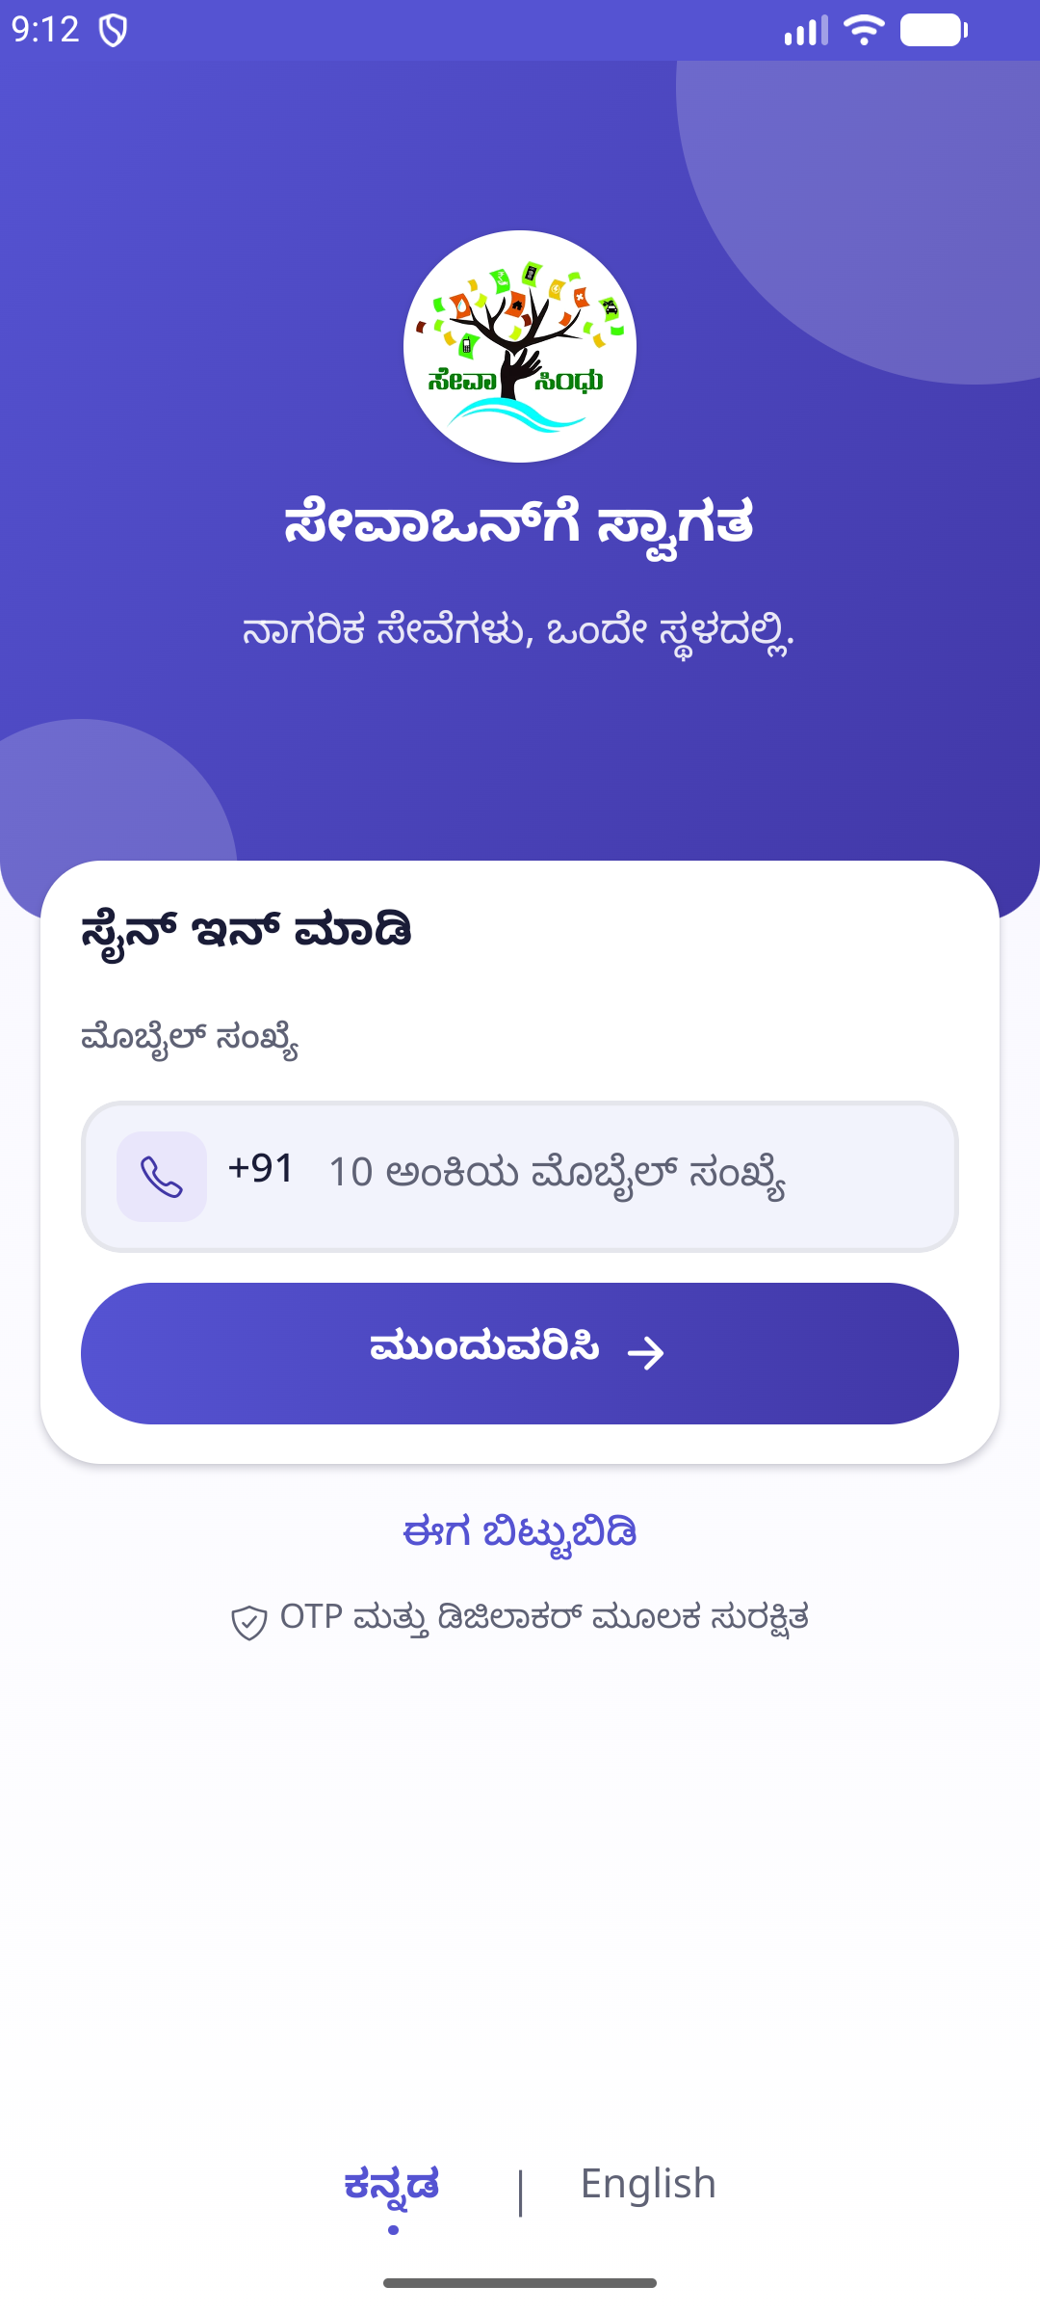
SEVAONE / MOBILE EXPERIENCE
ACCESS
Secure sign in
Mobile number entry, Kannada-first copy, and a clear path into OTP verification.
Login
SevaOne Citizen App
03 / 15
Notes:
Route: /(auth)/login. Steps: launch the app, enter a mobile number, continue.

Slide 4
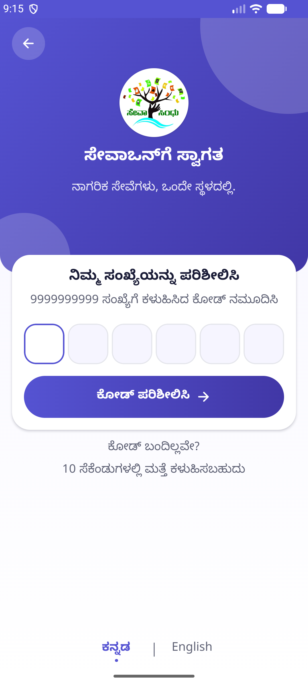
SEVAONE / MOBILE EXPERIENCE
VERIFICATION
OTP verification
A focused six-digit flow keeps the identity check simple and readable.
OTP
SevaOne Citizen App
04 / 15
Notes:
Route: /(auth)/otp. Steps: submit a mobile number and enter the one-time code.

Slide 5
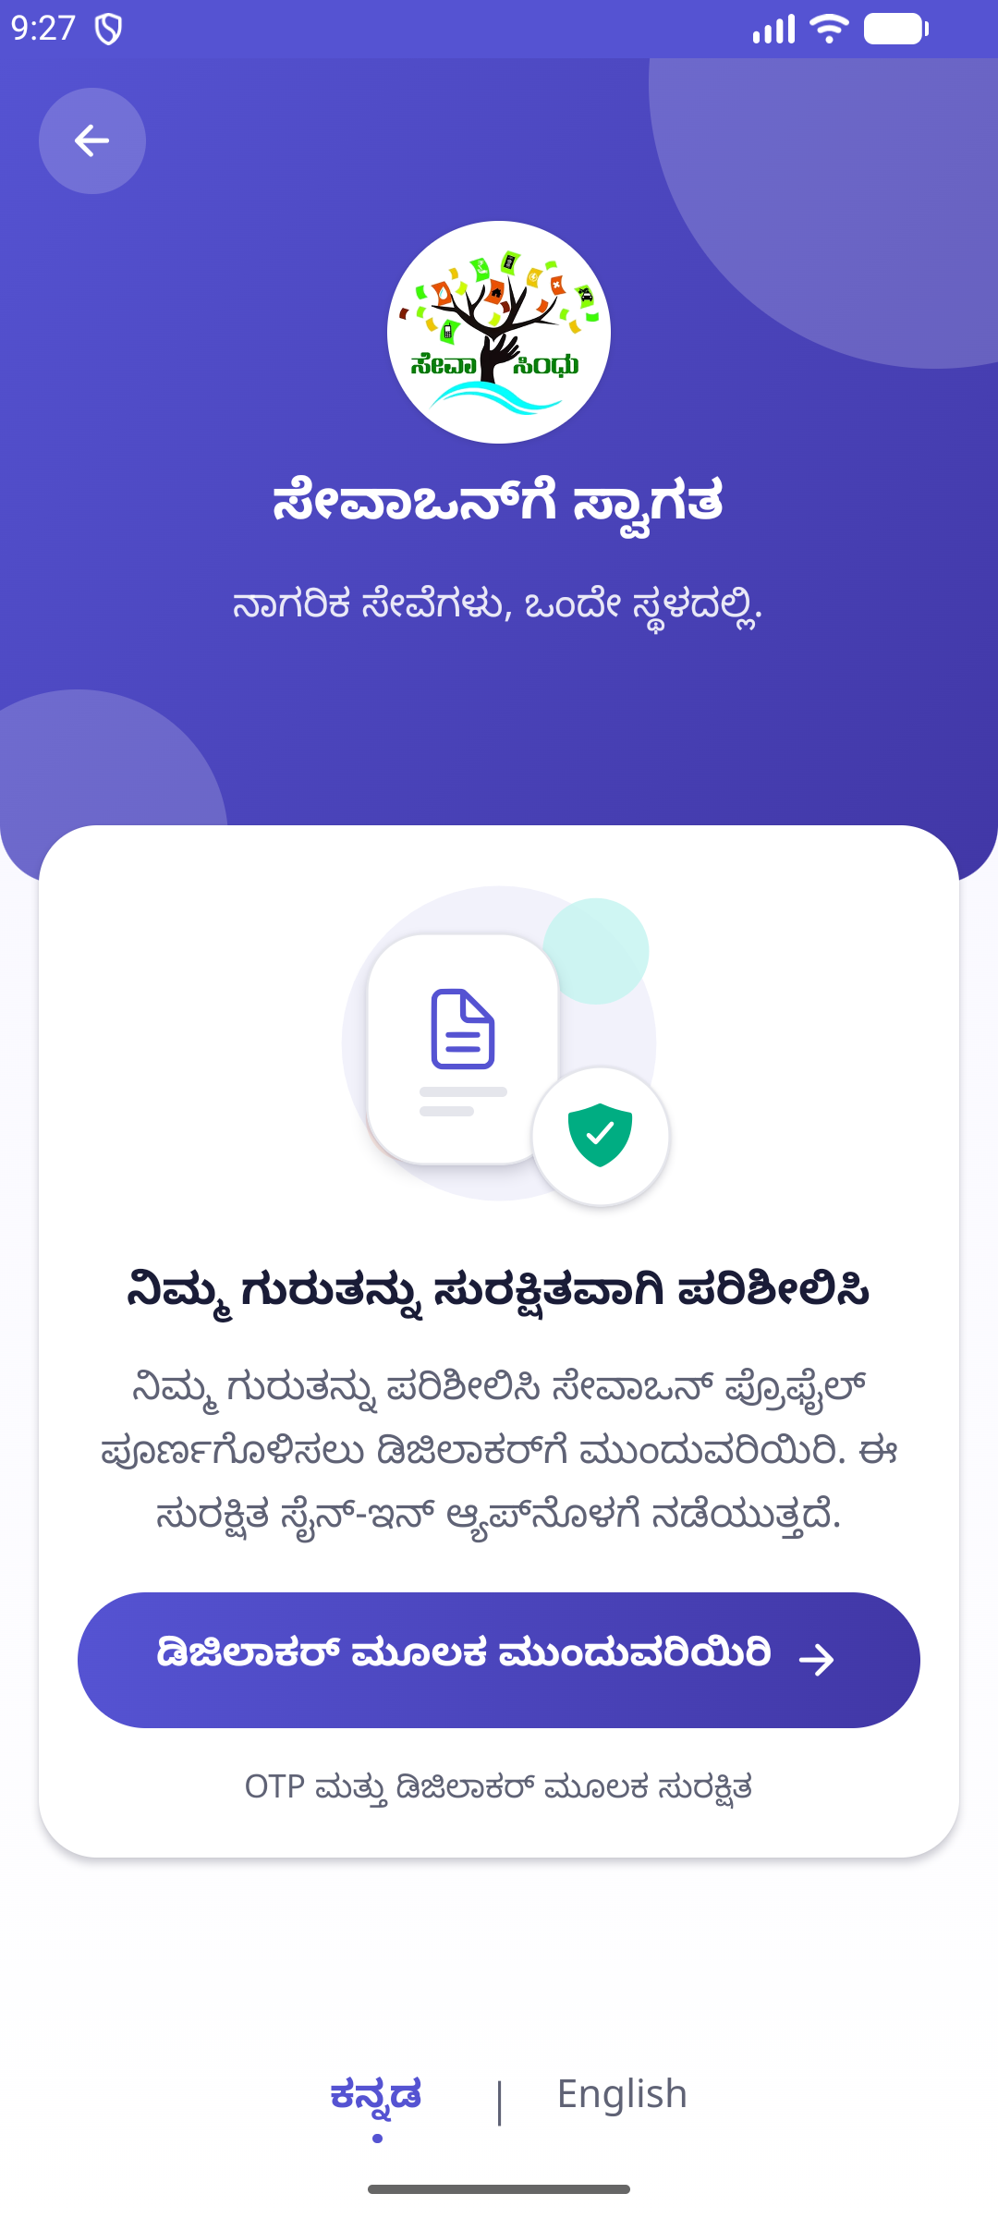
SEVAONE / MOBILE EXPERIENCE
IDENTITY
Continue with DigiLocker
A secure linking step completes identity verification inside SevaOne.
DigiLocker
SevaOne Citizen App
05 / 15
Notes:
Route: /(auth)/digilocker. Steps: after OTP verification, continue to DigiLocker when account linking is required.

Slide 6
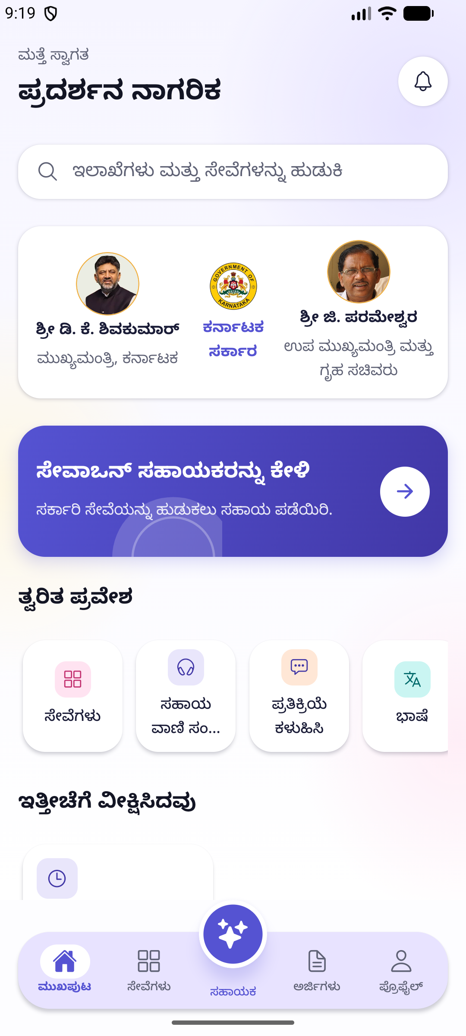
SEVAONE / MOBILE EXPERIENCE
HOME
A service hub at a glance
Search, government banner, assistant access, quick actions, and popular departments are grouped on one surface.
Home
SevaOne Citizen App
06 / 15
Notes:
Route: /(tabs). Steps: sign in, then land on Home.

Slide 7
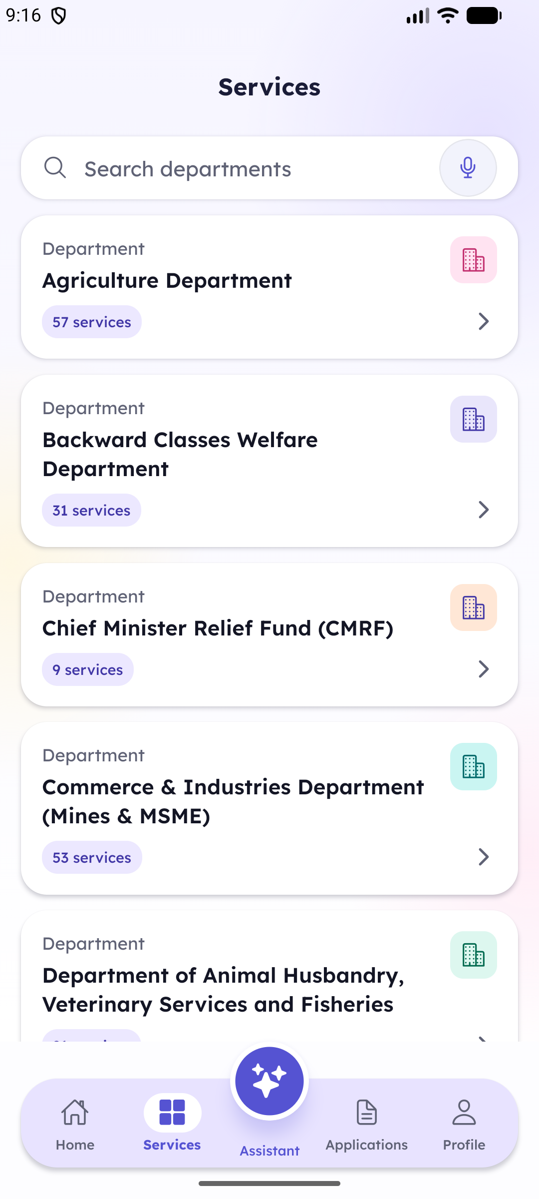
SEVAONE / MOBILE EXPERIENCE
CATALOGUE
Browse departments
Searchable department cards show service counts and keep discovery scannable.
Services
SevaOne Citizen App
07 / 15
Notes:
Route: /(tabs)/services. Steps: open the Services tab.

Slide 8
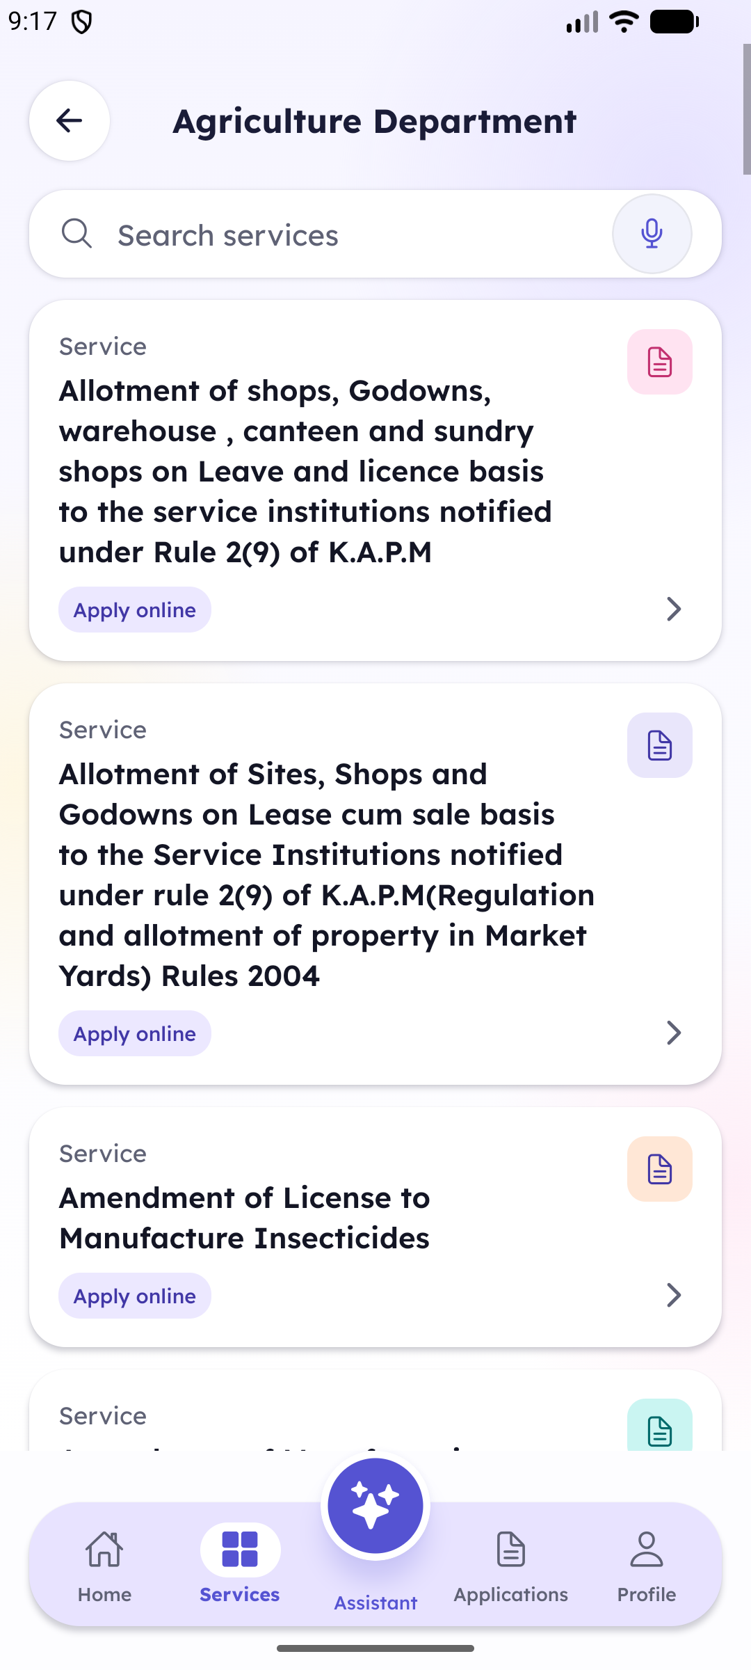
SEVAONE / MOBILE EXPERIENCE
CATALOGUE
Find a service quickly
Within a department, service cards surface the action and the online application path.
Department
SevaOne Citizen App
08 / 15
Notes:
Route: /(tabs)/services/[departmentId]. Steps: open a department.

Slide 9
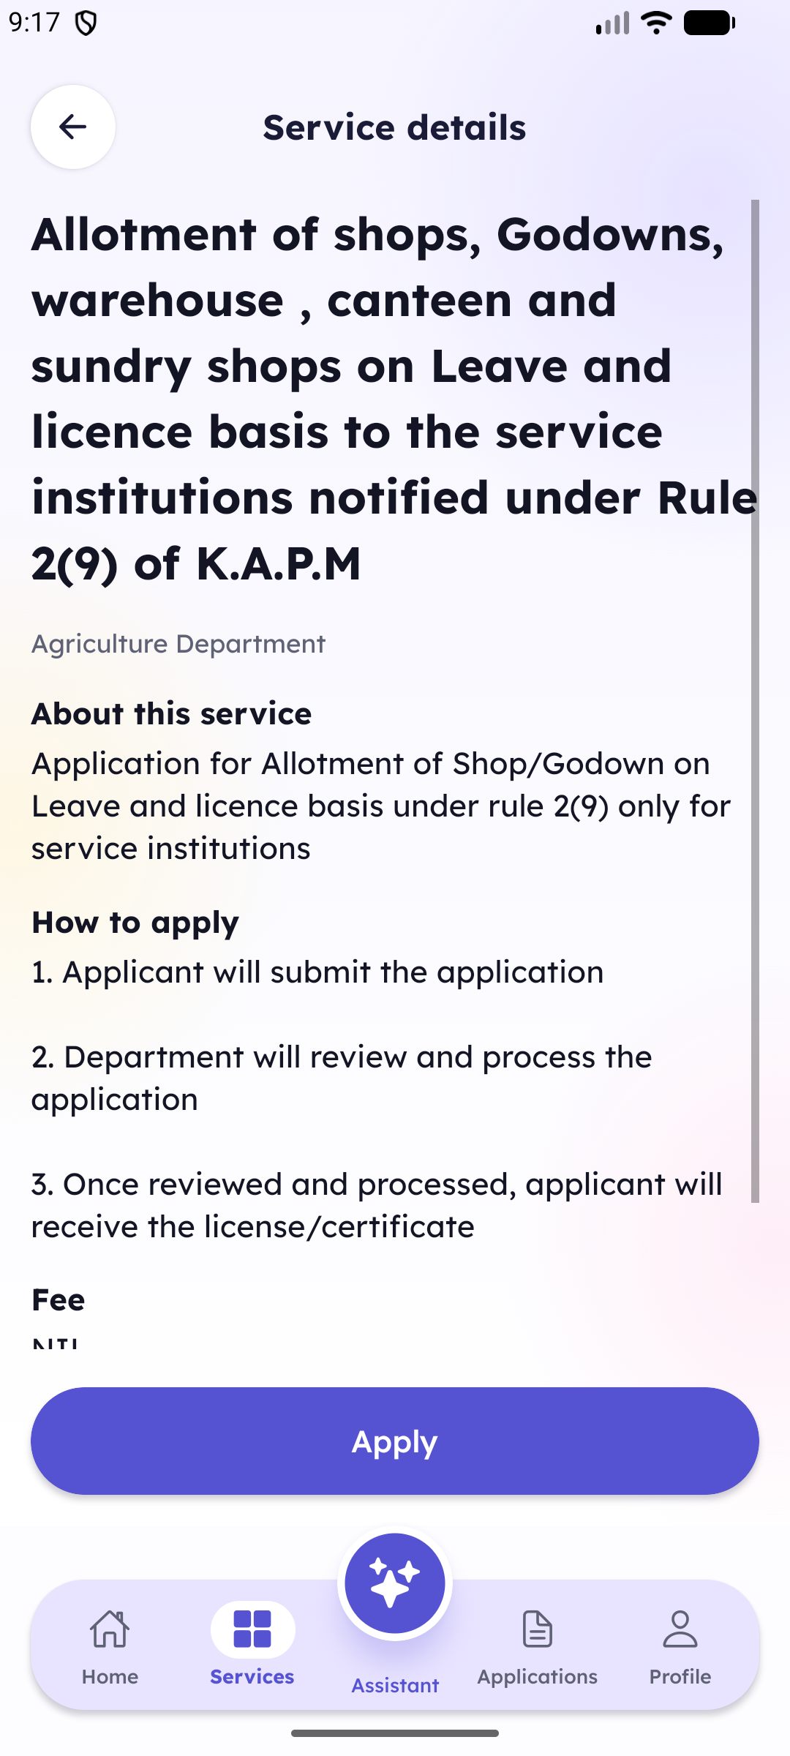
SEVAONE / MOBILE EXPERIENCE
DECISION
Understand before applying
Service details explain eligibility context, process steps, fee, and the Apply action.
Service detail
SevaOne Citizen App
09 / 15
Notes:
Route: /(tabs)/services/[departmentId]/[serviceId]. Steps: open a service card.

Slide 10
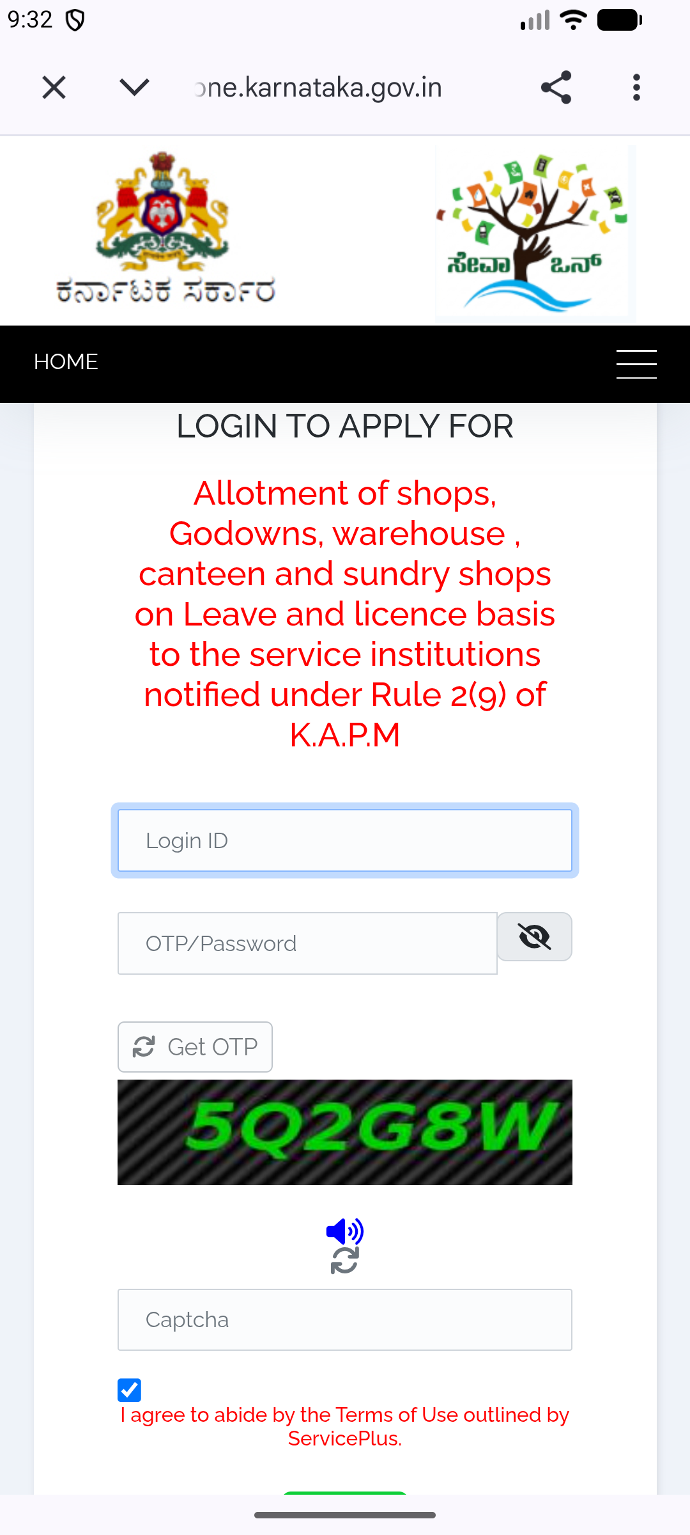
SEVAONE / MOBILE EXPERIENCE
APPLY
Continue in Chrome
The Apply action opens the official application page in a Chrome custom tab.
Apply
SevaOne Citizen App
10 / 15
Notes:
Route: service detail. Steps: open a service and tap Apply; the official ServicePlus flow opens in Chrome.

Slide 11
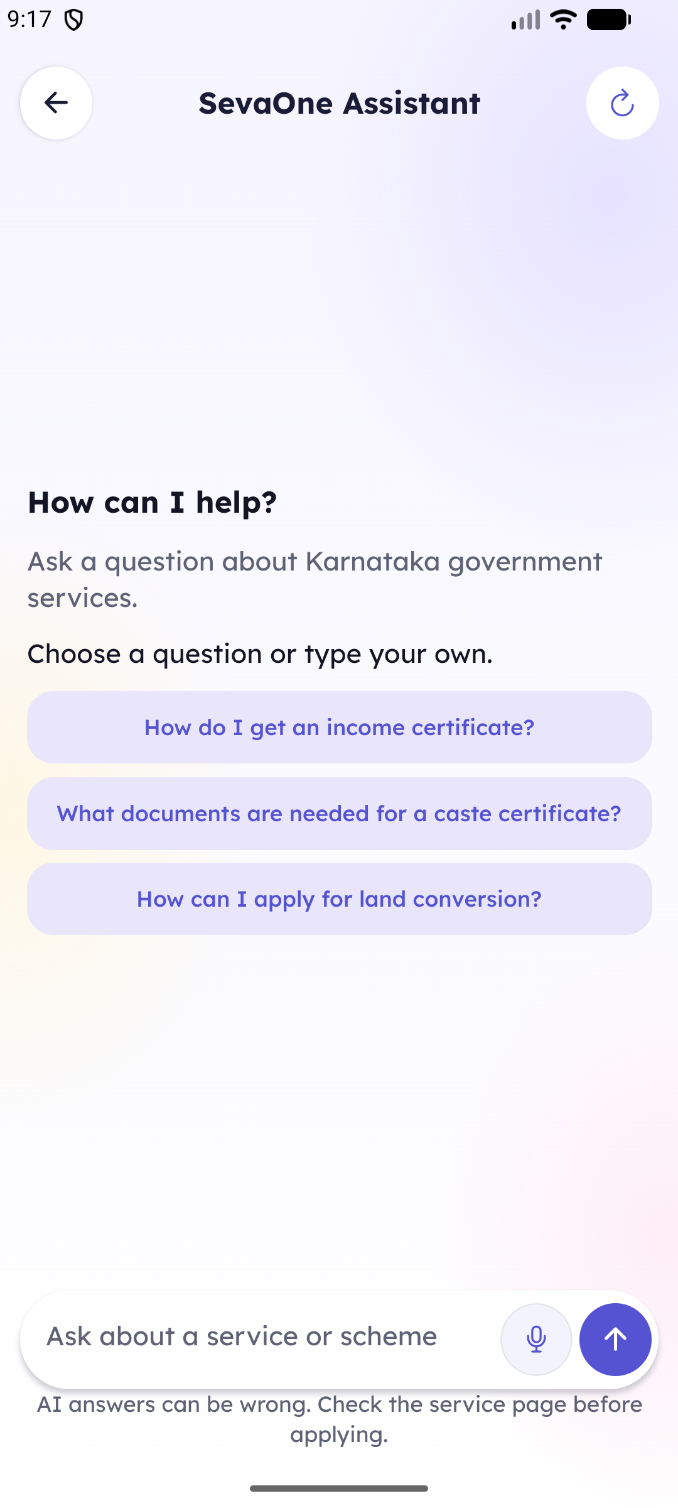
SEVAONE / MOBILE EXPERIENCE
GUIDANCE
SevaOne Assistant
Suggested questions and voice input help citizens reach the right service with less effort.
Assistant
SevaOne Citizen App
11 / 15
Notes:
Route: /assistant. Steps: tap the assistant button or Assistant tab.

Slide 12
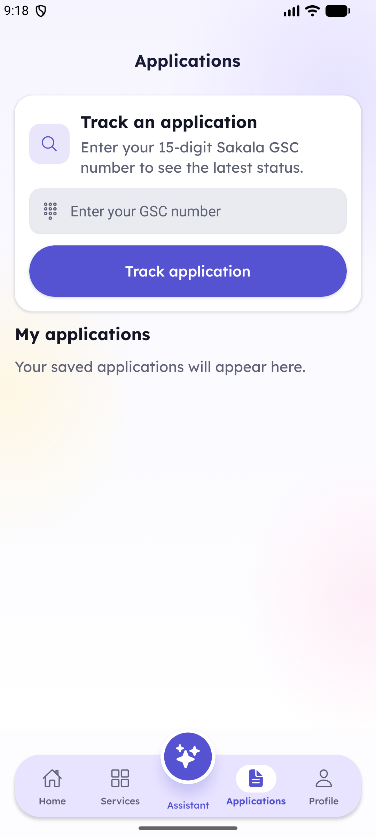
SEVAONE / MOBILE EXPERIENCE
TRACKING
Track an application
Citizens can enter a Sakala GSC number and review saved applications in one place.
Applications
SevaOne Citizen App
12 / 15
Notes:
Route: /(tabs)/applications. Steps: open the Applications tab.

Slide 13
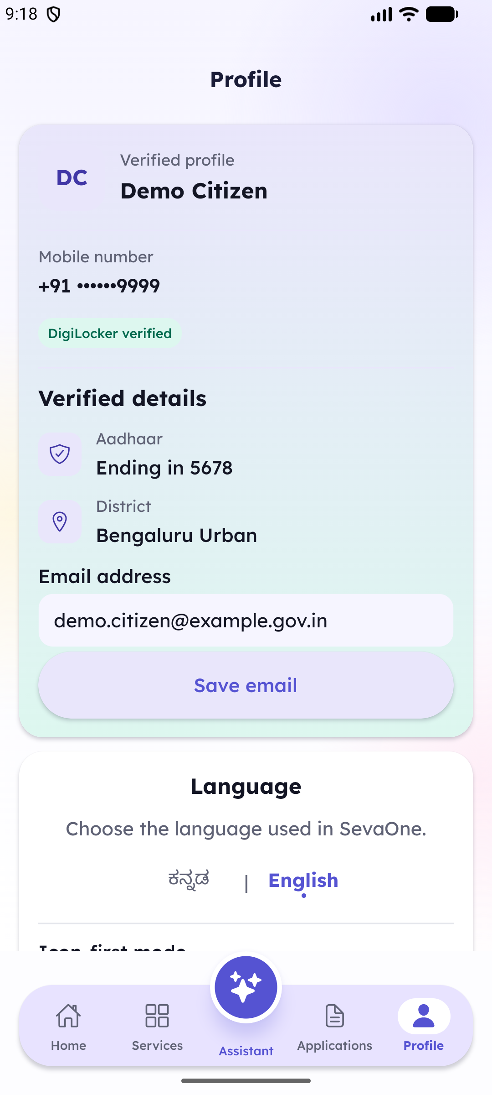
SEVAONE / MOBILE EXPERIENCE
ACCOUNT
A clear, verified profile
Profile identity, masked mobile number, DigiLocker status, verified details, email, and language settings stay together.
Profile
SevaOne Citizen App
13 / 15
Notes:
Route: /(tabs)/profile. Steps: open the Profile tab.

Slide 14
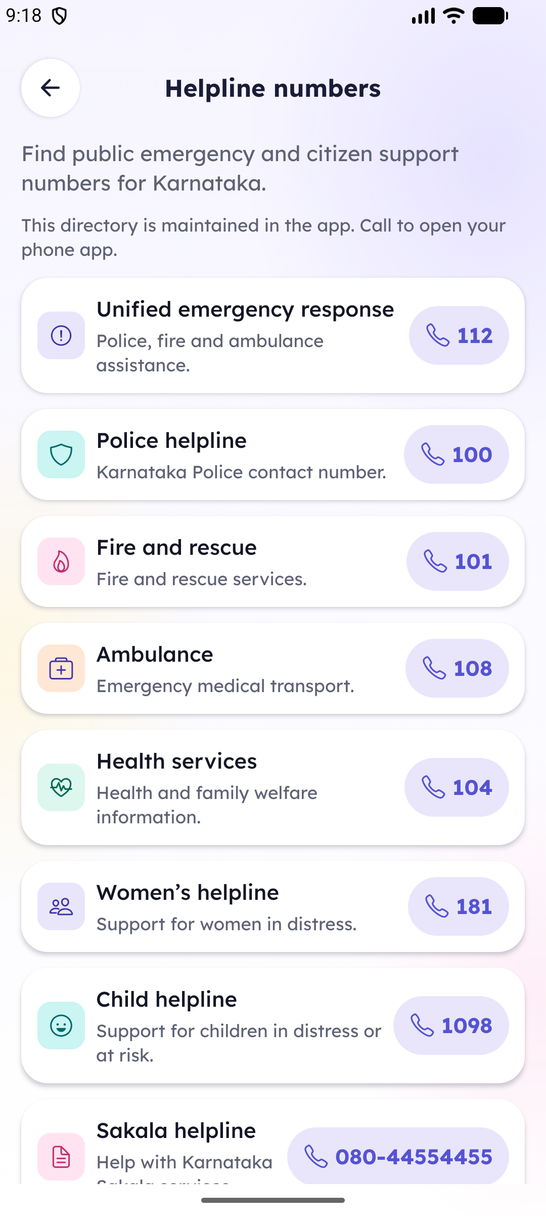
SEVAONE / MOBILE EXPERIENCE
SUPPORT
Helpline numbers
Emergency and citizen-support contacts are organized for quick calling from the app.
Helpline
SevaOne Citizen App
14 / 15
Notes:
Route: /helpline. Steps: Home → Helpline numbers.

Slide 15
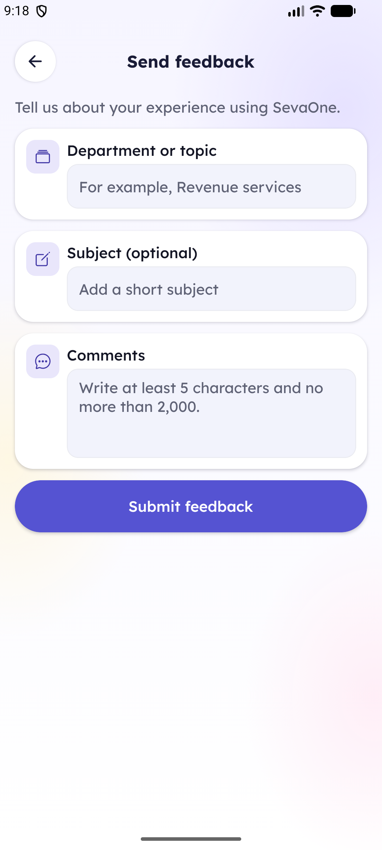
SEVAONE / MOBILE EXPERIENCE
FEEDBACK
A focused feedback form
Topic, subject, comments, and one clear submit action make feedback easy to send.
Feedback
SevaOne Citizen App
15 / 15
Notes:
Route: /feedback. Steps: Home → Send feedback.

