Slide 1
UML Fundamentals
Stands for Unified Modeling Language
UML is a Notation for diagramming (mainly)
a) Class Structure
b) Object Interaction
UML Class diagram is similar to ER Diagram

Slide 2
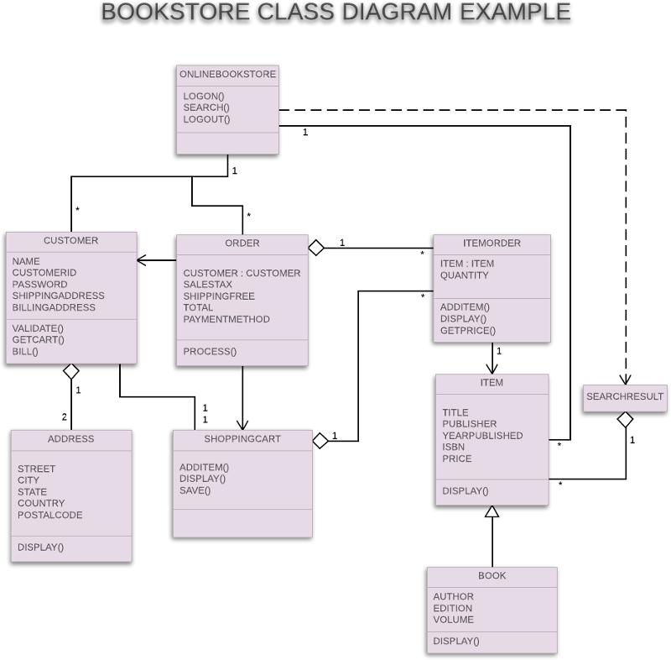
How does UML look?

Slide 3
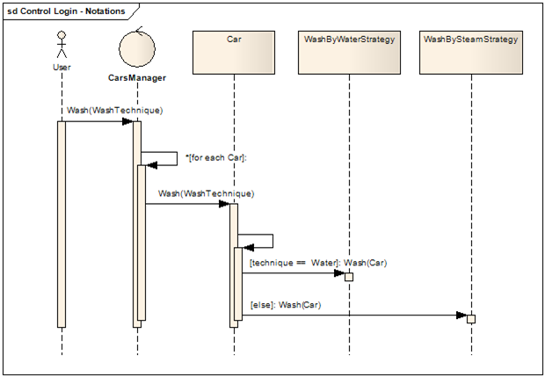
How does UML look?

Slide 4
Why UML?
Understanding Domain Model
Understand working of a system
Analyse Requirements
Design
Plan Code & Review
Communication (in a team)
Precise & Concise (at the same time)

Slide 5
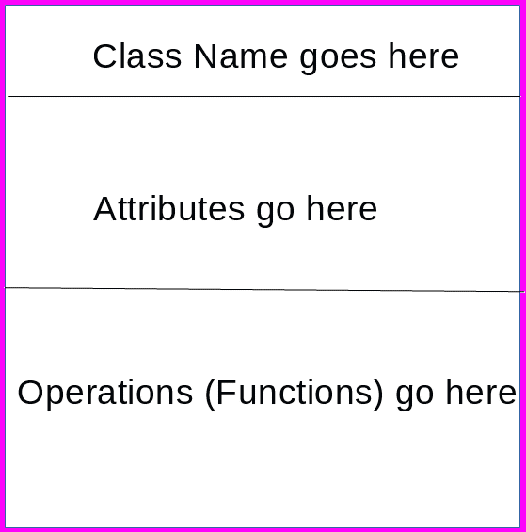
UML Class Representation

Slide 6
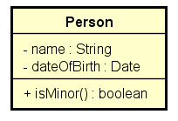
UML Class example
public class Person {
private String name;
private Date dateOfBirth;
public boolean isMinor() { ...}
}

Slide 7
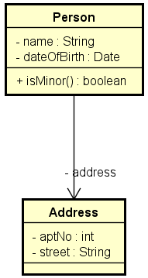
UML Class with Relationships
public class Person {
private Address address;
}
public class Address {
private int aptNo;
private String street
....
}

Slide 8
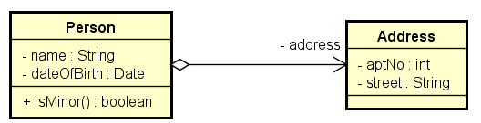
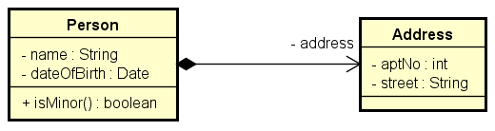
Ownership
Aggregate (Weak ownership)
Composite (Strong ownership)

Slide 9
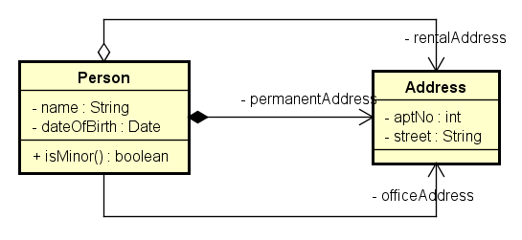
Person with many address
public class Person {
private Address rentalAddress;
private Address permanentAddress;
private Address officeAddress;
}

Slide 10
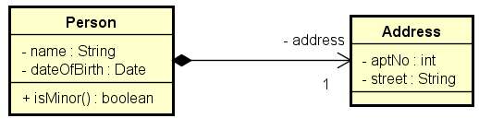
Multiplicity
A Person as exactly ONE address

Slide 11
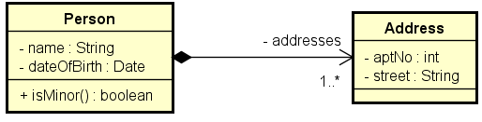
Multiplicity
A Person has MANY addresses (1 OR MANY in e.g.)
public class Person {
private List<Address> addresses;
}

Slide 12
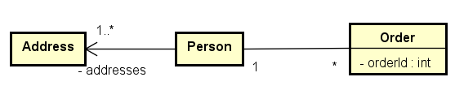
Unspecified Navigability
Conceptual Model
Design Model
Implementation Model

Slide 13
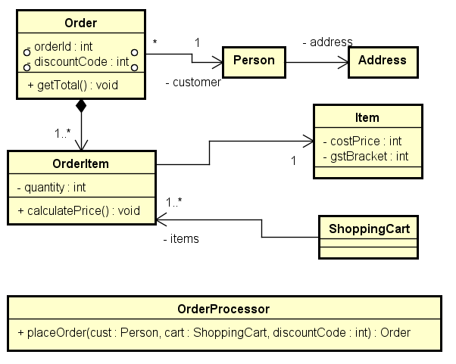
Online Ordering - Example

Slide 14
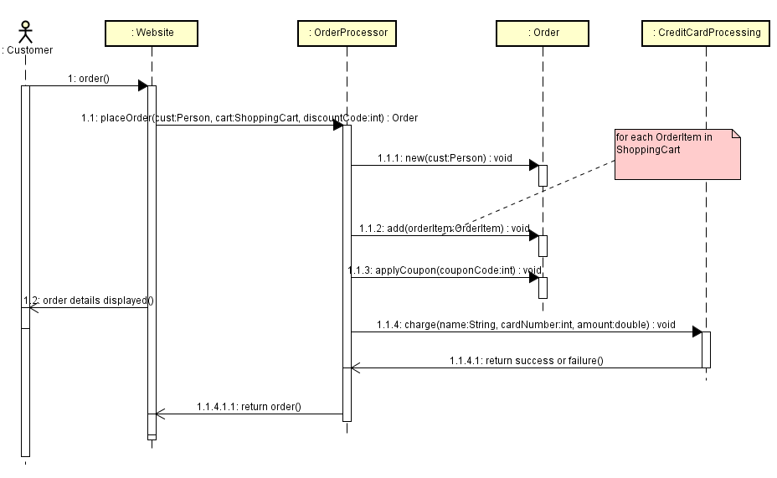
Sequence Diagram

Slide 15
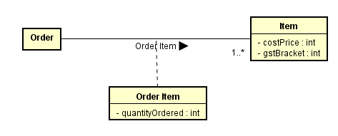
Class Diagram - Advanced
Conceptual Association with Association Class

Slide 16
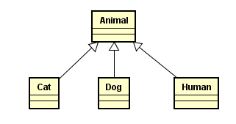
Class Inheritance

Slide 17
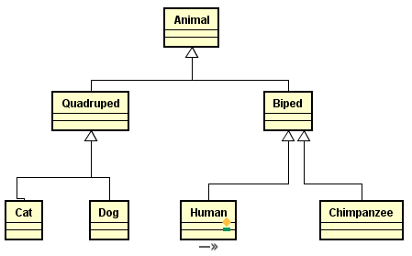
Inheritance

Slide 18
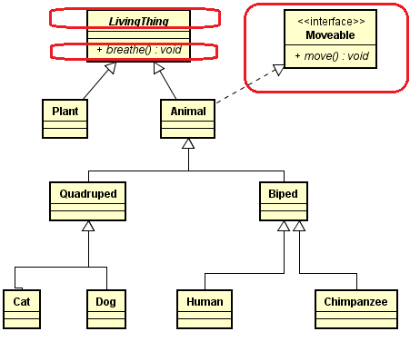
Inheritance with Interface
Implementation Specific Details

Slide 19
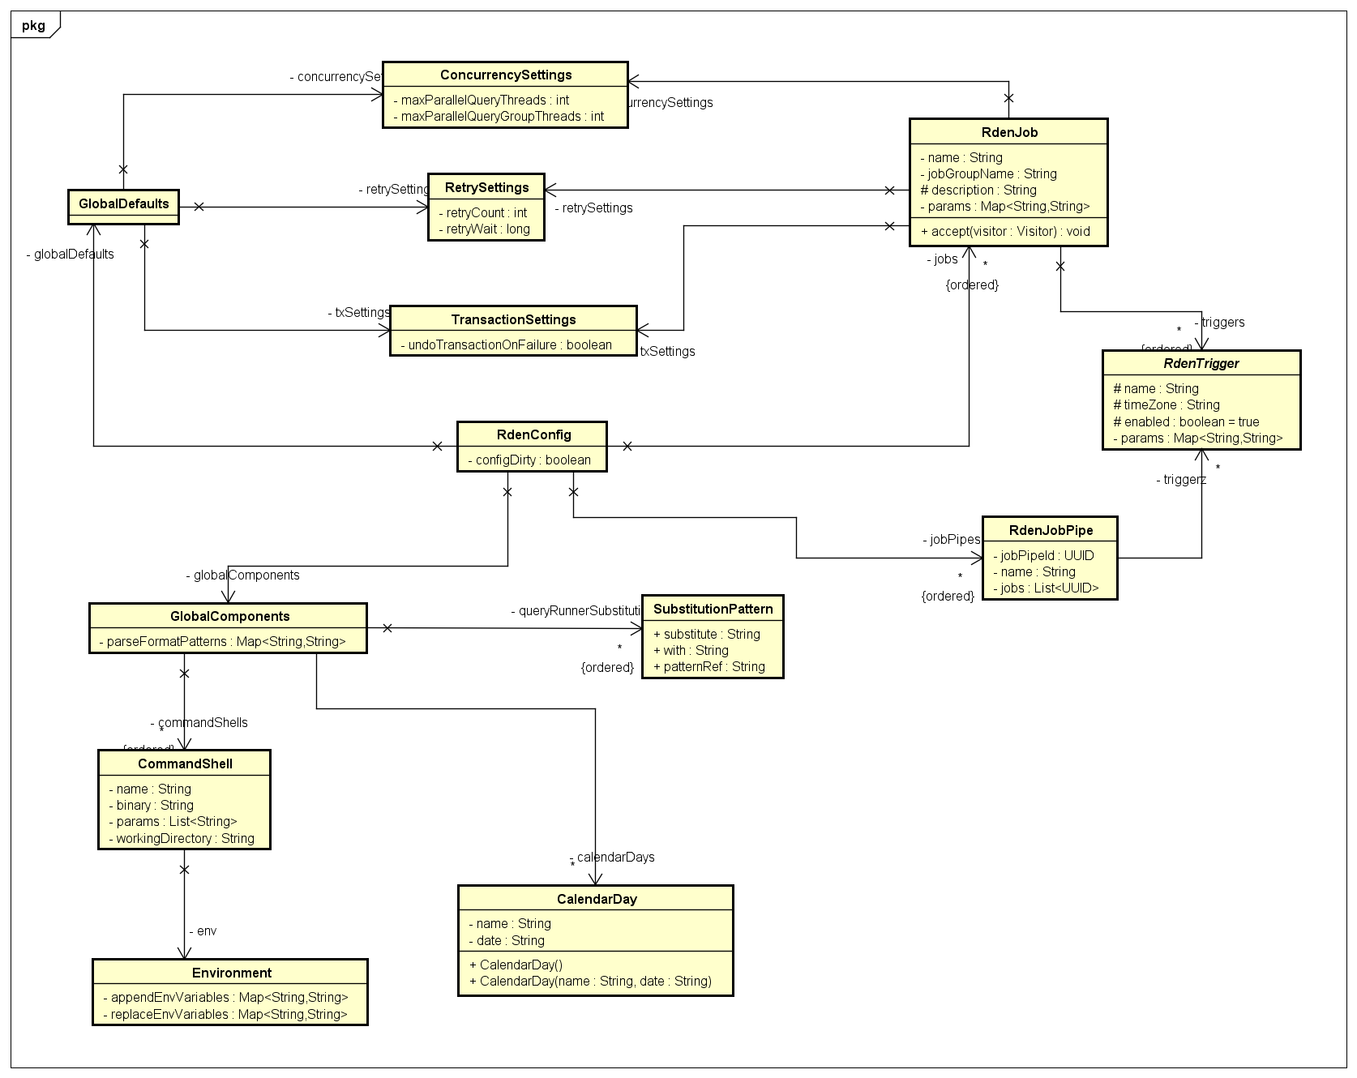
Real life Samples

Slide 20
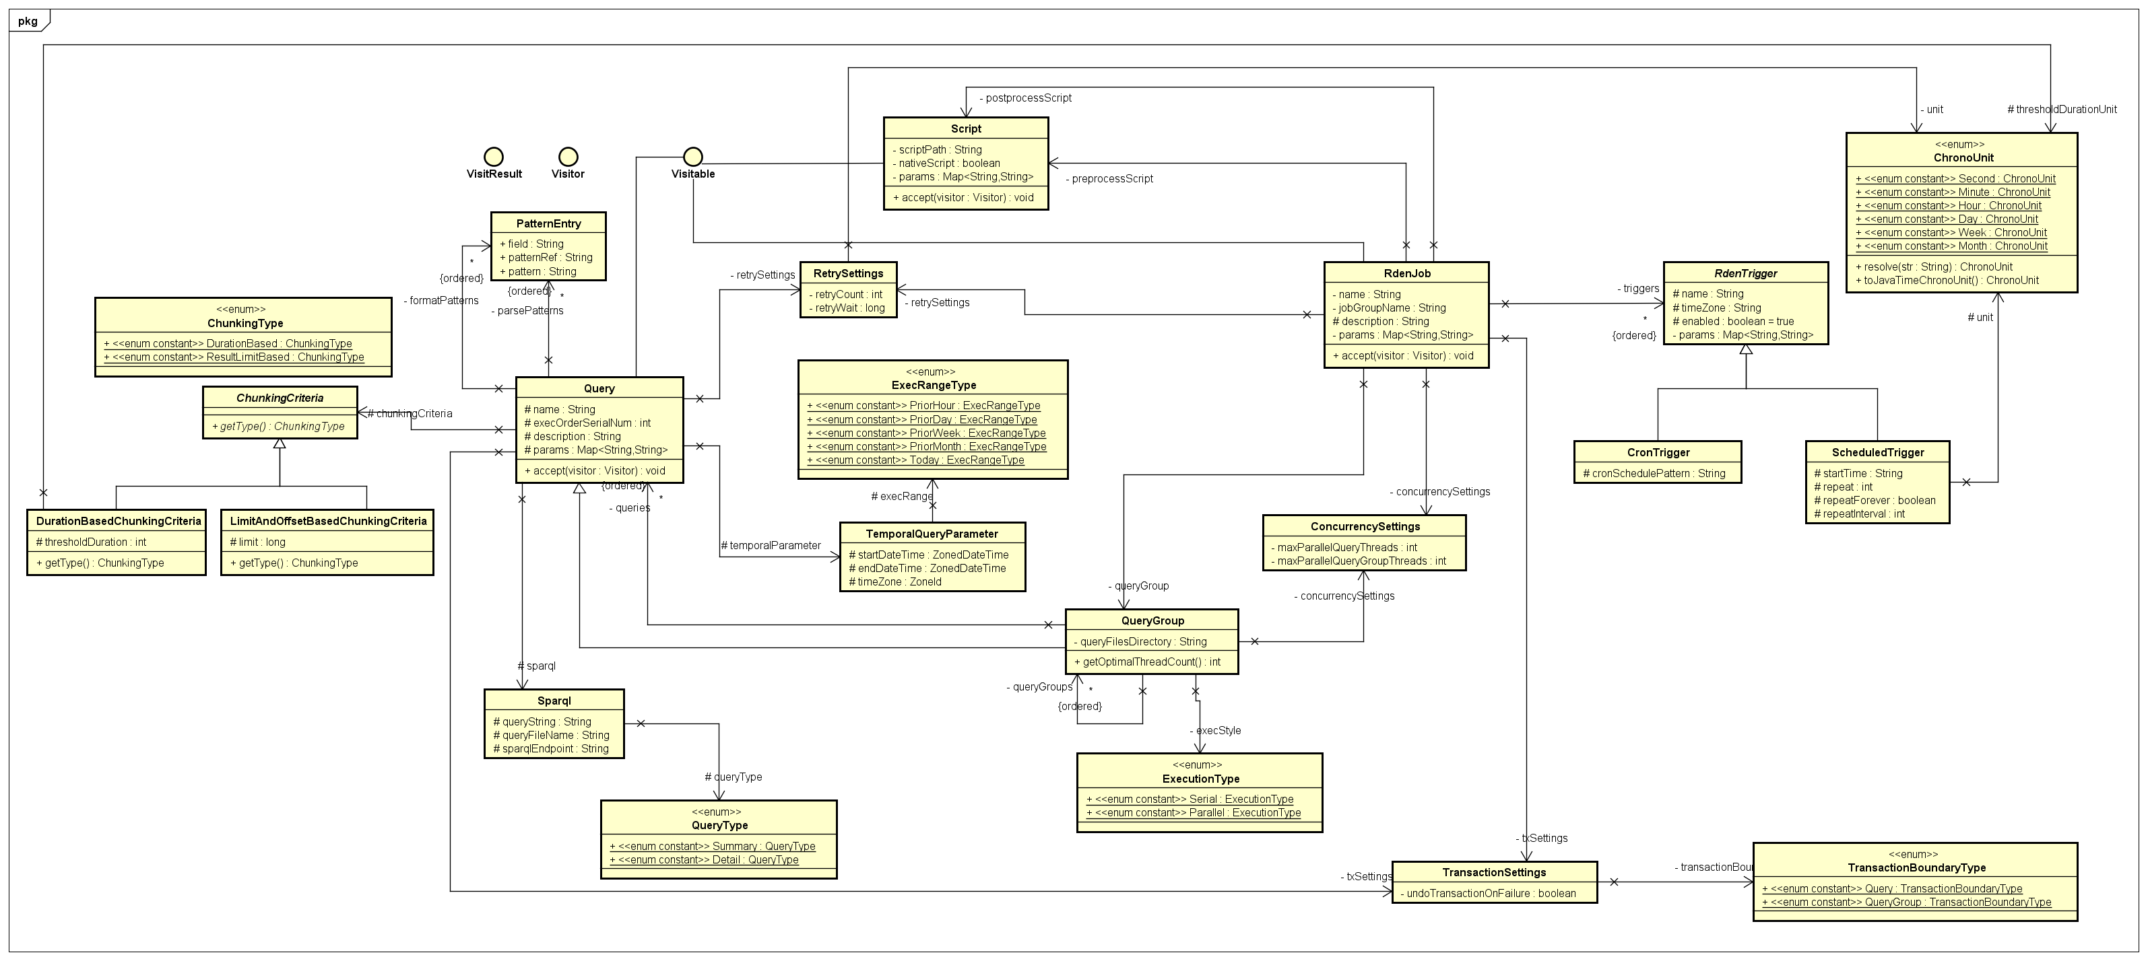
Real life Samples

Slide 21
Why UML?
Understanding Domain Model
Understand working of a system
Capturing Requirements
Design & Review
Communication (in a team)
Precise & Concise (at the same time)

Slide 22
Try it out with Free Tools
Astah Professional (Reverse Engineer Java. Generate Java, C++ code from diagram) - http://astah.net/
Bouml (http://www.bouml.fr/) - Reverse Engineer C++, Java
UML Designer (Eclipse Integrated Roundtrip Tools)
Visual Studio Integrated Tools
LucidChart (Online) - http://www.lucidchart.com/

Slide 23
What’s Next?
Questions ??
Discuss assignment
Draw UML for the assignment candidate classes

