Slide 1
Design Patterns
Creational Patterns
Singleton
Fluent Builder

Slide 2
Singleton
class PrintSpooler {
public:
static Company* getInstance();
void print(Document* doc);
private:
PrintSpooler();
}
-----------------------------------------
static PrintSpooler* s_instance;
PrintSpooler* PrintSpooler::getInstance() {
if (!s_instance) {
s_instance = new PrintSpooler();
}
return s_instance;
}

Slide 3
Singleton - A client view
int main() {
Document * doc = new Document(..);
..
..
PrintSpooler spool = PrintSpooler::getInstance();
spool.print(doc);
}

Slide 4
Fluent Builder - A client view
class OnlinePizzaOrderingSystem {
Pizza buildMyPizza() {
PizzaBuilder builder =
new PizaBuilder()
->withStuffedCrust()
->withSize(Size.Medium)
->withVeggieLoverSignatureToppings()
Pizza piza = builder.build();
return pizza;
}
}

Slide 5
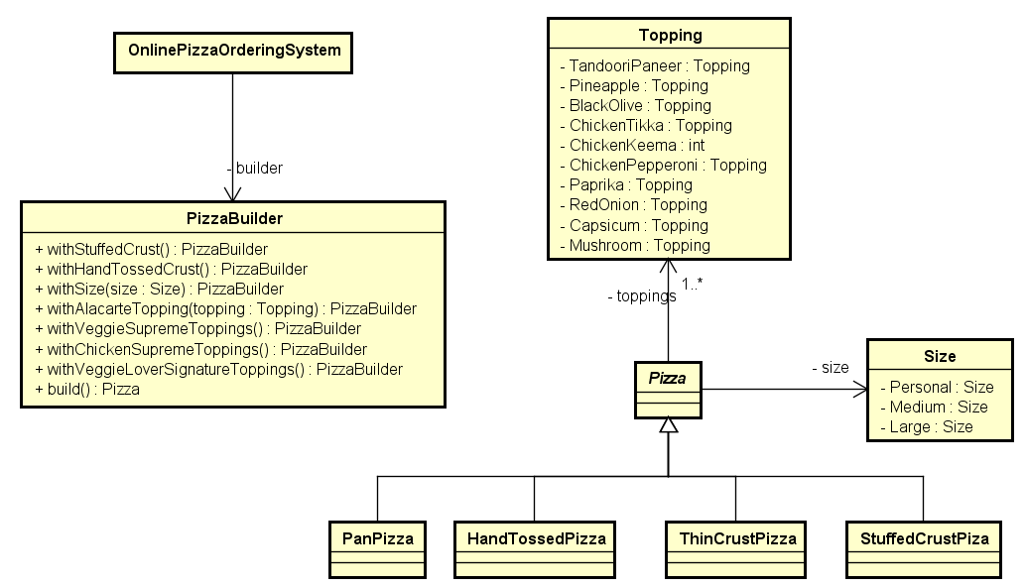
Fluent Builder

Slide 6
Fluent Builder Internals
class PizzaBuilder {
public:
PrintSpooler();
PizzaBuilder* withStuffedCrust();
PizzaBuilder* withVeggieLoversSignatureToppings();
Pizza* build();
}
-----------------------------------------
PizzaBuilder* PizzaBuilder::withVeggieLoversSignatureToppings() {
...
return this;
}
Pizza* PizzaBuilder::build() {
if () { .. .. return new StuffeCrustPizza(...);}
else if () { .. .. return new HandTossedPizza(...);}
}

