Slide 1
DAV6100: ARTIFICIAL NEURAL NETWORK FOR STOCK PRICE PREDICTION
Instructions:
Give your presentation a name and be sure to put your group number in the placeholder.
This template will be use for the final delivery of your project
<<Group 3>>
Srikanth Burra
Bhavitha Kora
Deepak Choudary Chundu
Vidyasagar Gali

Slide 2
Agenda
Instructions:
Do not edit this slide
Overview
Project Requirements
Data Profile
Conceptual Architecture
Demo
Project Milestones & Timeline
Team Responsibilities
Challenges
Lessons Learned

Slide 3




Overview
Instructions:
Use this slide to describe your project in as brief as 3 sentences. Feel free to update this with graphics
The project aims to develop a stock price prediction model using machine learning techniques such as LSTM neural networks.
With the rise of electronic financial transactions, trading strategies such as algorithmic trading, high-frequency trading, and AI-managed portfolios have become popular.
By accurately predicting stock prices, companies can make informed decisions about sales, manufacturing, servicing, and assembling, leading to better financial outcomes.
Collecting Data from API(alphavantage.co) and storing in RDS
Data Warehouse
Power BI

Slide 4
Project Requirements
Instructions:
You do not need to edit this slide. This is a summary of the project requirements
1. Design, Document, & Plan
3. Test the Solution
Develop a conceptual design architectures
Develop data flow diagrams and data models
Define analytics concepts with bus matrix
Define ETL Instructions
Define data attributes
A prototype is to be test
Break-testing and optimization of the database may be necessary (use of indexes)
Ensure that error-handling scenarios are considered
2. Develop and Build
4. Present and Deliver
Develop the warehouse solution using Amazon Web Services as the platform
Include two data structures:
Structured dataset
Semi/Unstructured dataset
Integrations:
Batch/Migration
Real-time
Data Visualization
Code Repository (GitHub)
Deliver an executive presentation
Demo the architectural components
Demo the visualizations in a data visualization platform like Tableau

Slide 5


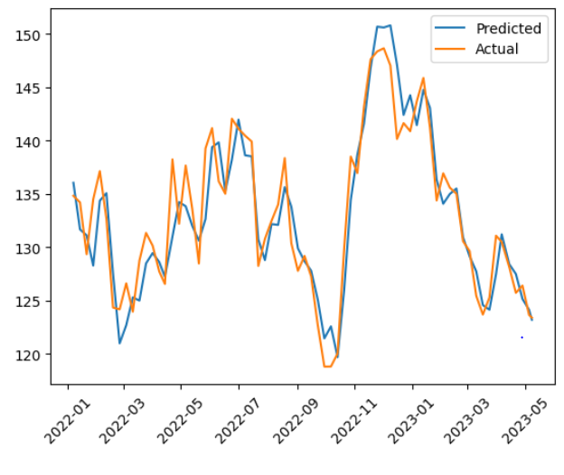
Data Profile: <<Dataset 1>>
Instructions:
Use this slide for every dataset you profile. You should summarize your datasets in these slides using basic statistics and information about the source and provenance of the data.
Dataset Summary
<<Sample Data output>>
Source of Information | Free Stock APIs in JSON & Excel | Alpha Vantage
Number of Records | 1227 rows × 6 columns
Frequency of updates | Weekly
Data type and structure | float or decimal, integer, date, datetime
Number of columns | 6
Granularity | N/A
Descriptive Statistics

Slide 6
Data type and structure
Instructions:
Use this slide to provide the conceptual architecture of your solution
In class we used Lucid Charts as an option to show the conceptual architecture, but I leave the decision to you
"Open": This column contains numeric data representing the opening price of a stock on a given date. It has a data type of either float or decimal.
"High": This column contains numeric data representing the highest price of a stock on a given date. It has a data type of either float or decimal.
"Low": This column contains numeric data representing the lowest price of a stock on a given date. It has a data type of either float or decimal.
"Close": This column contains numeric data representing the closing price of a stock on a given date. It has a data type of either float.
"Total Trade Quantity": This column contains numeric data representing the total number of trades made for a given stock on a given date. It has a data type of integer.
"Date": This column contains date values representing the date on which the stock was traded. It has a data type of date or datetime.

Slide 7
Conceptual Architecture
Instructions:
Use this slide to provide the conceptual architecture of your solution
In class we used Lucid Charts as an option to show the conceptual architecture, but I leave the decision to you
API
Python
RDS
Data output
Visualization

Slide 8









Instructions:
This is a placeholder. You do not need to edit, but you should plan to demo your solution at this point!
DEMO

Slide 9





Project Milestones & Timeline
Instructions:
Update the timeline slide with the high-level milestones of your project
Highlight the key milestones and specify the key dates for completion.
You do not have to edit the last milestone!
<<26/03/26>>
<<04/30/23>>
<< data Cleaning>>
<<milestone description>>
<< Loading data to RDS >>
<<milestone description>>
Deliver & Present
Present final solution to class
Determine peer score
<< ETL Operation>>
<<milestone description>>
<< Testing >
<<milestone description>>
<<03/12/2023>>
<<03/23/23>>
05/10/23

Slide 10
Team Responsibilities
Bhavitha
leads the project plan
Handling the datasets management
VidyaSagar
Dataset cleaning and ETL operations
Deepak
Operations in the Airflow
Srikanth
Storing the dataset in the S3 bucket
Visualizations and analysis of the data

Slide 11

Assumptions
Instructions:
Describe the assumptions made about your project that contextualize its limitations and constraints.
Feel free to edit/change this slide as much as necessary
1
3
Stationarity
Independence
2
4
Normality
Generalizability

Slide 12

Challenges
Instructions:
Describe the top 3 challenges of your project and why they were a challenge
Data migration fom API to RDS
Configuration of services

Slide 13

Lessons Learned
Instructions:
Provide a few key lessons learned and describe how you might implement them if you had another opportunity to do the project all over again
The following are the key lessons learned from the project.
Importance of Data
Preparation: The quality and accuracy of the machine learning model largely depend on the quality of the data. Preprocessing, cleaning, and transforming the data are important steps in the data preparation process.
Visualization:
Data visualization is critical in communicating insights from the data and the model results. Visualization tools such as Tableau and Python libraries such as Matplotlib and Seaborn allow you to create interactive visualizations that help users understand the data better.

Slide 14


