Slide 1



Slide 2

Name : Srikanth Graduation : B.tech batch : 295
Name : SAI KIRAN Graduation : B.tech batch : 295
Name : GOPINADH Graduation : B.tech batch : 295

Slide 3
Contents:-
Introduction
Problem Statement
Libraries used
Website URL’s for Web-Scrapping
Raw Data
Data Cleaning and Data Manipulation
Cleaned Data
Data Visualization
Conclusion

Slide 4

Engineering colleges in India face numerous challenges that impact the overall quality of education and the employability of graduates. Despite a large number of engineering institutions, many students graduate without the necessary skills, knowledge, and industry readiness required to excel in their careers.

Slide 5






Libraries Used:-

Slide 6
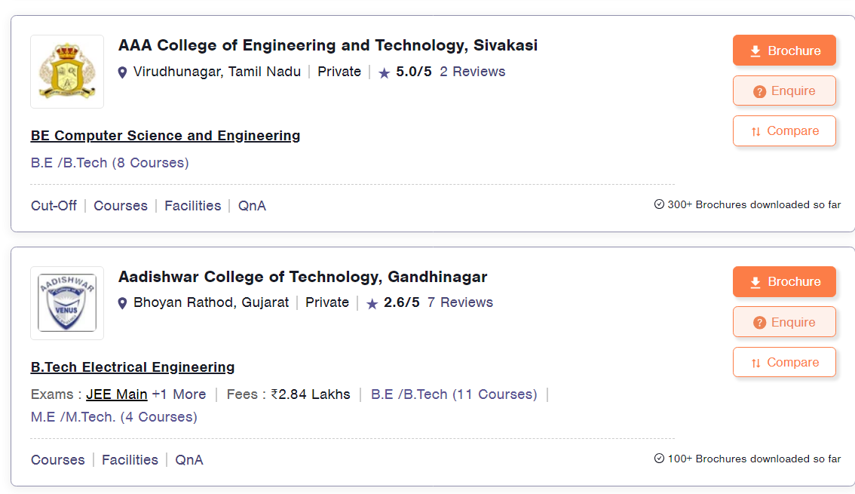
Website URL’s for Web-Scrapping :
URL : https://engineering.careers360.com/colleges/ranking?sort_by=1

Slide 7
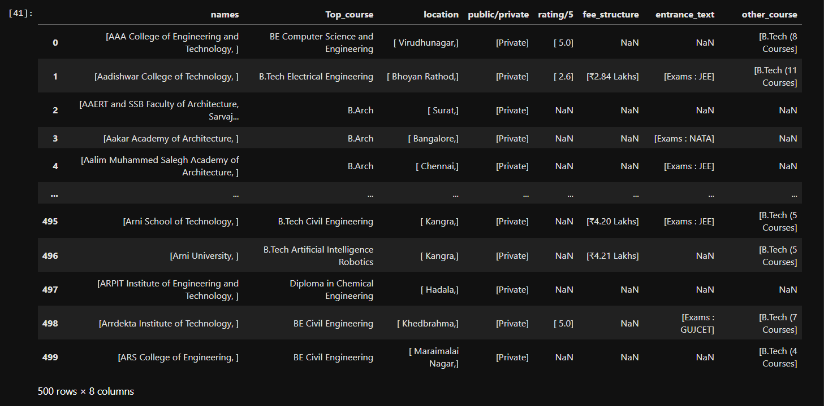
Raw data from website:-
Insights : We have got 500 rows and 8 columns in the Raw data.

Slide 8
Data Cleaning Steps :-
Identifying Null values.
Identifying duplicates values.
Removing special symbols.
Identifying the outliers and replacing with central tendancy .
Checking the info.
Treating columns and converting required columns from object to int or float data type.

Slide 9
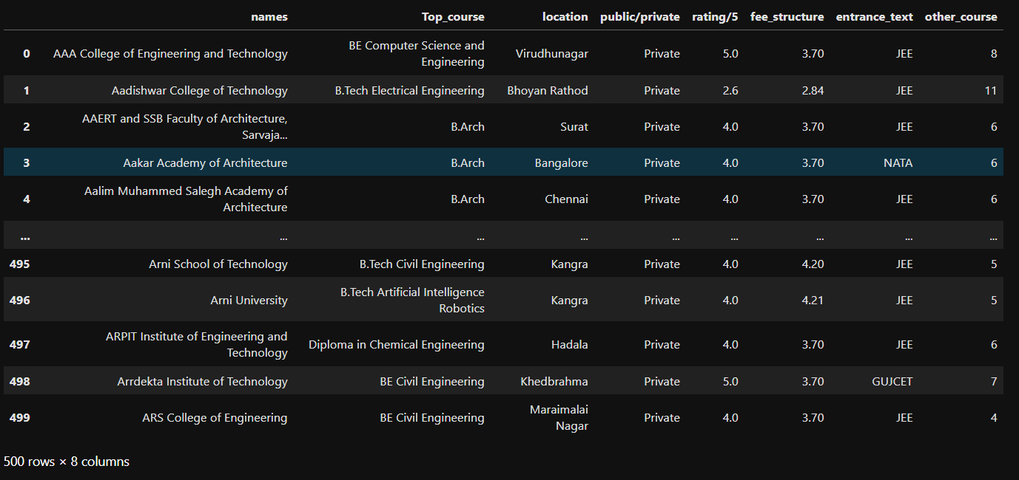
Cleaned Data frame :-
Insights : Finally we got 500 rows and 8 columns .

Slide 10
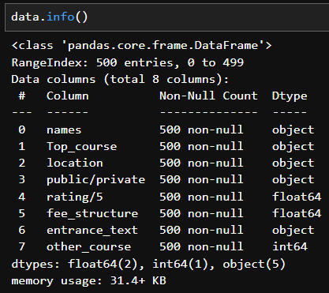
Info, null values :
We can now observe that after performing data cleaning on data frame we have no null values in the data now.
The necessary column’s conversion from object to float is likewise finished

Slide 11

Data Visualization :
Data visualization is the representation of data through use of common graphics, such as charts, plots, info graphics , and even animations.

Slide 12
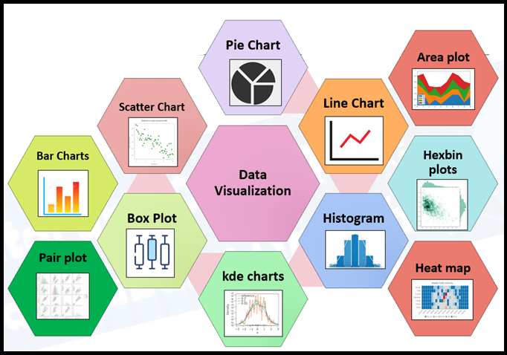
Data Visualization :
1 univariate :
1.1 single categorical
1.2 single numerical
2 Bi variety:
2.1 Categorical-Numerical
2.2 Numerical-Numerical
2.3 Categorical-Categorical
3. Multi - variate:
More than two columns can take
3.1 Categorical-Numerical-Categorical
3.2 Categorical-Numerical-Numerical
3.3 Categorical-Categorical-Categorical
3.4 Numerical-Numerical-Numerical

Slide 13
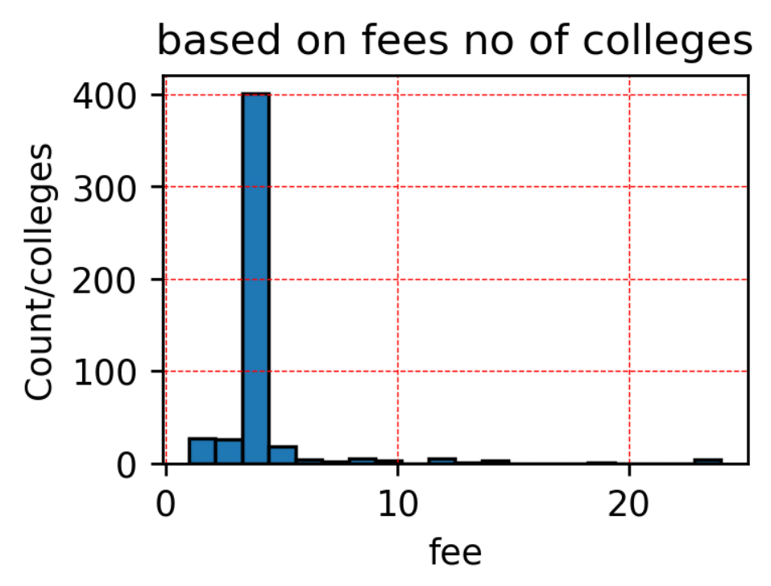
UNIVARIENT NUMERICAL ANALYSIS
Insights :Most of the colleges fees in between 5 L to 6 L . But Very college fees is 24L . (Histogram)

Slide 14
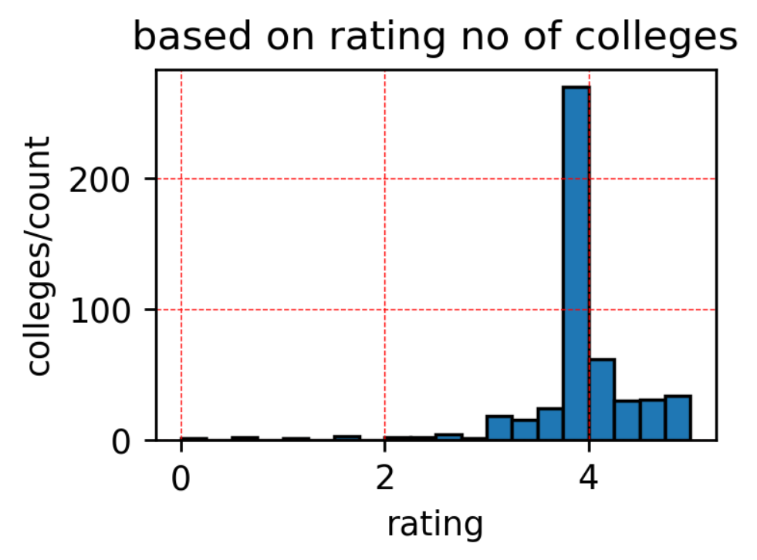
UNIVARIENT NUMERICAL ANALYSIS
Insights :Most of the having 3.9 rating. (Histogram)

Slide 15
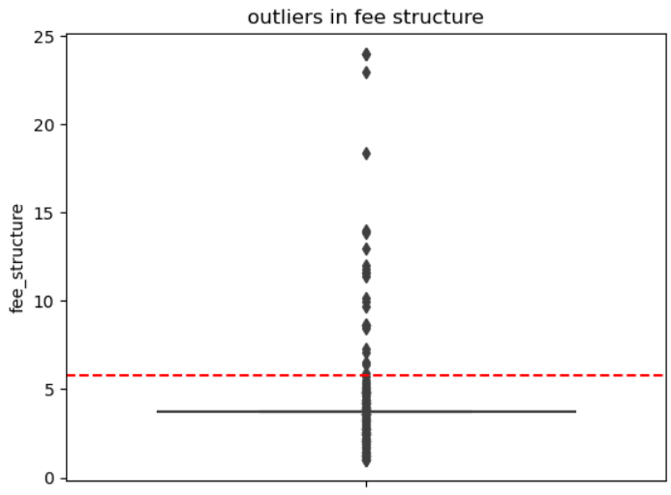
UNIVARIENT NUMERICAL ANALYSIS
Insights :Most of the Colleges has 5L to 10L Fees. But there is a outlier in fees with 24L.(Box Plot)

Slide 16
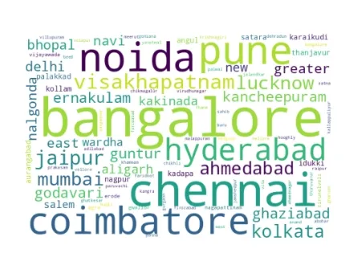
UNIVARIENT CATEGORY ANALYSIS
Insights :So most of the Colleges Location is in Bangalore.
( Word Cloud )

Slide 17
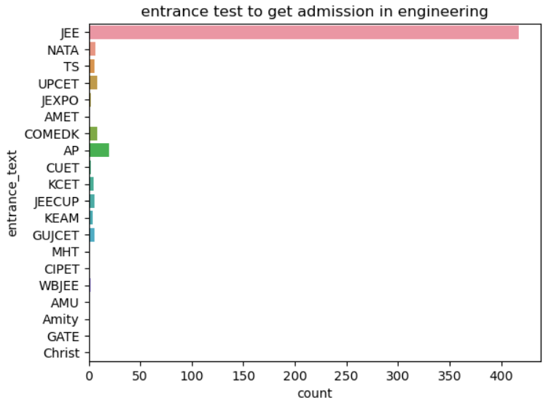
UNIVARIENT CATEGORY ANALYSIS
Insights : Around 400+ Colleges accepting JEE entrance test to get admission. ( Count Plot )

Slide 18
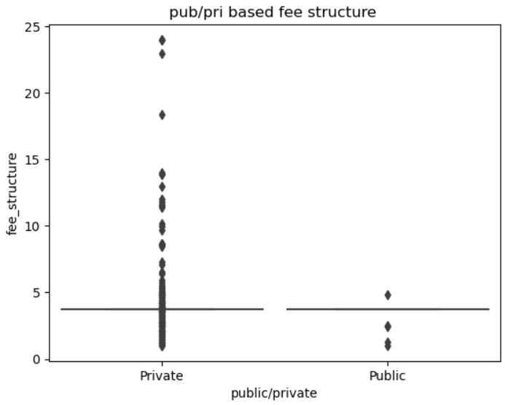
BIVARIENT NUMERICAL & CATEGORY ANALYSIS
Insights : Private Colleges Fees is High when compaired to public college Fees. (Box Plot )

Slide 19
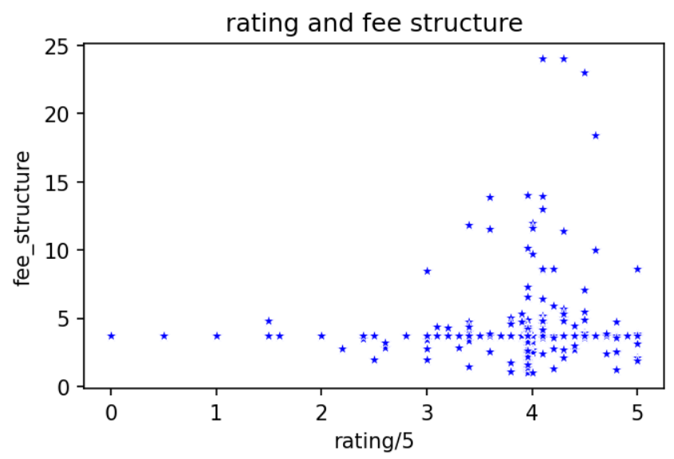
BIVARIENT NUMERICAL & NUMERICAL ANALYSIS
Insights :Most of the colleges have good ratings but some colleges have 4* to 5* with High Fees. (Scatter Plot)

Slide 20
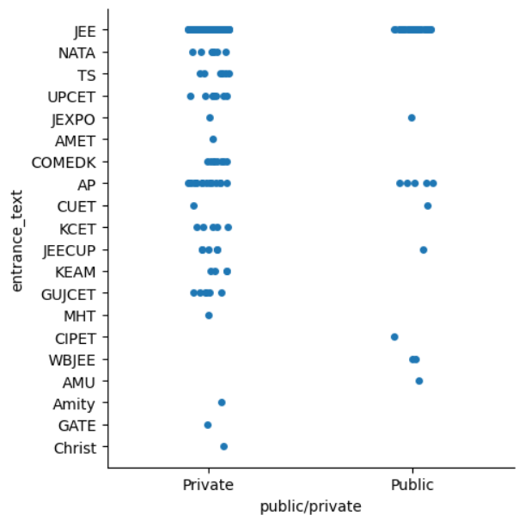
BIVARIENT CATEGORY & CATEGORY ANALYSIS
Insights : When we compare private and public colleges entrance exams. Most of then is accepting JEE. (Cat Plot)

Slide 21
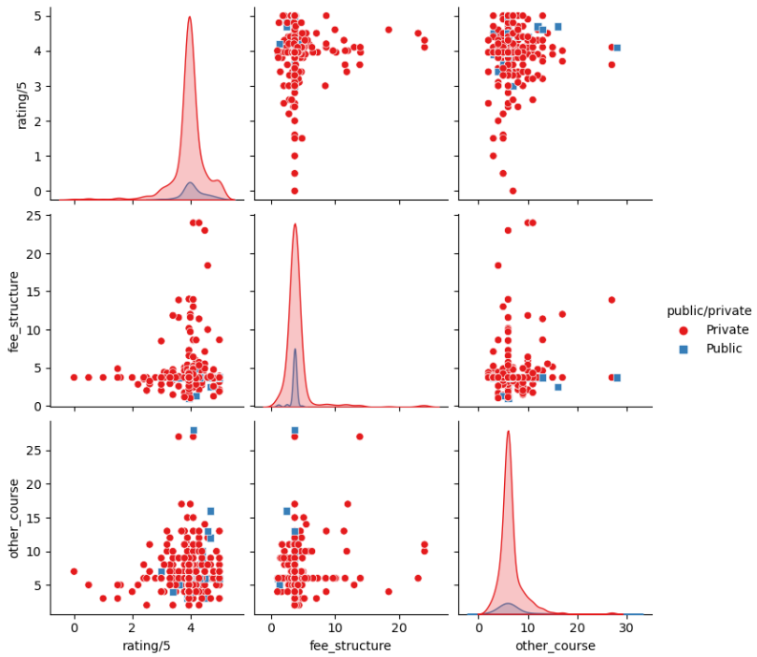
MULTIVARIENT ANALYSIS
Insights :The private college shows the dominance over the public colleges.On overall consideration :
on all asects private colleges palys the major roles over the public colleges

Slide 22


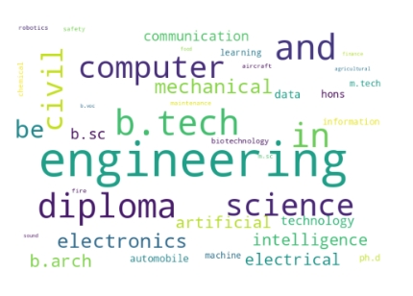
Finally: Science ,engineering,diploma,electrical,
b.arch,civil ...(Top courses in engineering colleges)
* Their we can see the psitive co relation
* Based on this aspects the students can join in the course to get the beautiful insights in their careers
Upon consideration : Better to choose the private sectors to get the quality of the education .
* where they can improve skills and knowledge .
* Most colleges be in Banglore ,chennai,etc.. in top cities.

Slide 23


