Slide 1
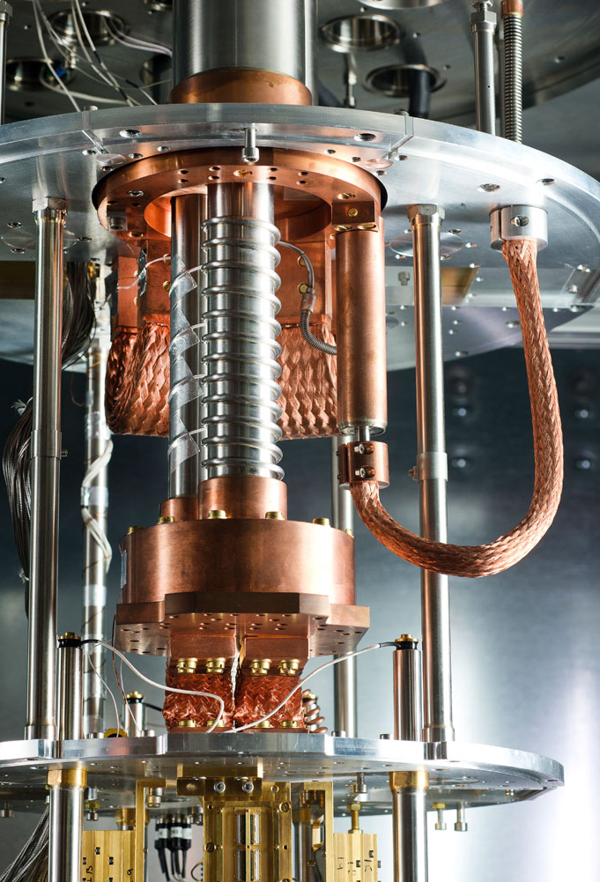
QUANTUM COMPUTING
Under the guidance of Dr. Liwen Shih
By Srikanth Maila (1413445)
Spandana Nandoori (1403403)

Slide 2
Appendix
QUANTUM BASICS – QUBITS, SUPERPOSITION, ENTANGLEMENT, TUNNELING
HOW D-WAVE WORKS ?
D-WAVE HARDWARE AND SOFTWARE ARCHITECTURE
LIGHT SWITCH GAME
TOQ
QSAGE
HADAMARD MATRIX USING QSAGE
TRAVELLING SALESMAN PROBLEM
TSP USING QSAGE
REFERENCES

Slide 3

QUBITS AND SUPERPOSITION
Rather than storing information as 0s or 1s as conventional computers do, a quantum computer uses qubits – which can be either 1 or 0 or both at the same time, this is called “quantum superposition”.
- D-Wave Sys Inc.
Fig: D-Wave Sys Inc.

Slide 4
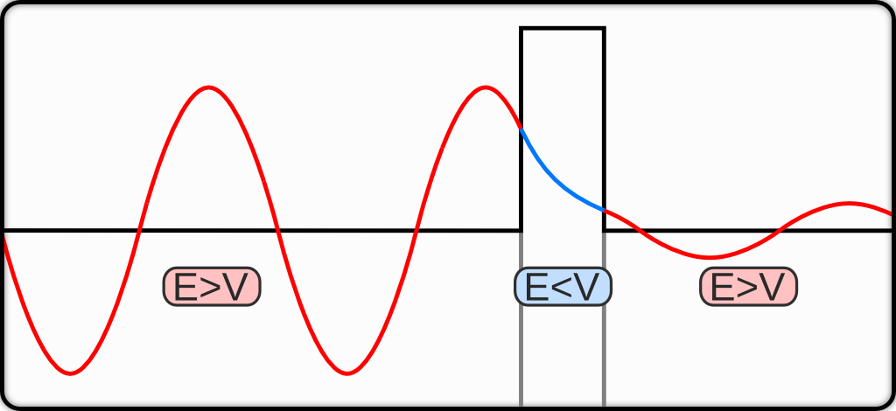
QUANTUM TUNNELING / ENTANGLEMENT
Quantum tunnelling is a phenomenon in which a quantum state traverses energy barriers higher than the energy of the state itself. Quantum tunnelling has been hypothesized as an advantageous physical resource for optimization in quantum annealing.
Quantum entanglement is a physical phenomenon that occurs when pairs or groups of particles are generated or interact in ways such that the quantum state of each particle cannot be described independently — instead, a quantum state must be described for the system as a whole.
Fig: “Quantum tunnelling” Wikipedia
References: “Computational multiqubit tunnelling in programmable quantum annealers” Sergio Boixo, Vadim N. Smelyanskiy, Alireza Shabani, Sergei V. Isakov, Mark Dykman, Vasil S. Denchev, Mohammad H. Amin, Anatoly Yu. Smirnov, Masoud MohseniHartmut Neven “Quantum tunnelling” Wikipedia. “Quantum entanglement” Wikipedia

Slide 5
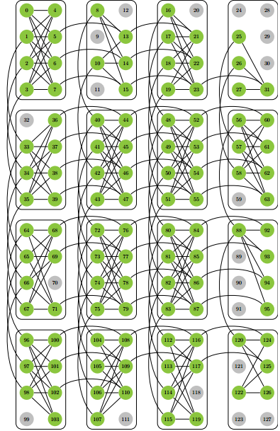
HOW D-WAVE WORKS ?
The front end accepts IM instances and maps them onto the hardware graph called CHIMERA GRAPH
So that weights hi are assigned to vertices (qubits) and Jij to edges in the hardware graph. The hardware carries out a process of quantum annealing to find a minimum-energy state S, as follows.
1. To initialize, qubits are placed in superposition ground states si = (α, β) such that α, β = √ .5(each binary state equally likely).
2. The annealing path from initial to final state involves increasing the “influence” of the weights hi and Jij on qubit states.
3. At the end of the annealing process, qubits and qubit pairs are weighted according to hi and Jij. If the system remains in ground state, the collection S of measured qubit states minimizes M(S).
fig: “Quantum annealing with more than one hundred qubits” Sergio Boixo Troels F.Rønnow, Sergei V. Isakov, Zhihui Wang, David Wecker, Daniel A. Lidar, John M. Martinis,and Matthias.
Reference: “Quantum annealing with more than one hundred qubits” Sergio Boixo Troels F.Rønnow, Sergei V. Isakov, Zhihui Wang, David Wecker, Daniel A. Lidar, John M. Martinis,and Matthias.

Slide 6
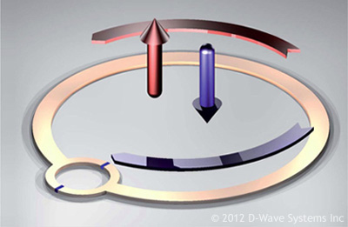
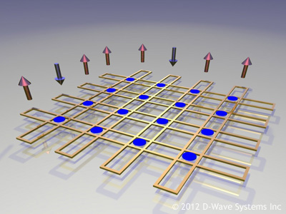
D-WAVE HARDWARE
The SQUID - a quantum transistor (Qubit), the basic building block of the D-Wave Quantum Computer. The arrows indicate the magnetic spin states which encode the bits of information as +1 and -1 values. Unlike regular bits of information, these states can be put into quantum mechanical superposition.
The qubits are connected together such that they can exchange information. This is achieved through the use of elements known as couplers. The couplers are also made from superconducting loops. By putting many such elements (qubits and couplers) together, we can start to build up a fabric of quantum devices that are programmable.
fig: “Introduction to the D-Wave Quantum Hardware” D-Wave Sys Inc.
Reference: “Introduction to the D-Wave Quantum Hardware” D-Wave Sys Inc.

Slide 7
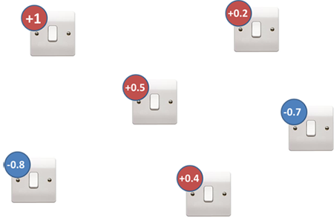
THE LIGHT SWITCH GAME
The light switch game involves trying to find the best settings for a bunch of switches.
Each light switch has a number associated with it, a 'bias value'.
We get to choose whether to turn each light switch ON or OFF. In this, ON = +1 and OFF = -1.
Reference: “Quantum Computing Primer” D-Wave Sys Inc.

Slide 8
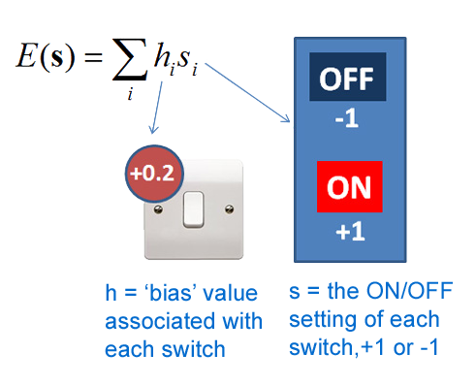
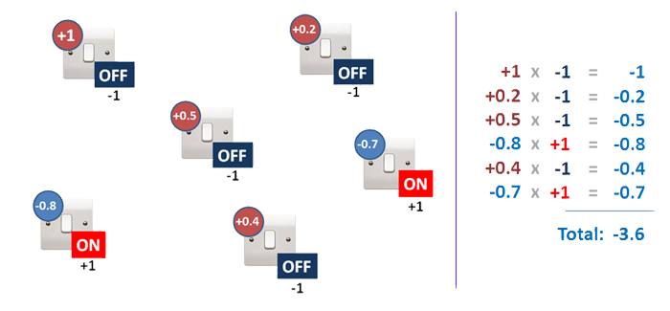
The objective of the game is to set the switches to get the lowest number. Mathematically, we call the bias values of each switch \( h_i \) and the switch settings are called \(s_i \).
Reference: “Quantum Computing Primer” D-Wave Sys Inc.

Slide 9
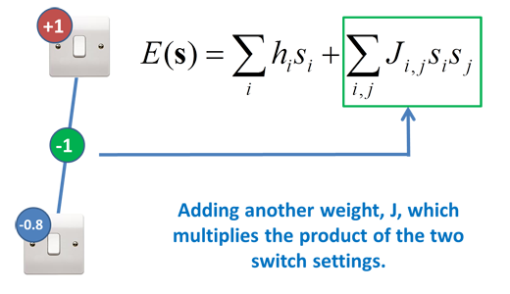
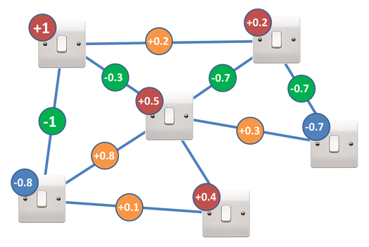
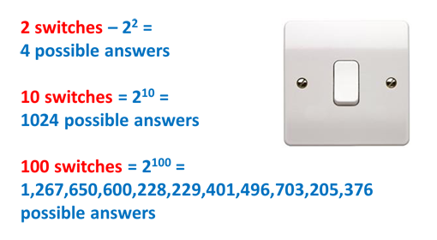
By adding another constraint as coupling strength
Reference: “Quantum Computing Primer” D-Wave Sys Inc.

Slide 10
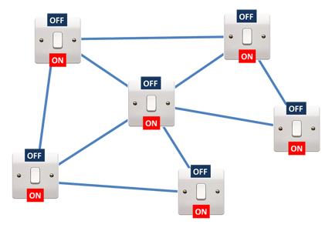
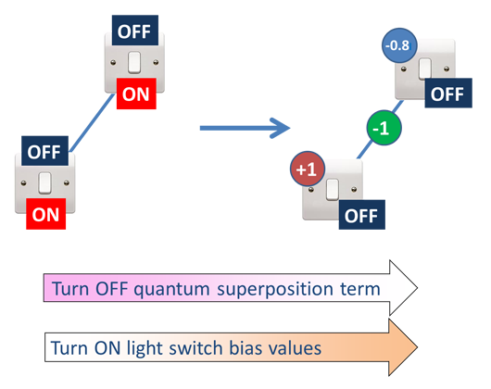
How Quantum Computing does this
Reference: “Quantum Computing Primer” D-Wave Sys Inc.

Slide 11
TOQ
ToQ is a standalone or program-callable translator. It accepts a C-like syntax which may control a series of one or more assert statements.
A simple program to (conditionally) build HUBOs --> QUBOs, and execute them on a D-Wave Quantum Computing System.
Implements a simple environment for assessing and evaluating assertions about the permissible values for a set of binary decision variables.
The input "program" may be from stdin or a file, and the output goes to stdout or a file.
Ref: Edward Farhi and Jeffrey Goldstone and Sam Gutmann and Michael Sipser}, Quantum Computation by Adiabatic Evolution, 2000.

Slide 12
Directives - may appear anywhere in the program text.
Declarations - variables must be declared before use, and all declarations must precede the first executable statement.
Asserts - Executable statements that act on bool: variables
assert: And( @b1, Or(@b2,@b3) ) assert:
Control-flow - Executable statements which control the flowof execution.
elseif: else: endif:
Executables - simple assignment and control-flow statementswhich are interpreted and determine
which assert statements are active.
"listconsts:" to get lists of the functions and constants. Alternately, enter
"toq -f" for a list of the functions
"toq -F" for a list of the functions with definitions
"toq -c" for a list of the constants
"toq -C" for a list of the constants with definitions
ToQ accepts five types of statements
Ref: Edward Farhi and Jeffrey Goldstone and Sam Gutmann and Michael Sipser}, Quantum Computation by Adiabatic Evolution, 2000.

Slide 13
real: press, temp, dilbert, omega
#~~~ omega = 34.5*PI press = 744.3
temp = 199.3*Sqrt(press-150)
assert: Xor( @b2,@b5 )
assert: NorMore( 1,@b1,@b3,@b5 )
if: (temp*Sin(omega*D2RADIANS) > 511)
# Very hot assert: And( @b5, Or(@b2,@b3) )
else: # Normal temp range assert: TwoOf( @b1,@b3,@b5 )
assert: And( @b2, Or(@b1,@b3) )
endif:
assert: Xor( @b1,@b2 ) end:
Here are some samples bool: @b1, @b2, @b3, @b4, @b5
Ref: Edward Farhi and Jeffrey Goldstone and Sam Gutmann and Michael Sipser}, Quantum Computation by Adiabatic Evolution, 2000.

Slide 14
Qsage:
Simplifies the task of writing C code to access the sapi_solveQsage(...) function from the SAPI library.
Generates C source files and compiles them with user-provided C to create an executable.
[-a argspec] -(defines a command line argument) each –a specifies four pieces of information:
command option letter
variable type
variable name
variable default value
-b {debug|optimize}
The optional build flag (-b) controls the type of compilation when qsage is used to generate an executable.
-i initialization-function
-o objective-function
-f finalization-function
These three required arguments allow the user to specify function names in the C program.
-p program-name
The name of the generated executable is program-name.

Slide 15
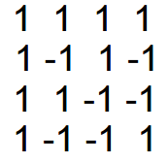
Hadamard matrix
An n x n matrix H = hij is an Hadamard matrix of order n if the entries of H are either +1 or -1 and such that HHt = nI, where Ht is the transpose of H and I is the order n identity matrix.
Put another way, a (+1,-1)-matrix is Hadamard if the inner product of two distinct rows is 0 and the inner product of a row with itself is n.
Example:
Ref: “Hadamard matrices and designs” Electrical and computer engineering, University of Colorado- Denver

Slide 16
Qsage Code
#include <stdio.h>
#include <stdlib.h>
#include <strings.h>
#include "qsage.h"
int *bool_state;
int hadamard_init()
{
printf("Matrix size = %dx%d\n", N, N);
bool_state = malloc(N * N * sizeof(int));
memset(bool_state, 0, N * N * sizeof(int));
return N * N;
}
#define ROW(i) (bool_state + (i)*N)
#define DOTPRODUCT(d,i,j) \
{ \
Ref: “Hadamard matrix example”,D-Wave sys Inc

Slide 17
int k, s = 0; \
for (k=0; k<N; ++k) \
s += ROW(i)[k] * ROW(j)[k]; \
d = s; \
}
double hadamard_obj(const int* state, size_t len)
{
double obj = 0.0;
int i, j;
for (i=0; i<N*N; ++i) /* Convert 0/1 variables to -1/+1 variables: */
bool_state[i] = 2*state[i] - 1;
for (i=0; i<N; ++i) /* For each pair of rows, compute the dot product: */
for (j=i+1; j<N; ++j)
{
int dp;
DOTPRODUCT(dp,i,j);
Ref: “Hadamard matrix example”,D-Wave sys Inc

Slide 18
obj += (dp > 0) ? dp : -dp;
}
return obj;
}
void hadamard_final(const int* state, size_t len)
{
int r, c;
for (r=0; r<N; ++r)
{
for (c=0; c<N; ++c) printf("%2d ", ROW(r)[c]);
printf("\n");
}
}
Ref: “Hadamard matrix example”,D-Wave sys Inc

Slide 19
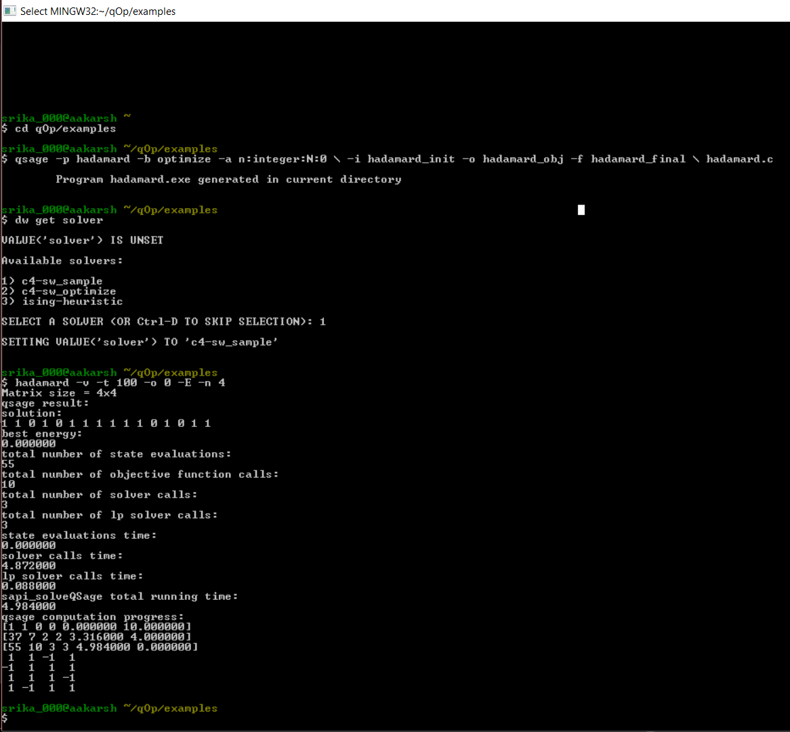
Output
Commands list:
qsage -p hadamard –b optimize –a n:integer:N:0 \
-i hadamard_init -o hadamard_obj -f hadamard_final \
hadamard.c
hadamard –v –t 100 –o 0 –E –n 4

Slide 20
TRAVEL SALESMAN PROBLEM
A classic algorithmic problem in the field of computer science.
Focused on optimization.
A mathematical problem which is easily expressed as a graph describing the locations of a set of nodes.
Reference: Cesari Giovanni “Divide and Conquer Strategies for Parallel TSP Heuristics”, Computers Operations Research , Vol.23, No.7, pp 681-694, 1996

Slide 21
Traveling Salesman Problem's Heuristic
Algorithm TSP:
⦁ First, find out all (n -1)! Possible solutions, where n is the number of cities.
⦁ Next, determine the minimum cost by finding out the cost of everyone of these (n -1)! Solutions.
⦁ Finally, keep the one with the minimum cost.
Ref: del Castillo M. Jose “A heuristic for the traveling salesman problem based on a continuous approximation”, Transportation Research Part B33 (1999) 123-152

Slide 22
Heuristic:
Input:
Number of cities n
Cost of traveling between the cities.
c (i, j) i, j = 1, . . , n.
Start with city 1
Output:
Vector of cities and total cost.
cost ← cost + minimum - cost
Ref: del Castillo M. Jose “A heuristic for the traveling salesman problem based on a continuous approximation”, Transportation Research Part B33 (1999) 123-152

Slide 23
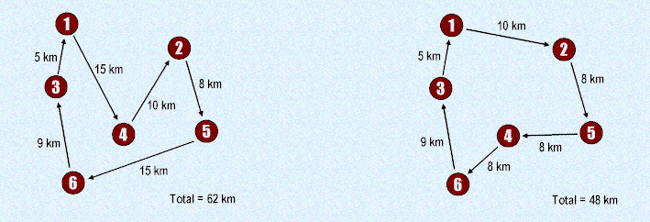
PROBLEM

Slide 24
Methods
1. Triangle inequality
2. The general traveling salesman problem
3. A heuristic solution proposed by Karp
4. Using greedy algorithm
Ref: Valenzuela I. Christine, Jones J. Antonia “Estimating the Held-Karp lower bound for the geometric TSP , European Journal of Operational Research 102(1997) 157-175

Slide 25
TSP with the Triangle-Inequality
When the cost function satisfies the triangle inequality, we can design an approximate algorithm for TSP that returns a tour whose cost is not more than twice the cost of an optimal tour.
Ref:van der Poort S. Edo, Libura Marek, Sierksma Gerard, vander Veen A. A. Jack “Solving the k-best traveling salesman problem”, Computers & Operations Research 26 (1999) 409-425

Slide 26
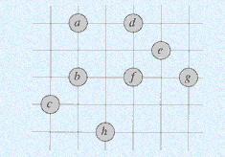
Operation of APPROX-TSP-TOUR:
Let root r be a in following given set of points (graph).

Slide 27
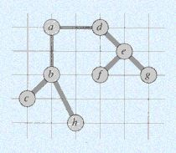
Construct MST from root a using MST-PRIM (G, c, r)

Slide 28
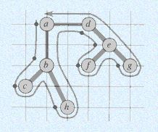
List vertices visited in preorder walk. L = {a, b, c, h, d, e, f, g}

Slide 29
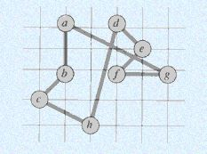
Return Hamiltonian cycle

Slide 30
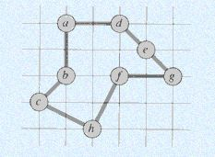
Optimal TSP tour for a given problem (graph) would be

Slide 31
Tsp using qsage - Algorithm
Initialization:
set number of cities - N.
load cost-matrix in to matrix - b[N][N].
create an array for storing intermediate path - result[N+1].
create an array for storing final path - final[N+1].
create an array for visited cities – visited[N].

Slide 32
Creating a function to generate limits
load matrix b[N][N].
compare elements of each row and pick lowest value.
add all lowest values of each row to get lowest bound.
compare elements of each row and pick highest value.
add all highest values of each row to get upper bound.
let lower bound = min, upper bound = max.
if function is called with 0, it should return minimum value.
if function is called with 1, it should return maximum value.
Cost matrix
1 | 5 | 4 | 2
2 | 1 | 5 | 4
9 | 6 | 2 | 4
7 | 5 | 3 | 4

Slide 33
Objective
determine lower and upper bounds.
start from 0th city and end with the same city.
so we have to calculate path in between.
i.e., path is 0 -> 1,2,3 (order varies) -> 0.
states are 0’s and 1’s generated by Qsage randomly.
consider only 2 states to determine cities as shown
0 0 – city 0
0 1 – city 1
1 0 – city 2
1 1 – city 3
calculate the path from randomly generated states.
set objective value to distance such that it is minimized

Slide 34
Finalization
final path = optimized path by objective function.
distance = cost minimized by objective function.

Slide 35
Code
/*----------------INITIALIZATION-----------------*/
int tsproblem_init()
{
// loading cost matrix into b[4][4]
b[0][0]= a_a;
b[0][1]= a_b;
b[0][2]= a_c;
b[0][3]= a_d;
b[1][0]= b_a;
b[1][1]= b_b;
b[1][2]= b_c;
b[1][3]= b_d;
b[2][0]= c_a;
b[2][1]= c_b;
b[2][2]= c_c;
b[2][3]= c_d;
b[3][0]= d_a;
b[3][1]= d_b;
b[3][2]= d_c;
b[3][3]= d_d;
#include<stdio.h>
#include<stdlib.h>
#include<strings.h>
#include "qsage.h"
int *visited;
int *result;
int *final;
int cost = 0, objective = 1000;
int b[4][4];
unsigned int bounds(unsigned int k);

Slide 36
/*---------------upper bound and lower bound----------------*/
unsigned int bounds(unsigned int k)
{
int i = 0,j =0;
unsigned int min_value = 0 , max_value = 0 , m = 0,min_row = 0,max_row =0;
if (k==0) // calculate minimum value when k=0
{
for(i=0;i<4;i++)
{
min_row = b[i][0];
for(j=0;j<4;j++)
{
if (b[i][j]<min_row) //min_row captures minimum element of each row
min_row = b[i][j];
}
min_value += min_row; //min_value calculates lower bound by adding all min_row's
}
return min_value; :
printf("\n\nNumber of Cities are: %d\n\n",N);
// setting visited array to track visited cities
visited = malloc(N * sizeof(int));
memset(visited, 0,N * sizeof(int));
// setting result array to store intermediate path
result = malloc((N+1) * sizeof(int));
memset(result, 0,(N+1)* sizeof(int));
// setting final array to store minimized path
final = malloc((N+1) * sizeof(int));
memset(final, 0,(N+1)* sizeof(int));
return N*N;
}

Slide 37
// calculate maximum value when k=1
if (k==1)
{
for(i=0;i<4;i++)
{
max_row = b[i][0]; //max_row captures maximum element of each row
for(j=0;j<4;j++)
{
if (b[i][j]>max_row)
max_row = b[i][j];
}
max_value += max_row; //max_value calculates upper bound by adding all max_row's
}
return max_value;
}
}

Slide 38
/*-----------------OBJECTIVE---------------------------------------*/
double tsproblem_obj(const int* state, size_t len)
{
double obj = 0.0 ;
int city=0;
int i=0,j=0,k=0, ncity;
// calculate lower and upper bounds
unsigned int lower = 0, upper = 0;
lower = bounds(0);
upper = bounds(1);
// resetting initial conditions for every iteration
cost=0;
result[0] = 0;result[1] = 0;result[2] = 0;result[3] = 0;result[4] = 0;
visited[0] = 1;visited[1] = 0;visited[2] = 0;visited[3] = 0;

Slide 39
// as path should start from 0 and end at 0
// consider only middle 3 cities [0, (1,2,3 - order varies), 0
// states are randomly generated 0 and 1's
// consider 6 states such that each city is determined by 2 states
// 0 1- city1 1 0- city2 1 1- city3
// 0 0 - city0 is already fixed as starting and end city
for(i = 0; i < 6; i+=2)
{
j= i+1;
ncity = ((2 * state[i]) + state[j]); // ncity = next city is determined by states
if (visited[ncity] != 1 ) // check weather city is visited ?
{
cost += b[city][ncity]; // cost is distance from city to next city from cost-matrix
city = ncity ;
visited[city] = 1; // setting city as visited
k = (i+2)/2;
result[k] = city; // intermediate path
}

Slide 40
else
{
goto label; // if city is visited jump to end
}
}
cost += b[city][0]; // else add distance cost for returning to start point
// if all cities are visited and total distance is between the limits (upper and lower bounds)
// obj = cost
label:
if(visited[0] == 1 && visited[1] == 1 && visited[2] == 1 && visited[3] == 1)
{
if ((cost < upper) && (cost > lower))
{
if (cost<objective) // comparing result with previous minimum value

Slide 41
{
objective = cost; // to store better results if present cost is less
final[0] = result [0];
final[1] = result [1]; // than previous cost
final[2] = result [2];
final[3] = result [3];
final[4] = result [4];
}
obj += cost;
}
else
obj += upper; // if cost is not between bounds return maximum
}
else
obj += upper; // if every city is not visited return maximum
return obj ;
}

Slide 42
/*----------FINAL---------------------------------------*/
void tsproblem_final(const int* state, size_t len)
{
int r;
printf("\n\n total distance travelled is:%d\n\n" ,objective);
printf(" path:\n\n ");
for (r=0; r<5; r++)
printf("%2d ", final[r]); // print final path
printf("\n");
}

Slide 43
Output commands
qsage -p tsproblem –b debug –a n:integer:N:0 –a b:integer:a_a:0 -a c:integer:a_b:0 -a d:integer:a_c:0 -a e:integer:a_d:0 -a g:integer:b_a:0 -a h:integer:b_b:0 -a j:integer:b_c:0 -a k:integer:b_d:0 -a l:integer:c_a:0 -a m:integer:c_b:0 -a q:integer:c_c:0 -a r:integer:c_d:0 -a s:integer:d_a:0 -a w:integer:d_b:0 -a x:integer:d_c:0 -a y:integer:d_d:0 \
-i tsproblem_init -o tsproblem_obj -f tsproblem_final \
tsproblem.c
tsproblem –v –t 500 –o 10 –E –n 4 -b 1 -c 5 -d 4 -e 2 -g 2 -h 1 -j 5 -k 4 -l 9 -m 6 -q 2 -r 4 -s 7 -w 5 -x 3 -y 4
Cost matrix
1 | 5 | 4 | 2
2 | 1 | 5 | 4
9 | 6 | 2 | 4
7 | 5 | 3 | 4

Slide 44
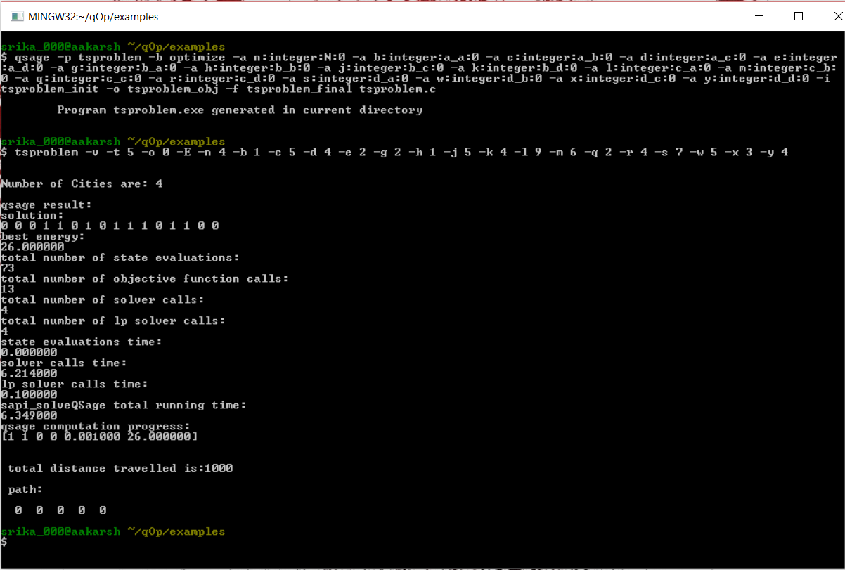
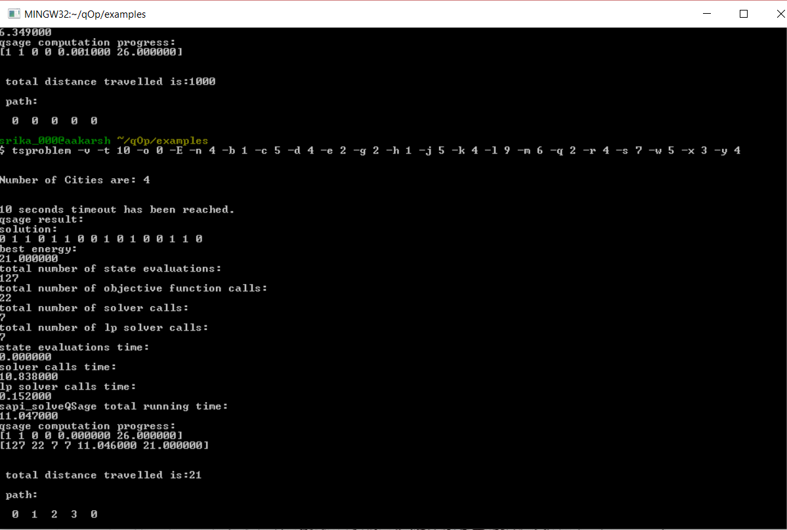
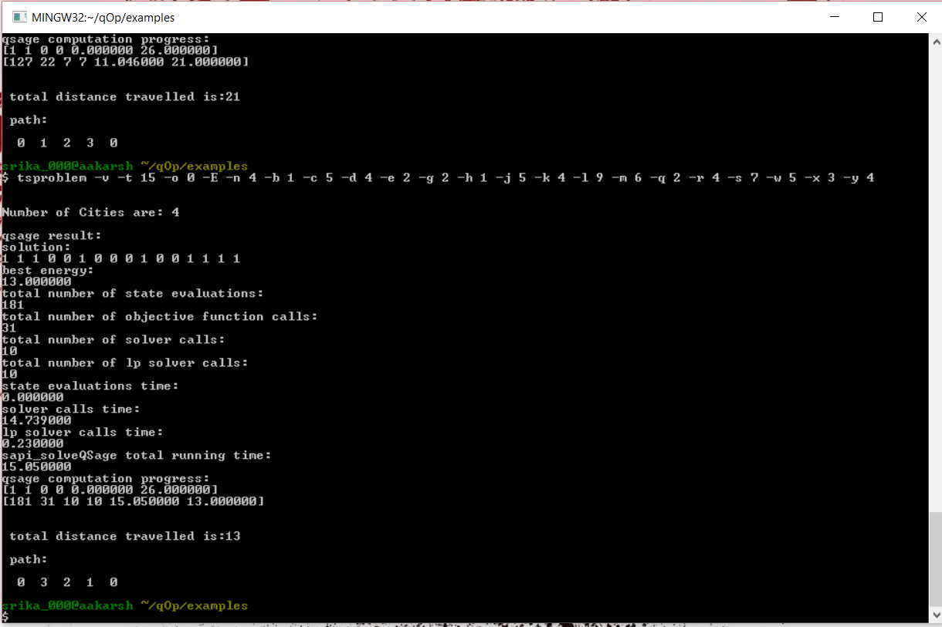
Output – trial 1
T = 5sec, 10sec, 15sec

Slide 45
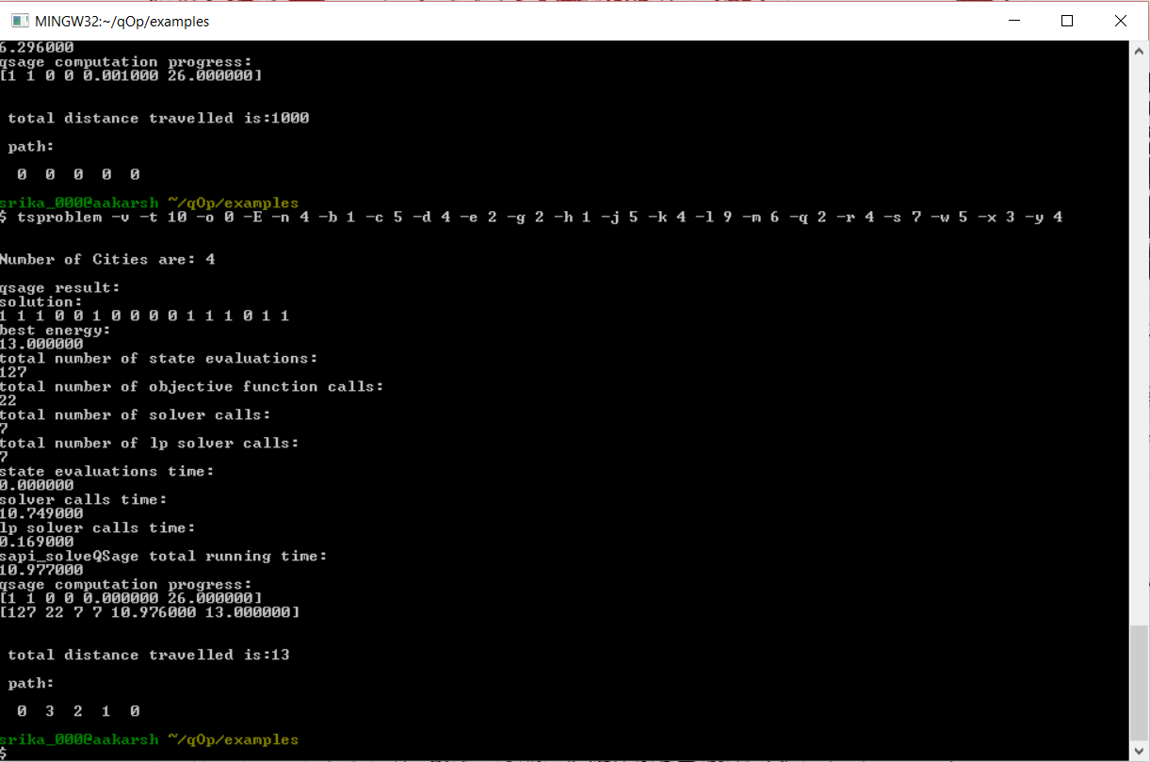
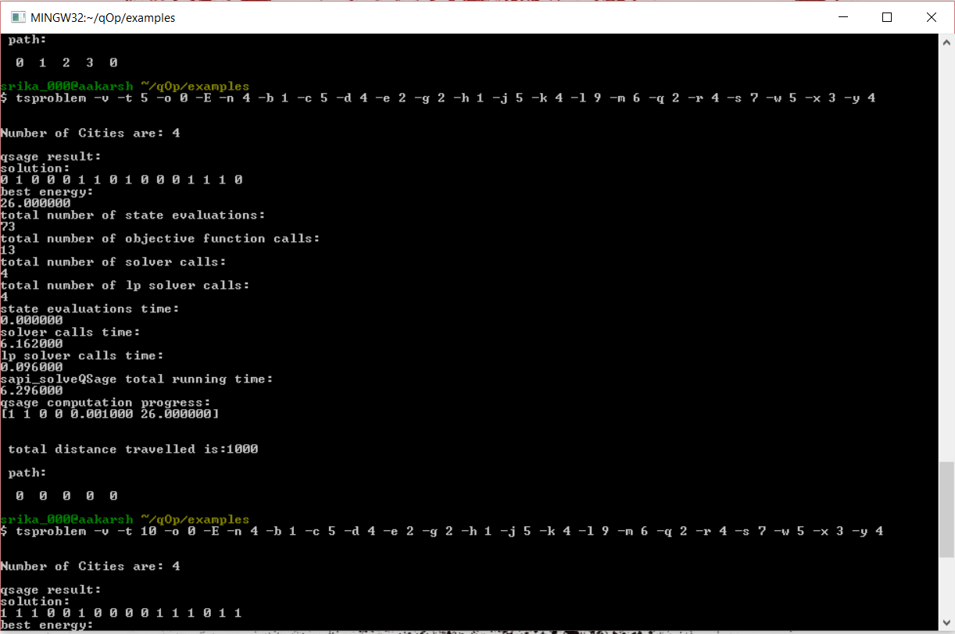
Output – trial 2

Slide 46
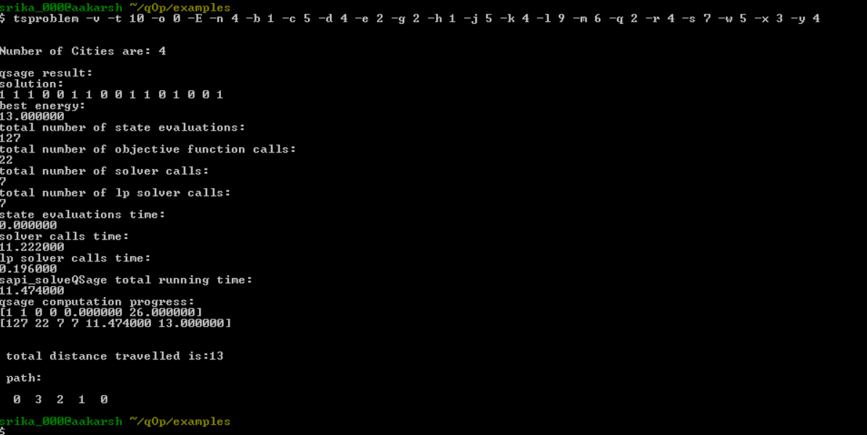
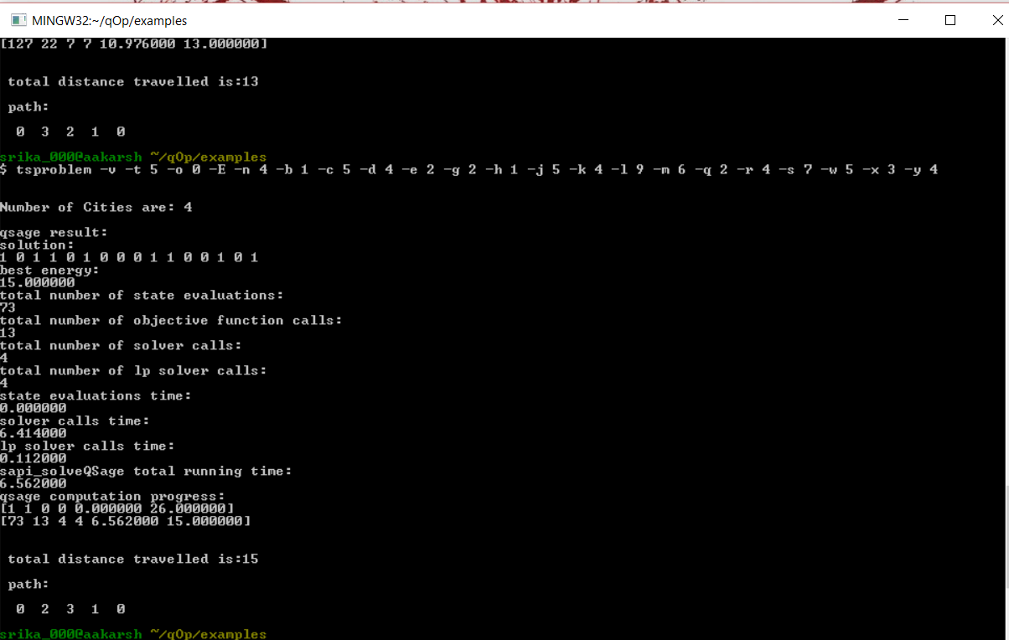
Output – trail 3

Slide 47
Comparing outputs

Slide 48
References
“Computational multiqubit tunnelling in programmable quantum annealers” Sergio Boixo, Vadim N. Smelyanskiy, Alireza Shabani, Sergei V. Isakov, Mark Dykman, Vasil S. Denchev, Mohammad H. Amin, Anatoly Yu. Smirnov, Masoud MohseniHartmut Neven.
“Experimental Evaluation of an Adiabatic Quantum System for Combinatorial Optimization” Catherine C. McGeoch Amherst College Amherst MA, USA. Cong Wang SimonFraser University Burnaby BC.
“Quantum annealing with more than one hundred qubits” Sergio Boixo Troels F.Rønnow, Sergei V. Isakov, Zhihui Wang, David Wecker, Daniel A. Lidar, John M. Martinis,and Matthias.
“Introduction to the D-Wave Quantum Hardware” D-Wave Sys Inc.
“Quantum Computing Primer” D-Wave Sys Inc.
“Hadamard matrix” D-Wave Sys Inc.
“Programming with D-Wave: Map Coloring Problem” E. D. Dahl, D-Wave Systems Nov 2013
Cesari Giovanni “Divide and Conquer Strategies for Parallel TSP Heuristics”, Computers Operations Research , Vol.23, No.7, pp 681-694, 1996
del Castillo M. Jose “A heuristic for the traveling salesman problem based on a continuous approximation”, Transportation Research Part B33 (1999) 123-152
Gutin Gregory,eo Anders, Zverovich Alexey “Traveling salesman should not be greedy:
van der Poort S. Edo, Libura Marek, Sierksma Gerard, vander Veen A. A. Jack “Solving the k-best traveling salesman problem”, Computers & Operations Research 26 (1999) 409-425
Valenzuela I. Christine, Jones J. Antonia “Estimating the Held-Karp lower bound for the geometric TSP , European Journal of Operational Research 102(1997) 157-175
“Hadamard matrices and designs” Electrical and computer engineering, University of Colorado- Denver

Slide 49


