Slide 1
Intelligent Finance Data Quality Improvement
Houtan Shirani-Mehr, Yahoo! Finance
Supervisor: Yugandhar Veluvali

Slide 2
About Me
PhD Candidate at University of Southern California
MS and BS from university of California, Irvine and Sharif university in 2007 and 2004, respectively
Published 12 peer reviewed conference and journal papers and one US patent
Interned in NASA JPL and Chevron in 2011 and 2010, respectively
2

Slide 3
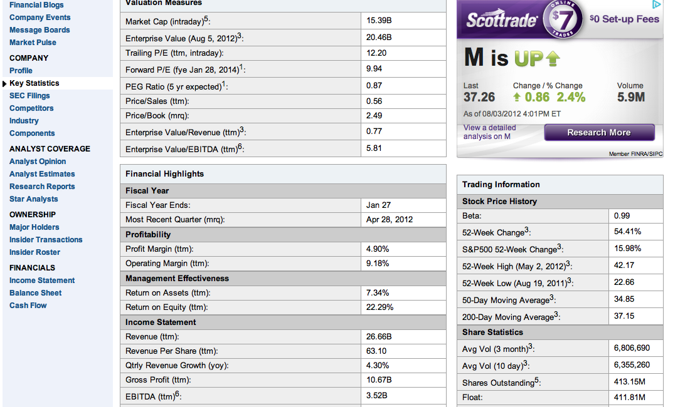
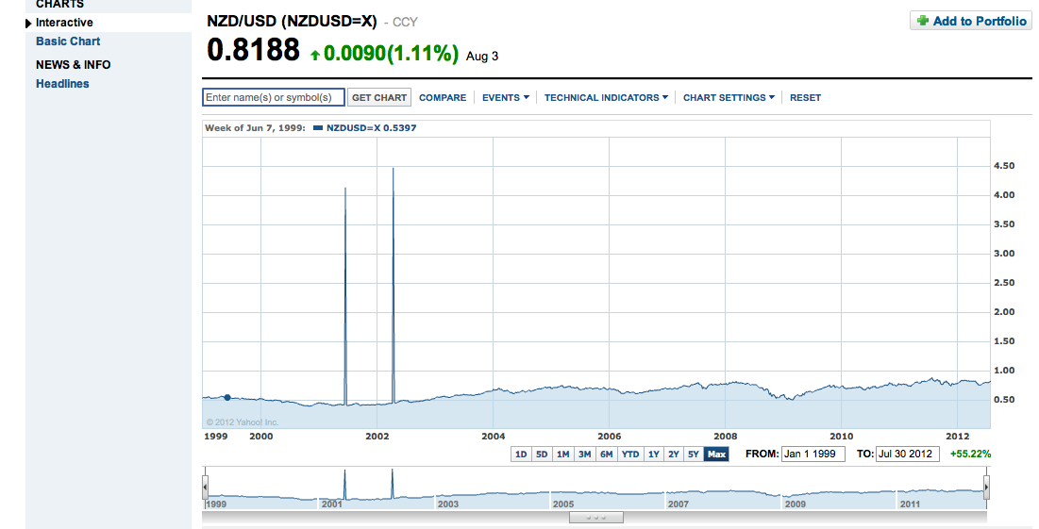
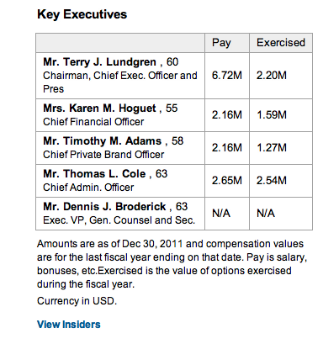
Motivation
Different types of anomalies in data

Slide 4
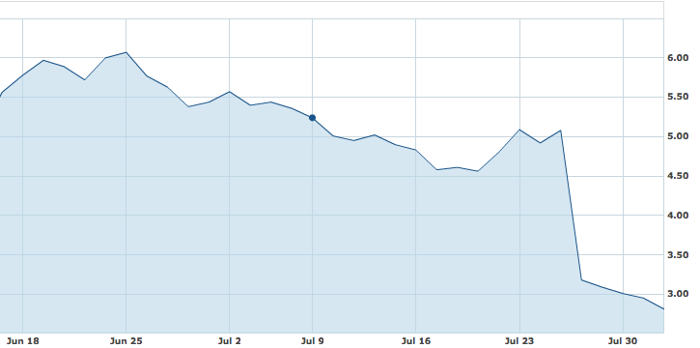
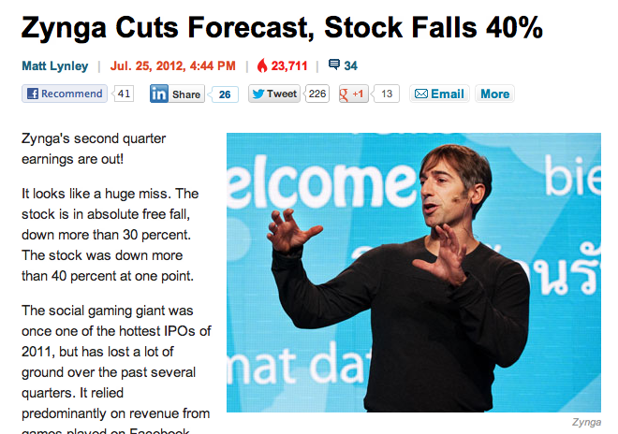
Problem Definition
Input data
Numerical data such as historical prices
Set S of data sets, S={S₁,S₂,…,S_{n}} where each S_{i} is a time series, i.e., S_{i}={s_{i,1},s_{i,2},s_{i,3},…s_{i,m}}
Incorrect data point
A value which significantly differs from the corresponding real world value
s_{i,j}, |s_{i,j}-r_{i,j}| ≤ ε
Challenge
Difficulty of modeling financial data
Additional data sources
News and other financial sources, e.g., Bloomberg
Formulation
Given a set of data sets S and external data sources E, find the incorrect data points

Slide 5

Approach
Feedback from output Data/Experts
Data Modeling Module:
e.g. KNN model
External Sources: News and other financial data
Anomaly Detection Module
Data without
anomaly
Input data sources
Potential future
anomalies

Slide 6
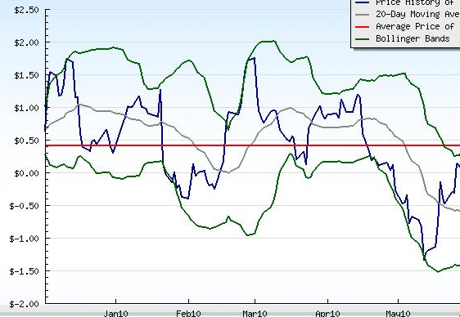
Closing Thoughts
What I learnt so far
Data quality challenges with financial data
Working with map-reduce programming model
Teamwork experience
Possible future directions
Online data anomaly detection
Extension of the framework to detect new trends in data
Tech Pulse submission
Given an input symbol s , and a given interval time T, find the top other symbols which are the most similar/dissimilar to s during T

