Slide 1

Basic Details of the Team and Problem Statement
Ministry/Organization Name/Student Innovation:
AICTE, MIC-Student Innovation Student Innovation
PS Code : SIH 1487
Problem Statement Title: Student Innovation
Team Name: Eco Warriors
Team Leader Name: Godavari Srikanth
Institute Code (AISHE): U-0020
Institute Name: K L University
Theme Name : Clean And Green Technology

Slide 2
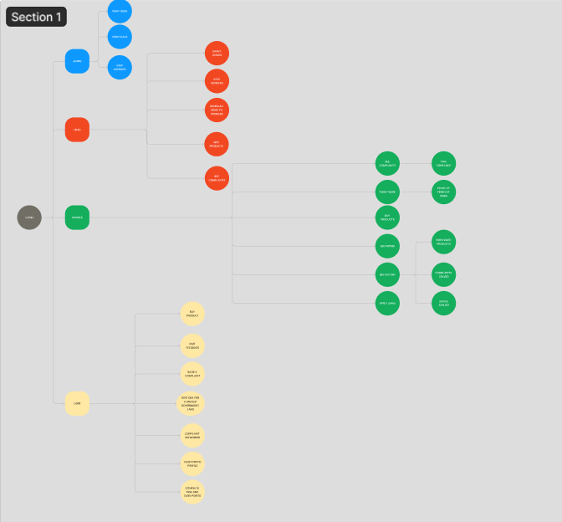
Idea or Approach Details
Describe your idea/Solution/Prototype here:
We are looking for a solution by creating a web-based Application that will serve as a platform for customers to get rid of accumulated plastic and other recyclable waste at home . The prototype will function as follows:
Users can share their Idea and can generate revenue in the form of Cashback points and with that Cashback points they can buy recycled products which are manufactured from reusable plastics from our website at cheaper prices.
Workers can also generate Cashback points based on their rating given by users and they can also buy products and get bonus based on their cashback points.
Users can conveniently schedule pickups for their recyclable waste materials from the comfort of their homes. This eliminates the need for users to transport their waste to recycling centers .
Users can track the progress of their waste pickups and receive notifications and updates on the status of their requests.
We will provide this website to government of Andhra Pradesh so that the users in the villages can know about it and can use/access through Panchayat Office and the users in the cities can easily access through the Website.
Describe your Technology stack here:
Frontend: HTML, CSS , Java Script , Bootstrap
Backend: Java Full stack (Spring Boot)
API: Google Map API , Payment Gateway API
Describe your Flow-Chart here:
Click on image to go through the link

Slide 3
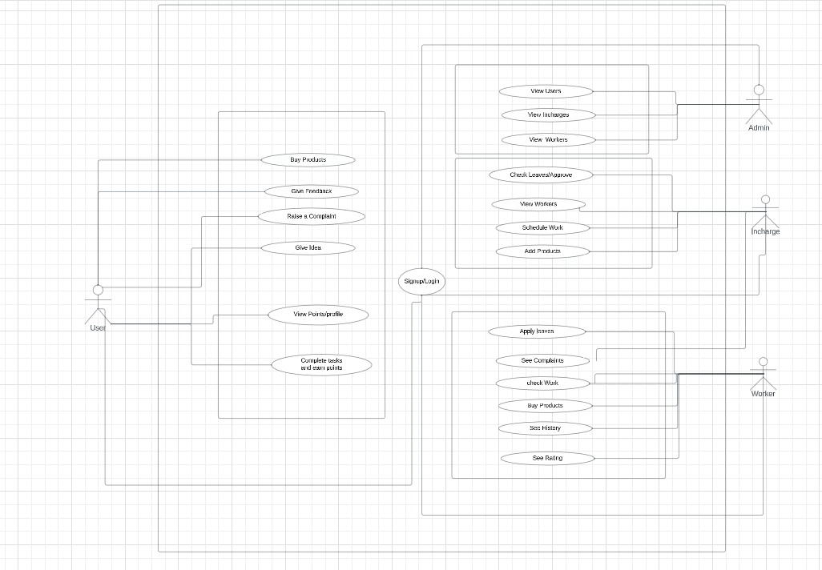
Use Case Diagram:
Describe your Use Case Diagram here
Describe your Dependencies /Showstopper here
Mysql
Java MVC
Java Spring
Themlyef
Java Web
GoogleMap Api
Payment Gateway Api
Fig 1:Use case Diagram for the web application

Slide 4
Team Member Details
Team Leader Name: Godavari Srikanth
Branch : Btech Stream :CSE Year ::3rd
Team Member 1 Name: Atla Rajendra
Branch : Btech Stream : CSE Year :3rd
Team Member 2 Name: Pendem Nethri Tirupathi
Branch : Btech Stream :CSE Year :3rd
Team Member 3 Name:Tammina Chandini
Branch : Btech Stream : CSE Year : 3rd
Team Member 4 Name:Yalamati Mahima Mani
Branch : Btech Stream :CSE Year : 3rd
Team Member 5 Name: Guttikonda Kavya Sri
Branch :Btech Stream :CSE Year : 3rd
Team Mentor 1 Name : Dr. Kondaveeti Siva Krishna
Category (Academic/Industry): ECE Faculty Expertise (AI/ML/Blockchain/): Domain Experience (in years):

